Slide 1
Membranes:
Their Structure,
Function and Chemistry
Instructor: Dr. Mahmoud A. Srour
Course: Cell Biology 0202211
Reading:
Becker’s World of the Cell, 8th ed/ 2012.
Chap 7, p. 156-193.
Lec # 9 Mon 15.10.2012

Slide 2
Functions of Membranes
Define boundaries & act as permeability barrier
Serve as loci of specific function
Possess transport proteins – regulate the movement of solutes
Contains receptors for external signals
Provide mechanisms for cell-to-cell contact, adhesion and communication

Slide 3
Functions of membranes

Slide 4
Boundaries
Permeability barrier because of the hydrophobic interior of the membrane
Plasma membrane
Intracellular membranes – compartmentalize the cell
Keep in desirable substance and keep undesirable out

Slide 5
Specific Function
Proteins are embedded in the membrane or are attached to the membrane and can perform various chemical reactions
Enzymes on the membrane of organelles can act as markers for specific activities,
Example: glucose-6-phosphatase is a membrane-bound enzyme found in the ER
Example: in vertebrate cells, plasma membrane contains enzymes that secret the materials of the ECM

Slide 6
Transport of Solutes
Regulates in and out of cell and organelles
Nutrients, ions, gases, water, and other substances
Products and waste removed
Move based on the concentration of solutes
Down the gradient – simple and facilitated diffusion
Against the gradient – requires energy input, active transport and pumps
Endocytosis and exocytosis also important

Slide 7
Detect and Transmit Signals
Signal transduction – detect specific signals at the membrane and mechanisms to transmit signals to the cell interior
Signal transduction: describes the specific mechanisms used to transmit such signals from the outer surface of cells to the cell interior
Signal molecule (ligand) binds to receptor, set up specific chemical event which is relayed by the second messengers

Slide 8
Communication
Allows cells to pass information between cells by way of openings
Gap junctions in animals
Plasmodesmata in plants

Slide 9
Models of Membrane Structure
Overton (1890): lipids form a coat around cells. The lipid coat is a mixture of cholesterol and lecithin
Langmuir: lipid monolayer made of amphipathic phospholipids
Gorter and Grendel (1925): formulated the lipid bilayer

Slide 10
Models of Membrane Structure (continued)
Davson and Danielli (1935):
Lipid layer coated on both sides with thin layers of proteins (protein-lipid-protein sandwich).
Modified in 1954, hydrophilic proteins might penetrate into membranes to provide polar pores to allow water soluble solutes to cross the membrane.
Robertson (early 1950s) looked at membranes by EM and observed extensive regions of “railroad tracks” with overall thickness of 6-8 nm; and devised the “unit membrane” concept

Slide 11
Membrane Structure

Slide 12
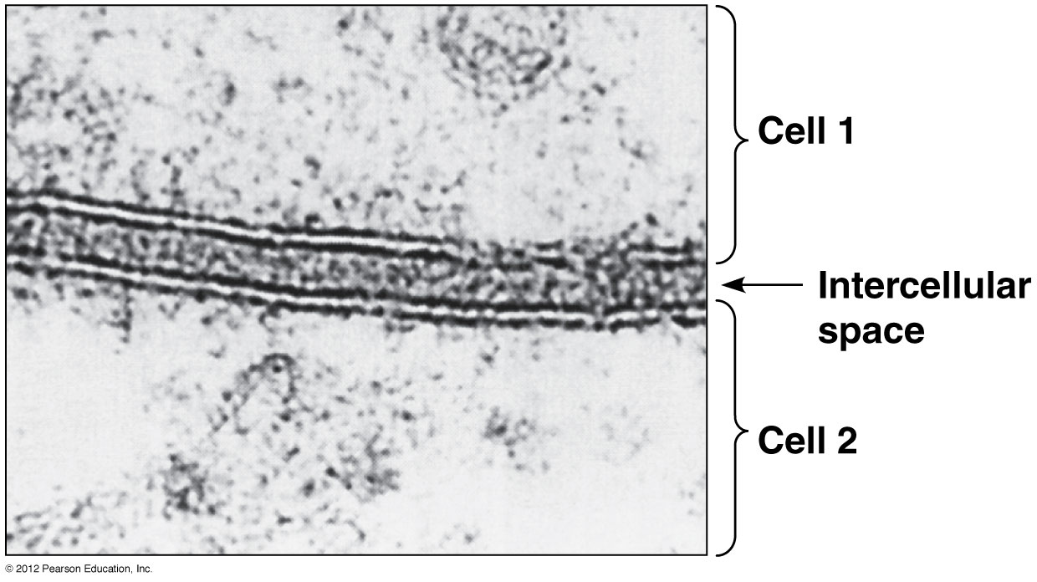
A trilaminar structure of membrane, visible under the TEM: common to all membranes
Figure 7-4
Notes:
common to all membrane> unit membrane

Slide 13
Shortcomings of Davson-Danielli Model
Membrane proteins were globular and with sizes and shapes inconsistent with the concept of thin sheets
Membranes vary in chemical composition and protein:lipid ratio, from 3 in some bacterial cells to 0.23 in myelin sheath of nerve axons
The protein/lipid ratio is 1.2 for outer membrane and 3.5 for inner membrane
Phosphlipases – remove heads of the lipids, not protected from lipase by protein
Most membrane proteins are insoluble in water, meaning they are hydrophobic – through the membrane

Slide 14
Membrane Composition

Slide 15
Singer & Nicolson: Fluid Mosaic Model
Singer and Nicolson (1972) – mosaic pattern of proteins discontinuously embedded in or attached to the fluid lipid bilayer
Three classes of membrane proteins:
Integral membrane proteins (transmembrane) are embedded within the lipid bilayer & held in place by affinity for hydrophobic interior of bilayer
Peripheral proteins are more hydrophilic and linked non-covalently to the polar head groups of phospholipids Lipid-anchored proteins
Lipid-anchored proteins: Hydrophilic proteins that reside on the surface and are covalently linked to a lipid that is inserted in the membrane

Slide 16
Fluid Mosaic Model

Slide 17
Unwin & Henderson:
Most membrane proteins contain transmembrane segments
Transmembrane segments anchor the protein to the membrane and hold it in proper alignment within the lipid bilayer

Slide 18
Fluidity
Lipids can move laterally in the membrane – parallel to the membrane surface
Proteins can also move laterally
Some proteins are restricted by their anchoring to one side or the other
Fluid Mosaic Model explains the shortcomings of the Davson/Danielli model

Slide 19
Membrane Lipids
Fluid part
Major classes of lipids
Phospholipids: phosphoglycerides and sphingolipids
Glycolipids
Sterols

Slide 20
Phospholipids
Glycerol-based – phosphoglycerides
Phosphatidyl -choline, -ethanolamine, -serine, -inositol are the most important
Sphingosine-based – sphingolipids
Sphingomyelin – one of the main phospholipids of animal cells

Slide 21
Phospholipid composition of several kinds of membranes

Slide 22
Glycolipids
Carbohydrate on the lipid
Most are derivatives of sphingolipids – glycosphingolipids
Cerebrosides – neutral glycolipid, galactose is the sugar in case of galactocerebroside
Gangliosides – has an oligosaccharide head group that contains one or more negatively charged sialic acid residues – act as antigens

Slide 23
The human ABO blood groups involve glycosphingolipids known as A antigen and B antigen

Slide 24
Sterols
In animals – cholesterol
In plants – phytosterols
Bacteria have hopanoids – sterol like molecules in plasma membrane, making it rigid, has hydrophilic side chain

Slide 25
Thin Layer Chromatography
Stationary phase – part that doesn’t move, support
Mobile phase – solvent that moves and separates the substances based on their polarity and affinity for the stationary phase

Slide 26
Fatty Acids
Part of lipids with the exception of sterols
12 to 20 C, usually 16 or 18 C to make a stable bilayer
Palmitate 16C saturated
Stearate 18C saturated
Oleate 18C unsaturated 1 C=C
Linoleate 18C unsaturated 2 C=C
Linolenate 18C unsaturated 3 C=C
Arachidonate 20C unsaturated 4 C=C
Kinked and not packed well – more fluid

Slide 27
Fatty Acids

Slide 28
Asymmetric Distribution of Lipids
Lipids are unequally distributed between the 2 monolayers of the membrane
Glycolipids are mostly on the outer layer (sugar out) for signaling and recognition events
Phosphatidyl-ethanolamine, -serine and -inositol are prominent on the inner layer to transmit signal to interior cell

Slide 29
Lipid “Movement”
Rotation – spin on it axis
Lateral diffusion – move in the layer that it is in – like wandering around in a crowded room
Transverse diffusion – rarely see flip from one layer to the other
Phospholipid translocator or ‘flippase’ allows for the flip-flop, specific

Slide 30
Lipid Bilayer is Fluid
The lipid bilayer behaves as a fluid that permits the movement of both lipids and proteins
Lipids can move as much as several mm per second within the monolayer
Lateral diffusion can be demonstrated using fluorescence recovery after photobleaching (FRAP)

Slide 31
Measuring lipid mobility in membranes by FRAP

Slide 32
Membranes:
Their Structure,
Function and Chemistry
Instructor: Dr. Mahmoud A. Srour
Course: Cell Biology 0202211
Reading:
Becker’s World of the Cell, 8th ed/ 2012.
Chap 7, p. 156-193.
Lec # 10 Sat 20.10.2012

Slide 33
Membranes Function Properly Only in the Fluid State
Membrane fluidity changes with temperature, decreasing as temperature falls and vice versa
Every lipid bilayer has a characteristic transition temperature T_{m}, the temperature at which it becomes fluid (“melts”) when warmed from a solid gel-like state
This change of state is called a phase transition,
Below the T_{m}, any functions that rely on membrane fluidity will be disrupted

Slide 34
Effects of Fatty Acid Composition on Membrane Fluidity
Fluidity of a membrane depends mainly on he fatty acids that it contains,
The length of fatty acid chains
The degree of saturation (more C=C will increase fluidity)
Long-chain and saturated fatty acids have higher T_{m}, whereas short-chain and unsaturated fatty acids have lower T_{m},

Slide 35
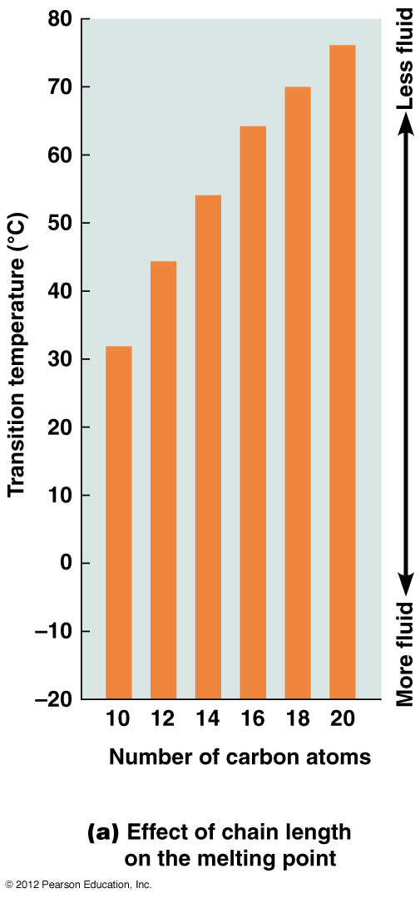
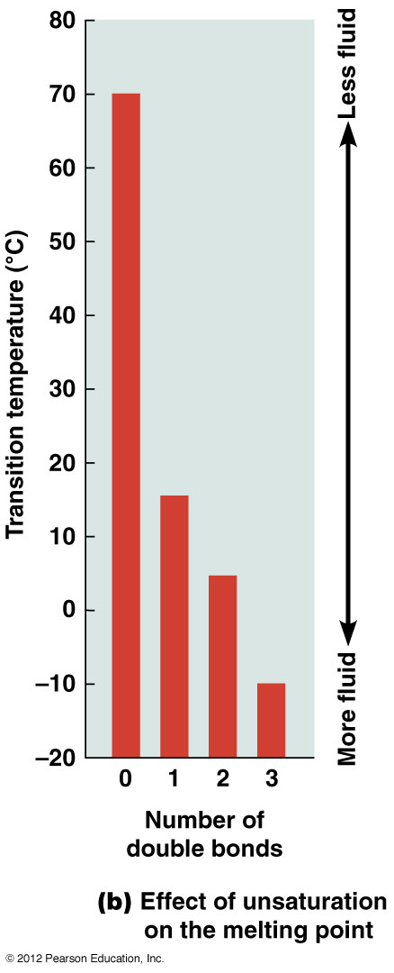

Slide 36
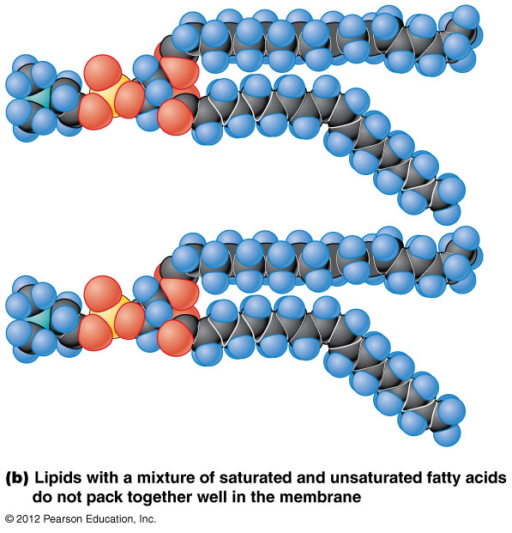
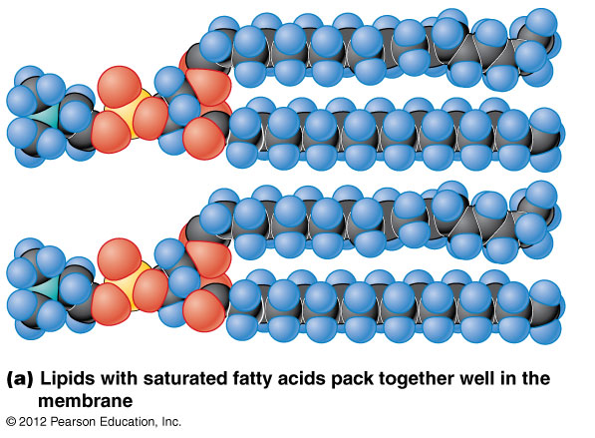
Effect of unsaturated Fatty Acids on the packing of membrane lipids

Slide 37
Effects of Sterols on Membrane Fluidity
The intercalation of rigid cholesterol molecules into a membrane decreases its fluidity and increases the T_{m}
Cholesterol also prevents hydrocarbon chains of phospholipids from packing together tightly and so reduces the tendency of membranes to gel upon cooling
Therefore cholesterol is a fluidity buffer; sterols in other organisms may function similarly

Slide 38
Effects of Sterols on Membrane Fluidity

Slide 39
Other effects of sterols on membranes
Sterols decrease the permeability of membranes to ions and small polar molecules
This is likely because they fill spaces between the hydrocarbon chains of phospholipids
This effectively blocks the routes that ions and small molecules would take through the membrane

Slide 40
Most Organisms Can Regulate Membrane Fluidity
Most organisms can regulate membrane fluidity by varying the lipid composition of the membranes
This is most important in poikilotherms, organisms that cannot regulate their body temperature
Poikilotherms use homeoviscous adaptation, compensating for changes in temperature by altering the length and degree of saturation of fatty acids in their membranes

Slide 41
Oxygen and desaturase enzyme
In some species of Micrococcu, a drop in temp activates an enzyme that removes two terminal carbons from the 18-carbon hydrocarbon tails
Some organisms like E. coli have a desaturase enzyme, which introduces double bonds into fatty acids as needed
Homeoviscus adaptation also occurs in yeast and plants & depends on increased oxygen solubility at low temp.
Oxygen acts as a substrate for desaturase, allowing for maintenance of membrane fluidity at lower temperatures

Slide 42
Lipid Rafts Are Localized Regions of Membrane Lipids That Are Involved in Cell Signaling
Localized regions of membrane lipids in association with specific proteins are called lipid microdomains, or lipid rafts
These are dynamic, changing composition as lipids and proteins move into and out of them
Lipid rafts in the outer monolayer of animal cells have elevated levels of cholesterol and glycosphingolipids and are less fluid than the rest of the membrane

Slide 43
Lipid raft formation (continued)
Lipid rafts contain actin-binding proteins, suggesting that the cytoskeleton may play a role in their formation and organization
Depleting cholesterol from a membrane, or disrupting the actin cytoskeleton, can both interfere with the targeting of proteins to rafts

Slide 44
Functions of lipid rafts
Lipid rafts are thought to have roles in detecting and responding to exracellular signals
For example, lipid rafts have roles in
transport of nutrients and ions across membranes
binding of activated immune system cells to their microbial targets
transport of cholera toxin into intestinal cells

Slide 45
Caveolae
Caveolae, small invaginations of the plasma membrane, are structurally related to lipid rafts
They contain a cholesterol-binding protein called caveolin, and are enriched in cholesterol, sphingolipids, and lipid-anchored proteins
Possible roles of caveolae: endocytosis, exocytosis, redox sensing, and regulation of airway function in the lungs

Slide 46
Membrane Proteins: the “Mosaic” Part of the Model
The mosaic part of the fluid mosaic model also includes lipid rafts and other lipid domains
However, it is membrane proteins that are the main components

Slide 47
The Membrane Consists of a Mosaic of Proteins: Evidence from Freeze-Fracture Microscopy
Support for the fluid mosaic model came from studies involving freeze-fracturing
A bilayer or membrane is frozen and then hit sharply with a diamond knife
The resulting fracture often follows the plane between the two layers of membrane lipid

Slide 48
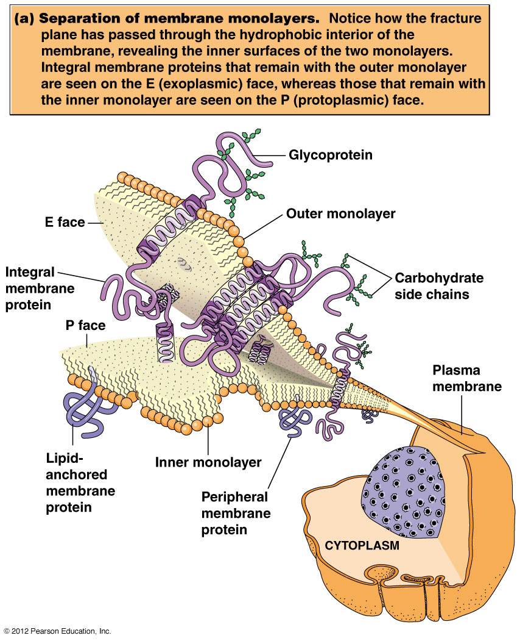

Slide 49
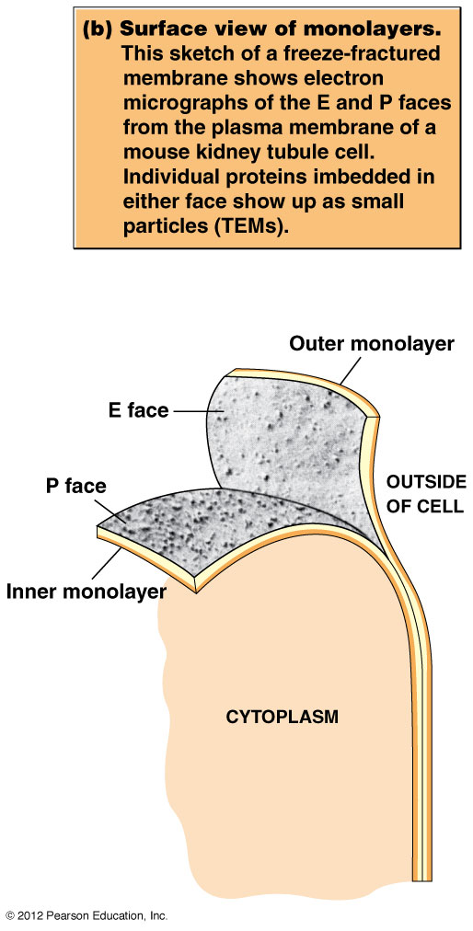

Slide 50
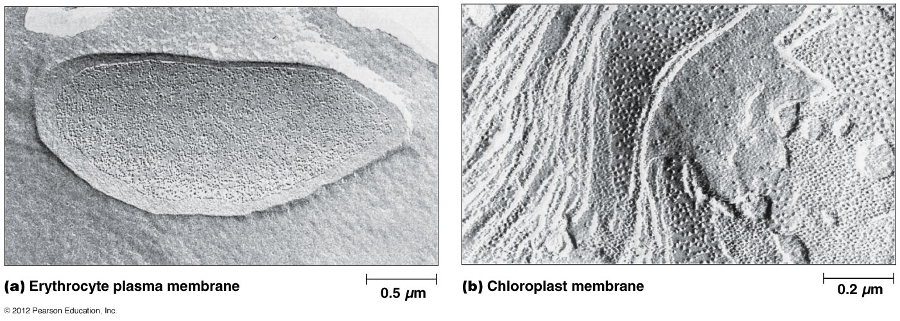
Membrane proteins visualized by Freeze-fracture EM
Erythrocyte membrane has a protein/lipid ratio of 1.14
Chloroplast membrane has a protein/lipid ratio of 2.33

Slide 51
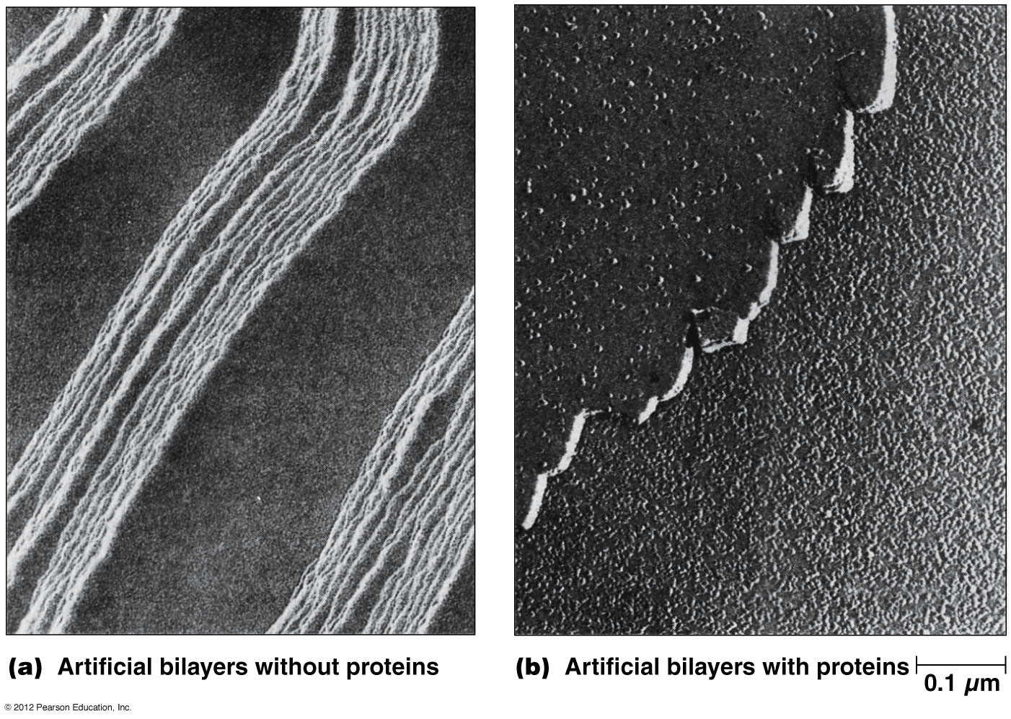
Freeze-Fracture comparison of lipid bilayers with and without added proteins

Slide 52
Membranes Contain Integral, Peripheral and Lipid-Anchored Proteins
Membrane proteins have different hydrophobicites and so occupy different positions in or on membranes
This, in turn, determines how easily such proteins can be extracted from membranes
Membrane proteins fall into three categories: integral, peripheral, and lipid-anchored

Slide 53
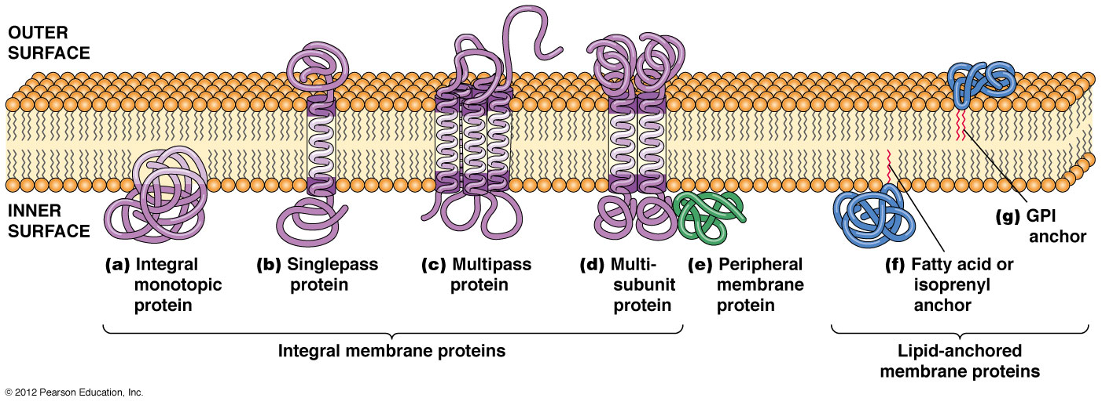
The main classes of membrane proteins
GPI: Glycosylphosphatidylinositol

Slide 54
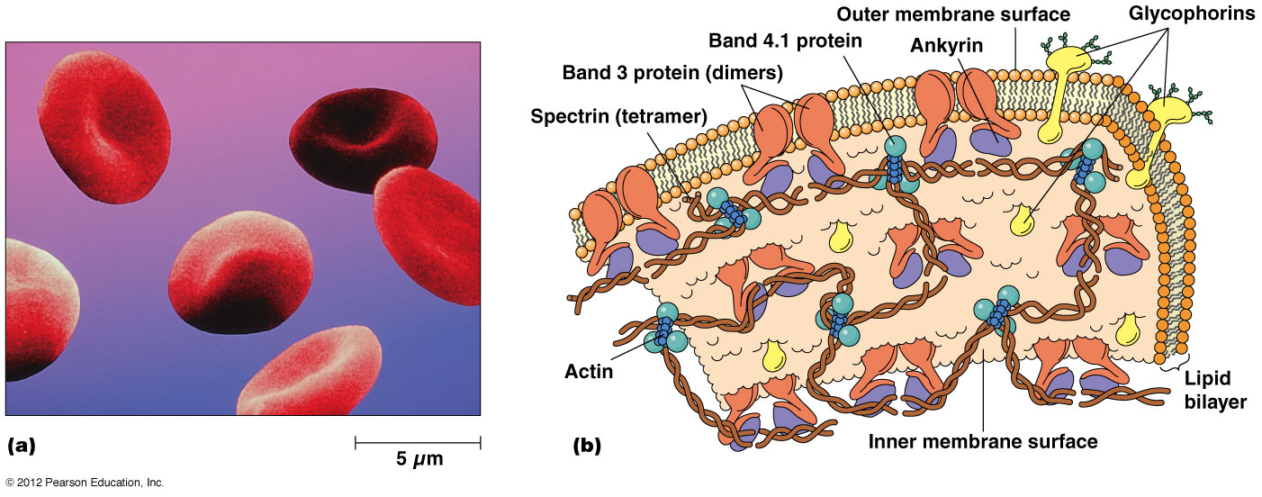
Structural features of erythrocyte membrane

Slide 55
Integral Membrane Proteins
Some integral membrane proteins, called integral monotropic proteins, are embedded in just one side of the bilayer
However, most are transmembrane proteins that span the membrane and protrude on both sides
Transmembrane proteins cross either once (singlepass proteins) or several times (multipass proteins)

Slide 56
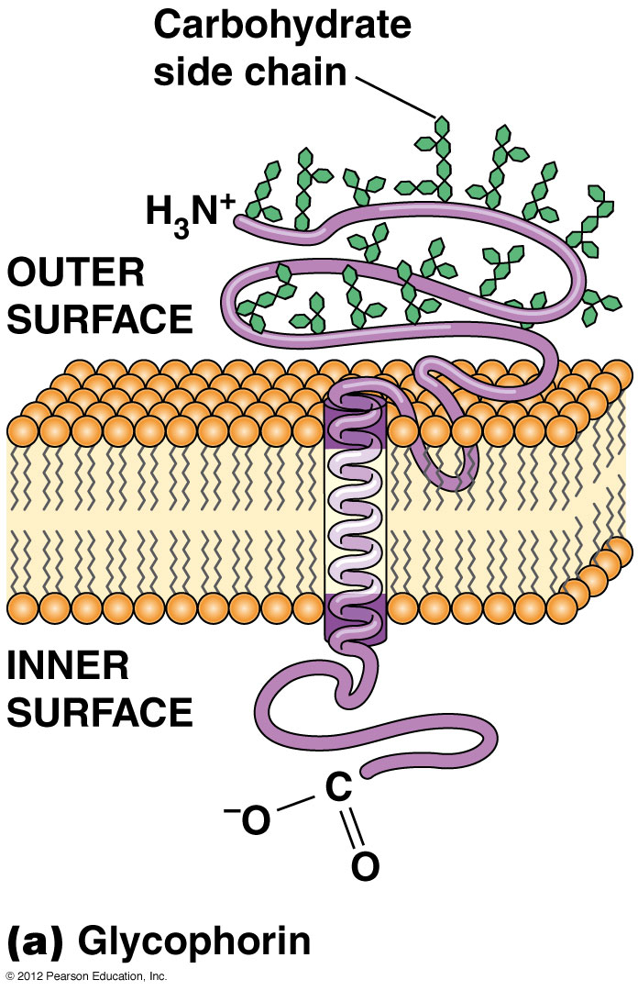
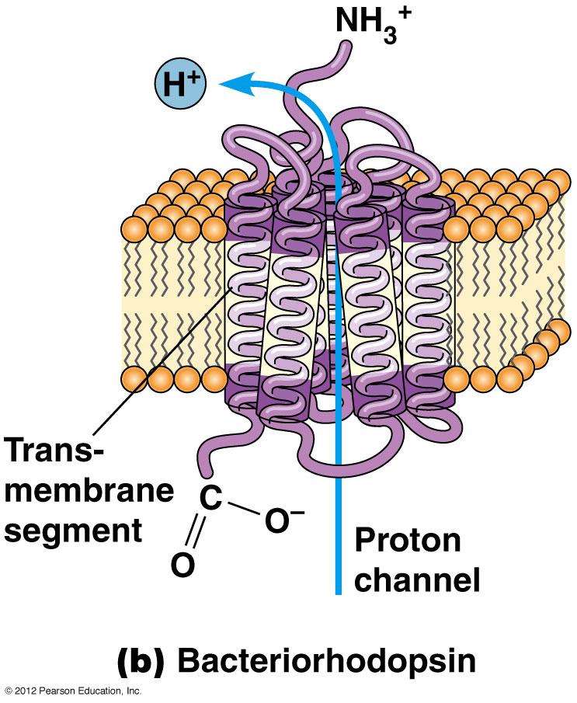
Structure of two integral membrane proteins (IMPs)
Singlepass IMP
Multipass IMP

Slide 57
Peripheral Membrane Proteins
Membrane proteins that lack discrete hydrophobic regions do not penetrate the lipid bilayer
These peripheral membrane proteins are bound to membrane surfaces through weak electrostatic forces and hydrogen bonds
Some hydrophobic residues play a role in anchoring them to the membrane surface

Slide 58
Lipid-Anchored Membrane Proteins
The polypeptide chains of lipid-anchored membrane proteins are located on the surfaces of membranes
They are covalently bound to lipid molecules embedded in the bilayer
Proteins bound to the inner surface of the plasma membrane are linked to fatty acids, or isoprenyl groups

Slide 59
The main classes of membrane proteins
GPI: Glycosylphosphatidylinositol

Slide 60
Types of lipid-anchored membrane proteins
Fatty acid-anchored membrane proteins are attached to a saturated fatty acid, usually myristic acid (14C) or palmitic acid (16C)
Isoprenylated membrane proteins are synthesized in the cytosol and then modified by addition of multiple isoprenyl groups (5C) usually farnesyl (15C) or geranygeranyl (20C) groups
GPI-anchored membrane proteins are covalently linked to glycosylphosphatidylinositol

Slide 61
The main classes of membrane proteins
GPI: Glycosylphosphatidylinositol

Slide 62
Proteins Can Be Separated by SDS-Polyacrylamide Gel Electrophoresis
Membrane proteins must be solubilized and extracted from membranes so that they can be studied
They are separated by electrophoresis

Slide 63
Isolation of Membrane Proteins
Peripheral membrane proteins are usually easy to isolate by altering pH or ionic strength
Chelating (cation binding) agents are also used to solubilize peripheral membrane proteins
Lipid-anchored proteins are isolated by similar means

Slide 64
Isolating integral membrane proteins
Integral membrane proteins are difficult to isolate from membranes
Often detergents are used that disrupt hydrophobic interactions and dissolve the lipid bilayer
For example, sodium dodecyl sulfate (SDS), a strong ionic detergent, is used to isolate and fractionate integral membrane proteins, but alters their function

Slide 65
SDS-Polyacrylamide Gel Electrophoresis
Electrophoresis is a group of techniques that use an electric field to separate charged molecules
How quickly a molecule moves during electrophoresis depends on both charge and size
Electrophoresis uses various support media most commonly polyacrylamide or agarose

Slide 66
Electrophoresis of membrane proteins
Membrane fragments are solubilized in SDS, which disrupts protein-protein and protein-lipid associations
The proteins are thus coated with negatively charged detergent molecules
The proteins are loaded onto a polyacrylamide gel and an electric potential applied

Slide 67
The negatively charged proteins run toward the positively charged bottom of the gel
Polypeptides move through the gel with the smallest moving fastest
The gel is stopped when the smallest proteins reach the bottom, and is stained with a dye such as Coomassie brilliant blue to show the proteins

Slide 68
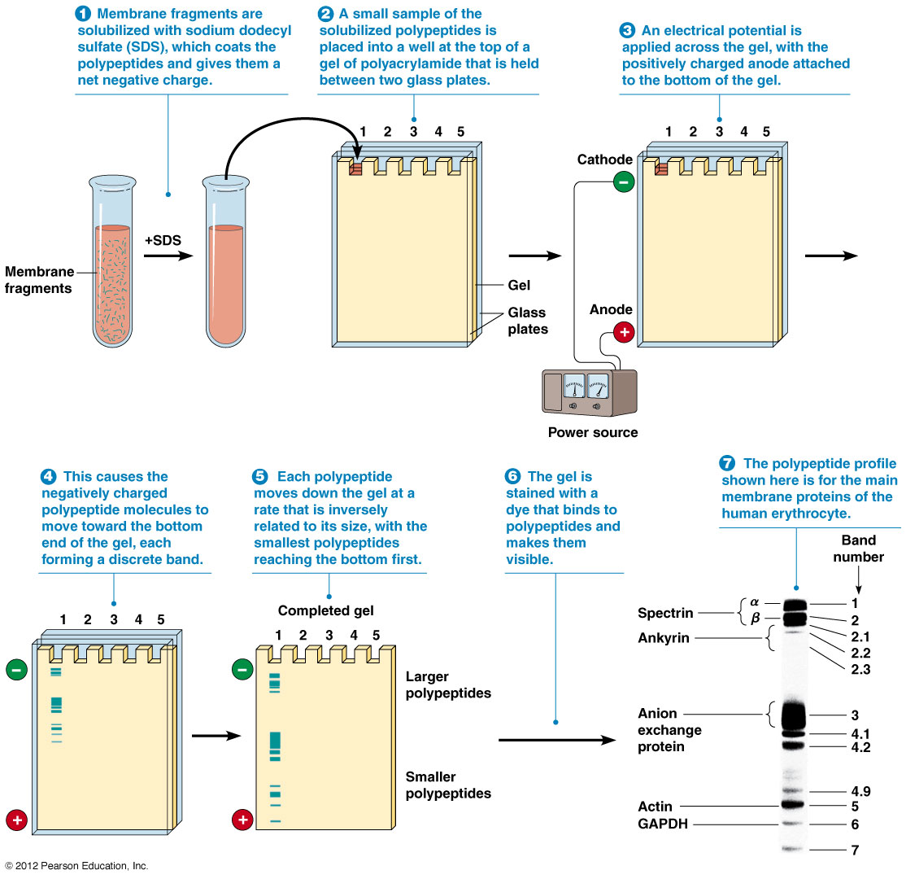

Slide 69
Additional techniques using electrophoresis
Two-dimensional SDS - PAGE (polyacrylamide gel electrophoresis) separates proteins in two dimensions, first by charge and then by size
Following electrophoresis, polypeptides can be identified by Western blotting
In this technique proteins are transferred to a membrane and bound by specific antibodies

Slide 70
Membranes:
Their Structure,
Function and Chemistry
Instructor: Dr. Mahmoud A. Srour
Course: Cell Biology 0202211
Reading:
Becker’s World of the Cell, 8th ed/ 2012.
Chap 7, p. 156-193.
Lec # 11 Mon 5.11.2012

Slide 71
Hydropathy Analysis
The number and location of transmembrane segments in a membrane protein can be predicted if the protein sequence is known
A hydropathy (or hydrophobicity) plot is used for this
A computer program identifies clusters of hydrophobic residues, calculating a hydropathy index for successive “windows” along the protein
positive peaks indicate the transmembrane area

Slide 72
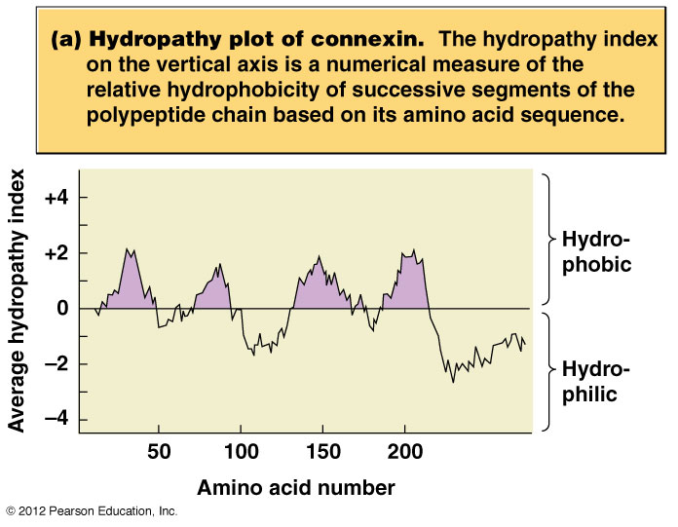

Slide 73
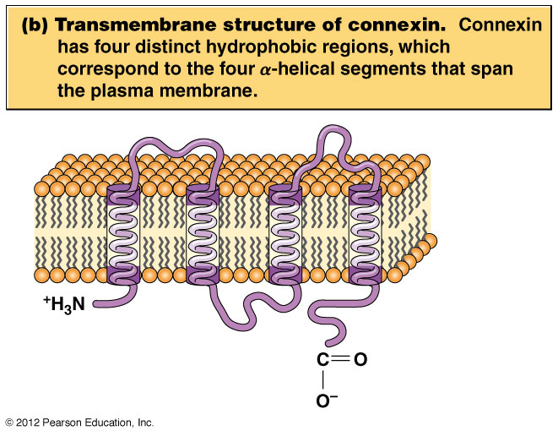

Slide 74
Molecular Biology Has Contributed Greatly to Our Understanding of Membrane Proteins
Within the past three decades the study of membrane proteins has been revolutionized by DNA sequencing and recombinant DNA technology
Amino acid sequence can be deduced from DNA sequence

Slide 75
Membrane Proteins Have a Variety of Functions
Enzymes – specific functions to specific membranes
Electron transport proteins – function in oxidative phosphorylation
Transport proteins – move nutrients
Channel proteins – hydrophilic molecule passage
Transport ATPase – move ions by use of ATP
Receptors – recognize and impinge on cell surface and transmit thru cell
Intercellular communications – gap junctions and plasmodesmata
Structural proteins – Stabilize membrane and cell

Slide 76
Membrane Proteins Are Oriented Asymmetrically Across the Lipid Bilayer
The part of the protein that is exposed on one side of the membrane is different than the other side
Can label the proteins on either side of the membrane depending on where the reagents are

Slide 77
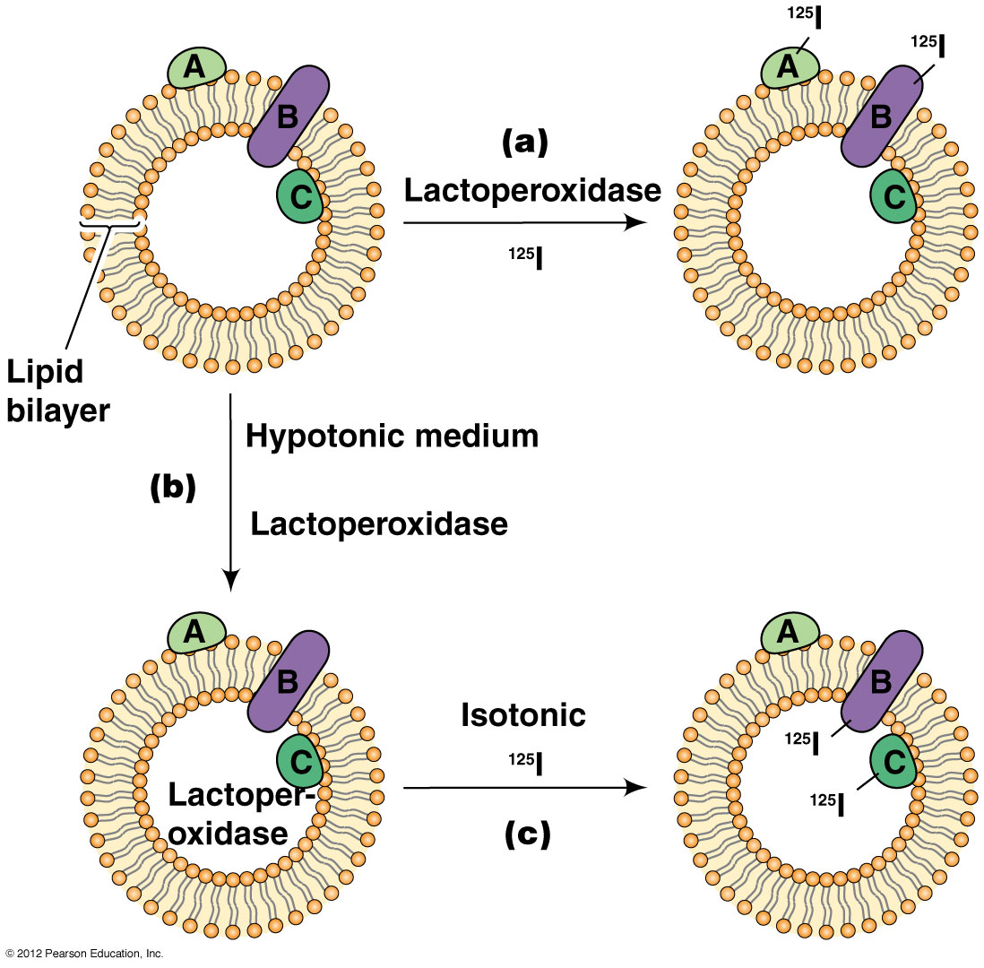
A method for labeling proteins exposed on one or both surfaces of a membrane vesicle

Slide 78
Many Membrane Proteins Are Glycosylated
Glycoproteins are membrane proteins with carbohydrate chains covalently linked to amino acid side chains
The addition of a carbohydrate side chain to a protein is called glycosylation
Glycosylation occurs in the ER and Golgi compartments

Slide 79
Glycosylation
Glycosylation involves linkage of the carbohydrate to
the nitrogen atom of an amino group (N-linked glycosylation), of an asparagine residue, or
the oxygen atom of a hydroxl group (O-linked glycosylation) of a serine, threonine, or modified lysine or proline residue

Slide 80
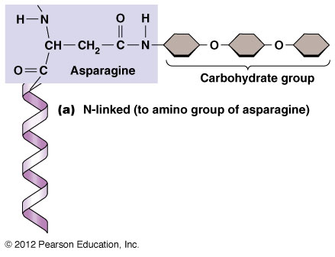
N-linked & O-linked Glycosylation of membrane proteins

Slide 81
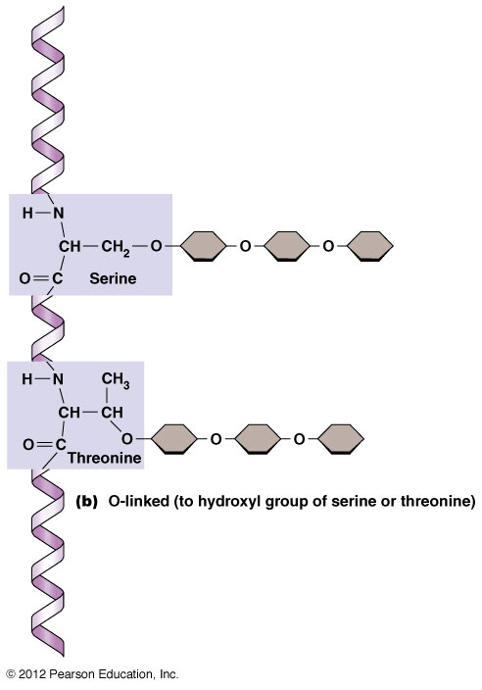

Slide 82
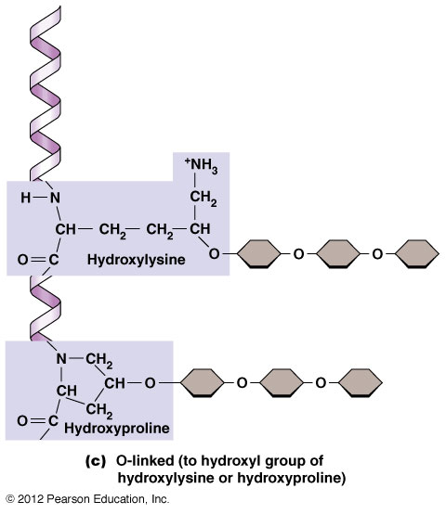

Slide 83
Carbohydrate chains attached to proteins
Carbohydrate chains attached to peptides can be either straight or branched and range in length from 2 to about 60 sugar units
The most common sugars are galactose, mannose, N-acetylglucosamine, and sialic acid

Slide 84
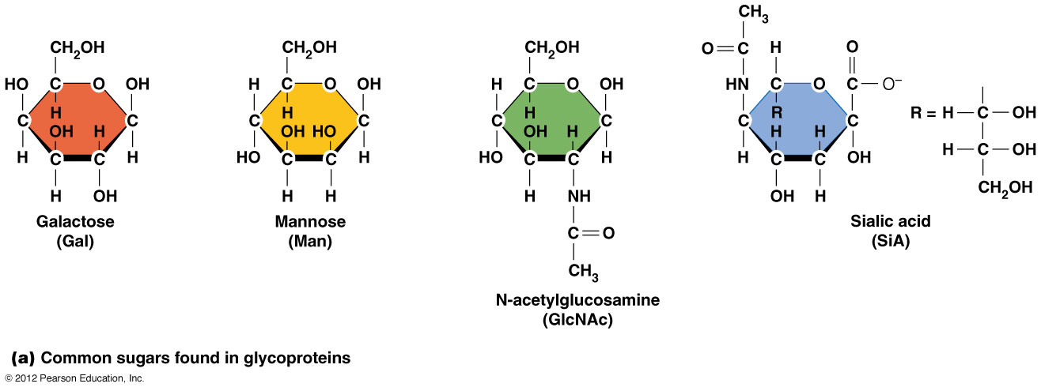
Examples of sugars found in proteins

Slide 85
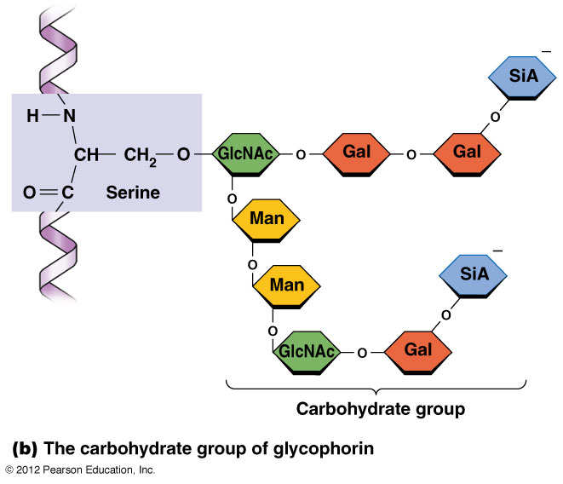
Examples of sugars found in proteins (Continued)
Glycophorin on RBC membrane has 16 such chains:
15 chains as O-linked &
1 chain as N-linked

Slide 86
Roles of glycoproteins
Glycoproteins are most prominent in plasma membranes, where they play a role in cell-cell recognition
The carbohydrate groups protrude on the outer surface of the cell membrane
Lectins are plant proteins that bind specific sugar groups very tightly, and can be used to study membrane glycoproteins

Slide 87
Glycocalyx
In animal cells, the carbohydrate groups of plasma membrane glycoproteins and glycolipids form a surface coat called a glycocalyx (meaning “sugar coat”)
The carbohydrate groups on the cell surface are components of the recognition sites of membrane receptors involved in antibody-antigen reactions

Slide 88
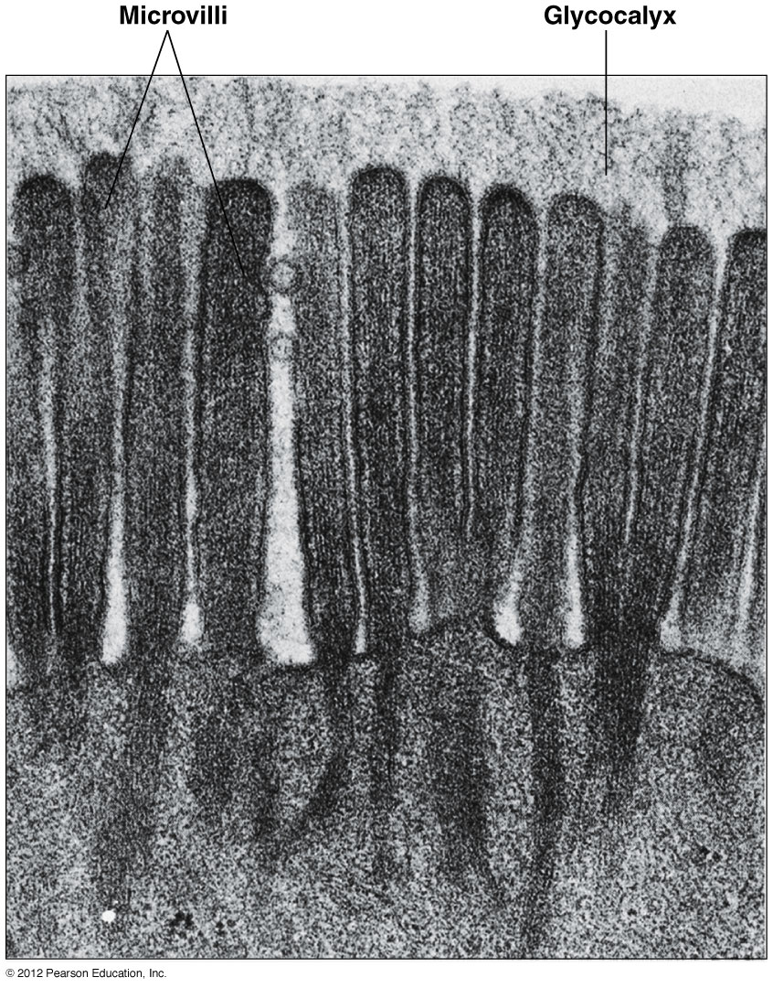
Glycocalyx of intestinal epithelial cells

Slide 89
Membrane Proteins Vary in Their Mobility
Membrane proteins are more variable than lipids in their ability to move freely within the membrane
Some proteins can move freely, whereas others are constrained because they are anchored to protein complexes

Slide 90
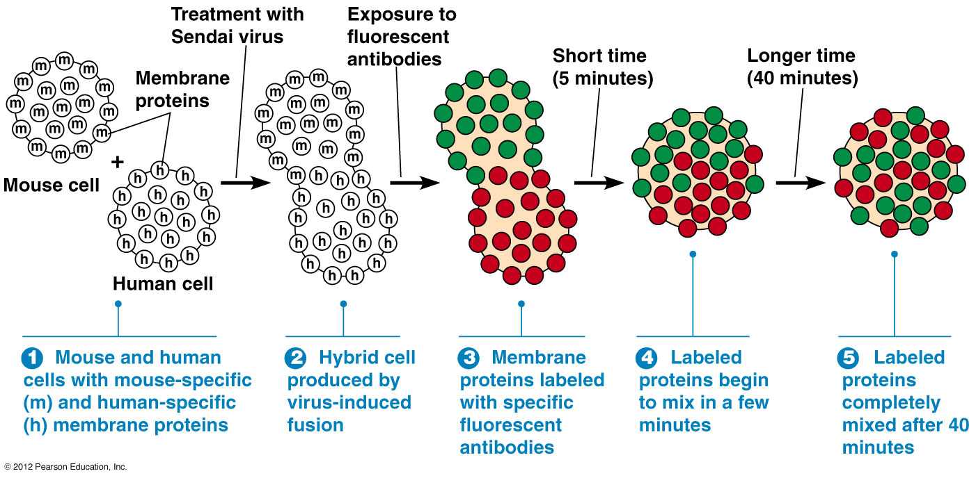
Demonstration of the mobility of membrane proteins by cell fusion

Slide 91
Protein Movement
Membrane proteins will move at more variable rates than lipids due to their size
Protein movement may be restricted by the presence of barriers such as the tight junction that connect cells or by the protein being anchored to a structure in the cell

