Slide 1
Flame Emission and Atomic Asorption

Slide 2
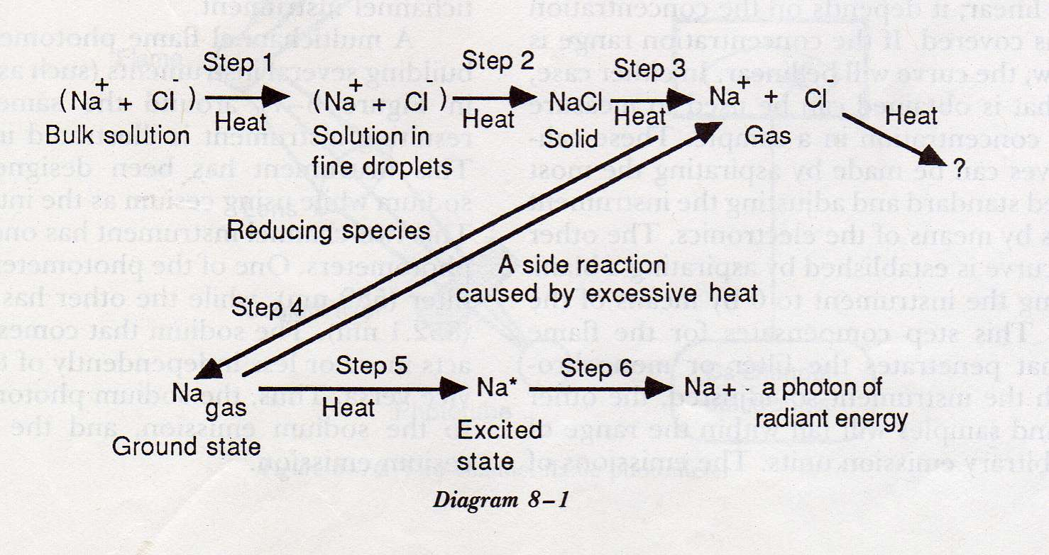
Principle

Slide 3
Energy Levels

Slide 4
Energy Levels

Slide 5
Flame Photometer components

Slide 6
Flame Photometer components

Slide 7
Flame Photometer components

Slide 8
Flame Temperature

Slide 9
Atomic Absorption

Slide 10
Atomic Absorption/ components

Slide 11
Atomic Absorption/ components

Slide 12
Atomic Absorption/ components

Slide 13
Flame conditions

Slide 14
Burners

Slide 15
Hollow Cathode Lamp

Slide 16
Atomic Absorption/ components/ Flameless

Slide 17
Interferences

