Slide 1
The Chemistry of the Cell
Instructor: Dr. Mahmoud A. Srour
Course: Cell Biology 0202211
Reading:
Becker’s World of the Cell, 8th ed/ 2012. Chap 2, p. 18-36.
Lec # 4 Sat 22.09.2012

Slide 2
The Chemistry of the Cell
Five principles important to cell biology are discussed in this chapter
Characteristics of carbon
Characteristics of water
Selectively permeable membranes
Synthesis by polymerization of small molecules
Self assembly

Slide 3
“Carbon is the most important atom in biological molecules.”
Vast majority of biological molecules are carbon-containing
An understanding of basic organic chemistry is important for understanding cell biology

Slide 4
Covalent bonds
Molecules: composed of atoms that are linked to one another through covalent bonds
In covalent bonds, neighboring atoms share electrons in order to fill their outermost electron orbital

Slide 5
Electron configuration of some biologically important atoms and molecules
Figure 2-1A

Slide 6
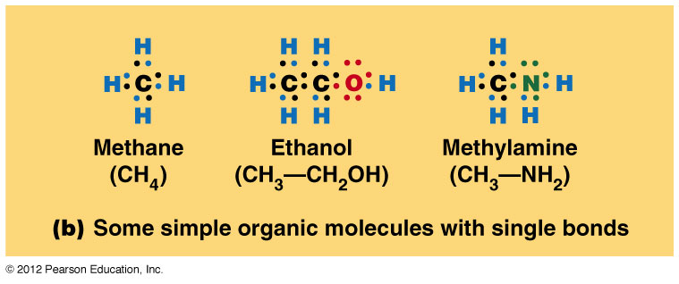
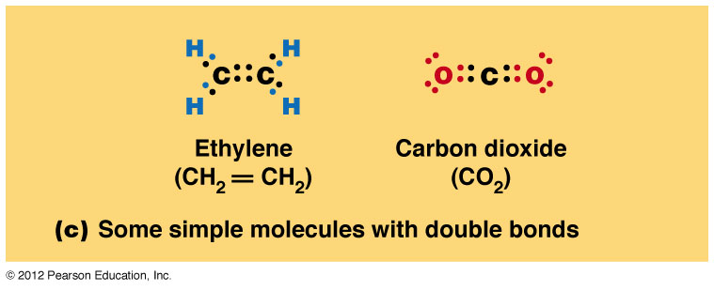
Figure 2-1B-D

Slide 7
Carbon-Containing Molecules are stable
It takes a lot of bond energy to break covalent bonds
Bond energy = amount of energy required to break 1 mole of bonds. Bond Energy is Measured in cal/mol,
One calorie is the amount of energy needed to raise the temperature of 1 g of water by 1ºC.

Slide 8
Bond energies of covalent bonds
A lot of energy is needed to break covalent bonds
C-C, 83 kcal/mol
C-N, 70 kcal/mol
C-O, 84 kcal/mol
C-H, 99 kcal/mol
Double and triple bonds are even harder to break
C=C, 146 kcal/mol
C≡C, 212 kcal/mol

Slide 9
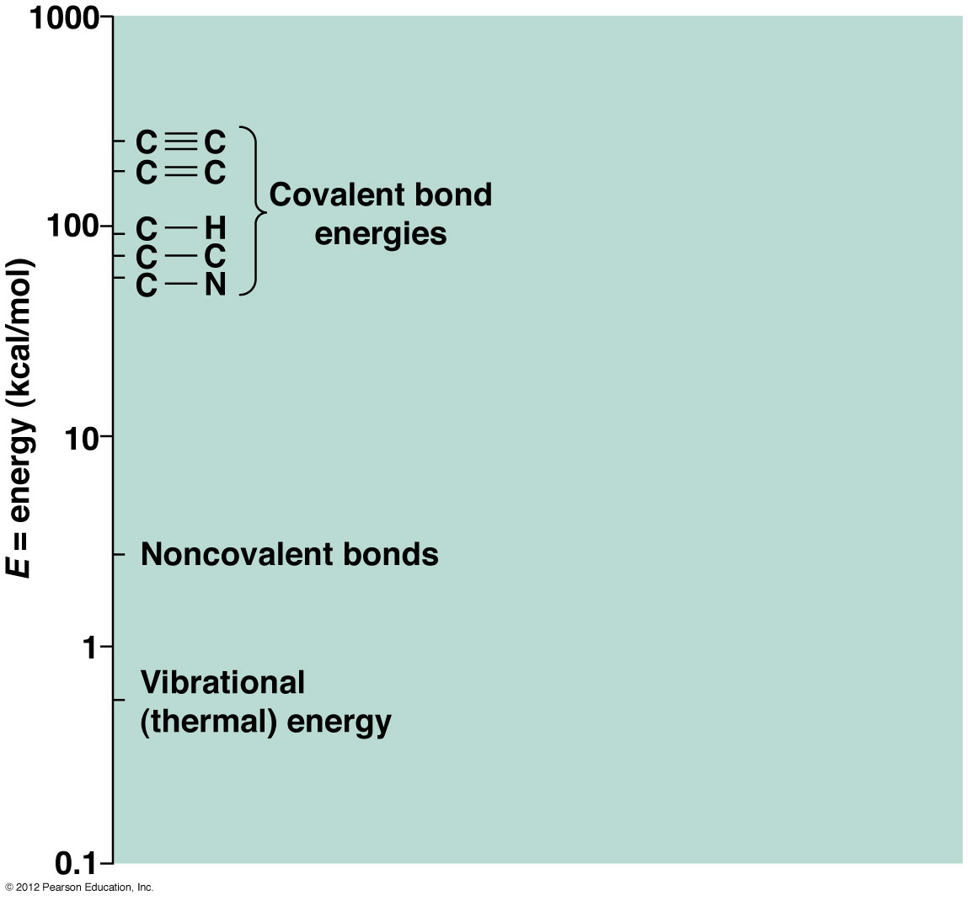
Energies of biologically important bonds
Notice that
covalent bonds are
much more stable
than non-covalent
bonds
Figure 2-2

Slide 10
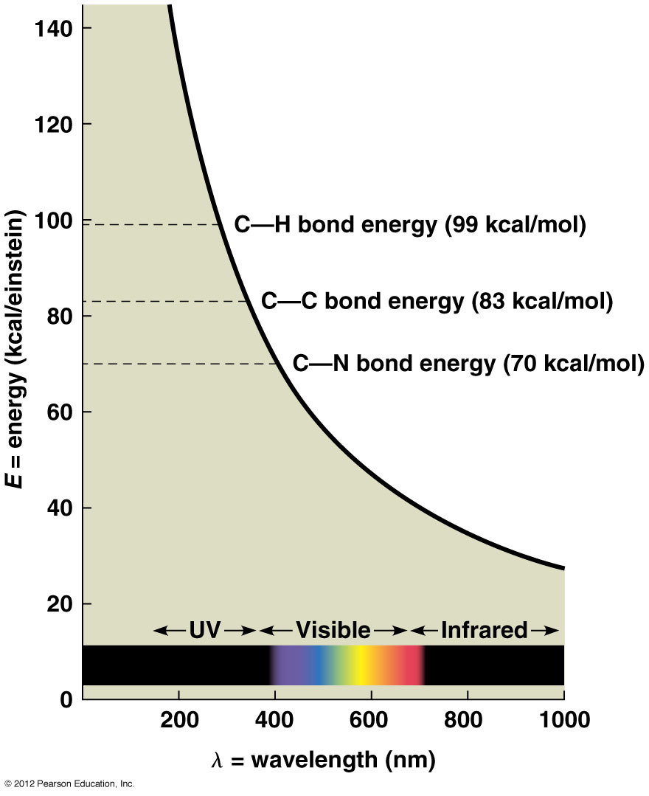
Relationship between energy and wavelength for electromagnetic radiation
Energy of light is inversely
proportional to the wavelength
Notice that visible light poses no threat
to covalent bonds. UV light does!
Figure 2-3

Slide 11
Diversity of Carbon-Containing Molecules
The principal atoms found in biological molecules are C, H, O, N, and less frequently S and P
The way in which these atoms are arranged within a molecule greatly affects the functioning of these molecules.

Slide 12
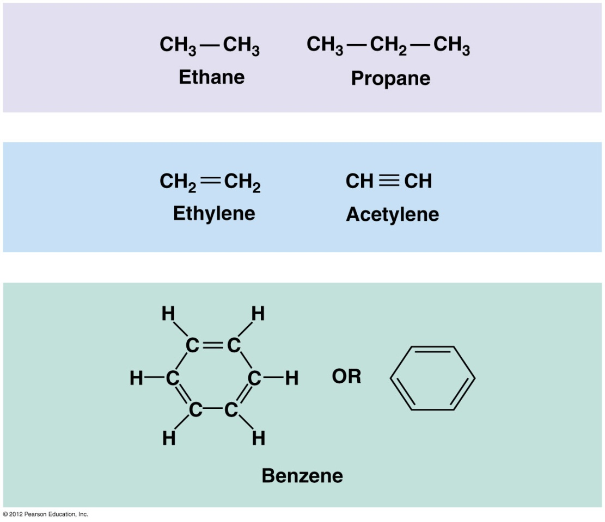
Hydrocarbons
Comprised entirely of C and H atoms as part of chains or ring structures
Insoluble in water
Figure 2-4

Slide 13
Common Functional Groups
Functional groups on carbon-containing molecules confer water solubility and chemical reactivity to the molecules in which they are found

Slide 14
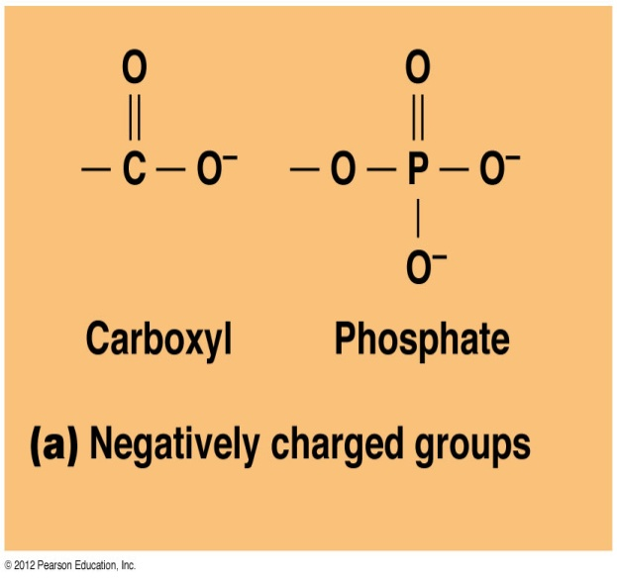
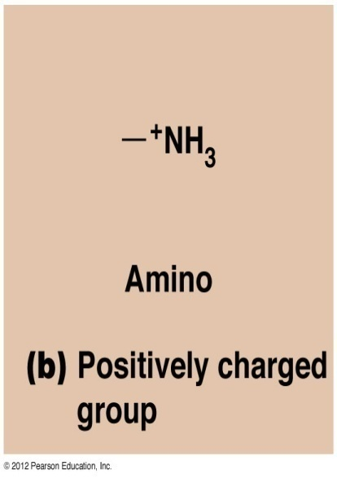
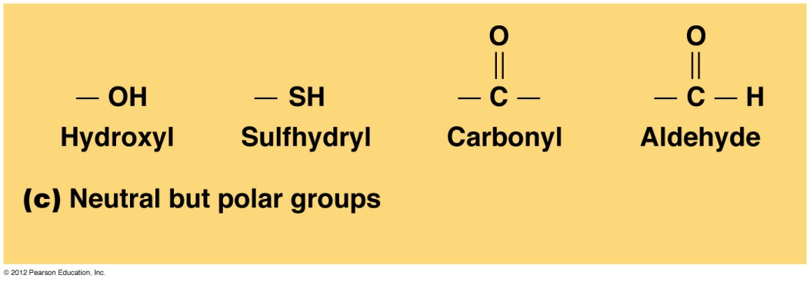
Common Functional Groups
Carboxyl and phosphoryl groups: ionized at near-neutral pH of most cells to give them a negative charge.
Amino groups: protonated to give them a positive charge.
Hydroxyl, sulfhydryl, carbonyl, and aldehyde groups are uncharged, but still polar.
Figure 2-5A,B

Slide 15
Carbon-Containing Molecules Can Form Stereoisomers
C has a tetrahedral geometry
i.e., it can form bonds with as many as 4 groups
If a C atom forms bonds with 4 different groups, it is called an asymmetric carbon
Molecules with asymmetric carbons can exist in different geometries or conformations

Slide 16
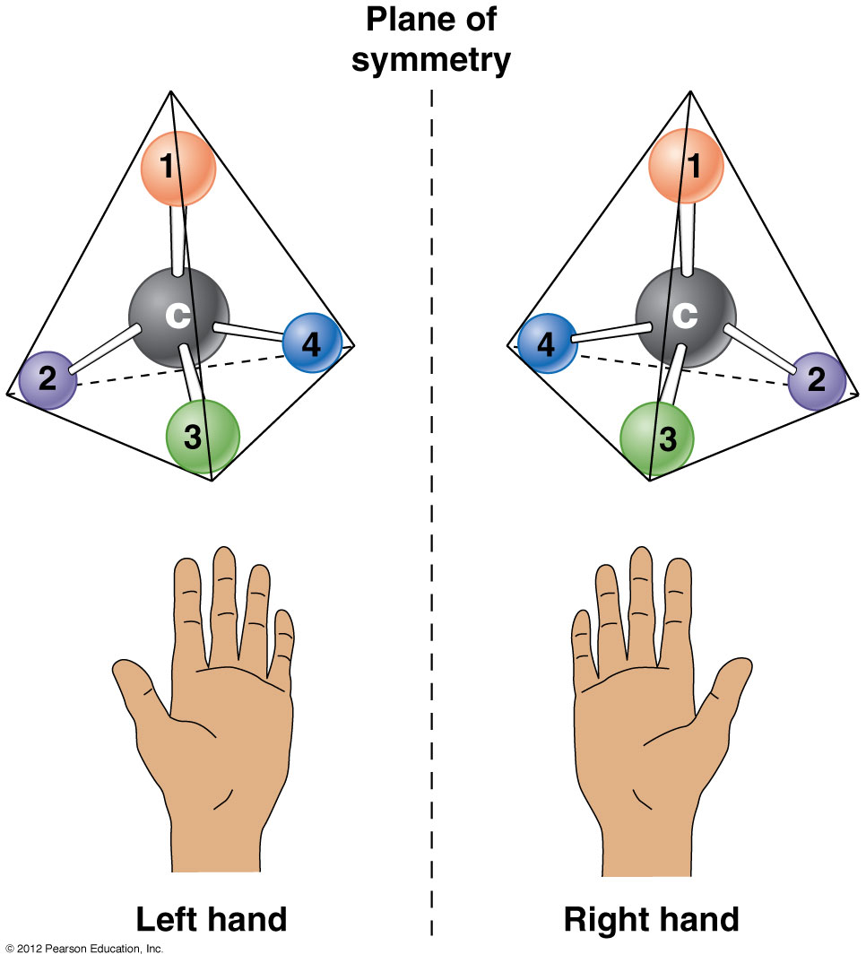
Stereoisomers
Stereoisomers have the
same chemical formula,
but their structures are
mirror images of one
another (like your hands).
Figure 2-6

Slide 17
Stereoisomers
How many asymmetric C’s are present in alanine?
The number of stereoisomers for a molecule with asymmetric C’s is 2^{n}, where n is the number of asymmetric C’s.
Therefore, there are 2 stereoisomers of alanine.

Slide 18
The 2 stereoisomers of alanine

Slide 19
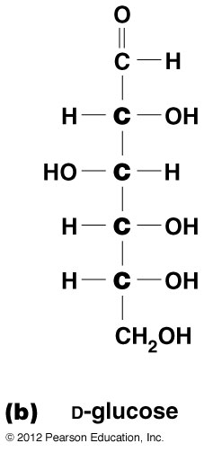
Stereoisomers of Glucose
How many asymmetric C’s are present in glucose?
How many stereoisomers of glucose are there?
Notes:
D-glucose is one of 16 isomers or 2E4 possible isomers.

Slide 20
The importance of water
Water has an indispensable role as the universal solvent in biological systems
Water makes up 75-85% of a cell’s weight
Most cells exist in an aqueous extracellular environment
Its chemical characteristics make water indispensable for life

Slide 21
Water Molecules are Polar
Polarity: uneven distribution of charge within a molecule
In H₂O, the O is electronegative; i.e., it draws electrons toward it

Slide 22
The tendency of water molecules to form H-bonds contribute to Water’s main properties
Cohesion/cohesiveness of water molecules: accounts for:
High surface tension of water
High specific heat
High heat of vaporization
Expansion of water upon freezing
Notes:
Cohesion is the attraction between molecules of the same kind.
Adhesion: clinging of one substance to another
Cohesion is the attraction between molecules of the same kind

Slide 23
Hydrogen-Bonding Between H₂O Molecules

Slide 24
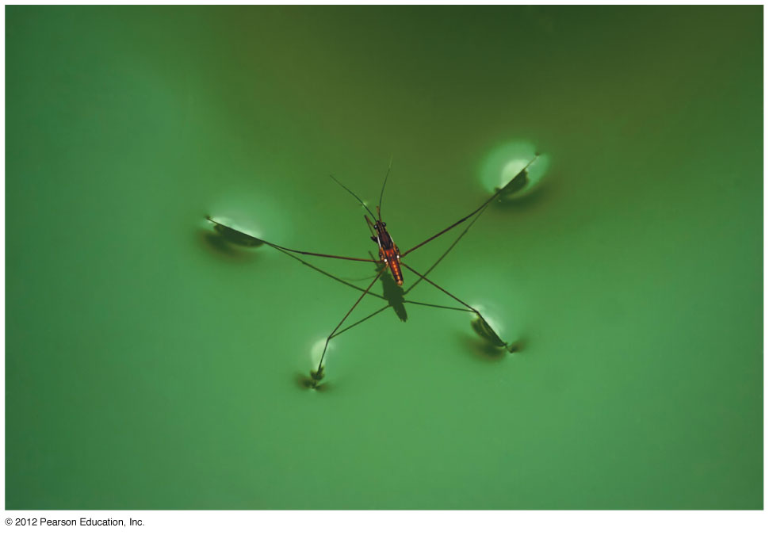
Walking on water
The high surface tension of water enables insects like this water strider to walk on the surface of a pond without breaking the surface.
Figure 2-9

Slide 25
Water is an excellent solvent
Hydrophilic molecules – dissolve readily in H₂O
e.g. Salts (such as NaCl)
Ionized molecules (such as those with carboxyl, phosphoryl, or amino functional groups)
Positively or negatively charged molecules (such as those with hydroxyl, carbonyl, or aldehyde functional groups)

Slide 26
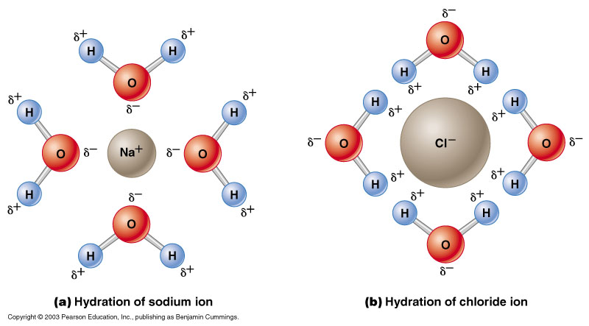
H₂O molecules disrupt electrostatic interactions between ions
in salts, forming spheres of hydration around each ion.

Slide 27
Solubility of Substances in H₂O
Hydrophobic molecules – insoluble in H₂O
Contain no polar regions; will not interact electrostatically with H₂O molecules
Tend to unite with one another; excluded by H₂O

Slide 28
The importance of Selectively Permeable Membranes
Cells cannot function as closed systems; must exchange with the extracellular environment
Exchange is not free, but is controlled
Cell membrane defines the boundaries of the cell and controls entry and exit of molecules and ions
Membrane is selectively permeable, allowing some things to pass but not others

Slide 29
Amphipathic nature of Membrane Lipids
Membrane is a bilayer, with hydrophobic
interior that serves as major barrier to
permeability
Charged or polar molecules are largely
prevented from crossing

Slide 30
Membrane Proteins
Membrane proteins are
intermediaries between the
intra- and extracellular spaces
Functions:
Transport proteins
Enzymes
Receptors
Ion channels

Slide 31
Membranes are selectively Permeable
Non-polar molecules pass through membrane easily
Polar or charged molecules do not unless they are very small (mw<100)
Examples of small molecules that can pass
Small, non-polar: O₂, CO₂
Small, polar: urea, ethanol, H₂O
Examples of small molecules that can not pass (on their own)
Ions: Na⁺, K⁺, Ca⁺⁺

Slide 32
The importance of synthesis by polymerization
String or polymer of small organic molecules (monomers)
Typically, linear arrays of monomers
Too large to cross a membrane; must be produced in the cell from monomers

Slide 33
Polymerization
The synthesis of a macromolecule from its smaller component monomers

Slide 34
Most Common Macromolecules in Cell Biology
Proteins: polymers of amino acids
Nucleic acids (DNA, RNA): polymers of nucleotides
Polysaccharides: polymers of monosaccharides

Slide 35
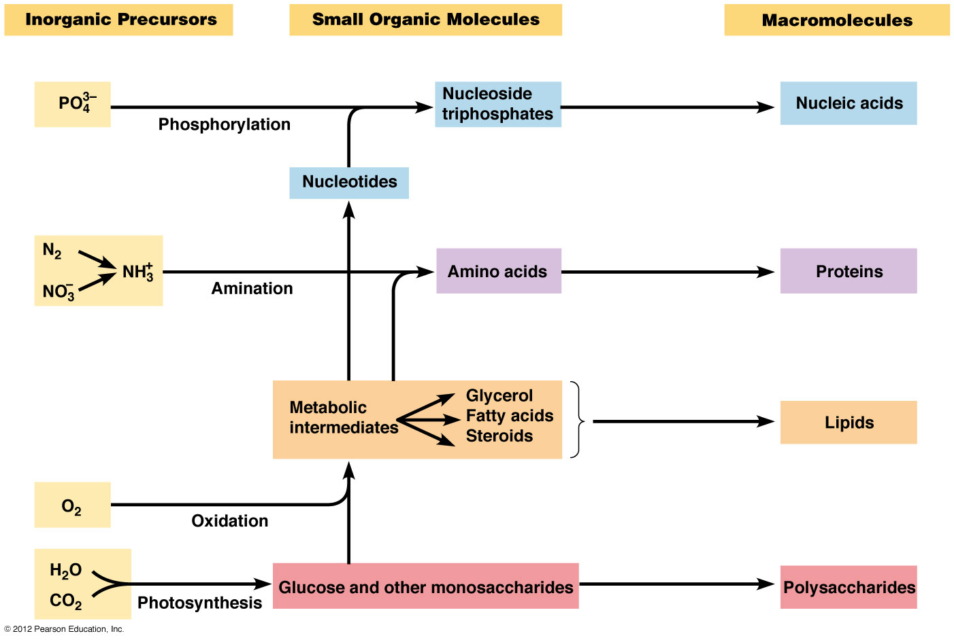
Synthesis of Biological Macromolecules by polymerization
Figure 2-15

Slide 36
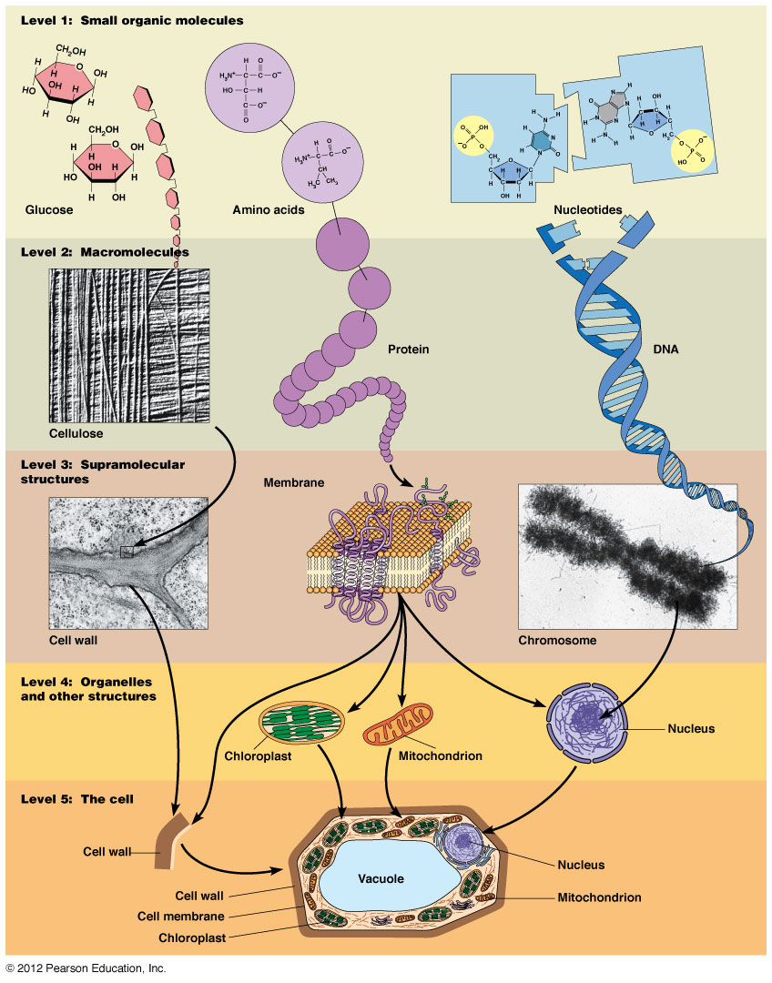
Hierarchy of Cellular Structures
Figure 2-14

Slide 37
What Do Macromolecules Do?
DNA and RNA contain genetic information (informational macromolecules)
Primary function is a coding function
DNA mRNA Protein
DNA contains instructions required for correct synthesis of all cellular proteins. DNA “codes for” protein, with mRNA as an intermediary in the process.
DNA is comprised of 4 different nucleotides (monomers). The sequence of nucleotides within the linear strand of DNA determines the order of the amino acids that will be built into the protein.
Sequence of DNA is the code that determines the sequence of the protein.

Slide 38
What Do Macromolecules Do?
Proteins
Multiple functions:
e.g., enzymes, transporters, chaperones, structure
Function is dependent upon sequence of amino acids
20 different amino acids. The sequence of aa’s in a protein determines how the protein folds and how the protein interacts with other proteins or with other cellular macromolecules.
Form dictates function.

Slide 39
What Do Macromolecules Do?
Polysaccharides
Storage (starch in plant cells, glycogen in animal cells)
What do they store? Monosaccharides! for use when necessary
Starch and glycogen are both polymers of glucose
Structure (cellulose in cell wall of plants; chitin in insect exoskeletons and crustacean shells)
Cellulose is also a polymer of glucose, but differs from starch in the way in which the glucose monomers are linked together.
Chitin is a polymer of N-acetylglucosamine (GlcNAc)

Slide 40
Polysaccharides
GlcNAc = N-acetylglucosamine
MurNAc = N-acetylmuramic acid

Slide 41
A Generic Model of Polymerization
Condensation Reaction
All macromolecules are synthesized by addition of one monomer at a time to the growing polymer in a reaction called a condensation reaction.
H₂O is released in the process. In order for this to occur, the last monomer at the end of the growing polymer must present a reactive H, and the incoming monomer must present a reactive –OH group.

Slide 42
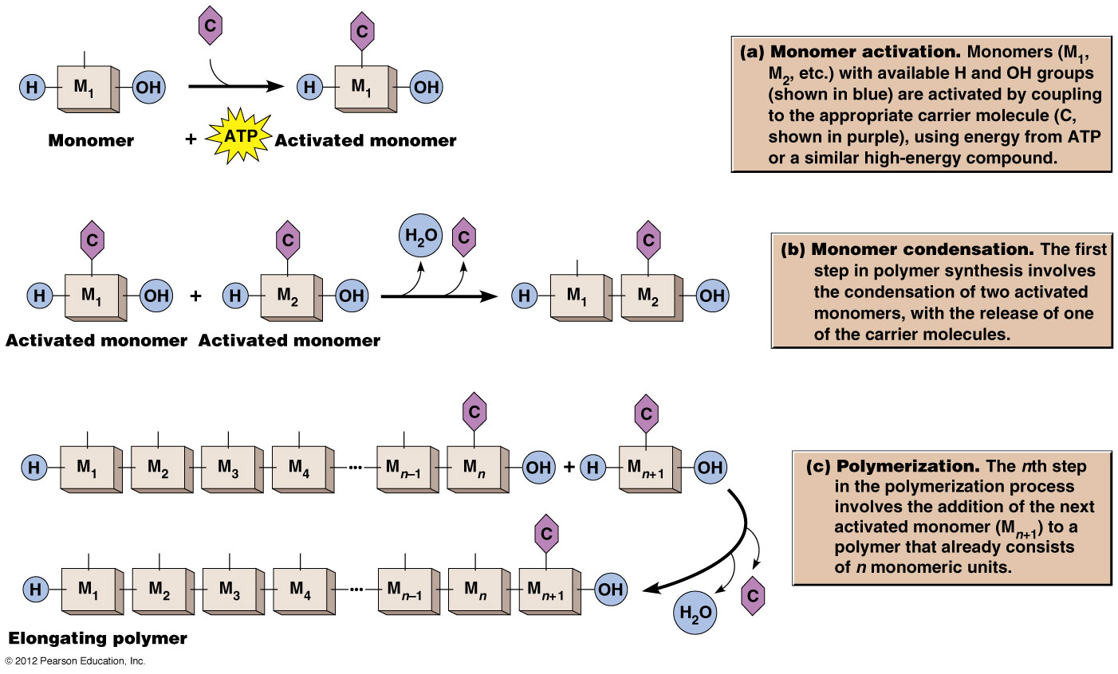
A Generic Model of Polymerization
H₂O is released during the condensation reaction that covalently
joins 2 monomers
Figure 2-17

Slide 43
*An Aside: What is ATP?
Adenosine triphosphate
A high energy compound
The 2 phosphoanhydride bonds are high-energy, i.e., much energy is released when they are broken or hydrolyzed.
Energy from ATP hydrolysis drives chemical reactions; in this case, the coupling of a monomer to its carrier molecule

Slide 44
The Self-Assembly of Proteins
Proteins are formed from sequential condensation reactions, each adding a new amino acid to the end of the growing chain.
Resulting linear chain of aa’s is called a polypeptide
Spontaneous intramolecular interactions occur between different regions of the polypeptide, causing the polypeptide to fold into the functional form of a protein
Spontaneous folding is an example of self-assembly
Information for proper folding (and hence function) is inherent in the amino acid sequence!

Slide 45
Self-Assembly of Proteins
Spontaneous self-assembly occurs under normal cellular conditions and gives rise to a protein in it’s functional, native form
Changing the cellular environment by:
increasing temperature
altering pH
addition of chemical
can cause the protein to unfold or denature, resulting in loss of function
Return to normal cellular conditions allows for renaturation and MAY lead to restoration of protein function

Slide 46
Denaturation/Renaturation
Denaturants are sufficient to disrupt non-covalent bonds, which are
the primary type of intramolecular interactions involved in protein
folding
Reducing agents (e.g., β-mercaptoethanol) are required for breaking
covalent disulfide bridges formed between sulfhyryl groups of 2
cysteine residues within a protein

Slide 47
Spontaneous Self-Assembly Can Occur Co-Translationally

Slide 48
Multimeric Proteins Are Assembled Post-translationally
Multimeric proteins: made up of more than one polypeptide
Each polypeptide is synthesized independently of the others
Each polypeptide will become one subunit of the protein complex
Subunits must be assembled to form the final functional protein complex

Slide 49
Chaperones and “Assisted” Self-Assembly
Chaperones: proteins which function by binding specifically to sites within a nascent polypeptide chain
Chaperone binding inhibits non-productive protein folding
Non-functional structures
Structures that can not interact with other subunits to form a multimeric protein complex
Chaperones assist self-assembly in these cases

Slide 50
Self-Assembly of Supramolecular Structures
Ribosomes: multiple RNAs and proteins
Membranes: phospholipids and membrane proteins
Cell wall: cellulose, other polysaccharides, proteins
Specific, sequential interactions between component molecules

