Slide 1
Electrophoresis
Chapter 6

Slide 2
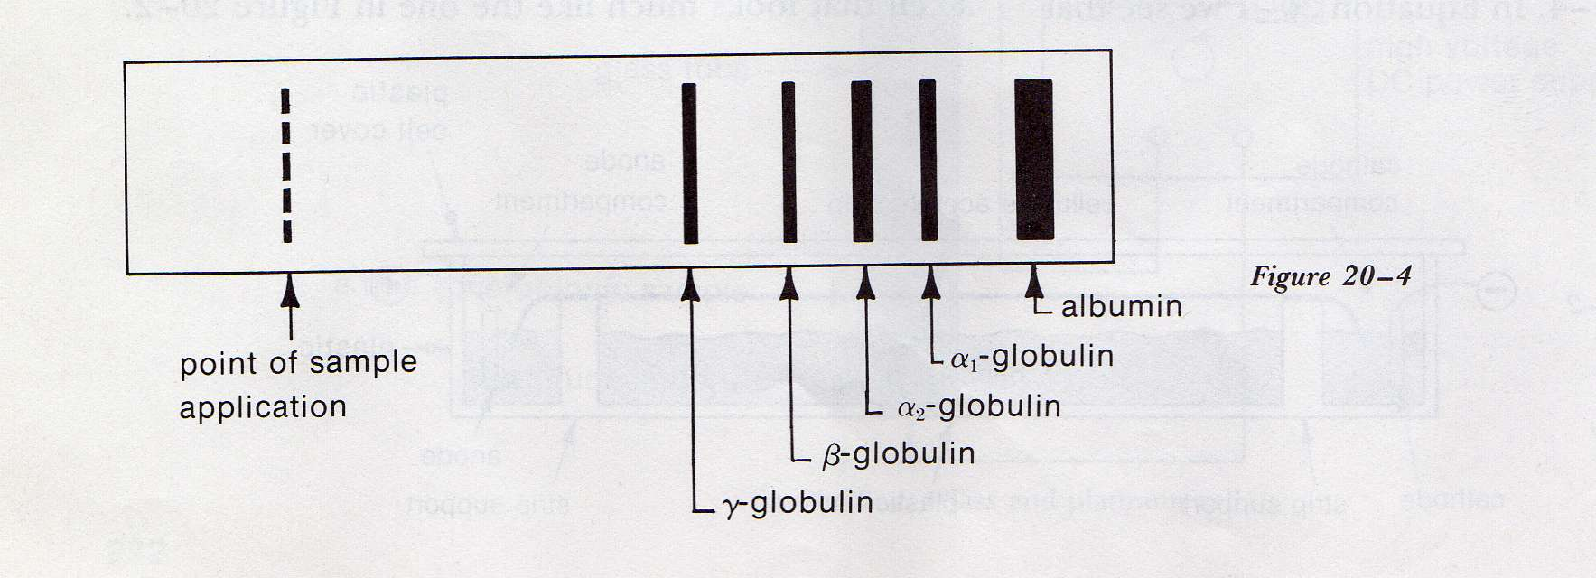
- Electrophoresis
- Iontophoresis
- Zone Electrophoresis
- Electropherogram

Slide 3
Particles in solution

Slide 4
Zeta Potential

Slide 5
Apparatus

Slide 6
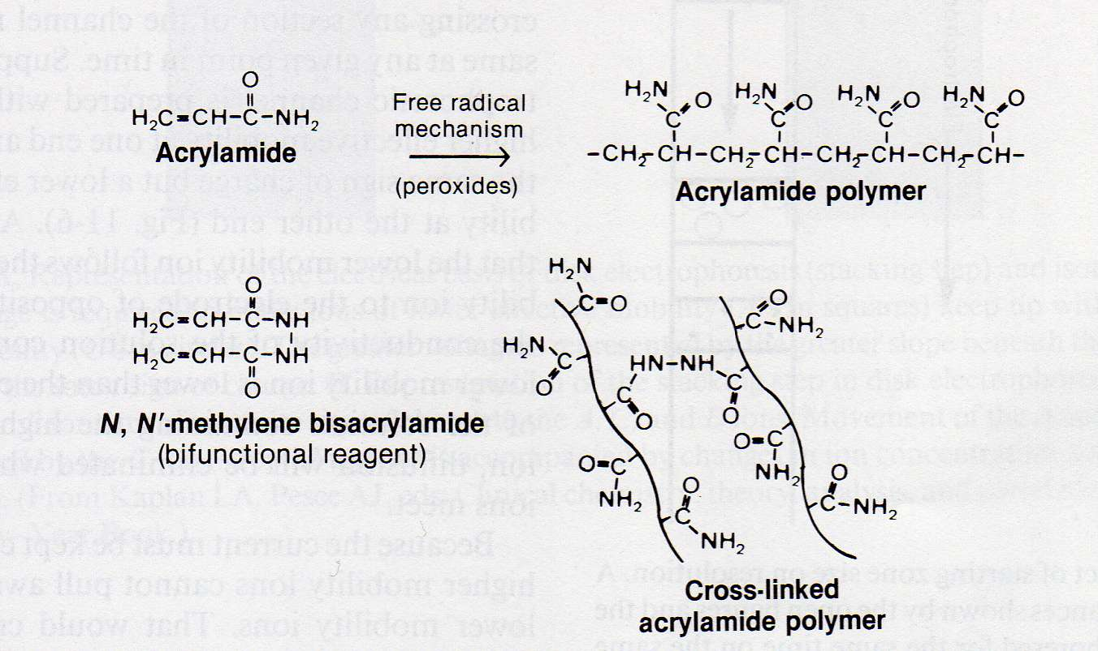
Support Media
Starch Gel and Cellulose Acetate
Agarose
Polyacrylamide Gel (PAGE)

Slide 7
Densitometry

Slide 8
Sample application and Resolution

Slide 9
Problems in Electrophoresis

Slide 10
Gel Electrophoresis (serum protein electrophoresis)

Slide 11
Isoelectric Focusing

Slide 12
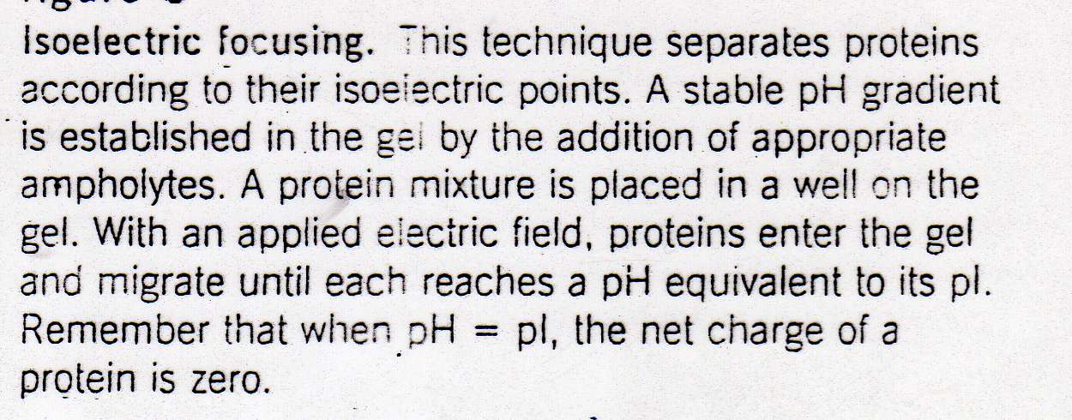
Isoelectric Focusing

Slide 13
SDS Electrophoresis

Slide 14
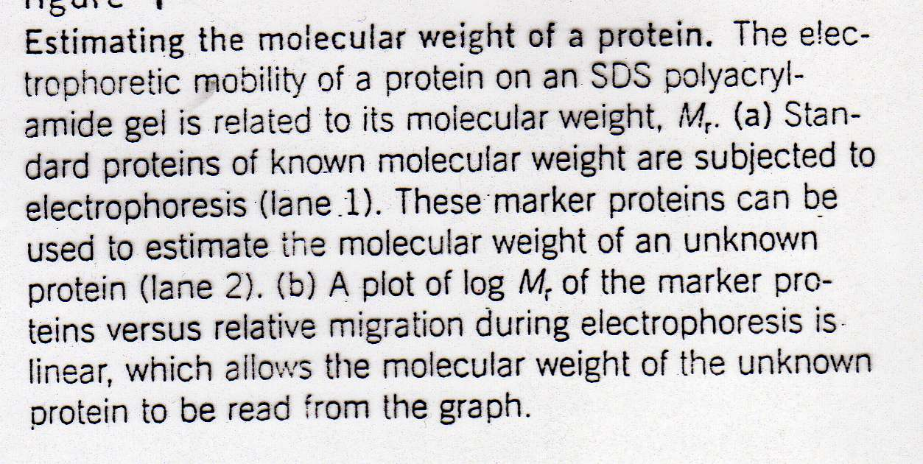
SDS Electrophoresis

Slide 15
2-D Electrophoresis

Slide 16
Capillary Electrophoresis

Slide 17
Electropherogram in CE

Slide 18
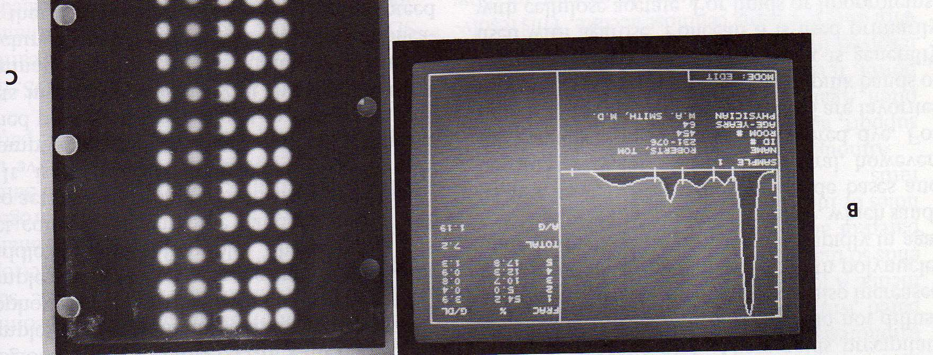
serum protein electrophoresis

Slide 19
Electrophoresis System

