Slide 1
A Preview of the Cell
Instructor: Dr. Mahmoud A. Srour
Course: Cell Biology 0202211
Reading:
Becker’s World of the Cell, 8th ed/ 2012. Chap 1, p. 1-8.
Lec # 1 Sat 08.09.2012

Slide 2
Introduction
What is a cell?
“the basic unit of biology” OR “the basic unit of life”
The basic structural and functional unit of living organisms, or the smallest structure capable of performing the essential functions characteristic of life
Notes:
Cytology: the study of cellular structure, based primarily on microscopic techniques.

Slide 3
A more thorough answer:
A membrane-bound compartment
Filled with aqueous solution of chemicals
Able to reproduce itself

Slide 4
All forms of life are made up of cells
Simplest life forms are single cells, e.g. bacteria
Higher life forms are multi-cellular
multiple specialized cell types
communication among various cell types required for survival of organism

Slide 5
The cell theory
In 1839, Schwann postulated the cell theory
(1) All organisms consist of one or more cells
(2) The cell is the basic unit of structure for all organisms
Later, Virchow (1855) added
(3) All cells arise only from preexisting cells

Slide 6
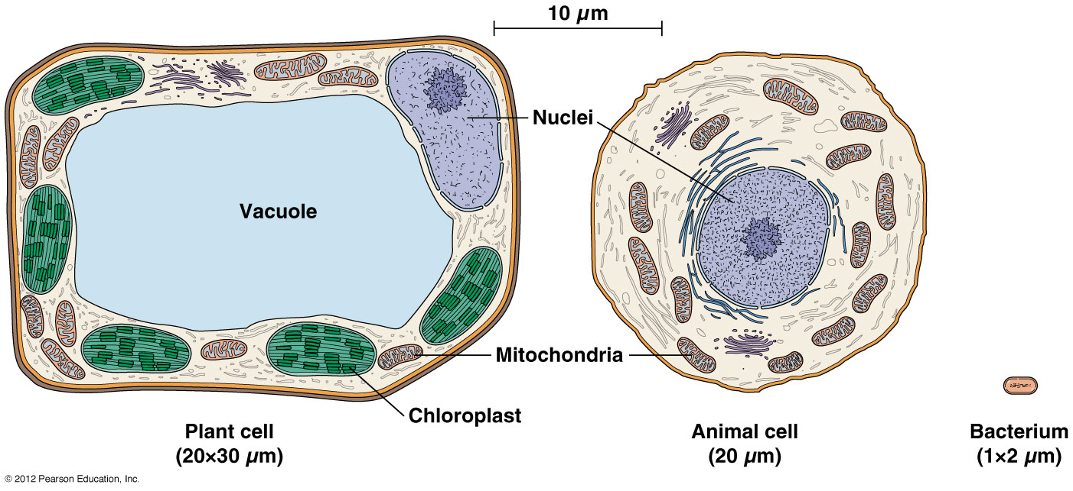
Typical Cell Architecture
Figure 1A-1

Slide 7
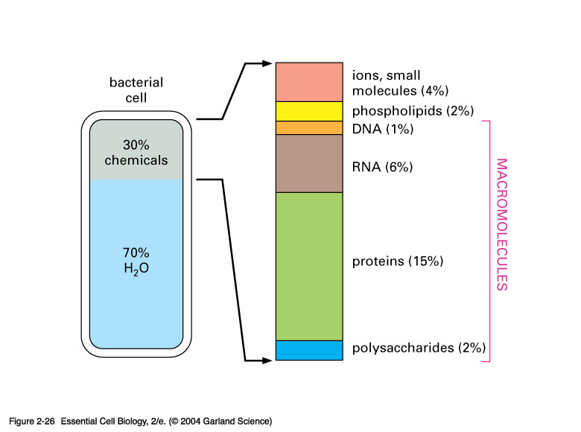

Slide 8
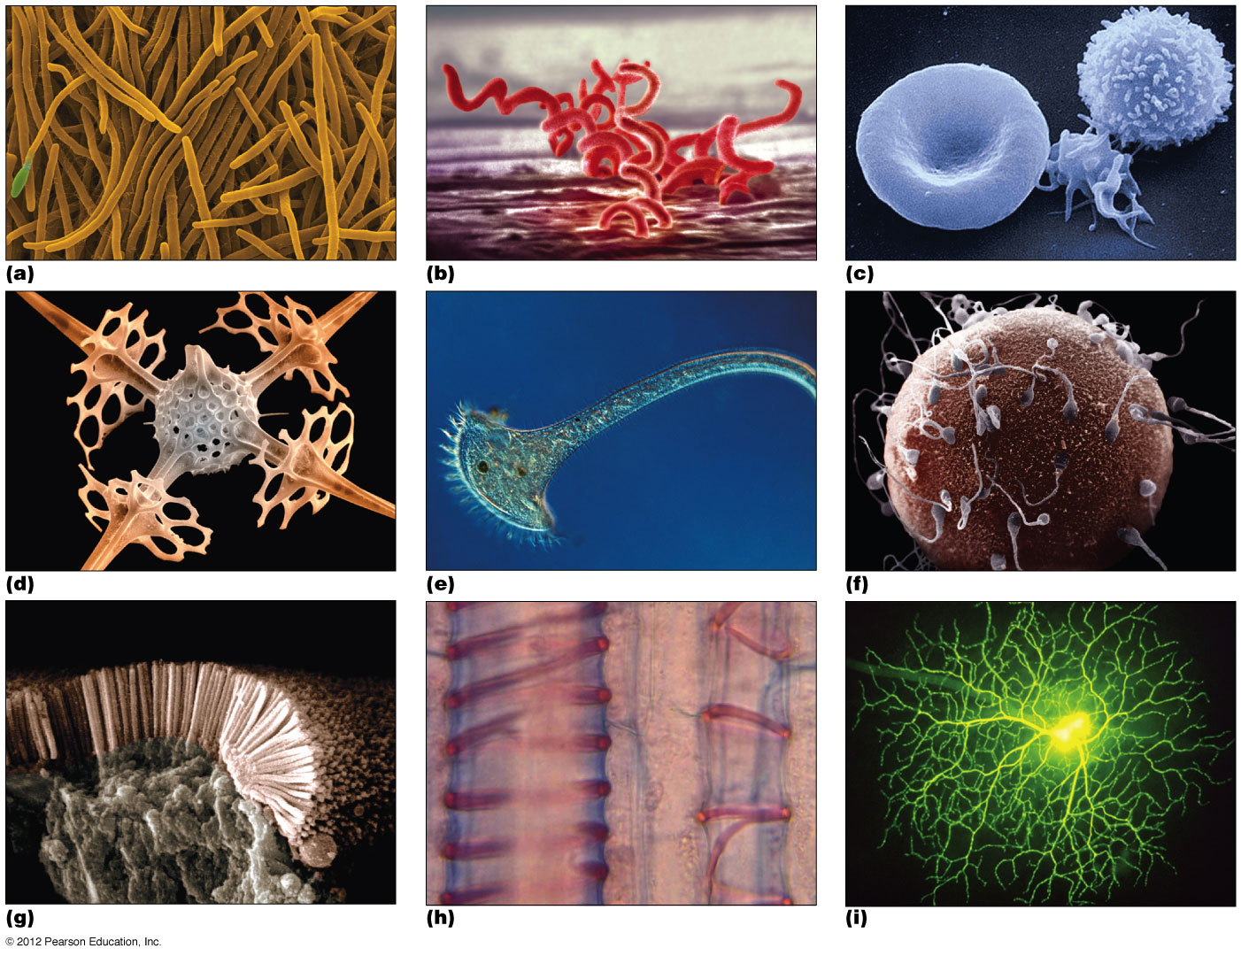
The cells of the world
Figure 1-1

Slide 9
The emergence of modern cell biology
What is cell biology?
Simple answer: The study of cells
The study of the
structure,
function,
reproduction,
behavior, and
evolution
of cells, leading to further understanding of life processes.

Slide 10
The emergence of modern cell biology
Three historical strands weave together into modern cell biology, each with important contributions to understanding cells
The cytology strand focuses mainly on cellular structure, and emphasizes optical techniques
The biochemistry strand focuses on cellular function
The genetics strand focuses on information flow and heredity
Notes:
Cytology: the study of cellular structure, based primarily on microscopic techniques.

Slide 11
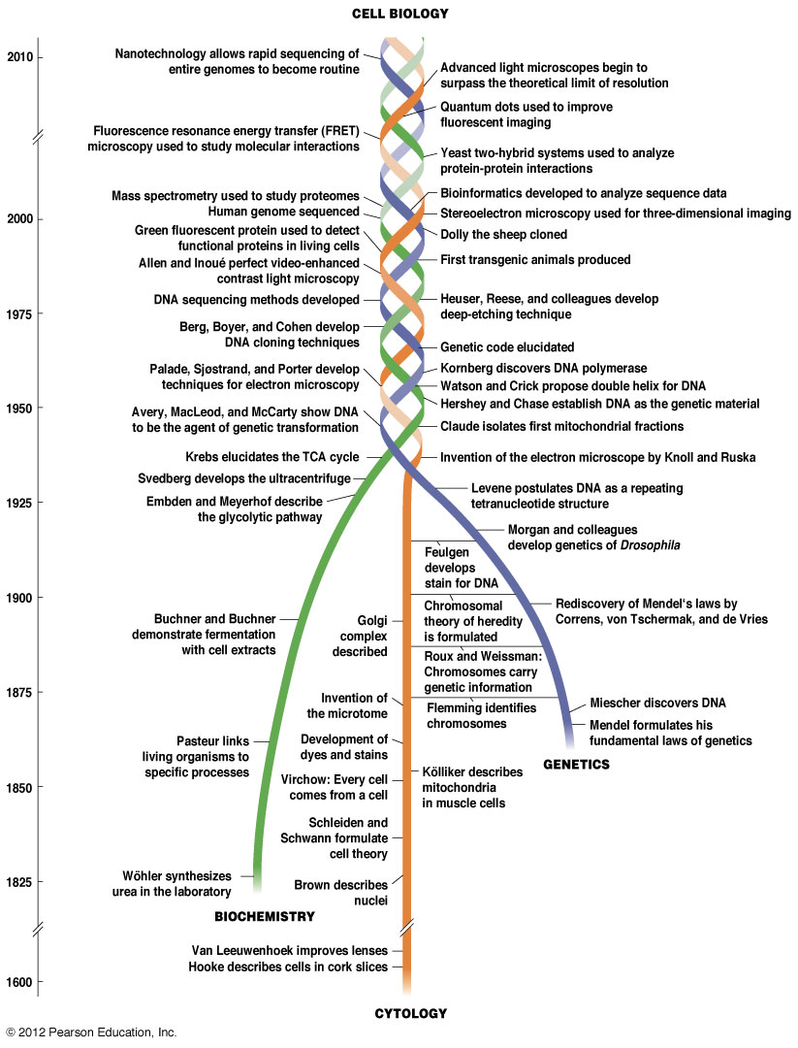
The cell biology time line
Figure 1-2

Slide 12
Cytology
The study of cell structure
Prefix cyto- and suffix –cyte are Greek for cell or “hollow vessel”, e.g. Erythrocyte; osteocyte
Observation of cell structure using microscopy and stained or unstained tissue or cells
Cells being studied can be either dead or alive

Slide 13
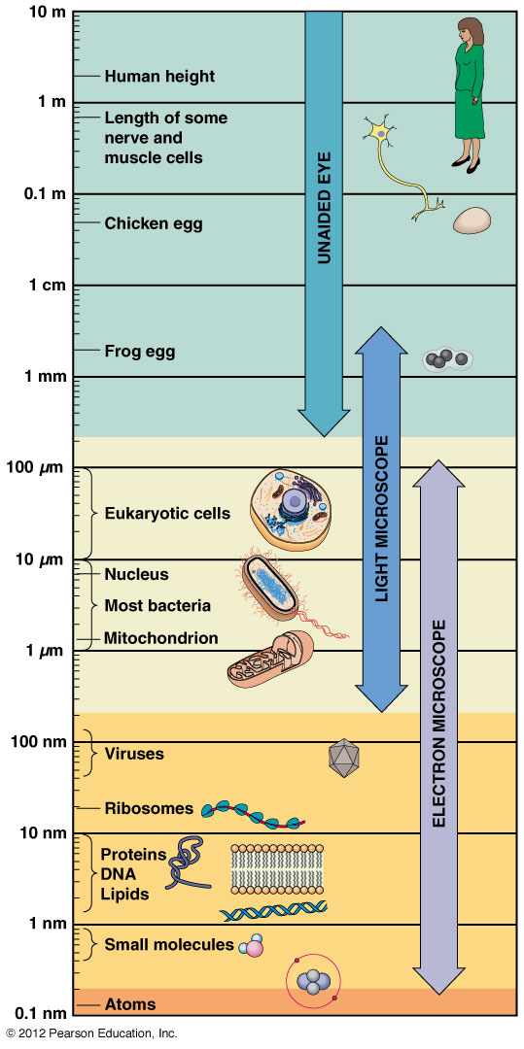
Cytology
Light Microscope – allows us to see cell structure
Brightfield microscopy – white light passes thru fixed tissue
Resolving power – able to see 2 things as individual
As you are able to see smaller and smaller objects, you also move from light to electron microscope
Figure 1-3 Relative resolving power of human eye, LM, EM

Slide 14
Biochemistry
Study of cell function at sub-cellular level or the biochemistry of biological structure and function
Uses techniques such as:
Ultracentrifugation (>100,000 rpm)
Chromatography
Electrophoresis
Mass Spectrometry
to separate and study sub-cellular components, such as organelles, nucleic acids (DNA, RNA), and proteins
Enzymatic reactions and metabolic pathways can be studied using techniques of biochemistry

Slide 15
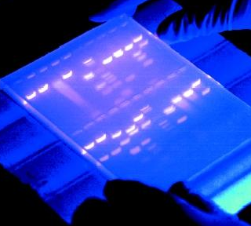
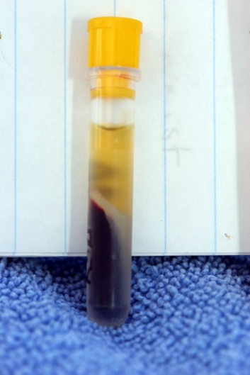
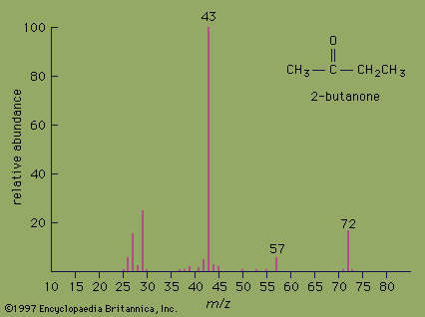
Important Developments in Biochem
Centrifugation
Electrophoresis
Mass Spectometery:is an analytical technique for the determination of the elemental composition of molecule. It is also used for elucidating the chemical structures of molecules
Chromatography

Slide 16
Genetics/Molecular Biology
Focuses on information flow inside the cell
Study of the genetic material (DNA, RNA)
Uses molecular biology techniques
Manipulation of DNA and RNA,
Important techniques include:
Nucleic acid hybridization
Recombinant DNA technology- cloning, restriction enzymes
DNA sequencing
Bioinformatics

Slide 17
The Scale of Components at the Cellular and Sub-Cellular Level
Micrometer (µm), also called a micron: 1 x 10⁻⁶ meter
Nanometer (nm): 1 x 10⁻⁹ meter
Angstrom (Å): 1 x 10⁻¹⁰ meter (or 0.1 nm)

Slide 18
Cell Size
Most cells range in size from 1-30 µm
Bacterial cells: 1-2 µm
Plant cells: 10-30 µm
Animals cells: 5-20 µm
Some animal cells can be quite large, for example:
Purkinje cells: ~ 50 mm;
Frog ovum: ~ 1 mm

Slide 19
Sub-Cellular Components
Organelles: sub-cellular, membrane-bounded compartments (animal and plant cells, not bacteria)
Size range: 0.2-5 µm
Nuclei > chloroplasts > mitochondria > lysosomes > peroxisomes

Slide 20
Other Sub-Cellular Components
Ribosomes (protein synthesis) ~ 25 nm
Microtubules (cytoskeleton) ~25 nm
Cell Membrane ~ 7-8 nm
Microfilaments ~ 7 nm
DNA helix ~ 2 nm (= 20 Å)

Slide 21
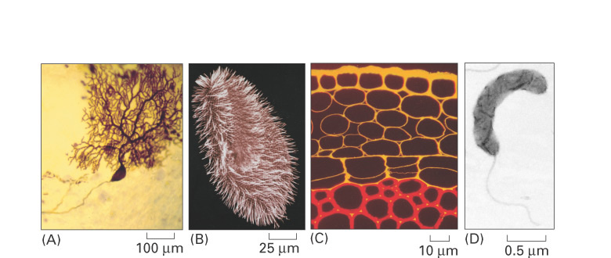
Not All Cells Are Alike!
Differences
Size, shape, function, chemical requirements

Slide 22
Similarities Among Cells
Similarities
Similar basic chemistry:
Genetic information in form of nucleic acids (DNA, RNA)
Genetic instructions translated in proteins (major molecules in cells)

Slide 23
Introduction to Microscopy
Limit of resolution: Distance required between 2 objects in order to be distinguished as separate entities
Typical light microscope
Wavelength of visible light = 400-700 nm
Limit of resolution = 200-350 nm
Resolving power: A microscope with smaller limit of resolution has a greater resolving power

Slide 24
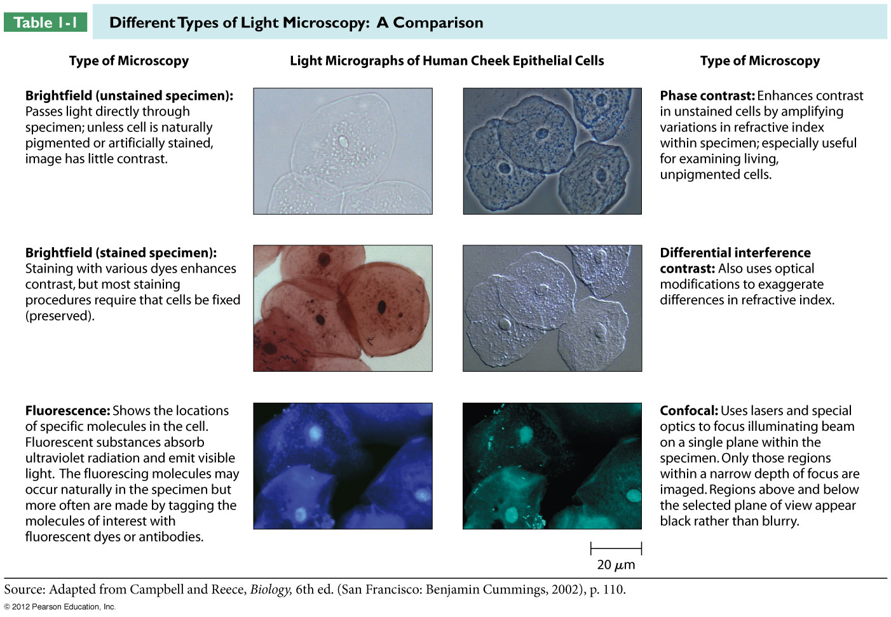
Table 1-1

Slide 25
Types of Microscopy
Brightfield Microscopy
Visible white light
Specimen has been “fixed”, dehydrated, embedded in a special medium, cut, and mounted onto a microscope slide
Disadvantage:
Cells are dead

Slide 26
Types of Microscopy
Phase-Contrast; Differential Interference Contrast (Nomarski) Microscopy
Method of choice for visualizing live, unstained cells.
Structurally distinct portions of cell have different refractive indices.
Phase-contrast uses special filters that amplify these differences, resulting in higher visual contrast to the observer.

Slide 27
Types of Microscopy
Fluorescence Microscopy
Fluorescently-tagged molecules used to visualize live cells.
UV light passed through specimen to excite fluorescent molecules.
Excited molecules emit visible light.
Limitation: focuses on only a single plane of the specimen at a time, yet fluorescent light is emitted throughout the specimen

Slide 28
Types of Microscopy
Confocal Scanning
Microscopy
Uses laser beam to illuminate a single focal plane or specimen.
Advantages:
Eliminates problem of halo effect from adjacent focal planes
Allows “serial” imaging through a thick section; production of 3D image of tissue

Slide 29
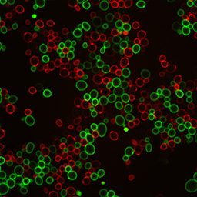
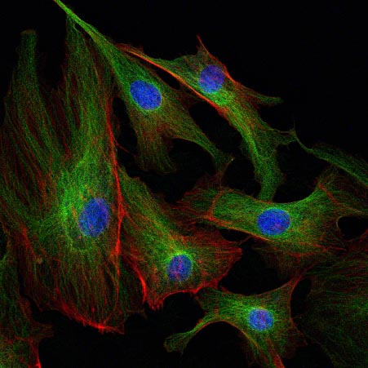
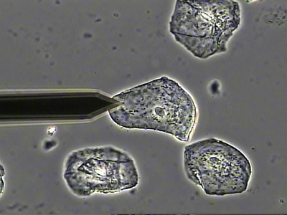
Observing Living Cells
Bright-field
Fluorescent probes
Confocal
Phase contrast

Slide 30
Types of Microscopy
Electron Microscopy
Greater magnification
EM: 100,000-fold mag
Light: 1,000-1,500-fold mag
Limits of resolution
EM: 2 nm
Light: 200-350 nm
Requires use of thinner tissue sections
EM: ~ 20 nm – 1 μm
Light: ~ 10 μm
Notes:
Invented in germany in 1931 by Max Knoll and Ernst Ruska

Slide 31
Electron Microscopy
Transmission Electron Microscopy (TEM)
Beam of electrons is focused and passed through specimen treated with a heavy metal stain.
Stain adheres differently to structurally-distinct components in the specimen.
As beam passes through stained specimen, electrons will be differentially absorbed or scattered, dependent upon the distribution of the stain.
After passing through the specimen, beam is focused onto a viewing screen or photographic film to reveal the image of the specimen.

Slide 32
Electron Microscopy
Scanning Electron Microscopy (SEM)
Beam of electrons is focused onto a metal-coated specimen.
Electrons that are scattered (deflected away from the specimen) are detected and used to build a digital image of the specimen on a video screen.

Slide 33
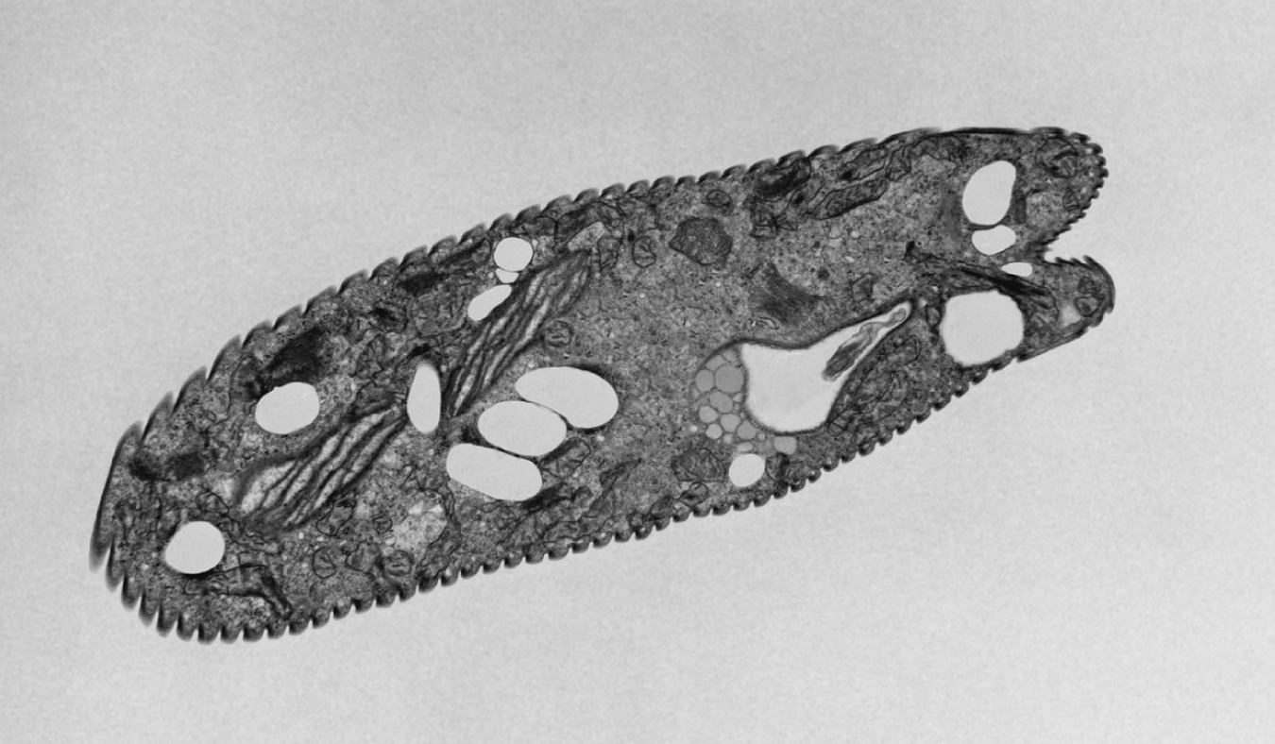
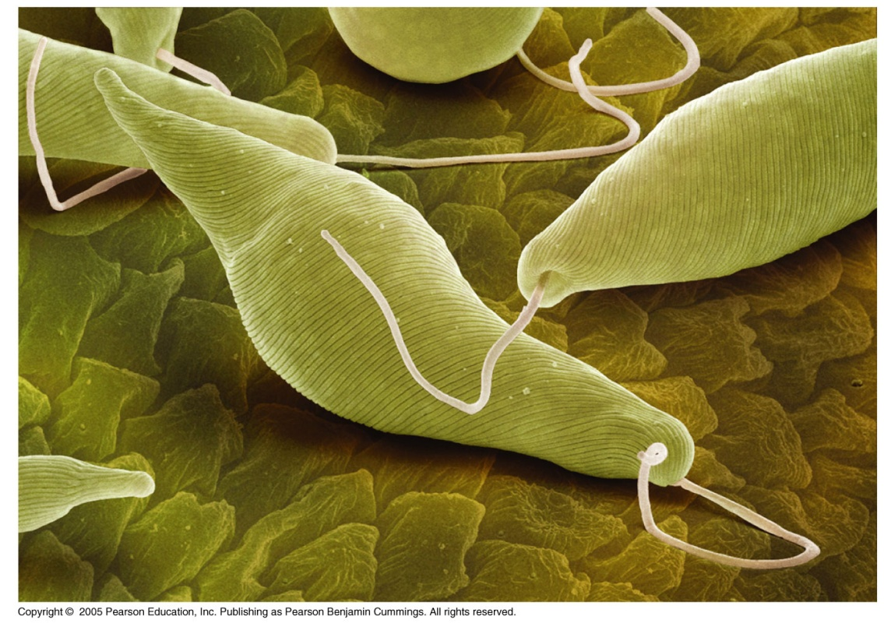
Electron Micrography
Transmission
Scanning

Slide 34
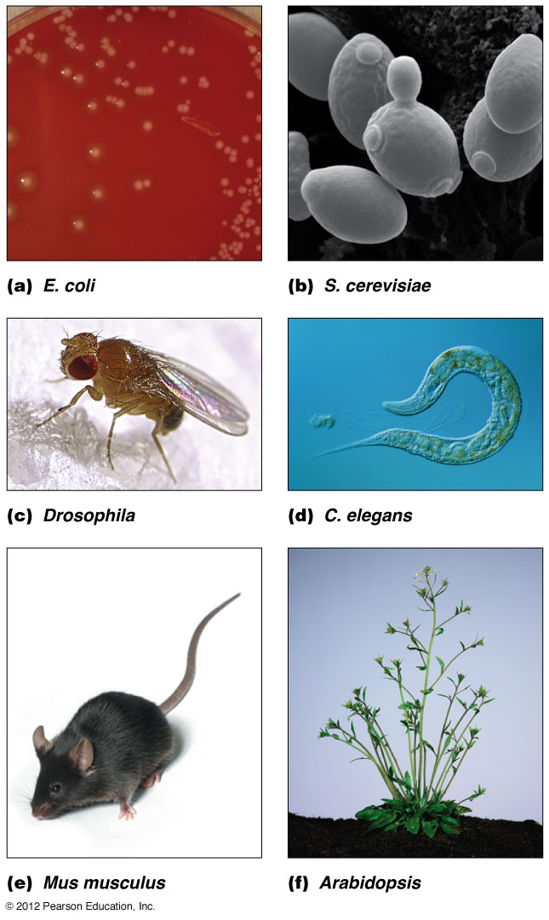
Model organisms in cell biology
Figure 1B-1

