Slide 1
Hematopoiesis IV
Lec # 4
Course: Clinical Hematology I (0202351)
Textbook:
Harmening DM. Clinical Hematology & Fundementals of Hemostasis, 5th ed. Philadephia: F.A. Davies. Chap 1

Slide 2
Bone-derived cells
Osteoblasts
Large cells, 30μm in diameter
May be traumatized in the process of BM aspiration
Cytoplasm show a prominent chromophobic zone that stains lighter than the rest of cytoplasm, usually away from nucleus
Often seen in BM from young children
Responsible for formation, calcification and maintainence of bone trabeculae. They secret large amounts of proteoglycans and collagen and contribute to structure of the bone & stromal matrix
Notes:
Bone formation & hematopoiesis are closely linked>

Slide 3
Osteoclasts
Giant (> 100μm ) multinucleated irregularly shaped marrow phagocytes, with 2-50 nuclei
Cytoplasm has numerous reddish lysosomal granules containing acid phosphatase
Capable of absorption of bone, Secrete enzymes that aid in dissolution of osteoid tissue & calcific bone

Slide 4
Osteoblast
Osteoclast

Slide 5
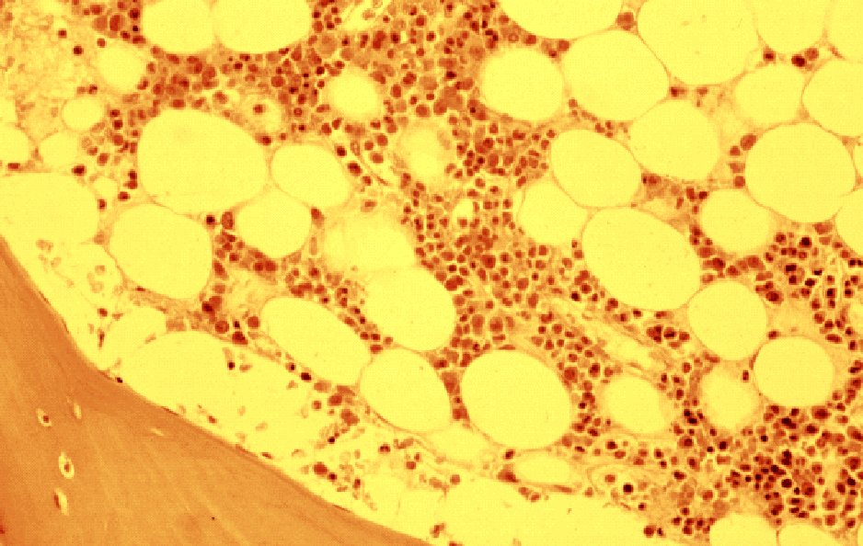
Normal red marrow
blood and fat
bone trabecula

Slide 6
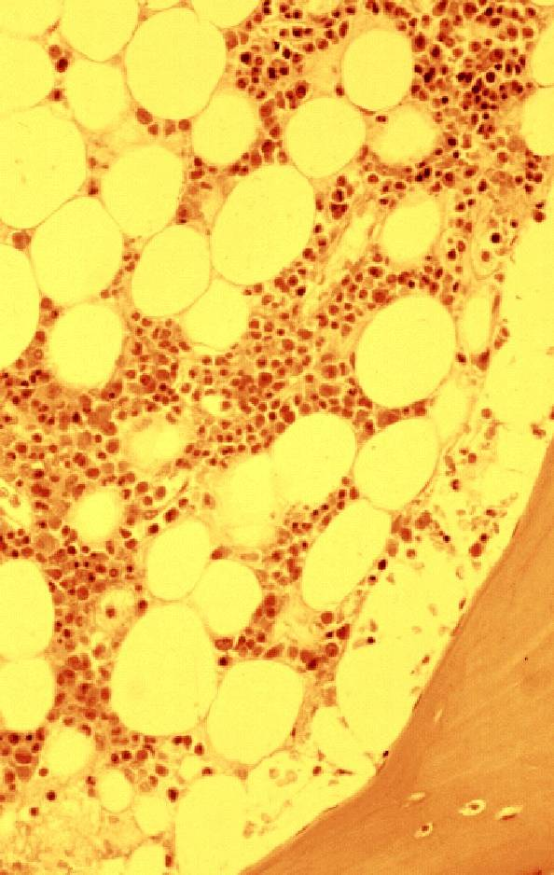
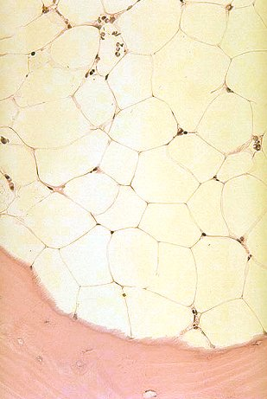
Bone marrow biopsy results
normal
aplastic anemia

Slide 7
Review of hematopoiesis
Life-long production of blood cells occurs in haematopoietic tissues
Very high turnover of cells> need replacement
Some 10E13 new cells must be replaced daily to maintain steady-state blood counts
Total adult BM has around 10E12 cells !!

Slide 8
Lifespan and production of blood cells
Cell type | Approximate lifespan | Production rate cells/day | Production rate cells/sec | Production rate Kg/year
Red Cells | 100-120 days | 2 x 10¹¹ | 2.3 million | 7.3
Neutrophils | t½ 6 hours | 3 x 10¹⁰ | 350,000 | 10.9
Platelets | 7 days | 1 x 10¹¹ | 1.2 million | 4.6
Lymphocytes | t½ 10 days | 1 x 10¹⁰ | 116,000 | 3.7
 |  |  | Annual total | 26.5 Kg

Slide 9
Molecular hematology
Cell cycle kinetics: Progression through cell cycle is regulated by specific combinations of cyclin dependent protein kinases (Cdk) and cyclin proteins

Slide 10
Specific cell ontogeny:
Multipotential stem cells-colony forming units
Colony stimulating factors & interleukines

Slide 12
Regulation of hematopoiesis by cytokines

Slide 13
HSC properties, phenotype, purification
About 0.5% of total BM nucleated cells
Capable of regenerating the whole hematopoietic system
Self-renewal
Majority are quiescent (in G0 phase), only <5% are dividing
Phenotype CD34⁺CD38⁻Lin⁻HLA-DR⁻Rh123^{Dull}
Plasticity
Notes:
Rh stands for Rhodamine: a supravital stain taken up by mitochondria, Rh ^{Bright}> mitotically active population of cells while Rh^{Dull} is quiescent cells.

Slide 16
Recombinant cytokines
Growth factors availabl commercially
G-CSF, GM-CSF, EPO
Indications for recomb factors
  Cancer patients with HIV
  Certain types of anemia
  Harvesting stem cells
ILs:
  Used for wound healing, activating lymphocytes & assisting growth of transplanted or damaged BM

Slide 17
CD nomenclature
Cluster of Designation
Clinical applications of CDs
  Allows differentiation and isolation of specific stem cells/ progenors
  Allows phenotypic characterization of cell in disease states using flow cytometry

Slide 19
Leukocytes (white blood cells)
Segmented neutrophil (filamented neutrophil or polymorphonuclear neutrophil)
Constitute 50-70% of WBCs in older children & adults
Nucleus: 2-5 lobes (usually 3)
Segmentation enables them to pass through endothelial cell barriers
Nuclear chromatin: heavily clumped, coarse or pyknotic and stains purplish red
Cytoplasm: light pink & contain secondary granules (fine, numerous and evenly distributed> lysosomes and contain Alkaline phosphatase) stain either pink or neutral color
Mature neutrophils: approx twice the size of an RBC
Migrate into tissues>>defense against infections
Band neutrophils: 2-6% of total neutrophils, occasionally contain dark primary granules

Slide 20
Site of Hemopoiesis
Fetus
  Yolk sac 0-2 months
  Liver & spleen 2-7 months
  Bone marrow 5-9 months
Infant
  Bone marrow, practically all bones
Adult
  Bone marrow, vertebrae, ribs, sternum, skull, sacrum & pelvis, proximal ends of femur

Slide 21
Origin & Development of Hematopoiesis during embryogenesis
Hemangioblast !
Yolk sac 3rd wk
AGM 4-5th wk
Liver 6-8th wk
BM 10-12th wk
∞
Definitive (AGM, liver, BM) erythroid cells are released into circulation around 60th day.
Primitive & definitive erythroid cells> (separate origin) ??
Notes:
Fig 2.1
AGM: aorta-gonad-mesonephros at the vitelline artery and ventral wall of the embryonic aorta .
After erythropoieisis starts in fetal liver, definitive erythroid cells are released into circulation at around 60th day.
Primitive and definitive erythropoietic cells are distinguished by cell morphology, cell-surface markers, cytokine responsiveness, growth kinetics, TFs programes, pattern of gene expression and Hb content.

Slide 22
Expansion and recession of hematopoietic activity in extramedullary and medullary sites
Figure 4-1 Williams 2007
Notes:
Figure 4-1 Williams 2007
Expansion and recession of hematopoietic activity in extramedullary and medullary sites. For details regarding the nature of yolk sac and hepatic hematopoiesis, see "Sites of Hematopoiesis: Embryogenesis and Early Stem Cell Development." Chapter 6 provides a more comprehensive treatment of this topic (see Fig. 6-1).

Slide 23
Stem Cells
Life-long production of blood cells occurs in hematopoietic tissues
Very high turnover of cells> need replacement
Some 10¹³ new cells must be replaced daily to maintain steady-state blood counts
Total adult BM has around 10¹² cells !!

Slide 24
Lifespan and production of blood cells
Cell type | Approximate lifespan | Production rate cells/day | Production rate cells/sec | Production rate Kg/year
Red Cells | 100 days | 2 x 10¹¹ | 2.3 million | 7.3
Neutrophils | t½ 6 hours | 3 x 10¹⁰ | 350,000 | 10.9
Platelets | 7 days | 1 x 10¹¹ | 1.2 million | 4.6
Lymphocytes | t½ 10 days | 1 x 10¹⁰ | 116,000 | 3.7
 |  |  | Annual total | 26.5 Kg

Slide 25
Stem Cells
Stem cell pool
Frequency of HSC in BM is 1/20 million nucleated cells
HSC assays: LT-BMC, NOD/SCID mouse repopulating assay
Renewal
Differentiation
Lineage selection
Maturation
Function
Cell death (apoptosis)
Stages in HSC development

Slide 26
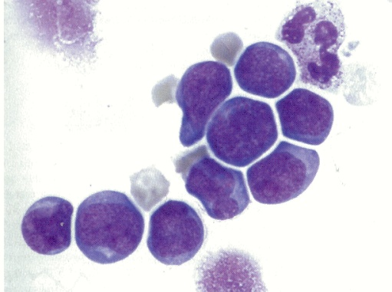
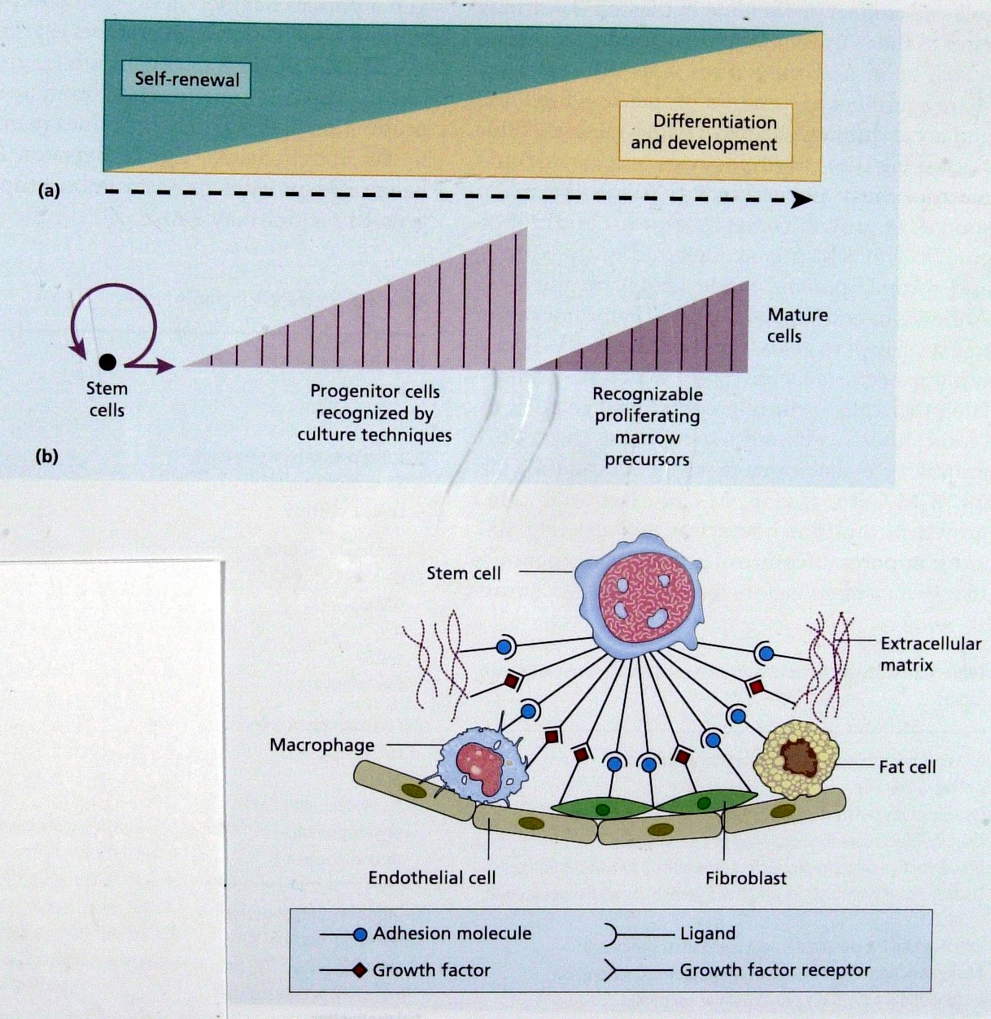
Stem Cell Hierarchy
(A) BM cells are increasingly differentiated and lose capacity for self renewal as they mature
(B) A single SC gives rise after multiple divisions (shown by vertical lines) to > 10E6 mature cells.
Notes:
explain that stem cells and progenitor cells not morphologically recognizable

Slide 27
Control of Hemopoiesis
Notes:
Eg epo, tpo, scf

Slide 28
Normal red marrow
blood and fat
bone trabecula

Slide 29
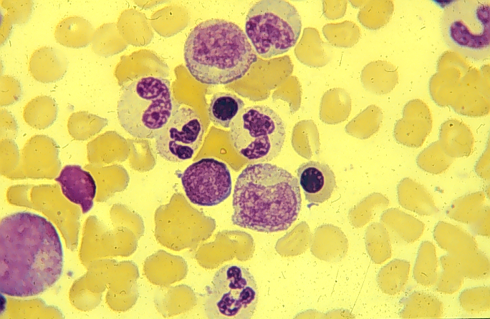
Marrow cells
red cell precursor
white cell precursor

Slide 30
Role of growth factors in haemopoiesis, multiple GFs act on the earlier stem and progenitor cells
Notes:
Figure 1.7/ Essential haematology 2006 /p7

Slide 31
Notes:
Fig 1.6: GFs may stimulate growth of early BM stem cells, direct differentiation to one or other cell type, stimulate cell maturation, suppress apoptosis or affect the function of mature non-dividing cells, as illustrated here for G-CSF fro an early myeloid progenitor and a neutrophil.

Slide 32
Notes:
Fig 1.5: (a) cells in the early embryo are able to generate all the tissues of the body and are known as totipotent cells. (b) specialized adult stem cells of the BM, nervous tissue, epithelial and other tissues give rise to differentiated cells of the same tissue and possibly to other tissues.

Slide 33
Definitions
HSC: hematopoietic precursor cell capable of giving rise to all lineages of blood cells
Pluripotent cell: cell that differentiates into many different cell lines. Has the potential to self-renew, proliferate and differentiate into erythrocytic, myelocytic, monocytic, lymphocytic and megakaryocytic blood cell lineages.
Hematopoietic progenitor cell: hematop precursor cell developmentally located between stem cells and the morphologically recognizable blood pprecursor cells, include multilineage and unilineage cell types.
Committed/progenitor cell: parent or ancestor cells that differentiate into one cell line
Notes:
Haematopoiesis: the production and development of blood cells normally occurring in the BM under the influence of hematopoietic growth factors
Hematopoietic progenitor cell: hematop precursor cell developmentally located between stem cells and the morphologically recognizable blood pprecursor cells, include multilineage and unilineage cell types.
Progenitor cell: parent or ancestor cell that differentiate into mature functional cells.
Precursor cells: all cells antecedent to mature cells.
Maturing cell: include those precursor cells within each lineage that are morphologically identifiable under the microscope.

Slide 34
Control of hemopoeisis by GFs
GFs act on cells expressing the corresponding receptor.
Notes:
Figure 1.8/ Essential haematology 2006 /p8

Slide 35
Model for control of gene expression by a transcription factor
Notes:
Figure 1.9/ Essential haematology 2006 /p8

Slide 36
Stages of cell cycle
Progression through cell cycle is regulated by specific combinations of cyclin dependent protein kinases (Cdk) and cyclin proteins
Notes:
Figure 1.10/ Essential haematology 2006 /p9

Slide 37
Representation of apoptosis in hematopoietic cells
Notes:
Figure 1.11/ Essential haematology 2006 /p10

Slide 38
Bone marrow biopsy results
normal
aplastic anemia

Slide 39
Bone marrow aspirate results
normal
acute leukemia

Slide 40
Sites of Hemopoiesis
Hematopietic system originates in embryonic yolk sac
Common precursor: Hemangioblast> origin of circulatory system & blood cells> both develop in close proximity
HSC migrate in embryo and seed live, spleen & BM
In birds and mice> AGM is another source of HSC> give a second wave of HSC that seeds the liver and probably give rise to adult hematopoietic system

Slide 41
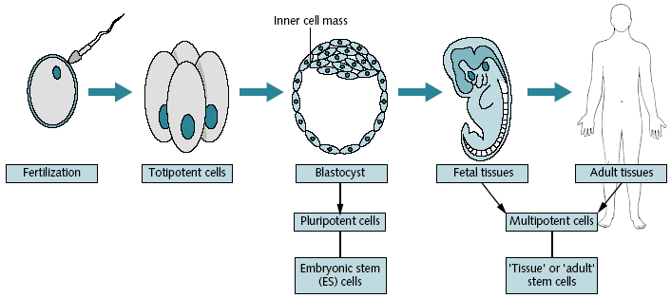
Sources & types of Stem cells
Ref: Provan D, Gribben J. Molecular hematology. 2005/Chap 3/page 26
Notes:
Fig. 3.1 Sources and types of stem cells. Adapted with gratitude from the National Institute of Health Stem Cell Infomation web site
stem cells have the unique and defining
characteristics of self-renewal and of differentiation into multiple
cell types. Thus, with each cell division there is an inherent
asymmetry in stem cells that is generally not found with
other cell types.
there are multiple different types of
stem cells, each defined by their production ability. Totipotent
stem cells are capable of generating any type of cell of the
body, including those of the extra-embryonic membranes,
such as the placenta
Pluripotent stem cells may
give rise to any type of cell found in the body except those
of the extra-embryonic membranes. They can produce ectoderm,
mesoderm or endoderm cells. Pluripotent stem cells
include embryonic stem cells, isolated from the inner cell
mass of the blastocyst, embryonic germ cells, isolated from
embryonic gonad precursors, and embryonic carcinoma cells, isolated from teratocarcinomas. Pluripotent stem cells
may be maintained indefinitely in culture under specialized
conditions that prevent differentiation. In particular,
embryonic stem cells have been used to generate ‘knockout’
mice, animals harboring targeted gene disruptions via homologous
recombination that permit the in vivo study of
individual gene function
Lastly, multipotent stem cells, such
as the HSCs of the bone marrow, are capable of giving rise
to multiple mature cell types, but only those of a particular
tissue, such as blood. Multipotent stem cells are found in
adults, perhaps in all tissue, and function to replace dead or
damaged tissue. Such stem cells are commonly referred to as
‘adult’ stem cells.

Slide 42
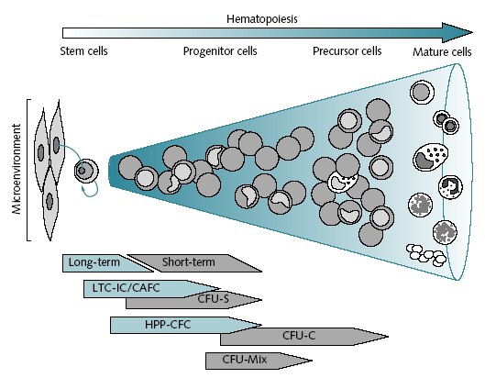
Notes:
Fig. 3.2 Schematic view of
hematopoiesis. Modified from Figure
12.1 in Hematology: Basic Principles
and Practice, 3rd Edition, Ronald
Hoffman, ed., 2000, with permission
from Elsevier

