Slide 1
Detectors

Slide 2
Photovoltaic Cell

Slide 3
Photovoltaic Cell

Slide 4
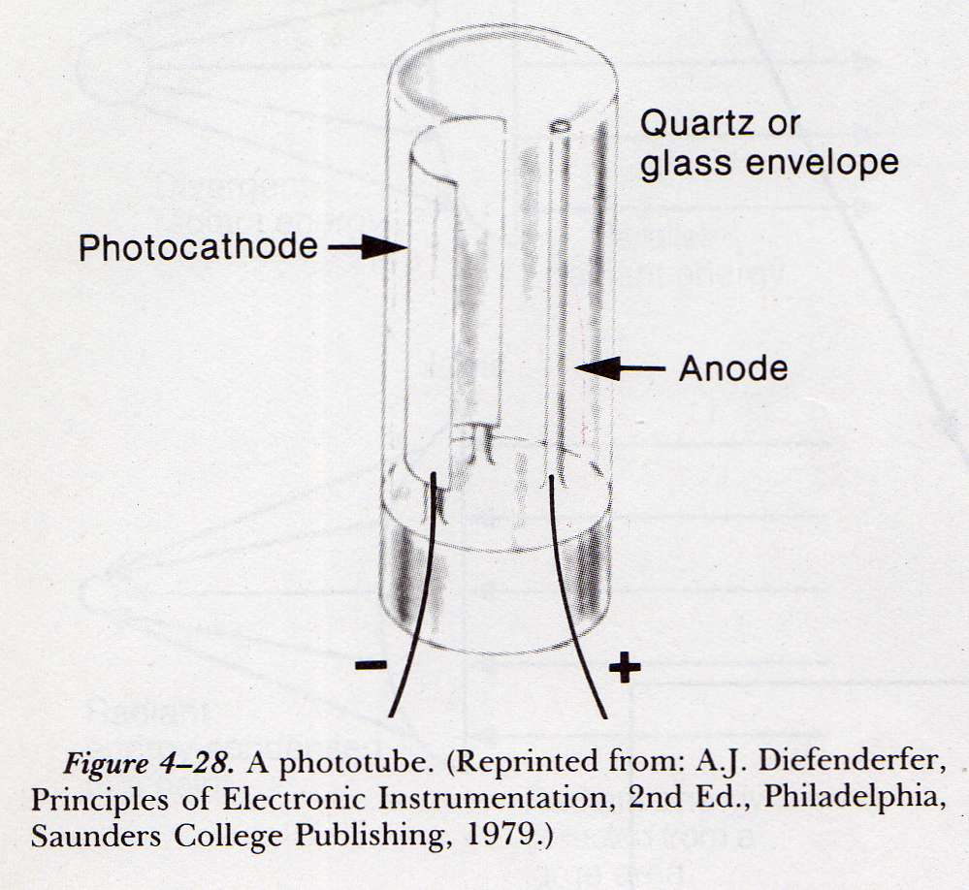
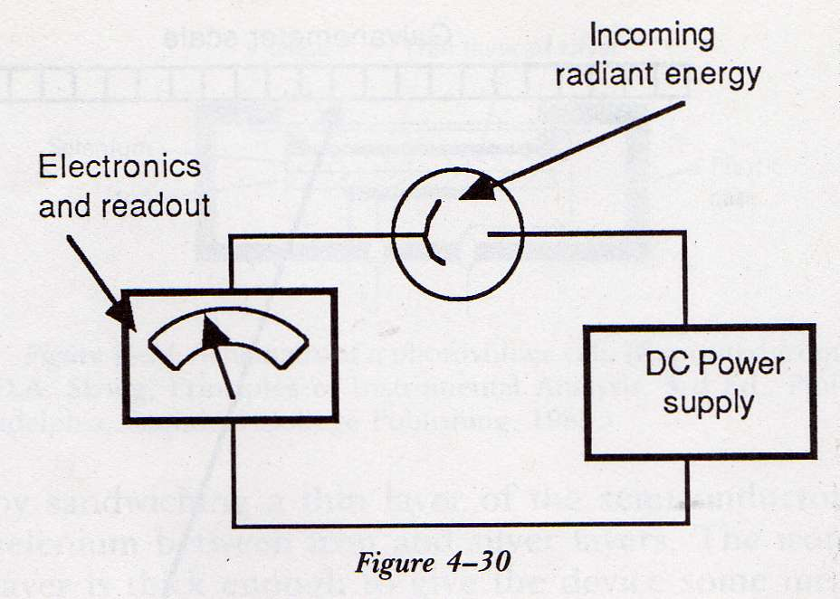
Photoemisive Tube

Slide 5
Photoemisive Tube

Slide 6
Photoemisive Tube

Slide 7
Photomultiplier Tube (PM)

Slide 8
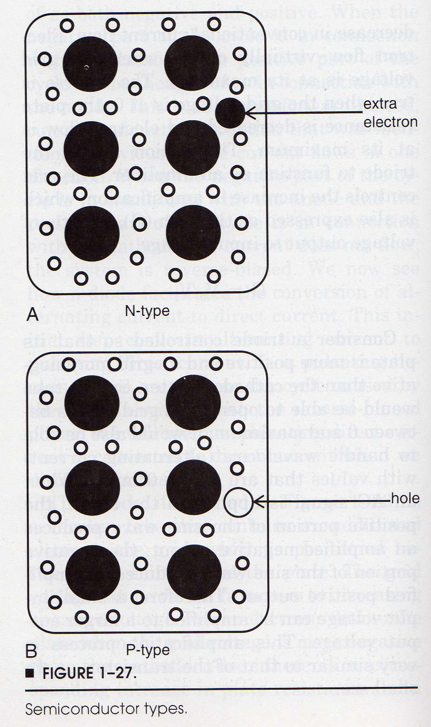
Semiconductors

Slide 9
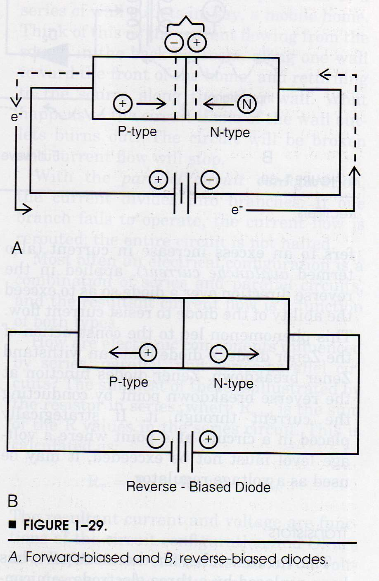
Semiconductors

Slide 10
Photodiode / Solid state

Slide 11
Spectral Response - Photodiode / Solid state

Slide 12
Photodiode / Solid state

Slide 13
Spectral Response /Photodiode / Solid state

Slide 14
Readout units

Slide 15
Readout units

Slide 17
Diode Array Spectrophotometer

Slide 18
Double-beam spectrophotometer/ in-space

Slide 19
Double-beam spectrophotometer/ in-space

Slide 20
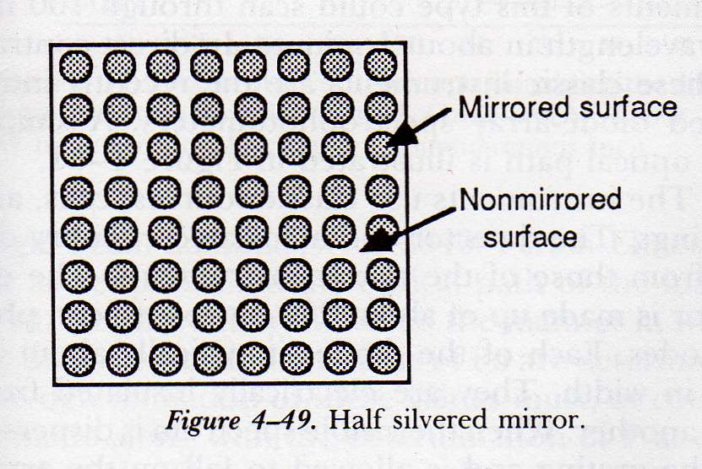

Slide 21
Double-beam spectrophotometer/ in-time

Slide 22
Double-beam spectrophotometer/ in-time

