Slide 1
Cells and Organelles
Instructor: Dr. Mahmoud A. Srour
Course: Cell Biology 0202211
Reading:
Becker’s World of the Cell, 8th ed/ 2012. Chap 4, p. 75.
Lec # 7 Mon 01.10.2012

Slide 2
Cells and organelles
Properties and Strategies of Cells
The Eukaryotic Cell in Overview
Agents That Invade Cells

Slide 3
Cells
Biologists recognized two types of cells
The simpler type is characteristic of bacteria (prokaryotes) and the more complex type characteristic of plants, animals, fungi, algae and protozoa (eukaryotes)
The main distinction between the two cells types is the membrane-bounded nucleus of eukaryotic cells

Slide 4
Three domains
Bacteria and archaea are as divergent from one another as humans and bacteria are
Biologists now recognize three domains, the archaea, bacteria and eukarya (eukaryotes)

Slide 5
Bacteria
These include most of the commonly encountered single-celled, non-nucleated organisms traditionally called bacteria
Examples include:
Escherichia coli
Pseudomonas
Streptococcus

Slide 6
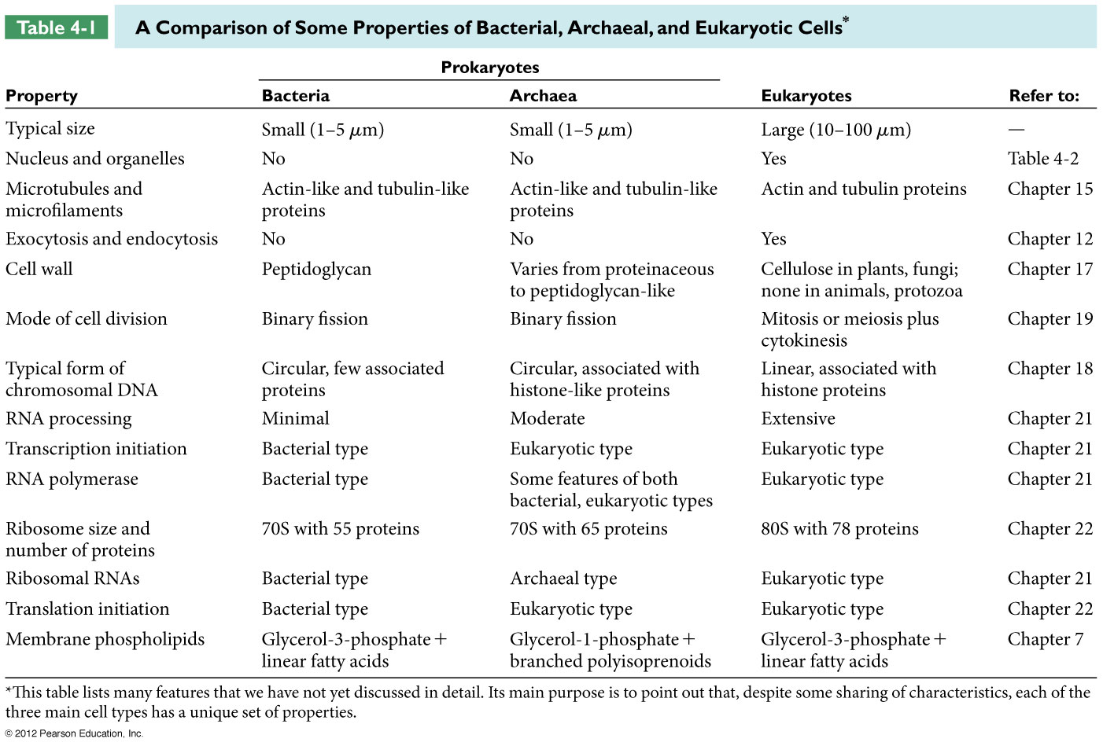

Slide 7
Archaea
Archaea were originally called archebacteria before they were discovered to be so different from bacteria
They include many species that live in extreme habitats and have diverse metabolic strategies

Slide 8
Types of archaea include:
methanogens - obtain energy from hydrogen and convert CO2 into methane
halophiles - occupy extremely salty environments
thermacidophiles - thrive in acidic hot springs
They are considered to have descended from a common ancestor that also gave rise to eukaryotes long after diverging from bacteria

Slide 10
Limitations on cell size
Cell size is limited by:
The need for adequate surface area relative to volume
The rates at which molecules can diffuse (???)
The need to maintain adequate local concentrations of substances required for necessary cellular functions

Slide 11
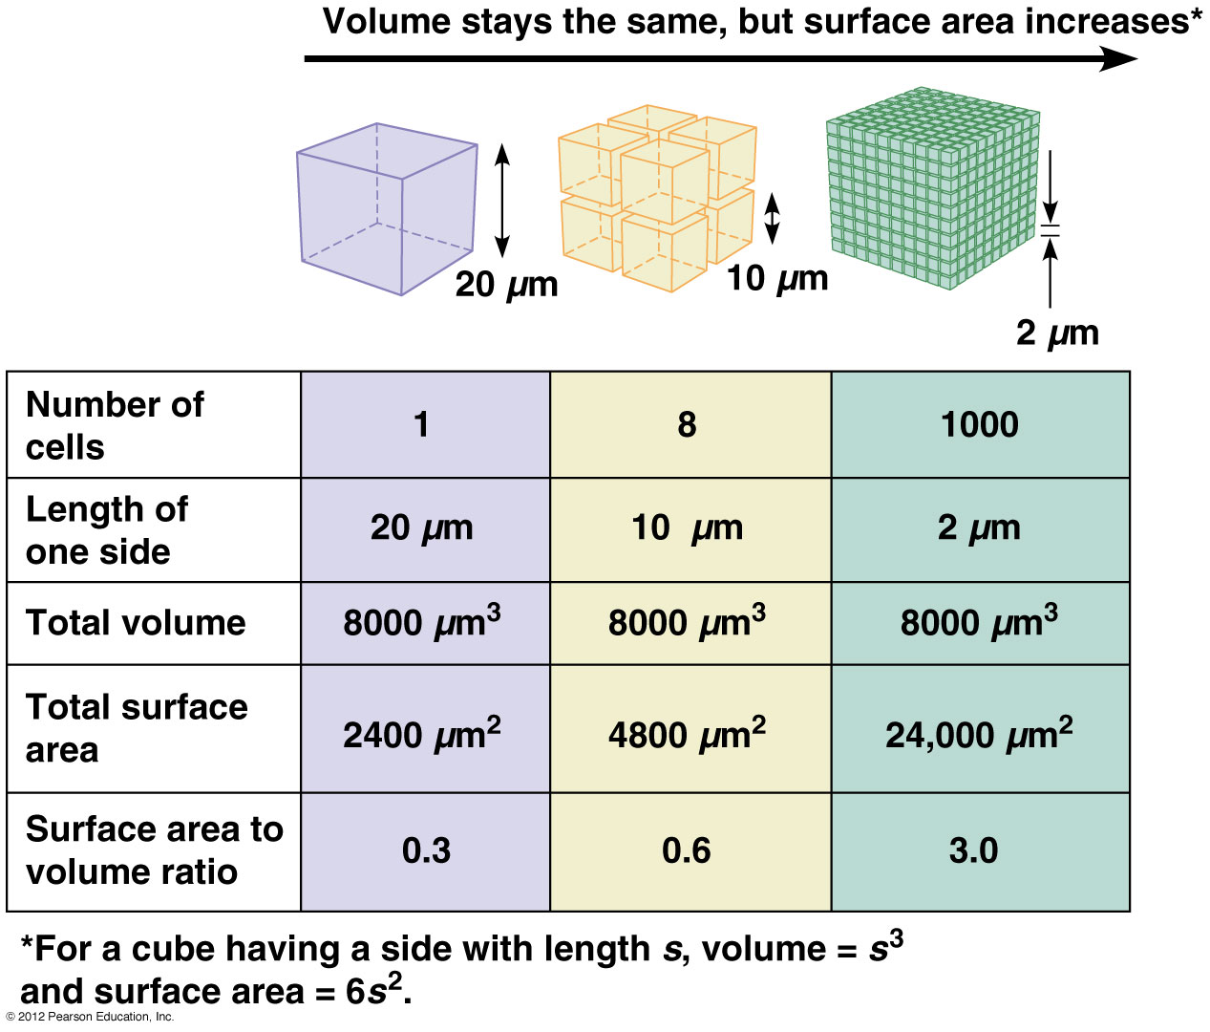

Slide 12
Eukaryotic Cells Use Organelles to Compartmentalize Cellular Function
A solution to the concentration problem is the compartmentalization of activities within specific regions of the cell
Most eukaryotic cells have a variety of organelles, membrane-bounded compartments that are specialized for specific functions
e.g. cells in a plant leaf have most of the materials needed for photosynthesis compartmentalized into structures called chloroplasts

Slide 13
Bacteria, Archaea, and Eukaryotes Differ from Each Other in Many Ways
There are shared characteristics among cells of each of the domains, bacteria, archaea and eukarya
However, each type of cell has a unique set of distinguishing properties

Slide 14
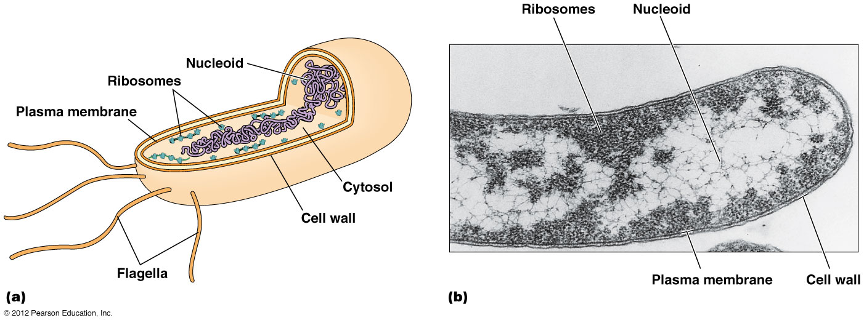
Presence of a Membrane-Bounded Nucleus

Slide 15
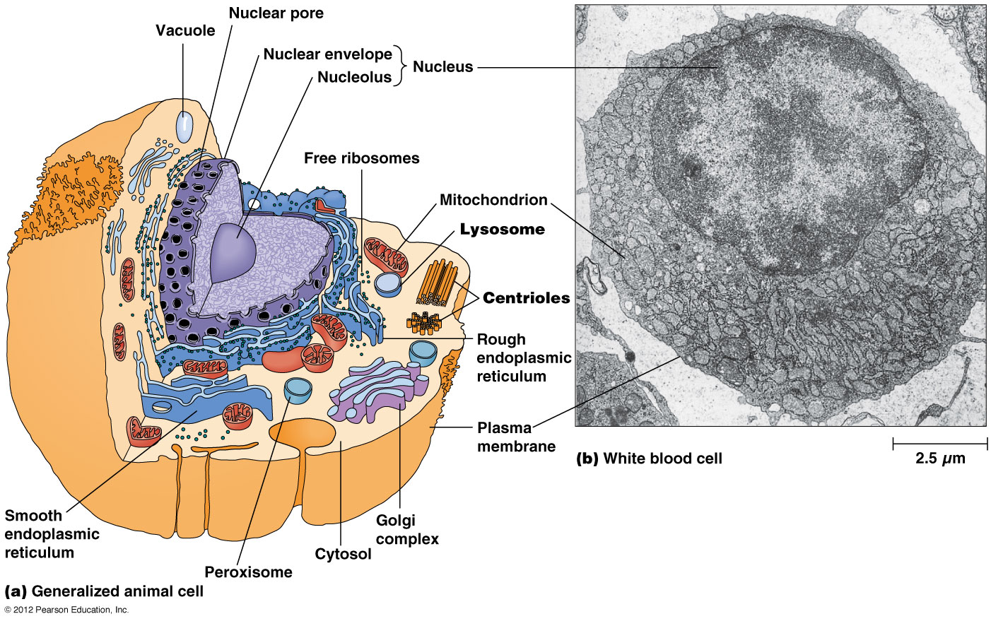

Slide 16
Use of internal membranes to segregate function
Nearly all eukaryotes make extensive use of internal membranes to compartmentalize specific functions and have numerous organelles
E.g., endoplasmic reticulum, Golgi complex, mitochondria, chloroplasts, lysosomes, peroxisomes and various types of vacuoles and vesicles
Each organelle contains the materials and molecular machinery needed to carry out the functions for which the structure is specialized

Slide 17
The cytoskeleton
Several nonmembranous, proteinaceous structures for cellular contraction, motility and support are found in the cytoplasm of eukaryotic cells
These include: microtubules, microfilaments, and intermediate filaments, all key components of the cytoskeleton, which imparts structure and elasticity to most eukaryotic cells
The cytoskeleton also provides scaffolding for transport of vesicles within the cell

Slide 18
Exocytosis and Endocytosis
Eukaryotic cells are able to exchange materials between compartments within the cell and the exterior of the cell
This is possible through exocytosis and endocytosis, processes involving membrane fusion events unique to eukaryotic cells

Slide 19
Organization of DNA
Bacterial DNA is present in the cell as a circular molecule associated with few proteins
Eukaryotic DNA is organized into linear molecules complexed with large amounts of proteins called histones
Archaeal DNA is circular and complexes with proteins similar to eukaryotic histone proteins

Slide 20
Segregation of Genetic Information
Prokaryotes and eukaryotes differ in how genetic information is allocated to daughter cells upon division
Bacterial and archaeal cells replicate their DNA and divide by binary fission with one molecule of the replicated DNA and the cytoplasm going into each daughter cell
Eukaryotic cells replicate DNA and then distribute their chromosomes into daughter cells by mitosis and meiosis, followed by cytokinesis, division of the cytoplasm

Slide 21
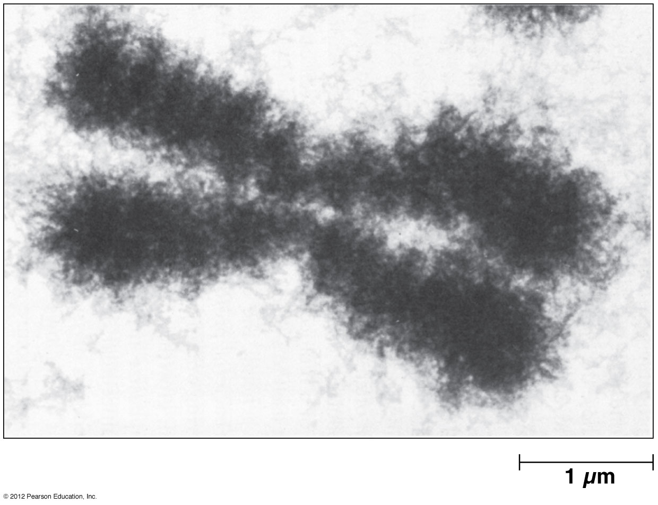
Eukaryotic chromosome

Slide 22
Expression of DNA
Eukaryotic cells transcribe genetic information in the nucleus into large RNA molecules which are processed and transported into the cytoplasm for protein synthesis
Each RNA molecule typically encodes one polypeptide
Bacteria transcribe genetic information into RNA, and the RNA molecules produced may contain information for several polypeptides
In both bacteria and archaea, RNA molecules become involved in protein synthesis before transcription is complete

Slide 23
Cell Specialization Demonstrates the Unity and Diversity of Biology
cells resemble one another in fundamental ways
However they differ from one another in important aspects
Unicellular organisms must carry out all the necessary functions in one cell
Multicellular organisms have cells which are specialized for particular functions

Slide 24
The Eukaryotic Cell in Overview: Pictures at an Exhibition
The structural complexity of eukaryotic cells is illustrated by the typical animal and plant cells
A typical eukaryotic cell has: a plasma membrane, a nucleus, membrane bounded organelles and the cytosol (?) interlaced by a cytoskeleton
In addition, plant and fungal cells have a rigid cell wall, surrounded by an extracellular matrix

Slide 25
The Plasma Membrane Defines Cell Boundaries and Retains Contents
The plasma membrane surrounds every cell
It ensures that the cells contents are retained
It consists of lipids, including phospholipids and proteins and is organized into two layers

Slide 26
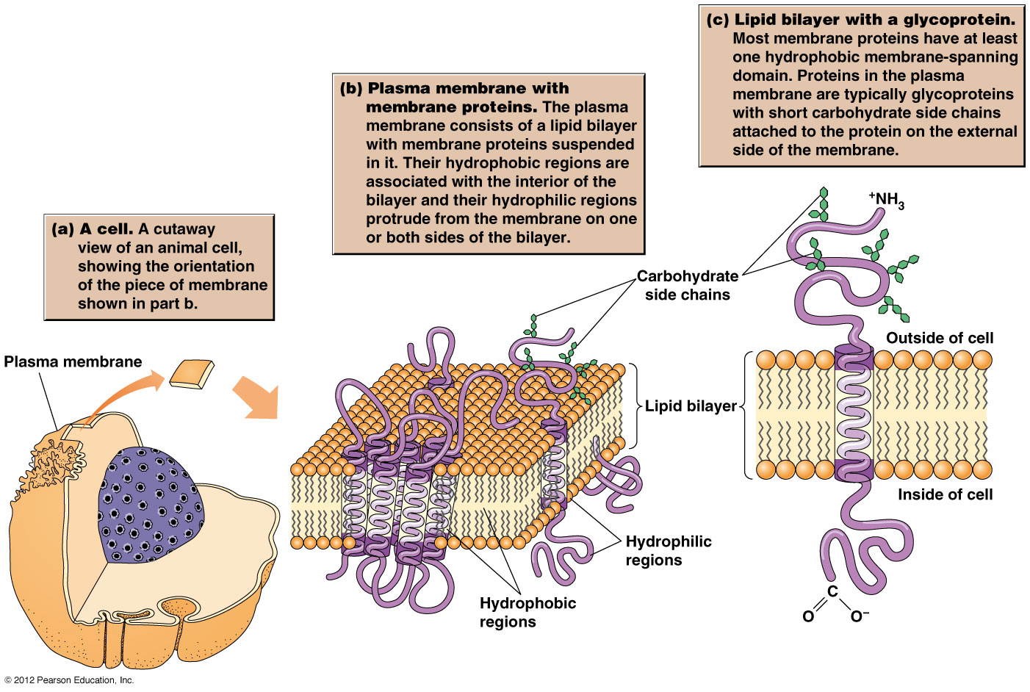
Organization of the plasma membrane

Slide 27
The Nucleus is the Information Center of the Eukaryotic Cell
The most prominent structure in the eukaryotic cell is the nucleus
It contains the DNA and is surrounded by the nuclear envelope, composed of inner and outer membranes
The nuclear envelope has numerous openings called pores, each of which is a transport channel, lined with a nuclear pore complex

Slide 28
Cells and Organelles
Instructor: Dr. Mahmoud A. Srour
Course: Cell Biology 0202211
Reading:
Becker’s World of the Cell, 8th ed/ 2012. Chap 4, p. 75.
Lec # 8 Mon 08.10.2012

Slide 29
Intracellular Membranes and Organelles Define Compartments
The internal volume of the cell outside the nucleus is called the cytoplasm and is occupied by organelles and the semifluid cytosol
A number of heritable human disorders are caused by malfunctions of specific organelles

Slide 30
The Mitochondrion
Mitochondria, found in all eukaryotic cells, are the site of aerobic respiration
They are comparable in size to bacteria
Most eukaryotic cells contain hundreds of mitochondria, each of which is surrounded by an inner and outer mitochondrial membrane

Slide 31
Mitochondrial similarity to bacterial cells
Mitochondria contain small circular molecules of DNA (mtDNA is 16,588 bp long, contains 37 genes: 22 genes encode tRNAa, 2 genes encode rRNA and 13 genes encode polypeptides)
The mitochondrial chromosome encodes some RNAs and proteins needed for mitochondrial function
They also have their own ribosomes, to carry out protein synthesis

Slide 32
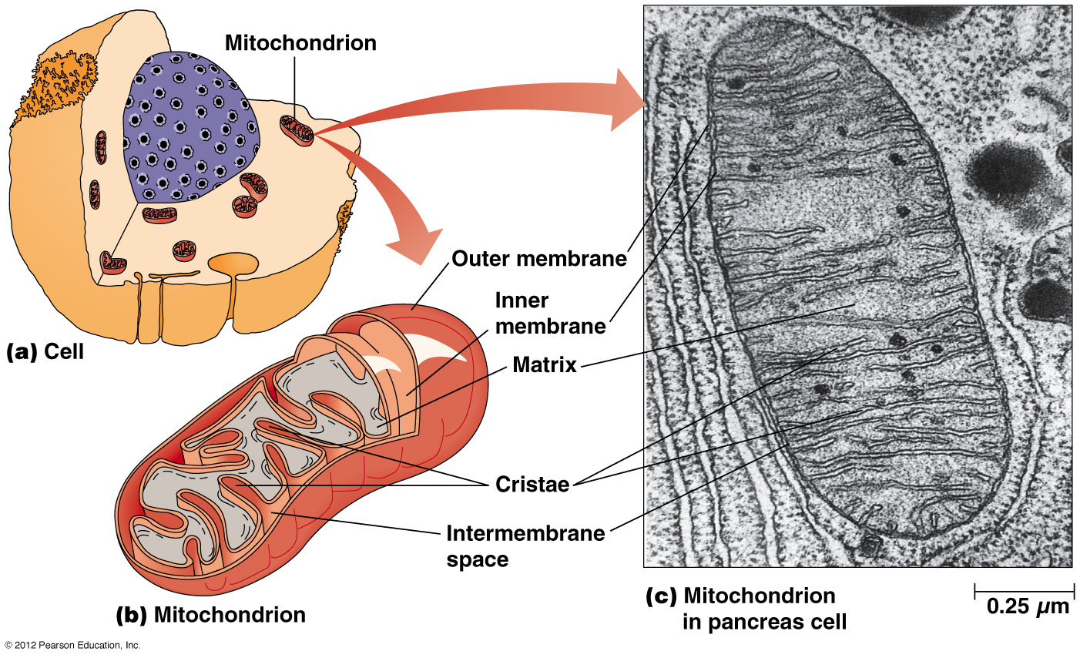
The Mitochondrion

Slide 33
Mitochondrial function
Oxidation of sugars and other fuel molecules in mitochondria extracts energy from food and stores it in ATP (adenosine triphosphate)
Most molecules for mitochondrial function are localized on the cristae (infoldings of the inner mitochondrial membrane) or the matrix (fluid that fills the inside of the mitochondrion)

Slide 34
Varied number and location of mitochondria
Number and location of mitochondria varies among cells according to their role in that cell type
Tissues with high demand for ATP have many mitochondria, located within the cell at the site of greatest energy needs
E.g., sperm and muscle cells

Slide 35
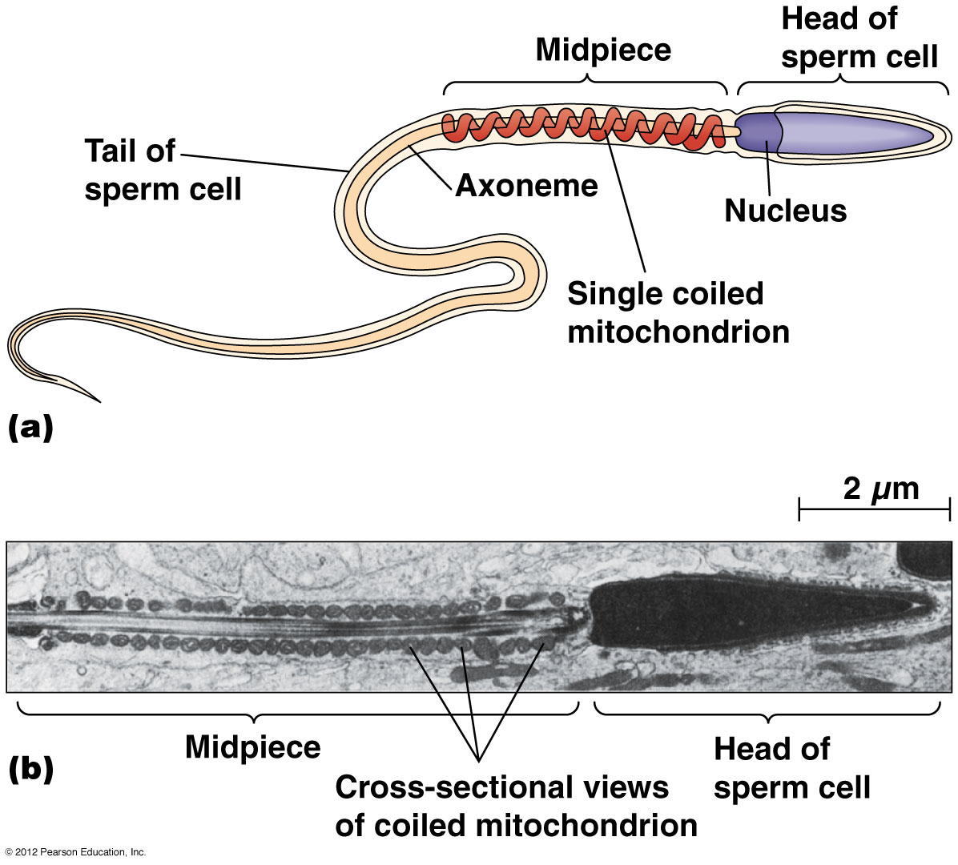
Localization of the Miochondrion within a sperm cell

Slide 36
Mitochondrial disorders
Most disorders associated with mitochondria are characteristic of either muscle or nerve tissue.
Mitochondrial disorders include 35 myopathies and a variety of disorders affecting nerve function
Examples:
Mitochondrial encephalopathy: defect in in tRNA of the amino acid Leucine. Affects the brain tissue.
Hypertrophic cardiomyopathy: defect in the tRNA of the amino acid Isoleucine. Affects the heart tissue.

Slide 37
The Chloroplast
The chloroplast is the site of photosynthesis in plants and algae
They are large, and can be quite numerous in the cells of green plants
They are surrounded by both inner and outer membranes and contain a system of flattened membranous sacs called thylakoids, stacked into grana

Slide 38
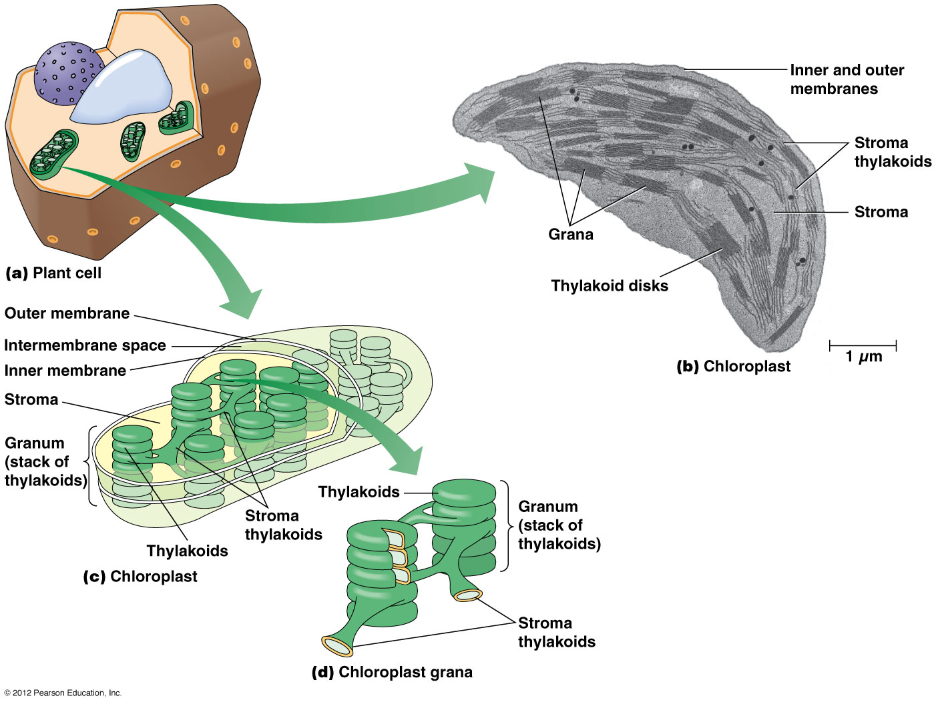

Slide 39
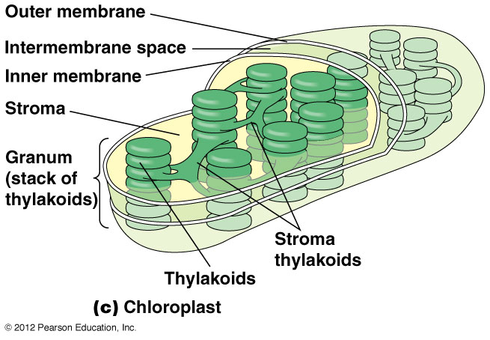
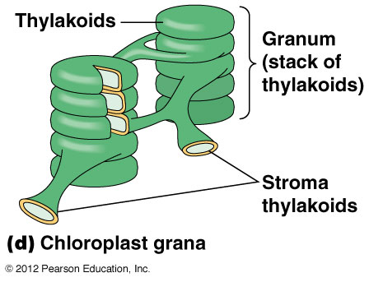

Slide 40
Chloroplast function
Chloroplasts are the site of photosynthesis, a process that uses solar energy and CO₂ to produce sugars and other organic compounds
This process is the reverse of the mitochondrial reactions that oxidize glucose into CO₂
Chloroplasts are found in photosynthetic cells and contain most of the enzymes needed for photosynthesis

Slide 41
Chloroplast function (continued)
Reactions that depend on solar energy, take place in or on the thylakoid membranes
Reactions involved in the reduction of CO₂ to sugar occur within the stroma, a semifluid in the interior of the chloroplast
Like mitochondria, chloroplasts contain their own ribosomes, and a small circular DNA molecule that encodes some RNAs and proteins needed in the chloroplast

Slide 42
Plastids
Plastids are specialized for particular functions
Chromoplasts are responsible for coloration in flowers, fruits and other plant structures
Amyloplasts are specialized for storing starch (amylose and amylopectin)

Slide 43
The Endosymbiont Theory: Did Mitochondria and Chloroplasts Evolve from Ancient Bacteria?
Both mitochondria and chloroplasts have their own DNA and ribosomes and can produce some of their own proteins
However, most of the proteins needed in these organelles are encoded by nuclear genes
Overall there are many similarities between processes in mitochondria and chloroplasts and those in bacteria

Slide 44
The Endoplasmic Reticulum
Almost every eukaryotic cell has a network of membranes in the cytoplasm, called the endoplasmic reticulum (ER)
It consists of tubular membranes and flattened sacs called cisternae
The internal space of the ER is called the lumen
The ER is continuous with the other membranes in the cell

Slide 45
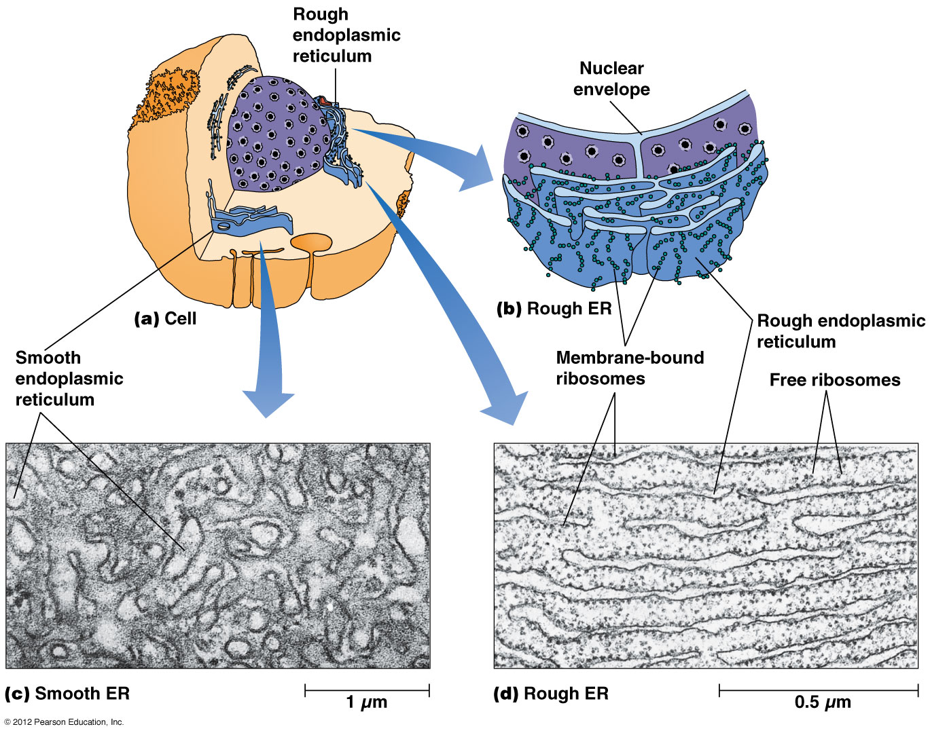

Slide 46
Rough endoplasmic reticulum
ER can be rough or smooth in appearance
Rough ER is studded with ribosomes on the cytoplasmic side of the membrane
These ribosomes synthesize polypeptides that accumulate within the membrane or are transported across it to the lumen
Free ribosomes are not associated with the ER

Slide 47
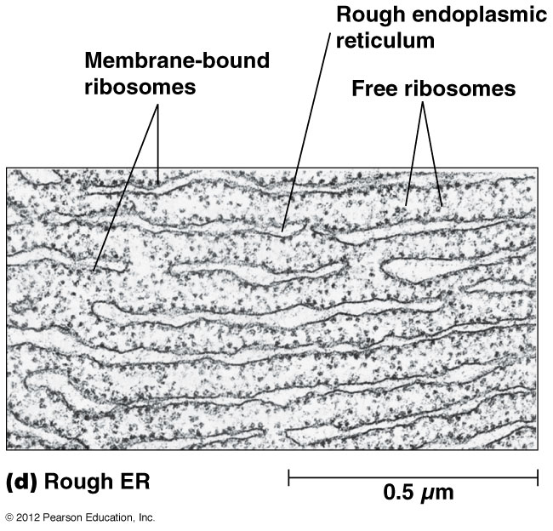

Slide 48
Smooth endoplasmic reticulum
Smooth ER has no role in protein synthesis
It is involved in the synthesis of lipids and steroids such as cholesterol and its derivatives
Smooth ER is responsible for inactivating and detoxifying potentially harmful substances
Sarcoplasmic reticulum has critical functions in contraction

Slide 49
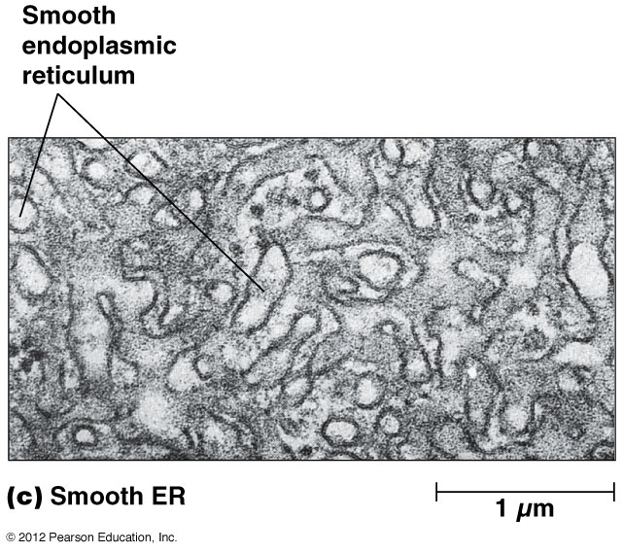

Slide 50
The Golgi Complex
The Golgi complex, closely related to the ER in proximity and function, consists of a stack of flattened vesicles known as cisternae
It plays an important role in processing and packaging secretory proteins, and in complex polysaccharide synthesis
It accepts vesicles that bud off of the ER

Slide 51
The Golgi complex is like a processing station
The contents of vesicles from the ER are modified and processed in the Golgi complex
E.g., secretory and membrane proteins are mainly glycosylated (the addition of short-chain carbohydrates), a process that begins in the ER and is completed in the Golgi complex
The processed substances then move to other locations in the cell through vesicles that bud off of the Golgi complex

Slide 52
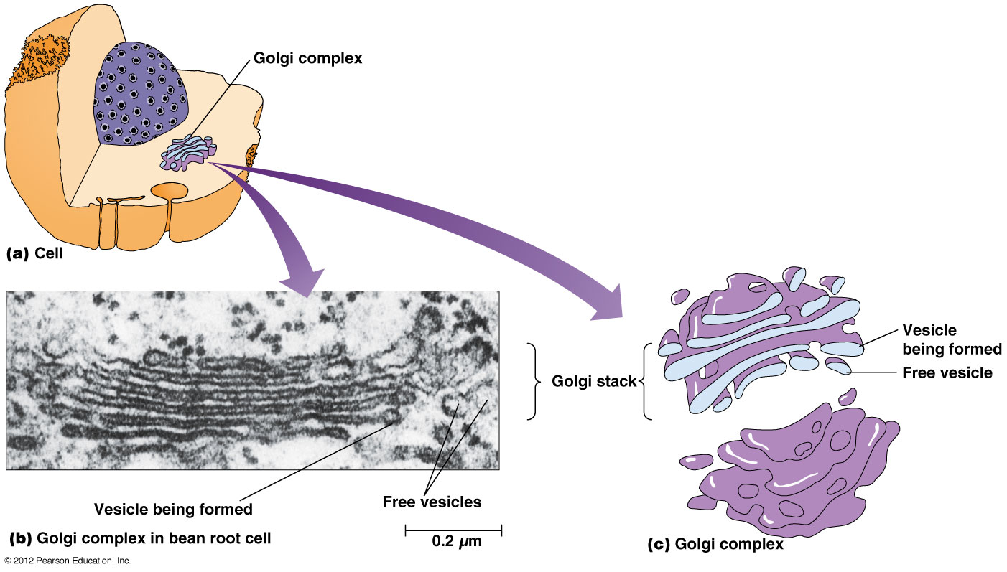

Slide 53
Secretory Vesicles
Once processed by the Golgi complex, materials to be exported from the cell are packaged into secretory vesicles
These move to the plasma membrane and fuse with it, releasing their contents outside the cell
The ER, Golgi, secretory vesicles and lysosomes make up the endomembrane system of the cell, responsible for trafficking substances through the cell

Slide 54
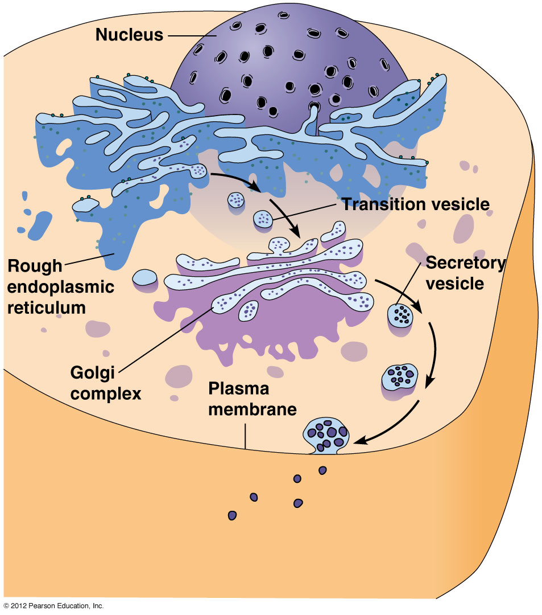
The process of secretion in eukaryotic cells

Slide 55
The Lysosome
Lysosomes are single membrane organelles that store hydrolases, enzymes that can digest any kind of biological molecule
These enzymes are sequestered to prevent them from digesting the contents of the cell
A special carbohydrate coating on the inner lysosome membrane protects it from digestion

Slide 56
Lysosomal disorders
Over 40 heritable lysosomal storage diseases are known, each characterized by the accumulation of a specific substance or class of substances- most commonly polysaccharides or lipids, that would normally be catabolized by lysosomal enzymes.
Examples:
I-cell disease: due to defect in N-acetylglucosamine phosphotransferase
Tay-Sachs disease: defective or missing enzyme β-N-acetylhexosaminidase A which cleaves the terminal N-acetylgalactosamine from the glyco portion of the glycolipid (ganglioside G_{M2})

Slide 57
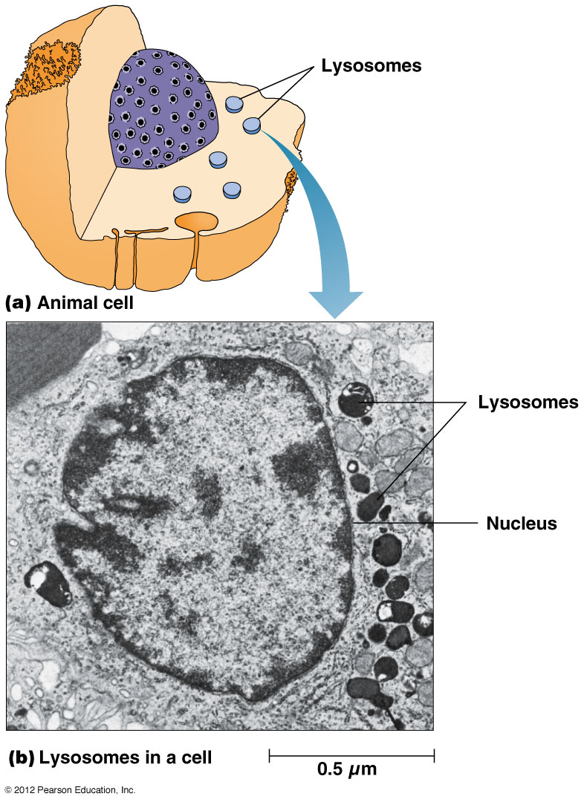
Lysosomes

Slide 58
The Peroxisome
Peroxisomes resemble lysosomes in size and appearance
They are surrounded by a single membrane and perform several functions depending on cell type
Peroxisomes are especially prominent in the liver and kidney cells of animals

Slide 59
Hydrogen peroxide
H₂O₂ is highly toxic to cells but can be formed into water and oxygen by the enzyme catalase
Eukaryotic cells have metabolic processes that produce H₂O₂
These reactions are confined to peroxisomes that contain catalase, so that cells are protected from the harmful effects of peroxide

Slide 60
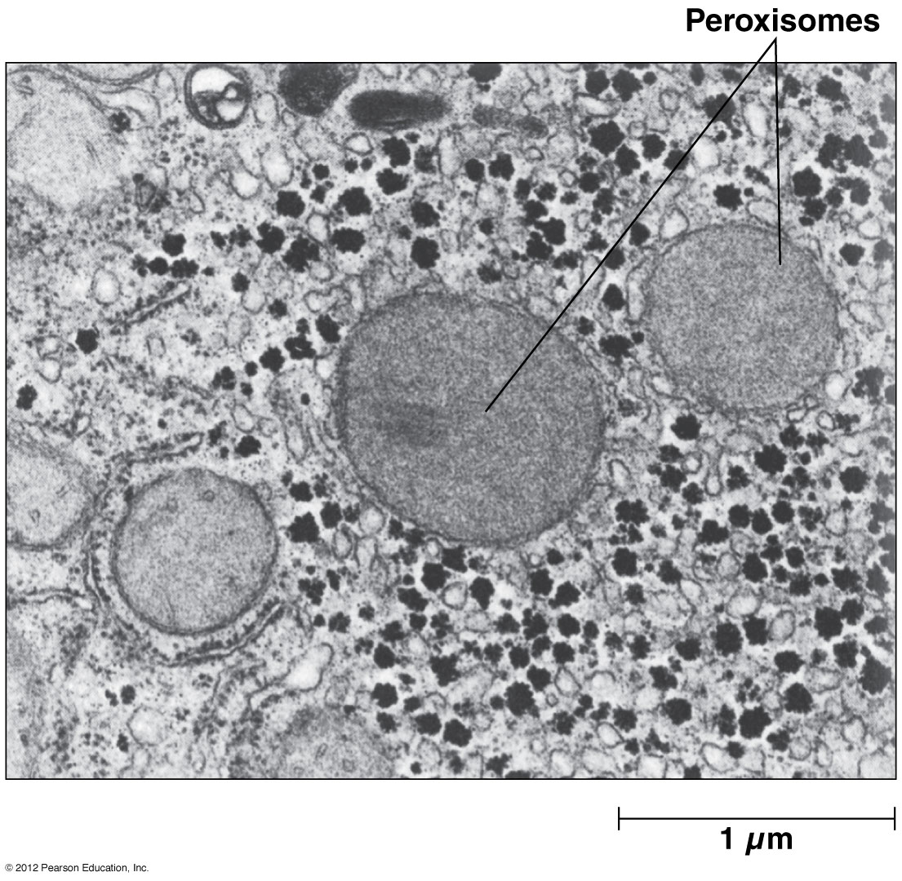
Animal peroxisomes

Slide 61
Other functions of peroxisomes
Peroxisomes detoxify other harmful compounds, and catabolize unusual substances
In animals, they play roles in oxidative breakdown of fatty acids, especially longer chain fatty acids (up to 22 carbon atoms)
Some serious human diseases result from defects in one or more peroxisomal enzymes, normally involved in degrading long-chain fatty acids

Slide 62
Peroxisomal disorders
Due to its broad cellular functions, there are many known peroxisomal disorders.
Examples:
Neonatal adrenoleukodystrophy : in some forms of NALD, the defective gene product is a membrane protein involved in the transport of long-chain fatty acids

Slide 63
Vacuoles
Some cells contain a membrane-bounded vacuole
In animal and yeast cells they are used to temporary storage or transport
Phagocytosis leads to the formation of a membrane bound particle, called a phagosome
When this type of vacuole fuses with a lysosome, the contents are hydrolyzed to provide nutrients to a cell

Slide 64
Vacuoles
Some cells contain a membrane-bounded vacuole
In animal and yeast cells they are used to temporary storage or transport
Phagocytosis leads to the formation of a membrane bound particle, called a phagosome
When this type of vacuole fuses with a lysosome, the contents are hydrolyzed to provide nutrients to a cell

Slide 65
Plant vacuoles
Most mature plant cells contain a single large vacuole called a central vacuole
The main function of the central vacuole is to maintain the turgor pressure that keeps the plant from wilting
Tissues wilt when the central vacuole no longer presses against the cell contents (fails to provide adequate pressure)

Slide 66
Ribosomes
Ribosomes are not really organelles because they are not enclosed by a membrane
They are found in all cells but differ slightly in bacteria, archaea and eukarya in their size and composition
Each cell type has a unique type of ribosomal RNA

Slide 67
Ribosomes are very small
Ribosomes can only be seen under the electron microscope
They have sedimentation coefficients in keeping with their small size
Sedimentation coefficient: a measure of how rapidly a particle sediments in an ultracentrifuge, expressed in Svedberg units (S)
Ribosomes have values of 80S (eukaryotes) or 70S (bacteria and archaea)

Slide 68
Ribosome subunits
Ribosomes have two subunits, the large and small subunits, with sedimentation coefficients of 60S and 40S respectively
Bacteria and archaea have large and small subunits of 50S and 30S, respectively
The S values of large and small subunits does not add up to the value for the complete ribosome, because S values depend on both size and shape

Slide 69
The Cytoplasm of Eukaryotic Cells Contains the Cytosol and Cytoskeleton
The cytoplasm of a eukaryotic cell is the interior of the cell not occupied by the nucleus
The cytosol is the semifluid substance in which the organelles are suspended
The synthesis of fats and proteins and the initial steps in releasing energy from sugars takes place in the cytosol
The cytosol is permeated by the cytoskeleton

Slide 70
The cytoskeleton
The cytoskeleton is a three-dimensional array of interconnected microfilaments, microtubules and intermediate filaments
It gives a cell its distinctive shape and internal organization
It also plays a role in cell movement and cell division

Slide 71
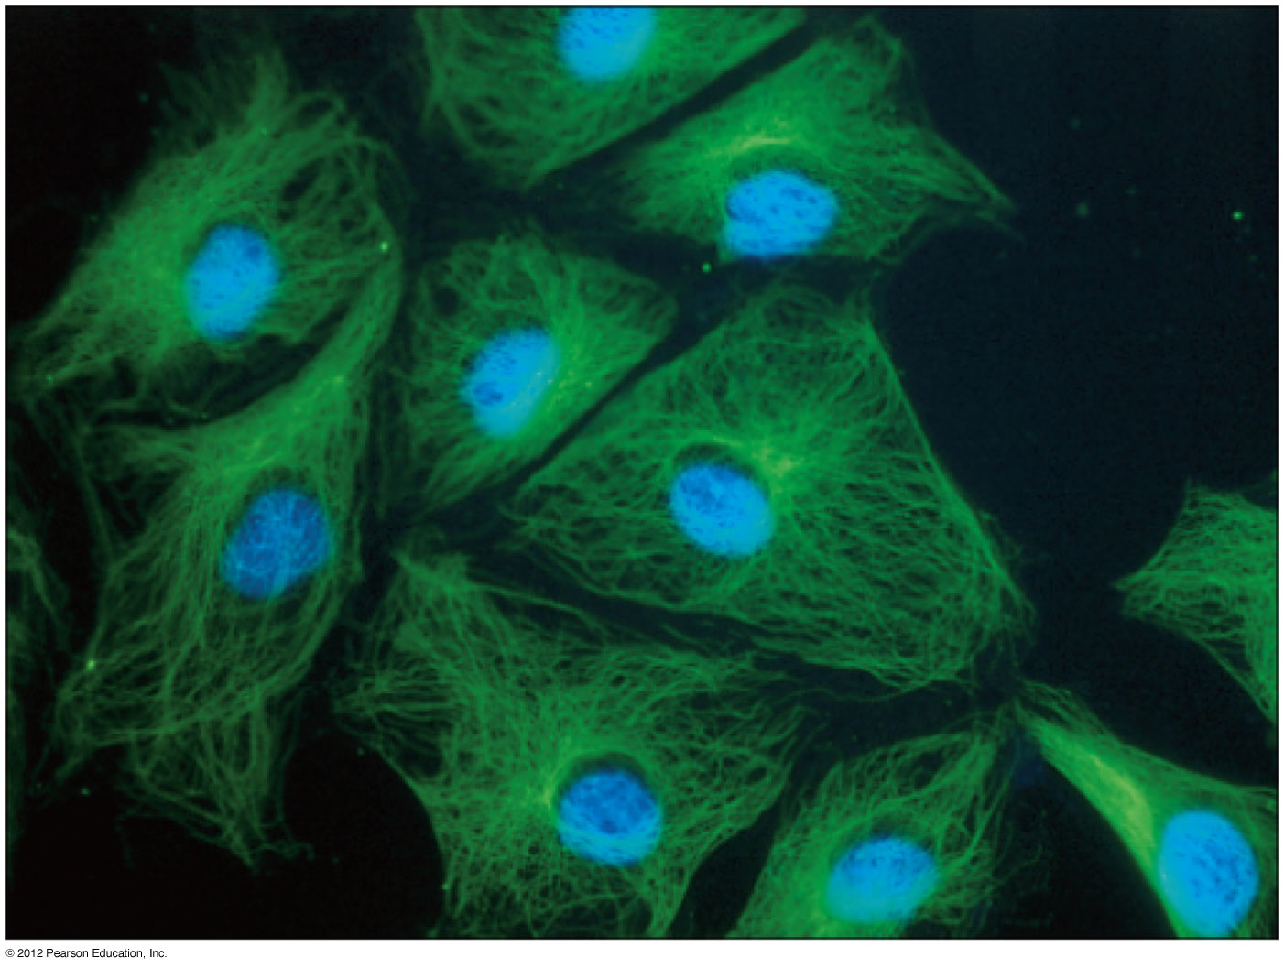

Slide 72
The cytoskeleton (continued)
The cytoskeleton serves as a framework for positioning and moving organelles and macromolecules within the cell
It may do the same for ribosomes and enzymes
Even some of the water within the cell (20-40%) may be bound to microfilaments and microtubules

Slide 73
Components of the cytoskeleton
There are three structural elements of the cytoskeleton
Microtubules
Microfilaments
Intermediate filaments

Slide 74
The Extracellular Matrix and the Cell Wall Are “Outside” the Cell
Most cells are characterized by extracellular structures
For many animal cells these structures are called the extracellular matrix (ECM) and consist mainly of collagen fibers and proteoglycans
For plant and fungal cells, these are cell walls, consisting mainly of cellulose microfibrils

Slide 75
Motility and the ECM
Plant cells are nonmotile and thus suited to the rigidity that cell walls confer on an organism
Animal cells are motile and therefore are surrounded by a strong but elastic network of collagen fibers
Bacteria and archaea may be motile or not; their cell walls provide protection from bursting due to osmotic differences between the cell and the surrounding environment

Slide 76
The ECM
The primary function of the ECM is support but the types of materials and patterns in which they are deposited regulate a variety of processes
In animal cells, a network of proteoglyans surrounds the collagen fibers
In vertebrates, collagen is the most abundant protein in the animal body, as it is also found in tendons, cartilage and bone

Slide 77
Additional functions of the ECM
Processes regulated by the ECM may include:
Cell motility and migration
Cell division
Cell recognition and adhesion
Cell differentiation during embryonic development

