Slide 1
Visualizing
Cells and Molecules
Instructor: Dr. Mahmoud A. Srour
Course: Cell Biology 0202211
Reading:
Becker’s World of the Cell, 8th ed/ 2012. Appendix A, p. A.1- A.29.
Lec # 2 Sat 15.09.2012

Slide 2
Optical principles of microscopy
The illuminating wavelength sets a limit on how small an object can be seen
Three elements are needed to form an image:
A source of illumination
A specimen
A system of lenses

Slide 3
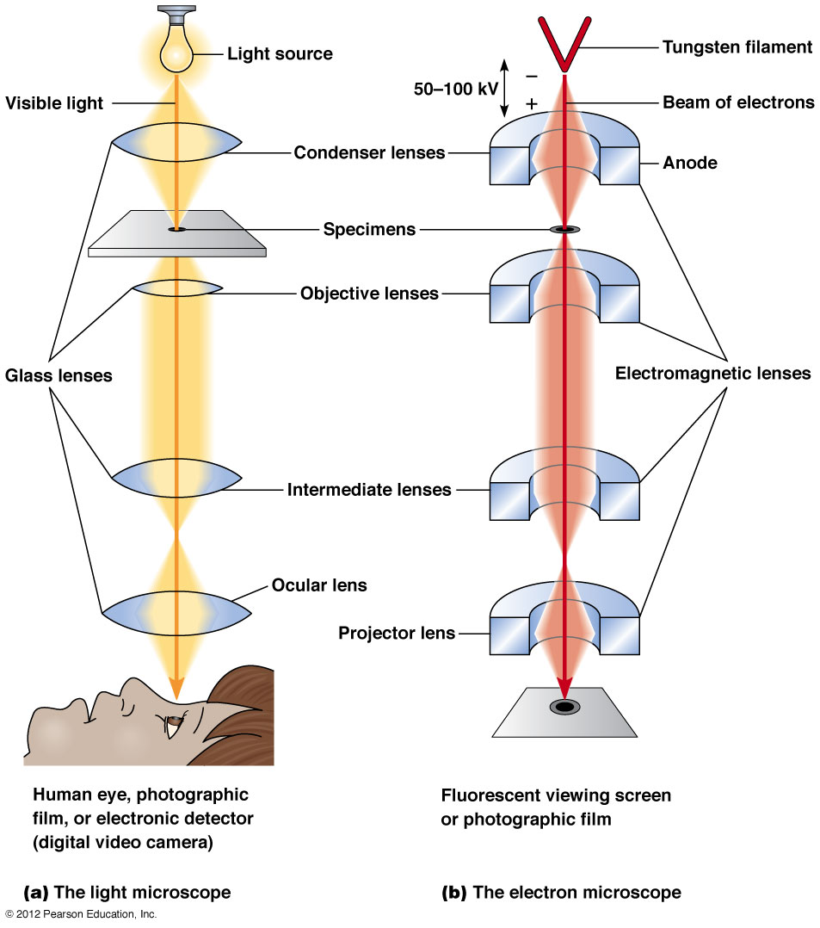
Optical system of the LM & EM
Figure A-1

Slide 4
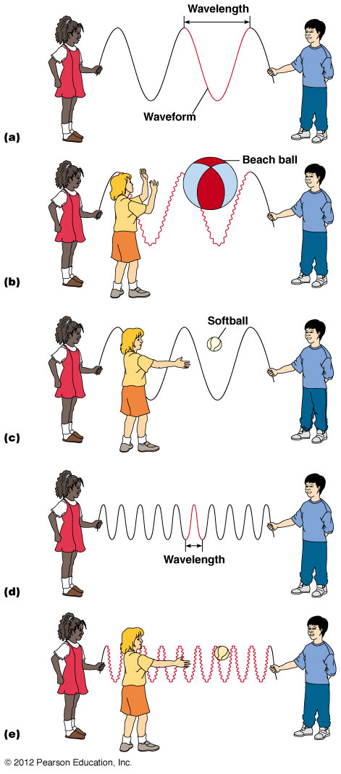
Wave, motion, wavelength and perturbation
Figure A-2

Slide 5
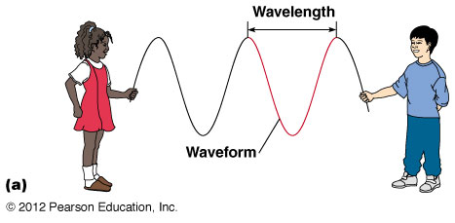
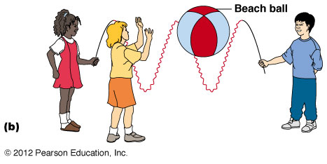
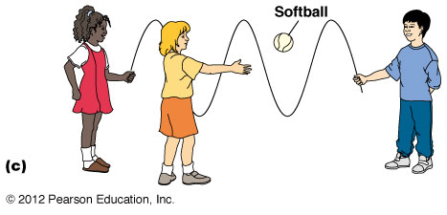

Slide 6
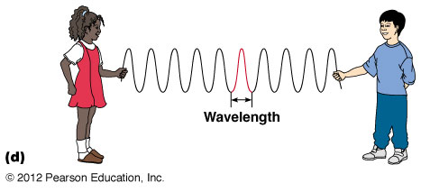
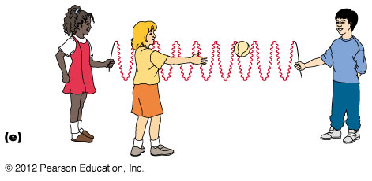

Slide 7
Activity!
Based on the previous example/figure, why small objects like ribosomes and viruses can be seen only by EM and not by LM?

Slide 8
Resolution limit
Resolution refers to the ability to distinguish adjacent objects as separate from one another
Interference: the process by which two or more waves combine to reinforce or cancel one another producing a wave equal to the sum of the two combining waves
When you look at a specimen through a series of lenses, the image that you see is really just a pattern of either additive or canceling interference of the waves that went through the lenses, a phenomenon called “Diffraction”

Slide 9
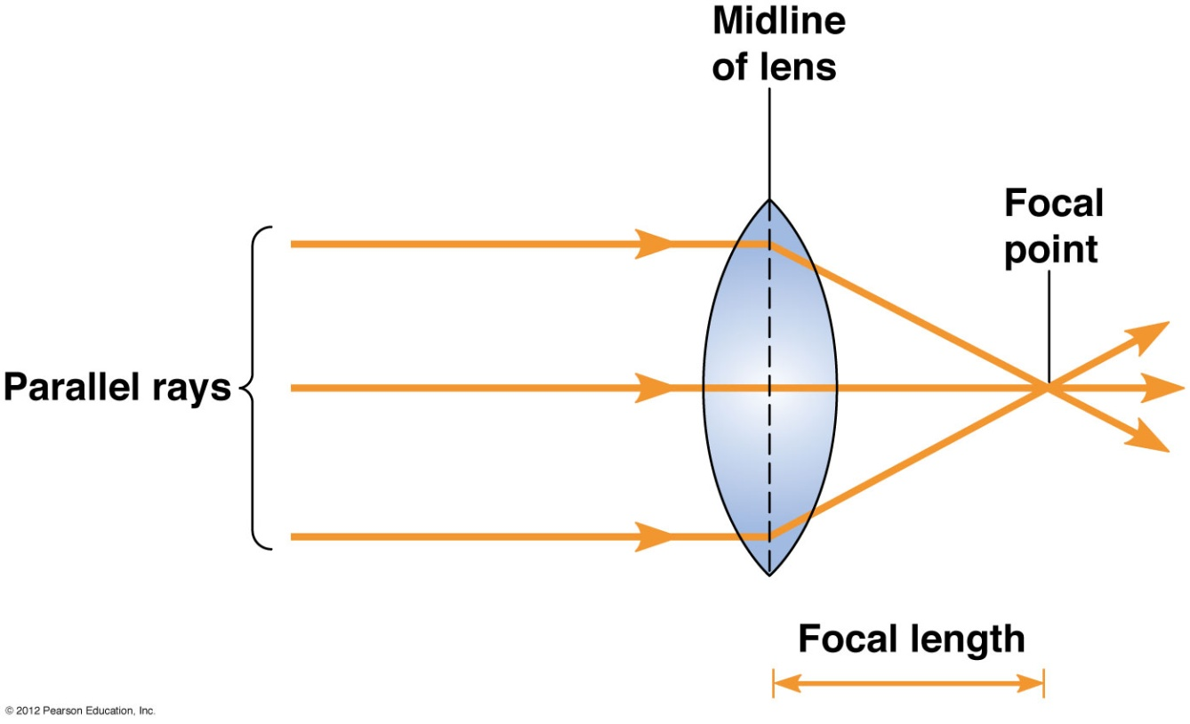
Focal length & angular aperture
Focal length: the distance between the midline of the lens and the point at which rays passing through the lens converge to a focus
Figure A-3

Slide 10
The focal length is determined by:
Index of refraction of lens
The medium in which it is immersed
The geometry of the lens

Slide 11
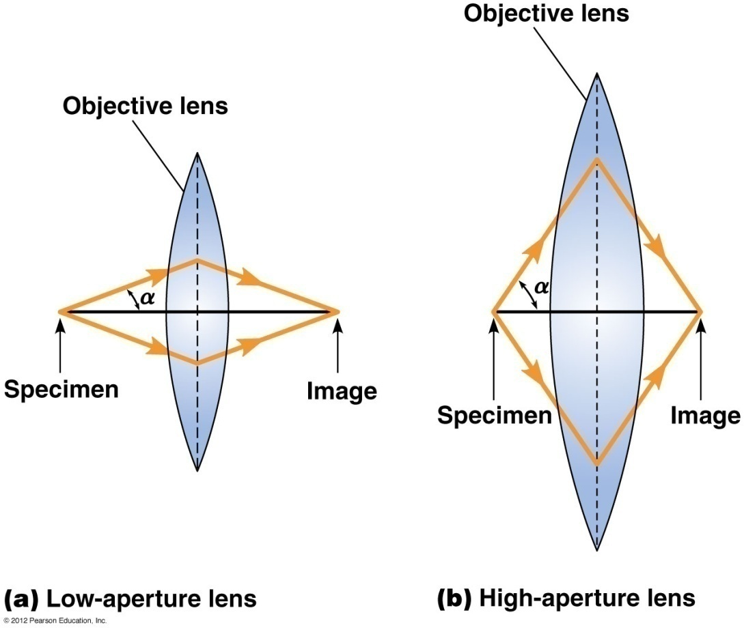
Angular aperture: the half-angle α of the cone of light entering the objective lens of the microscope from the specimen
In the best LM, α≈70˚
Figure A-4

Slide 12
Factors that affect Resolution
Resolution is governed by
Wavelength of the light used to illuminate the specimen
Angular aperture
Refractive index of the medium surrounding the specimen
The effect of these variables on resolution is described by Abbe equation: r=0.61 λ/n sinα
r: resolution; λ: wavelength; n: refractive index of medium between specimen & objective lens; α: angular aperture. 0.61: a constant that represents the degree to which image points can overlap and still be recognized as separate points by an observer.

Slide 13
The value “n sinα” is called the Numerical aperture (NA) of the objective lens,
r = 0.61 λ/NA

Slide 14
Practical limit of resolution
LM: wavelength of visible light is 400-700 nm, and the shortest wavelength is this range that is practical to use for illumination is the blue light of ~450 nm; refractive index of air is 1.0; α=70˚ & sin α is 0.94
For LM, r= (0.61) (450)/ (1)(0.94) =~ 300 nm
If Immersion oil (rf=1.5) is used between lens and specimen, r=(0.61)(450)/(1.5)(0.94)=~200 nm

Slide 15
Useful magnification is ~ 1000X of NA (1.0-1.4), therefore the useful mag in LM ranges from 1000X in air to 1400X with immersion oil
Mag greater than 1400X is referred to as “empty magnification”

Slide 16
EM: the wavelength of electrons is ~ 100,000 times shorter than that of the photons of visible light,
The theoretical r= 0.002 nm, but practical r is close to 2 nm
Useful magnification of EM is ~ 100 times of LM or ~ 100,000X.

Slide 17
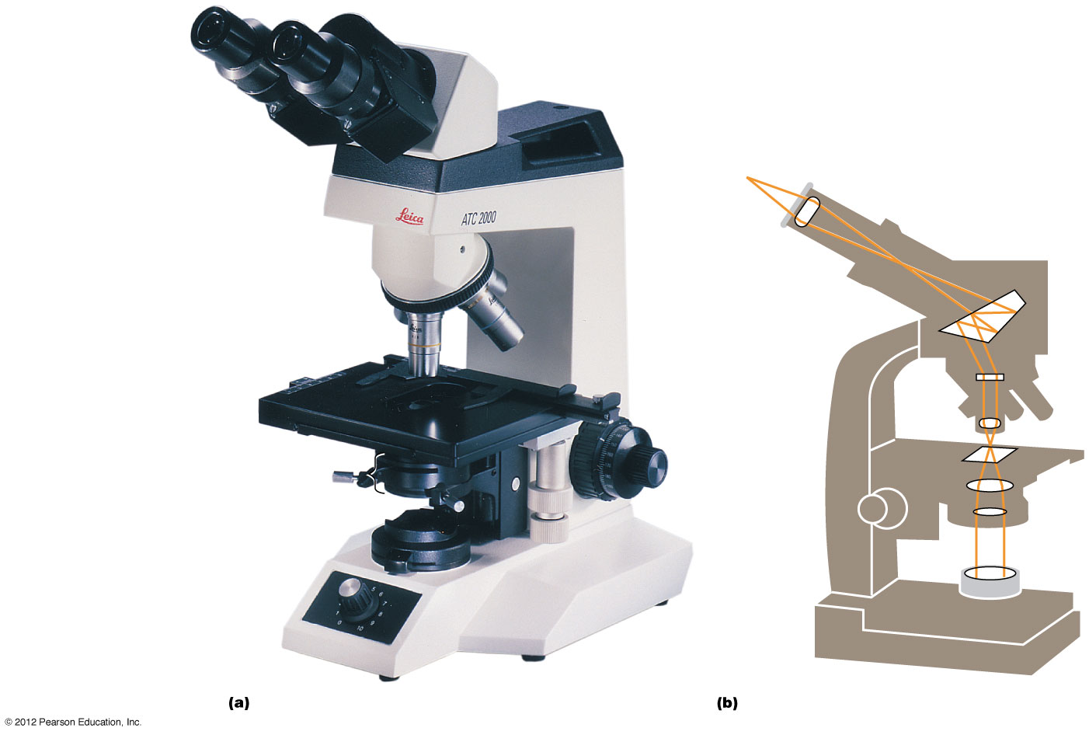
The Light Microscope
Figure A-5

Slide 18
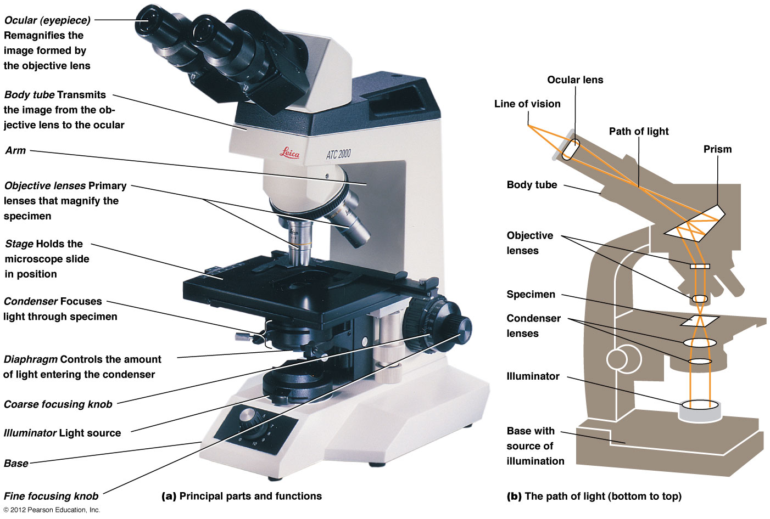
The Light Microscope/ compound microscope
Figure A-5

Slide 19
The Light Microscope/ compound microscope
Today, the LM uses several lenses in combination and thus called Compound microscope
The elements of microscope described till now form the form of LM called Brightfield microscope
Used to visualize samples that have colors or some other properties that affects the amount of light passing thru specimen

Slide 20
Phase-contrast Microscopy
It detects differences in refractive index and thickness
Used to visualize living and unstained specimens
It is widely used in microbiology and tissue culture

Slide 21
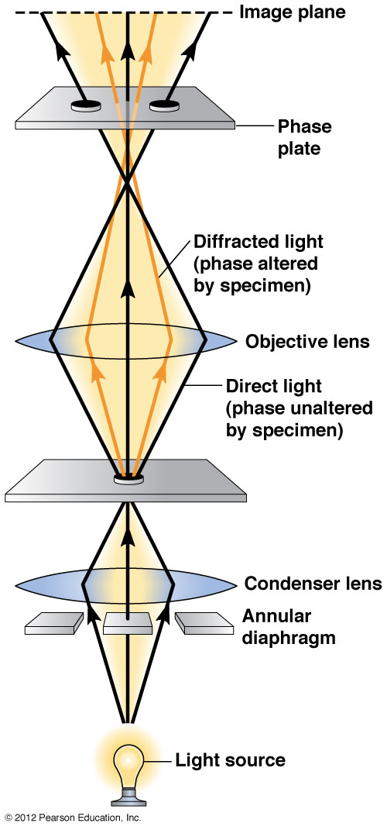
Phase-contrast Microscopy
Figure A-6

Slide 22
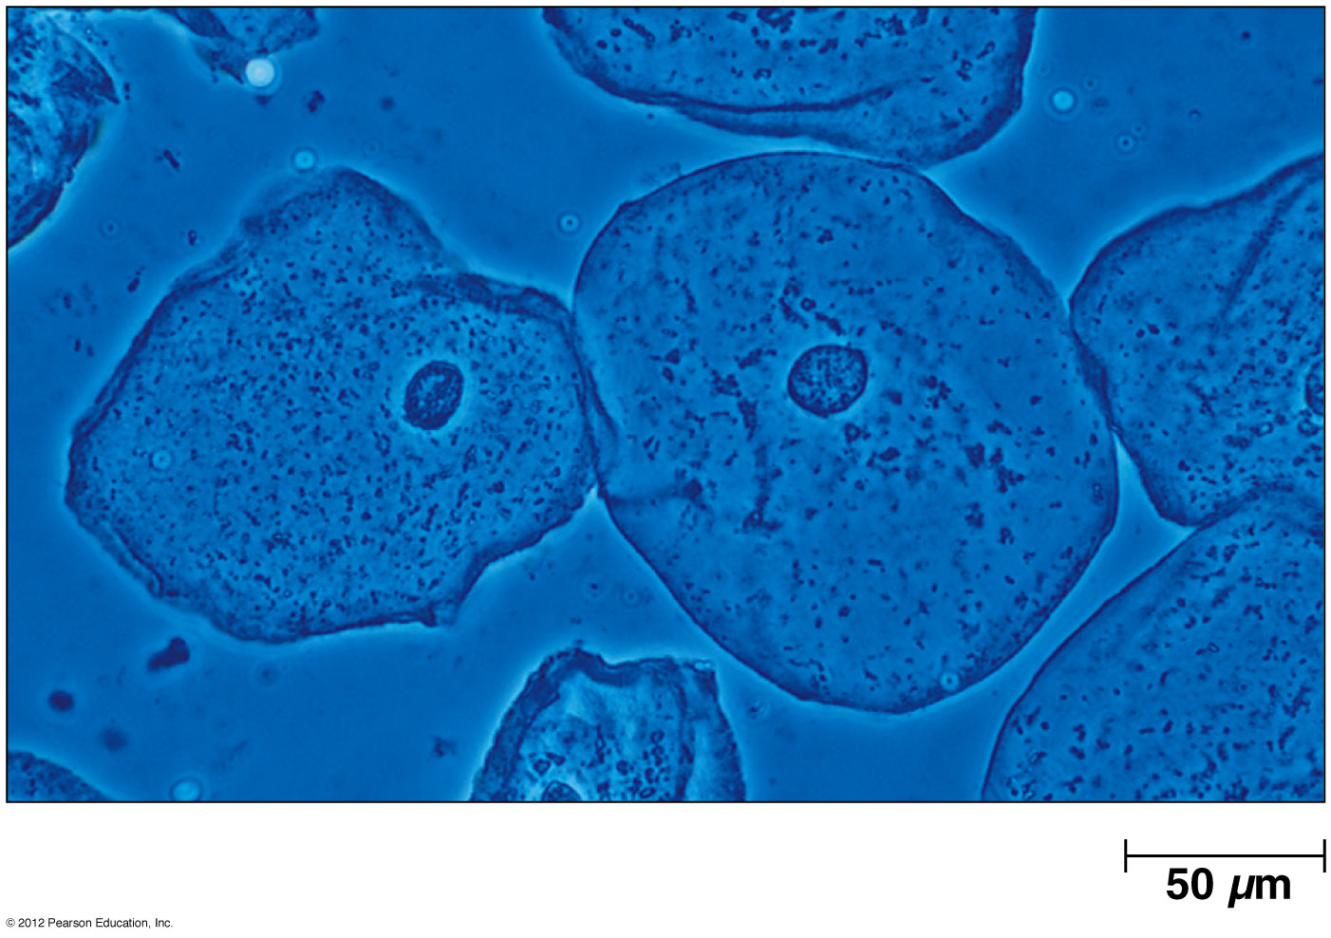
Phase-contrast microscopy: unstained & unprocessed epithelial cells
Figure A-7

Slide 23
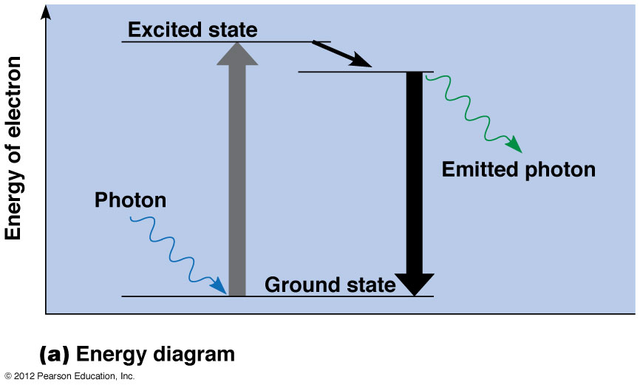
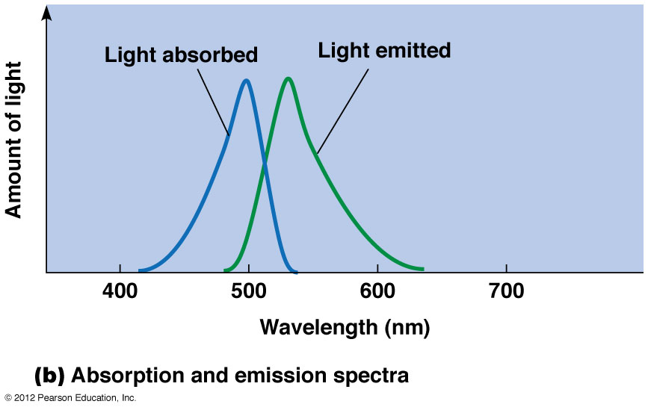
Fluorescent microscopy
It can detect the presence of specific molecules or ions within cells

Slide 24
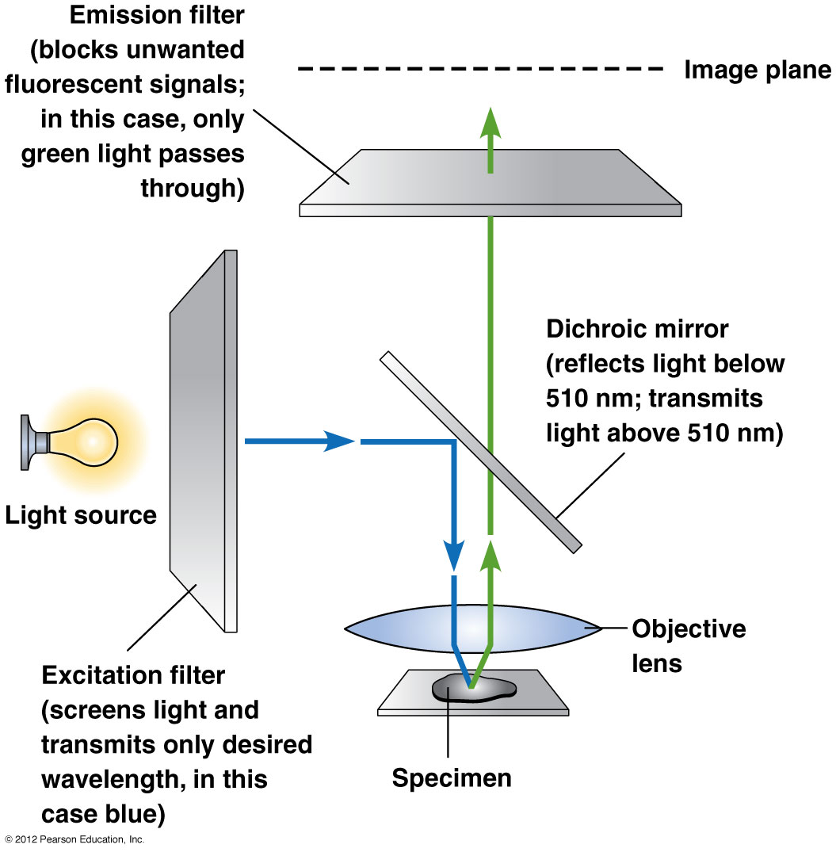
Optics of the Fluorescence microscope

Slide 25
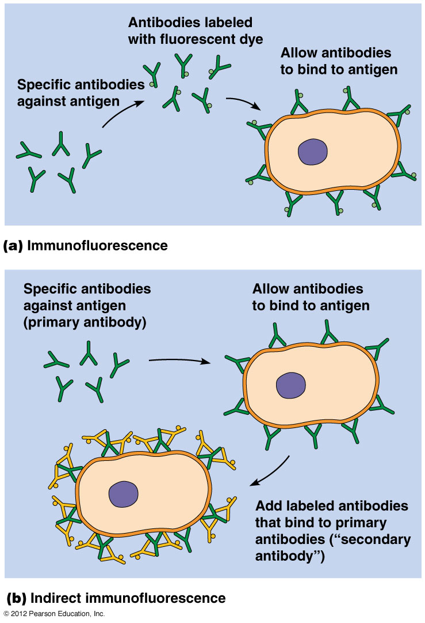
Immunostaining using Fluorescent Antibodies
Requirements for immunostaining:
Antigen in specimen
Antibody specific for Antigen
Fluorescent dye like fluorescein or rhodamine (or quantum dots)

Slide 26
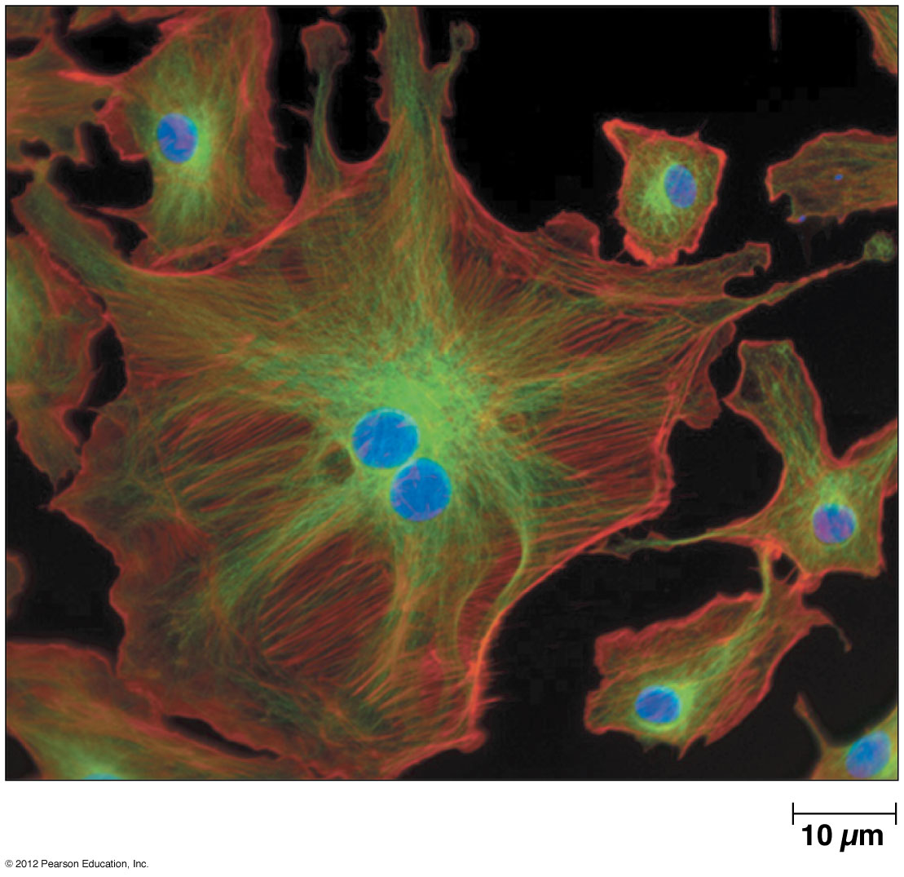
Fluorescence microscopy
Different probes can be imaged using different combinations of fluorescent filters & the different images can be combined to generate striking pictures of cellular structures

Slide 27
Sample preparation techniques for LM
Unstained versus stained samples
Specimen preparation:
Fixation: kill the cells while preserving their structural appearance, e.g. formaldehyde, glutaraldehyde, acetic acid, picric acid
Sectioning: specimens are embedded in a medium that hold it rigidly in position while sections are cut, e.g., Paraffin wax, epoxy plastic resin, or quick frozen.

Slide 28
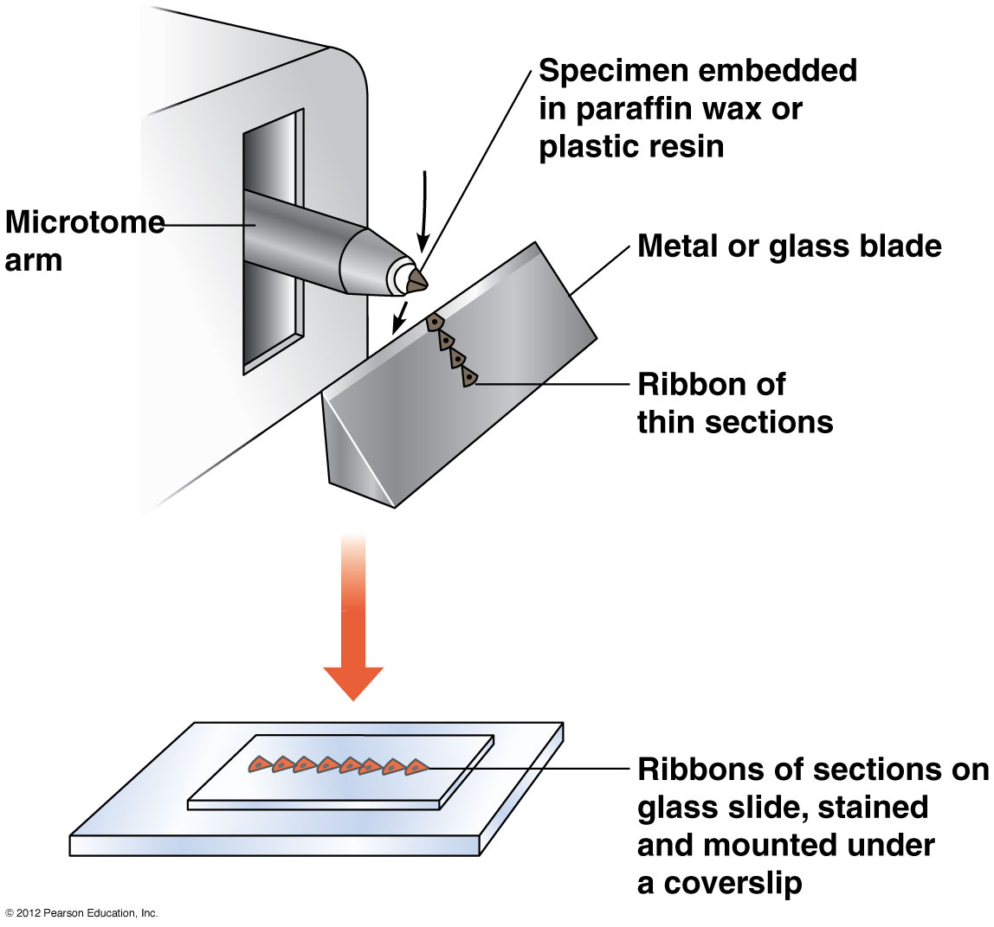
Sectioning with a microtome

Slide 29
Sample preparation techniques for LM
Specimen preparation: (continued)
Staining: using various dyes and antibodies. Once specimen is stained, it is covered with a glass coverslip for protection

Slide 30
Visualizing
Cells and Molecules II
Instructor: Dr. Mahmoud A. Srour
Course: Cell Biology 0202211
Reading:
Becker’s World of the Cell, 8th ed/ 2012. Appendix A, p. A.1- A.29.
Lec # 3 Mon 17.09.2012

Slide 31
The Electron Microscope
EM has two basic designs:
Transmission EM (TEM)
Scanning EM (SEM)
Most of the parts of the TEM are similar in name and function to their counterparts in LM, but their physical orientation is reversed

Slide 32
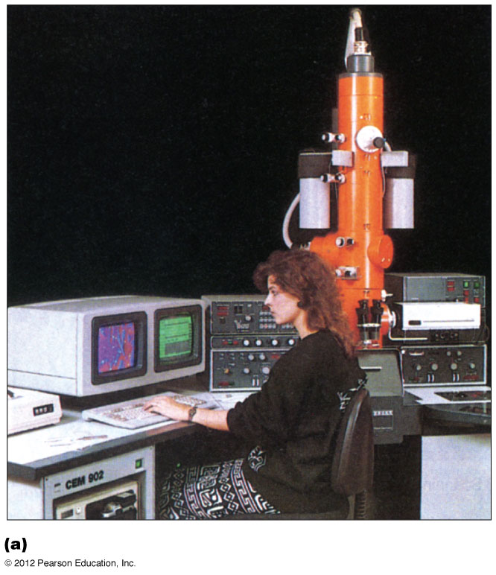
TEM

Slide 33
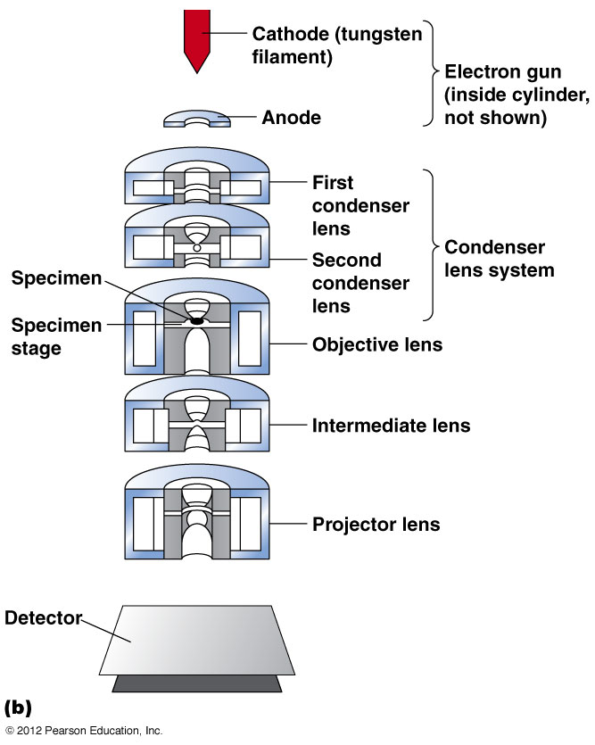
TEM

Slide 34
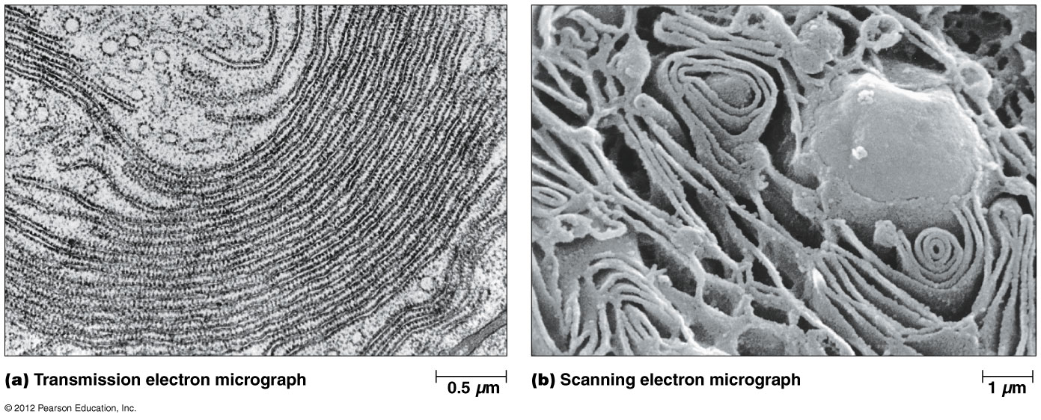
Comparison of TEM & SEM

Slide 35
TEM: components
Vacuum system and electron gun: electrons cannot travel very far in air, a strong vacuum must be maintained along the entire path of the electron beam
Some TEM uses a cold trap device (metal insert cooled with liquid Nitrogen)
Electron gun: assembly of several components; a tungsten filament (cathode, 50-100 kV) that emits electrons when heated; an anode kept at 0.0 V, this causes electrons to accelerate along the anode cylinder, acceleration voltage

Slide 36
Electromagnetic lenses and image formation: electrons have negative charge and their movement is controlled by magnetic forces
The image capture system: electrons strike a fluorescent screen or photographic film (electron micrograph), or digital camera
Voltage: an electron beam is too weak to penetrate far into biological samples, sp specimens must be thin, usually no more than 100 nm. Thicker sections require a special High-voltage EM(200-1000 kV)

Slide 37
Scanning EM
SEM reveals the surface structure of cells and organelles
Accelerating voltage is 5-30 kV
the beam of electrons are focused into an intense spot that is moved back and forth over the specimen surface by the “beam deflector”
Electrons that sweep over the specimen are excited and emit secondary electrons, that are detected by a scintillation detector which in turn emits photons of light. The photons are captured by a video screen

Slide 38
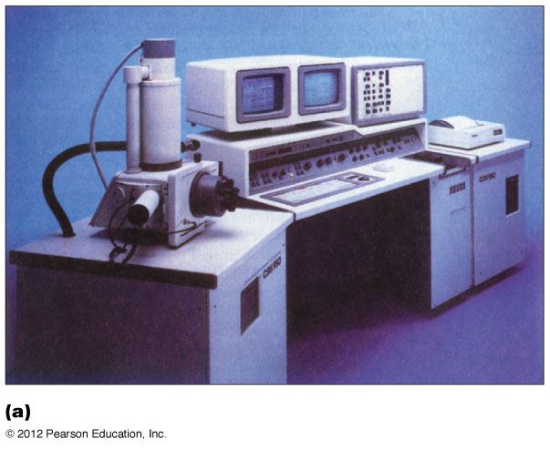
SEM

Slide 39
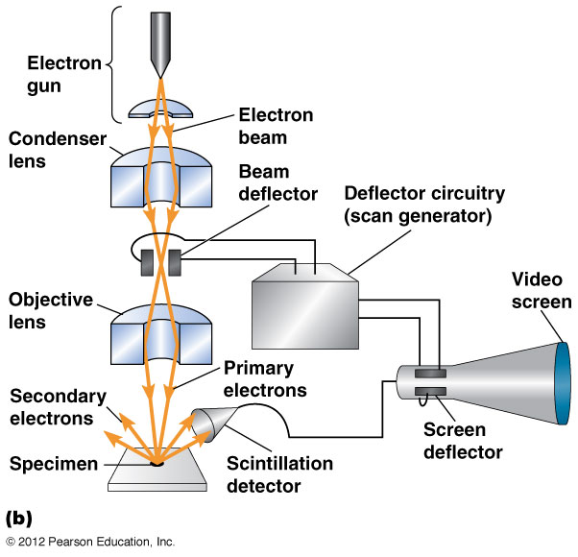
SEM

Slide 40
Sample preparation techniques for EM
Fixation: mostly aldehydes, most common is glutaraldehyde. Cryofixation involves extremely rapid freezing (within 20 msec). It is usually followed by freeze substitution, where water is replaced by organic solvent such as acetone or propylene oxide
Embedding in liquefied epoxy plastic resin
Ultrathin sectioning using ultramicrotome: sections are 50-100 nm. Sections are picked up on a circular copper grid
Staining: specimens are often stained with a 1-2% solution of buffered osmium tetroxide (OsO4)

Slide 41
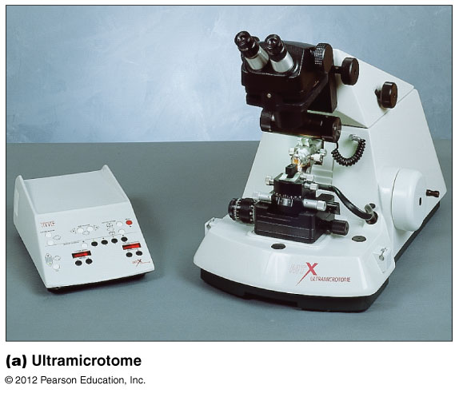
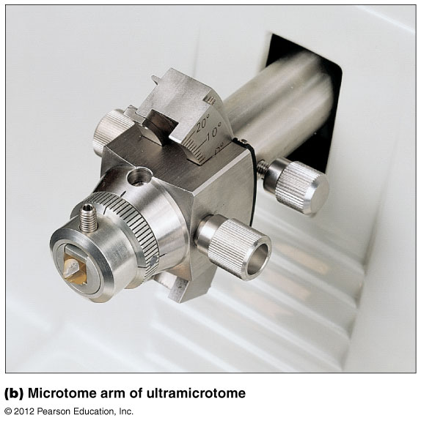
Ultramicrotome

Slide 42
Antibodies can localize molecules in EM
Immunoelectron microscopy (ImmunoEM): Abs are linked to electron dense substances like colloidal gold particles that appear as opaque dots
correlative microscopy: dynamic images of a cell are taken using LM often using Abs and/or GFP. The same cell is processed and viewed using ImmunoEM. It is used to determine where a protein is found at very high resolution

Slide 43
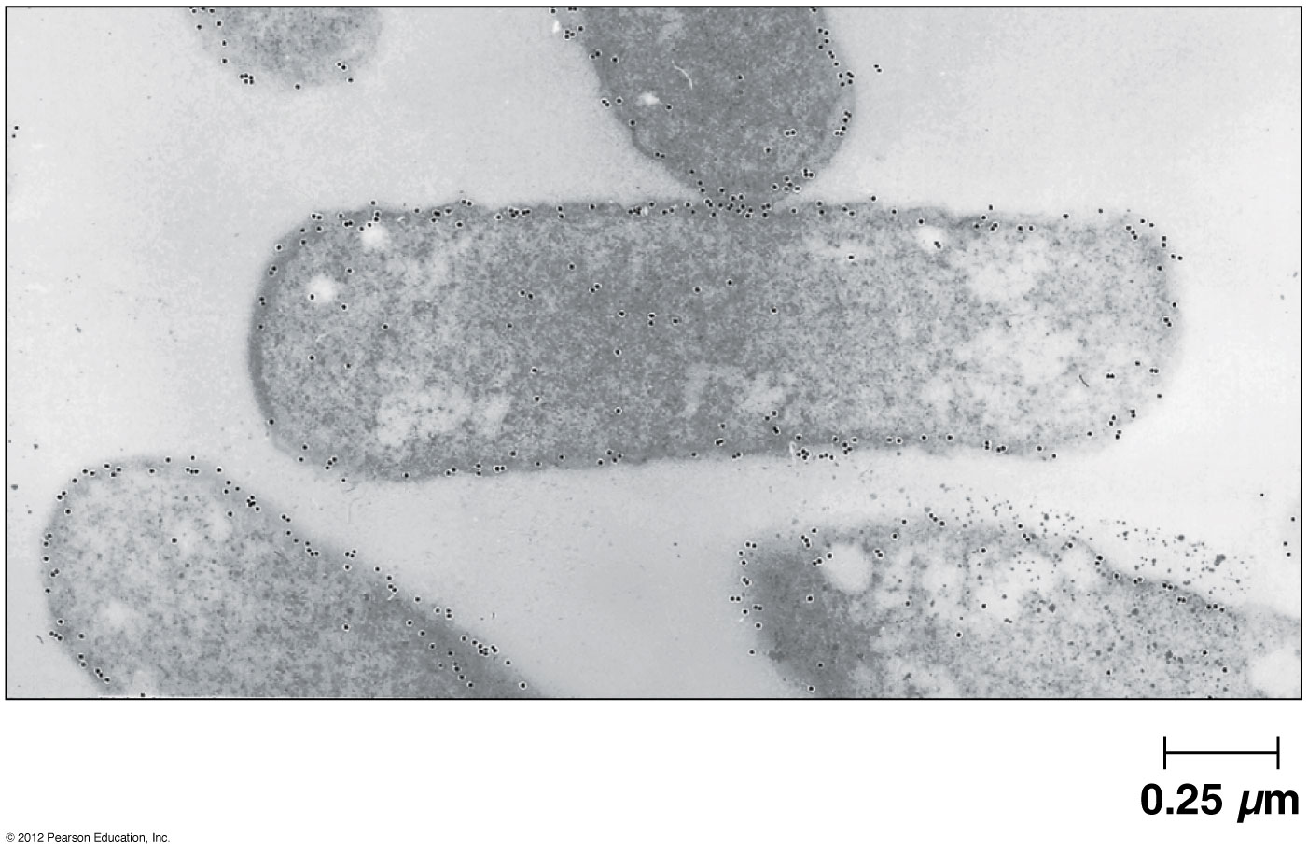
The use of Gold-labeled Antibodies in EM

Slide 44
Negative staining can highlight small objects in relief against a stained background
Negative staining is one of the simplest techniques in TEM. It can also be used to study intact specimens against a darkly stained background M
Method:
Ultrathin plastic film is overlaid on the copper grid, suspended in a drop of liquid and air dried
A drop of stain such as uranyl acetate or phosphotungstic acid is applied to the film surface. The edges of grid are plotted at several places to absorb excess stain

Slide 45
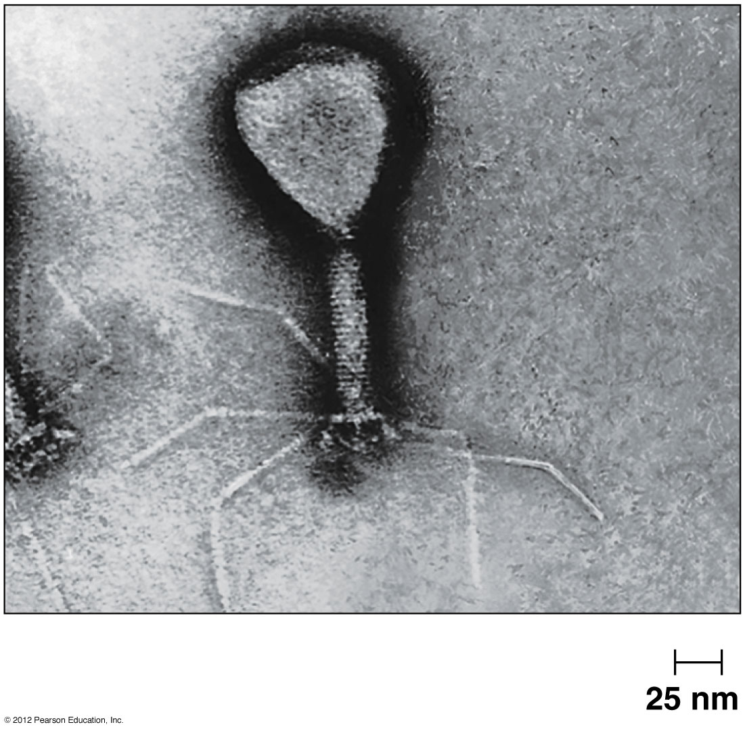
Negative staining
Electron micrograph of a bacteriophage

Slide 46
Shadowing techniques use metal vapor sprayed across a Specimen’s surface
Isolated particles and macromolecules can be visualized by shadowing which involves spraying a thin layer of an electron-dense metal such as gold or platinum at an angle across the surface of a biological specimen

Slide 47
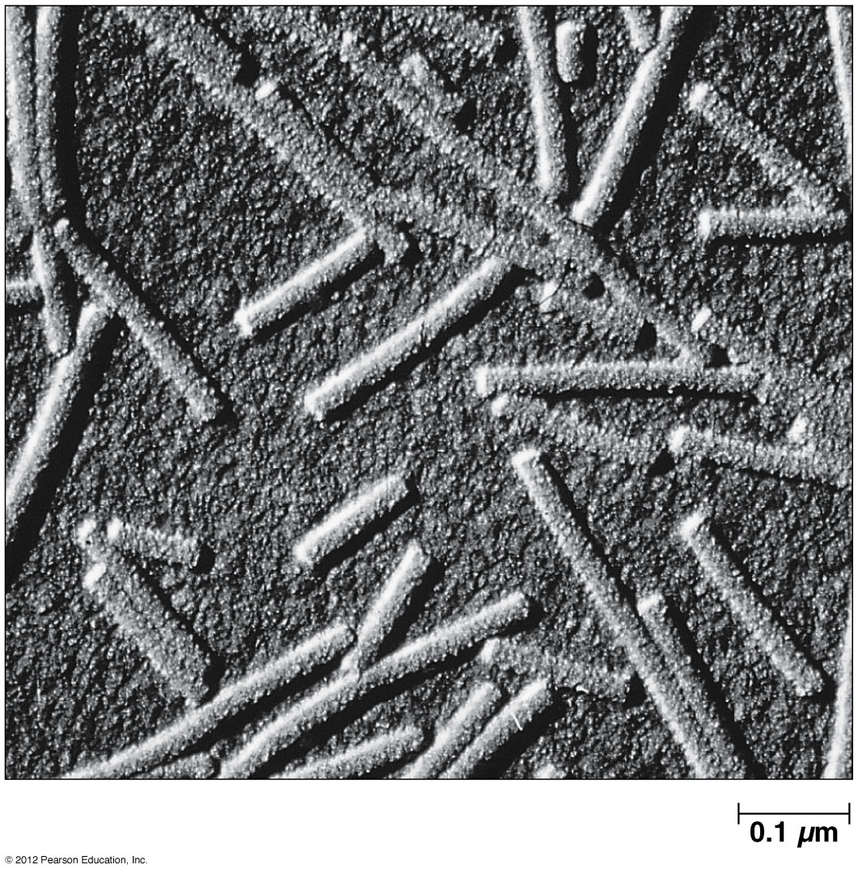
Shadowing
Electron micrograph of tobacco mosaic virus particles

Slide 48
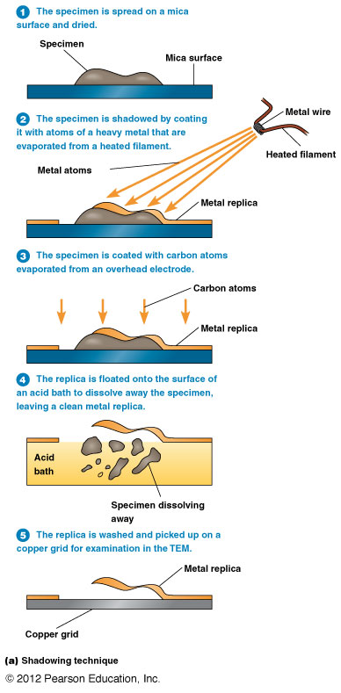
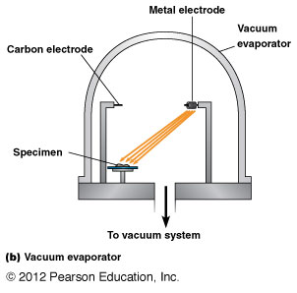
The technique of shadowing

Slide 51
Freeze fracturing and freeze etching are useful for examining the interior of membranes
Freeze fracturing: specimens are rapidly frozen in liquid nitrogen or liquid helium, placed in a vacuum and struck with a sharp knife edge.
Platinum/carbon shadowing is used to create a replica of fractured surface
Freeze etching: after fracturing the specimen, the microtome arm is placed directly over specimen for a short period of time (few seconds to several minutes). This causes small amount of water to evaporate (sublime) from the surface to the cold knife producing an etching, that is an accentuation of surface detail.

Slide 52
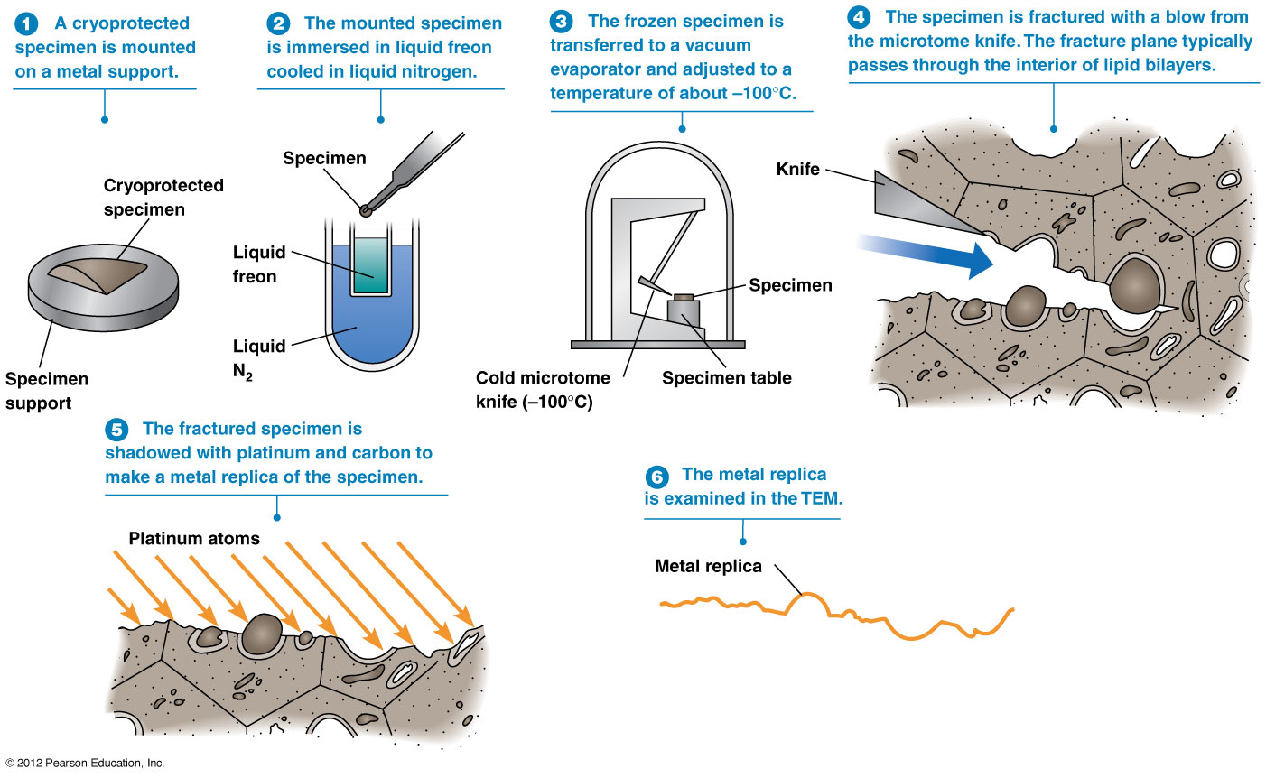
The technique of freeze fracturing

Slide 53
The technique of freeze fracturing

Slide 54
The technique of freeze fracturing

Slide 55
The technique of freeze fracturing

Slide 56
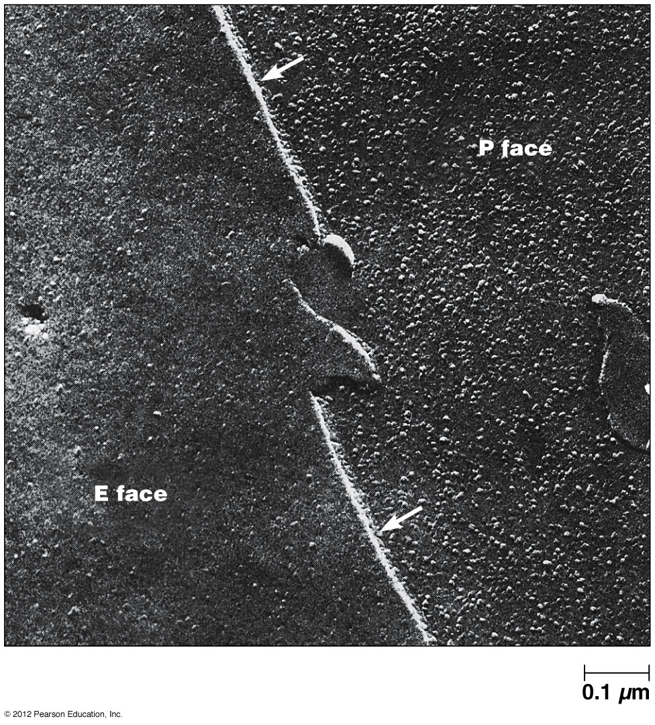
Freeze fracturing of the plasma membrane

Slide 57
Freeze etching: after fracturing the specimen, the microtome arm is placed directly over specimen for a short period of time (few seconds to several minutes). This causes small amount of water to evaporate (sublime) from the surface to the cold knife producing an etching, that is an accentuation of surface detail.

