Slide 1
The Macromolecules of the Cell
Instructor: Dr. Mahmoud A. Srour
Course: Cell Biology 0202211
Reading:
Becker’s World of the Cell, 8th ed/ 2012. Chap 3, p. 41-71.
Lec # 5 Mon 24.09.2012

Slide 2
Proteins
“Proteins are without a doubt the most important and ubiquitous macromolecules in the cell.”
Proteins are extremely important macromolecules in all organisms, occurring nearly everywhere in the cell
Proteins fall into nine different classes

Slide 3
Classes of Proteins
Based on function, Proteins fall into nine different classes:
Enzymes function as catalysts, increasing the rates of chemical reactions
Structural proteins - physical support and shape
Motility proteins - contraction and movement
Regulatory proteins - control and coordinate cell function
Transport proteins - move substances in and out of cells

Slide 4
Classes of proteins (continued)
Hormonal proteins - communication between cells
Receptor proteins - enable cells to respond to chemical stimuli from the environment
Defensive proteins - protect against disease
Storage proteins - reservoirs of amino acids

Slide 5
Amino Acids
Typically, the cell contains 20 different aa
All aa’s (except glycine!) have an α carbon attached to 4 different groups
3 groups are the same for all aa’s
The 4th group distinguishes each aa from all the rest. Referred to as R or as the side chain
Each aa has a C-terminus and an N-terminus

Slide 6
Amino Acids Exist as Stereoisomers
Only the L forms of amino acids are incorporated into proteins

Slide 7
Side chains are mostly hydrocarbons, which are nonpolar and will not readily dissolve in H₂O (hydrophobic)

Slide 8
The polarity of aa’s in these 2 groups allows them to readily dissolve in H₂O (hydrophilic)
Polar, charged aa’s are often further subdivided into acidic and
basic aa’s. Aspartate and Glutamate are often referred to as
aspartic acid and glutamic acid

Slide 10
Peptide Bond Formation
Condensation reaction joining 2 aa’s
H₂O comes from ionized O of carboxyl group of first aa and 2 H’s on ionized amino group of second aa
Resulting bond between the C of the carboxyl group and the N of the amino group is called a peptide bond
Resulting dipeptide has an N-to-C directionality

Slide 11
Bonds and Interactions Important for Protein Folding and Stability
Polypeptides fold and assemble to give rise to functional proteins
The shape or form of a functional protein is often referred to as its conformation

Slide 12
Bonds and Interactions Important for Protein Folding and Stability

Slide 13
Levels of Organization in Protein Structure

Slide 14
Primary Structure
The linear sequence of amino acids, always (by convention) written N to C
Information for higher order structures is inherent in the primary sequence

Slide 15
Secondary Structure
Caused by H-bonding between nearby amino acids
Common elements of secondary structure are the α helix and β sheets

Slide 16
The α Helix
Spiral; Backbone made up of atoms of peptide bonds and the α carbons
3.6 aa’s/turn
H-bonding between imino group (-NH-) of one peptide bond and carbonyl group (-C O-) of another, 4 aa’s away on adjacent turn of the helix
Each aa is H-bonded to 2 other aa’s
Helix formers: Leu, Met, Glu
Helix breakers: Gly, Pro
H-bonding does not lead to helix formation! The helix forms and is stabilized by H bonds.

Slide 17
Predominantly helical proteins form fibers
Structure of fibrous proteins is largely dictated by helices
α-keratin (found in hair) forms into long, extensive helices
3 helices wind to form a protofibril
11 protofibrils associate in a “9+2” structure to form a microfibril
Protofibrils associate to form macrofibrils
Macrofibrils course throughout the hair cell

Slide 18
The β Sheet
Also called a pleated sheet
α carbons form the pleats; side chains jut out from pleats on alternating sides of the sheet
Can form in a single polypeptide or between 2 polypeptides
H-bonding between imino group and carbonyl group of 2 juxtaposed aa’s
Can be parallel or anti-parallel

Slide 19
Depictions of Secondary Structural Elements
Helices depicted as spirals or cylinders
Sheets depicted as thick arrows with the arrowhead designating the C-terminus
Certain combinations of helices and sheets are often found in proteins, and are referred to as motifs
Motifs confer a specific function to the protein

Slide 20
Tertiary Structure
Due to interactions between side chains of aa’s within a polypeptide
Tertiary structure is dependent on aa sequence
Important interactions for tertiary structure include H-bonding, ionic bonding, van der Waals interactions, hydrophobic interactions, and disulfide bonds
Determines the final conformation of most proteins

Slide 21
Globular Proteins
Most proteins contain numerous regions of different secondary structure
These regions can interact and fold to give rise to a globular protein with different functional domains
Globular domains are elements of tertiary structure

Slide 22
Most proteins are comprised of multiple regions of
different secondary structure.

Slide 23
Functional Domains of Globular Proteins

Slide 24
Multifunctional Proteins Have Multiple Functional Domains
GAPDH structure
One domain binds substrate
One domain bonds a necessary
cofactor required for the
enzymatic reaction

Slide 25
Quaternary Stucture
Applies only to multimeric proteins
Refers to the structure achieved upon subunit assembly
Depends on interactions between side chains of the aa’s in each subunit
Interactions include H-bonding, ionic bonding, van der Waals interactions, and disulfide bonds

Slide 26
Nucleic acids

Slide 27
Nucleic Acids
DNA (DeoxyriboNucleic Acid): repository of genetic information
RNA (RiboNucleic Acid):
mRNA (messenger RNA): intermediary between DNA and protein in protein synthesis; “codes for” protein
rRNA (ribosomal RNA): part of the ribosome; involved in protein synthesis
tRNA (transfer RNA): carriers of amino acids
snRNA (small nuclear RNA): involved in RNA splicing

Slide 28
Nucleic Acids
Other types of small RNA:
MicroRNA (miRNA): regulatory RNAs, 20-30 nts long, derived from endogenous RNAs
Small interefering RNAs (siRNA): derived from exogenous sources (e.g., infection by RNA virus)

Slide 29
Localization of Nucleic Acids Within the Cell
DNA is found predominantly in the nucleus
RNA is synthesized in the nucleus
RNA functions mainly in the cytoplasm, where protein synthesis occurs

Slide 30
Nucleotides
Nucleotides: the monomers of nucleic acids
Nucleotides are comprised of 3 different components:
1) an aromatic nitrogenous base
2) a 5-carbon sugar (a pentose)
3) 1 to 3 phosphate groups

Slide 32
Nomenclature
Free base: a base (A,G,C,T, or U) found free in solution
Nucleoside: base + sugar (either deoxyribose or ribose)
Nucleotide: base + sugar + phosphate(s)
nucleoside monophosphate = base + sugar + 1 phosphate
nucleoside diphosphate = base + sugar +
2 phosphates
nucleoside triphosphate = base + sugar +
3 phosphates

Slide 33
More Nomenclature
Ribonucleotides sometimes designated as rAMP, rGMP, rCMP

Slide 34
Phosphate Groups
5’ Carbon
γ phosphate
β phosphate
α phosphate

Slide 35
Nucleic Acid Polymerization
5’-UACG-3’
During nucleic acid
polymerization, a
phosphodiester bond
forms between the
α phosphate of an
incoming nucleoside
triphosphate and
the 3’ –OH at
the end of the growing
chain. Inorganic
pyrophosphate (the
β and γ phosphates)
and H₂O are released
as byproducts. Note
the 5’ to 3’ directionality
of the
nucleic acid!
5’-TACG-3’

Slide 36
Base-pairing in Nucleic Acids
Specific H-bonding occurs between bases in nucleic acids, causing bonding of two separate strands (molecules) or intramolecular folding within a given strand
Generally: Purines H-bond to pyrimidines
Specifically: A H-bonds to T (in DNA), U (in RNA)
A-T or A-U basepair
G H-bonds to C
G-C basepair

Slide 37
Base-pairing in Nucleic Acids
A-T basepairs are
joined by 2 H-bonds
G-C basepairs are
joined by 3 H-bonds
G-C basepairs are
stronger!
The two strands are
complementary to
each other and
anti-parallel!

Slide 38
DNA is a Double-Stranded Helix
DNA is a ladder of 2 complementary, H-bonded, anti-parallel strands of DNA, twisted into a right-handed helix
The sides of the ladder = the sugar-phosphate backbone
The rungs of the ladder = the H-bonded basepairs

Slide 39
RNA is Single-Stranded
RNA bases can form base pairs
RNA can basepair with DNA (e.g. as part of RNA synthesis) or with RNA
RNA is NOT found as a double-stranded helix
RNAs contain regions of self-complementarity. They can fold over and basepair with themselves intramolecularly. Such folded RNAs are said to have secondary structure.

Slide 40
The Macromolecules of the Cell
Instructor: Dr. Mahmoud A. Srour
Course: Cell Biology 0202211
Reading:
Becker’s World of the Cell, 8th ed/ 2012. Chap 3, p. 41-71.
Lec # 6 Sat 29.09.2012

Slide 41
Polysaccharides

Slide 42
Polysaccharides
Long chains of monosaccharides
e.g., starch and glycogen (storage)
cellulose (structure)
The monosaccharides are the monomers
Usually comprised of a long chain of a single monosaccharide (such as glucose in starch and glycogen)
Sometimes comprised of a chain of 2 alternating monosaccharides

Slide 43
Monosaccharides
Simple sugars, such as glucose

Slide 44
The Chemistry of Monosaccharides
Sugars are either aldehydes or ketones
Sugars have 2 or more –OH groups
Sugars generally have 3 to 7 carbons: triose, tetrose, pentose (e.g., ribose and deoxyribose), hexose, heptose
Sugars have the general chemical formula of C_{n}H_{2n}O_{n}

Slide 45
D-Glucose

Slide 46
α and β forms of D-glucose

Slide 47
Common Dissacharides
Disaccharides: 2 covalently-linked monosaccharides
Glycosidic bonds (or linkages): the bonds joining 2 monosaccharides
α-linkage: sugar 1 has –OH group on C1 in the α (upward) position
β-linkage: sugar 1 has –OH group on C1 in the β (downward) position
1,4-linkages: occur between C1 of the first sugar and C4 of the second sugar
1,6-linkages: occur between C1 of the first sugar and C6 of the second sugar

Slide 48
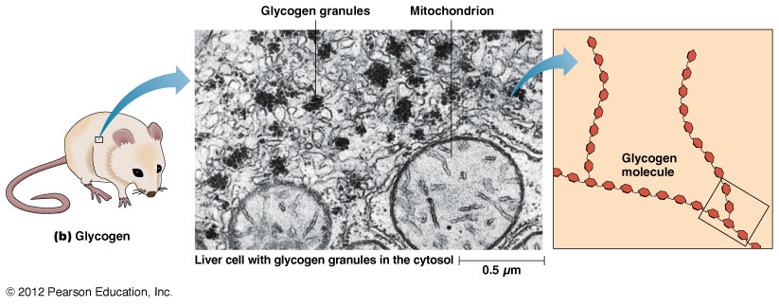
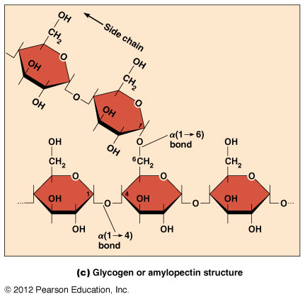
Glycogen vs. Starch

Slide 49
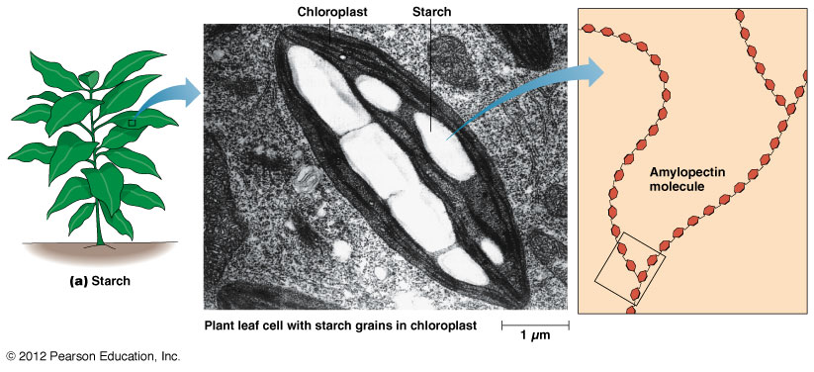
Glycogen vs. Starch

Slide 50
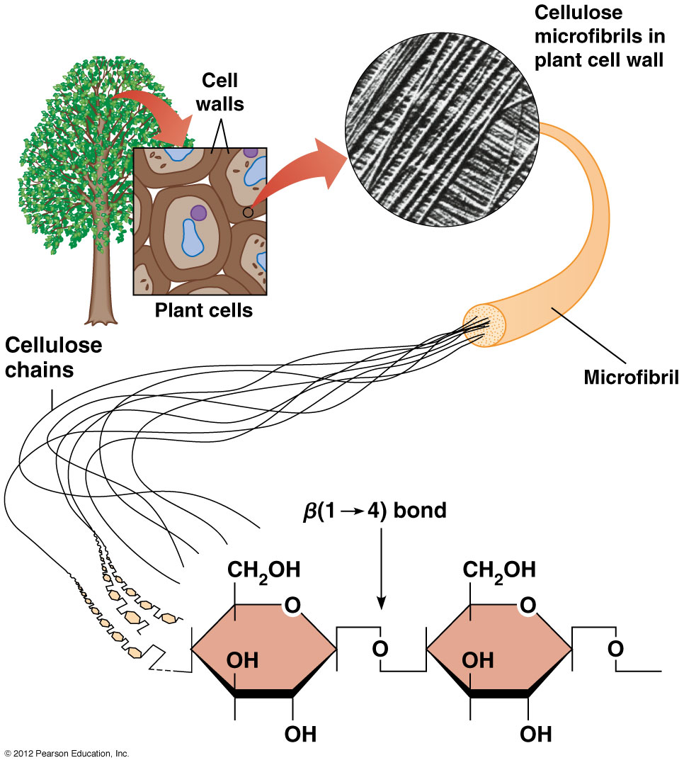
Cellulose
*Fungal cellulose (dependent on the species) contains either β(1-4) or
β(1-3) glycosidic bonds

Slide 51
Common Derivatives of Glucose
Many polysaccharides are comprised of glucose derivatives
N-acetylglucosamine (GlcNAc) and N-acetylmuramic acid (MurNAc) are both derived from b-glucosamine, a derivative of glucose
GlcNAc and MurNAc are found in structural polysaccharides

Slide 52
Common Derivatives of Glucose
Alternating GlcNAc and MurNAc make up the polysaccharides of bacterial cell walls, with β(1-4) glycosidic bonds

Slide 53
Common Derivatives of Glucose
Chitin is comprised of repeating GlcNAc, with β(1-4) glycosidic bonds
Chitin is the polysaccharide found in insect exoskeletons and crustacean shells

Slide 54
Polysaccharide Structure Depends on the Type of Glycosidic Bonds Involved
α- and β-glycosidic bonds are associated with marked structural differences
Starch and glycogen (α polysaccharides) form loose helices that are not highly ordered due to the side chains
Cellulose (that forms β linkages) exists as rigid linear rods that aggregate into microfibrils, about 5-20 nm in diameter and about 36 cellulose chanis
Plant and fungal cells walls contain these rigid microfibrils in a noncellulose matrix containing other polymers (hemicellulose, pectin) and a protein called extensin

Slide 55
Lipids

Slide 56
Features of lipids
Although heterogeneous, all have a hydrophobic nature, and thus little affinity for water; they are readily soluble in nonpolar solvents such as chloroform or ether
They have relatively few polar groups, but some are amphipathic, having polar and nonpolar regions
Functions include energy storage, membrane structure, or specific biological functions such as signal transmission

Slide 57
The main classes of lipids
The lipids can be divided into six classes based on their structure
Fatty acids
Triacylglycerols
Phospholipids
Glycolipids
Steroids
Terpines

Slide 58
Fatty Acids
Long hydrocarbon chains with a polar carboxyl group at one end
Amphipathic
Contain an even number of carbons (usually 12-24)
Synthesized by stepwise addition of acyl groups (2-carbon units from acetyl coenzyme A)
2-Carbon
acyl group
CoA

Slide 59
Fatty Acids
Saturated Fatty Acids
Every C is bonded to the maximum number of H’s
Have the chemical formula of C_{n}H_{2n}O₂
Linear
Pack together well
Unsaturated Fatty Acids
Some C’s are doubled-bonded
Double bonds form kinks
Do not pack together well

Slide 60
Fatty Acids

Slide 61
Fatty Acids

Slide 62
Triacylglycerols (Triglycerides): are storage lipids
Glycerol esterified to 3 fatty acids
Fatty acids are added one at a time
Fatty acids can be the same or can differ in the chain length and degree of saturation

Slide 63
Triacylglycerols
Body fat of animals: comprised mostly of triglycerides with saturated fatty acids. Tight packing of linear fatty acids leads to solid fat.
Plant oils: comprised mostly of triglycerides with unsaturated fatty acids. Tight packing cannot occur due to kinks. Plant oils (such as those we use in cooking) are liquid. Partial hydrogenation of vegetable oils gives us the solids of margarine and shortening.

Slide 64
Phospholipids
Important membrane components
Amphipathic in nature
Membrane phosoglycerides invariably have in addition, a small hydrophilic alcohol linked to phosphate group by ester bond and represented above as R group

Slide 65
Phosphoglycerides
Modified glycerol; C1 esterified to a phosphate group
Phosphate group is esterified to a small polar head group (R)
C2 and C3 esterified to fatty acids

Slide 66
Sphingolipids
Similar to phosphoglycerides, but contain sphingosine instead of glycerol
Important in membrane structure and cell signaling
Based on amine Sphingosine that contains a long hydrocarbon tail with one double bond near the polar end
Amino group on C2 forms an amide bond with the carboxyl group of a fatty acid to form ceramide
Sphingolipid = ceramide + polar head group (phosphate + R) on C1

Slide 67
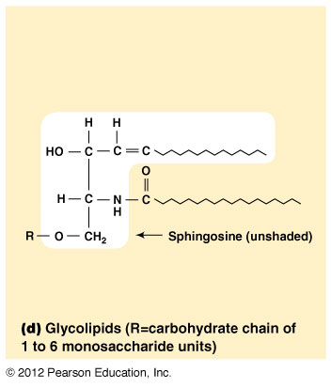
Glycolipids
Similar to sphingolipids, but have a carbohydrate group attached to C1
Carbohydrates are polar, making glycolipids amphipathic
Found in cell membranes, especially in plant cells and in cells of the nervous system
Carbohydrate groups attached to a glycolipid may be one to six sugar units (D-glucose, D-galactose, or N-acetyl-D-galactosamine)

Slide 68
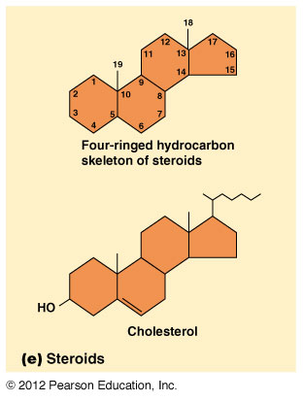
Steroids
Steroids are derivatives of a four-ringed hydrocarbon skeleton, which distinguishes them from other lipids
Steroids differ from one another in degree of saturation and in functional side groups jutting out from ring structure
Prototypical steroid is cholesterol
Cholesterol is amphipathic and is found in cell membranes
Cholesterol serve as precursor for all steroid hormones (sex hormones, glucocorticoids, mineralocorticoids)

Slide 69
Common Steroid Hormones

Slide 70
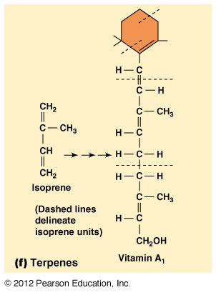
Terpenes
Terpenes are synthesized from the five-carbon compound isoprene and are sometimes called isoprenoids
Isoprene and its derivatives are joined in various combinations to produce substances such as vitamin A and carotenoid pigments

Slide 71
Other isoprene-based compounds
The isoprene-based compounds, dolichols, are involved in activating sugar compounds
Electron carriers such as coenzyme Q and plastoquinone are also isoprene derivatives
Polyisoprenoids, polymers of isoprene, are found in cell membranes of the Archaea

