Slide 1
Signal Transduction Mechanisms:
Messengers & Receptors
(I)
Instructor: Dr. Mahmoud A. Srour
Course: Cell Biology 0202211
Reading:
Becker’s World of the Cell, 8th ed/ 2012.
Chap 14, p. 392-421.
Lec # 16 Sat 08.12.2012

Slide 2
Chemical Signals and Cellular Receptors
Cells produce signals, in some cases by displaying molecules on their surfaces or by releasing a chemical signal
Multicellular organisms can control the activities of specialized cells through release of chemical messengers

Slide 3
Different Types of Chemical Signals Can Be Received by Cells
Signaling molecules are often classified based on the distance between the site of production and the target
Endocrine signals are produced far from the target tissues, which they reach via the circulatory system
Paracrine signals are diffusible and act over a short range

Slide 4
Other types of signaling molecules
Juxtacrine signals require physical contact between sending and receiving cells
Autocrine signals act on the same cell that produces them

Slide 5
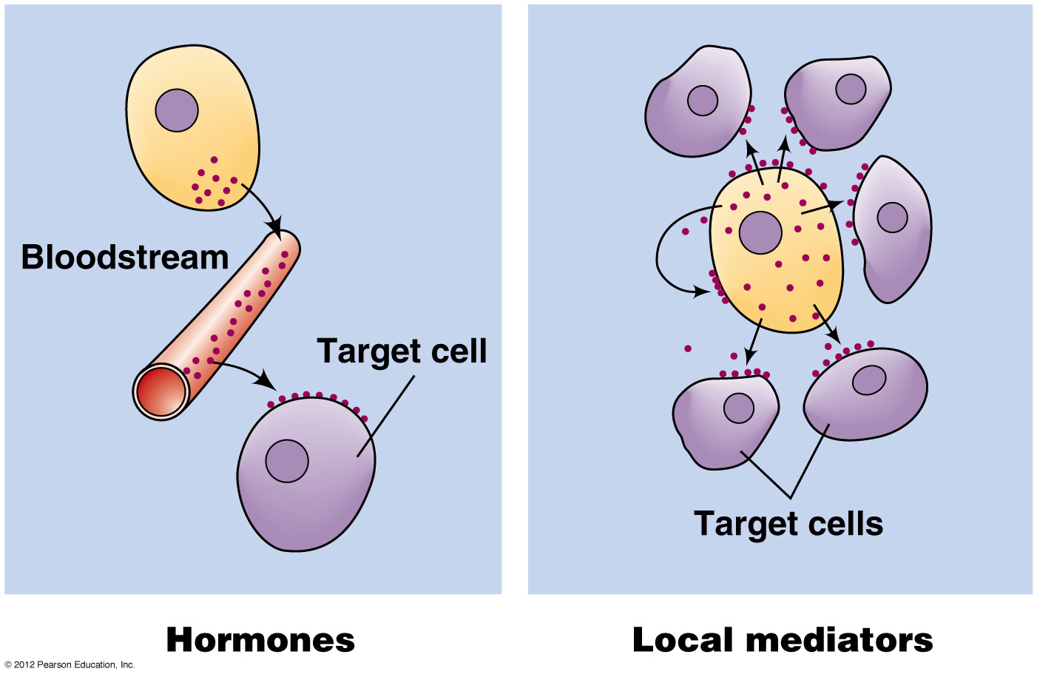
Cell-to-cell signaling by hormones & local mediators

Slide 6
Ligands and receptors
When a messenger reaches its target, it binds to receptors on the surface of the target cell
A messenger that binds a target receptor is called a ligand; it may bind a receptor on the surface or inside the target cell
In either case, the ligand is the “primary messenger”

Slide 7
Second messengers
Ligand binding may trigger production of molecules in the receiving cell
These small molecules or ions that relay signals from one location to another in the cell are called second messengers
A cascade of changes may be induced in the receiving cell

Slide 8
Signal transduction
The ability of a cell to respond to ligand-receptor binding by altering its behavior or gene expression is called signal transduction

Slide 9
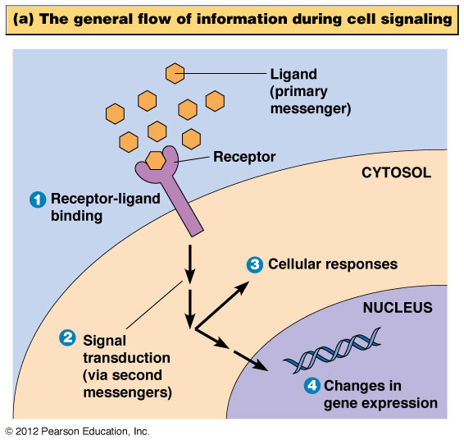
The overall flow of information during cell signaling

Slide 10
Receptor Binding Involves Specific Interactions Between Ligands and Their Receptors
Messengers bind to receptors in a highly specific way, through several noncovalent bonds
This is achieved through
The binding site (or binding pocket) on the receptor that fits the messenger very closely
The necessary amino acid side chains, positioned to form chemical bonds with the messenger

Slide 11
Receptor-ligand interactions
In most cases the binding of a receptor and ligand resembles the binding of an enzyme and its substrate
The receptor specific for a certain ligand is called the cognate receptor
A receptor bound to its ligand is said to be occupied

Slide 12
Receptor Affinity
The relationship between the [ligand] in solution and the number of receptors occupied can be described in terms of receptor affinity
The dissociation constant, K_{d}, is the [free ligand] needed to produce a state in which half the receptors are occupied
Receptors with high ligand affinity have low K_{d} and vice versa

Slide 13
Coreceptors
Receptor-ligand interactions can be affected by coreceptors on the cell surface
They help to facilitate receptor-ligand interaction via physical interaction with the receptor
One well-studied class of such molecules is heparan sulfate proteoglycans including glypicans and syndecans

Slide 14
Receptor Down-Regulation
Cells are geared to sense ligand concentration changes rather than fixed concentrations
When receptors are occupied for prolonged periods, the cell adapts to no longer respond to the ligand
Such changes are called receptor down-regulation, which can be accomplished in two ways

Slide 15
Mechanisms of receptor down-regulation
Cells can down-regulate receptors in two ways
Cells reduce the density of receptors on their cell surfaces via receptor-mediated endocytosis
Cells can adapt to signals by desensitization, alterations to the receptor that lower its affinity for the ligand
A common method of desensitization is phosphorylation

Slide 16
Agonists and antagonists
It is possible to make synthetic ligands that bind even more tightly or selectively than the real ligand
Agonists: drugs that activate the receptor they are bound to
Antagonists: bind receptors without triggering a change, and prevent the naturally occurring messenger from activating the receptor

Slide 17
Receptor Binding Activates a Sequence of Signal Transduction Events Within the Cell
When a ligand binds to its cognate receptor it either induces a change in receptor conformation or causes receptors to cluster
Once this takes place, a preprogrammed sequence of events is initiated inside the cell

Slide 18
Signal Integration
Cells can be exposed to a multitude of signals at any given moment
Cells must integrate these signals to produce appropriate responses
A single receptor can activate multiple pathways, or multiple pathways can converge onto the same molecules

Slide 19
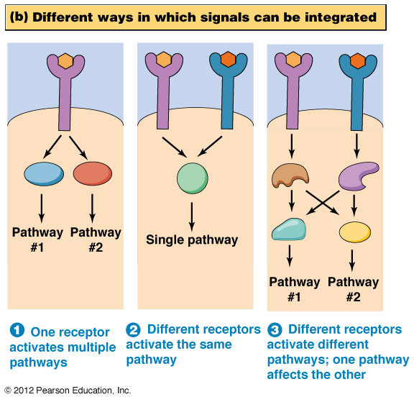
“Signaling crosstalk”

Slide 20
Signal Amplification
Very small quantities of ligand are often sufficient to elicit a response from a target cell
At each step in the resulting cascade of events, a signaling intermediate stimulates the production of many molecules needed for the next step
This multiplication of the effect of the signal is called signal amplification

Slide 21
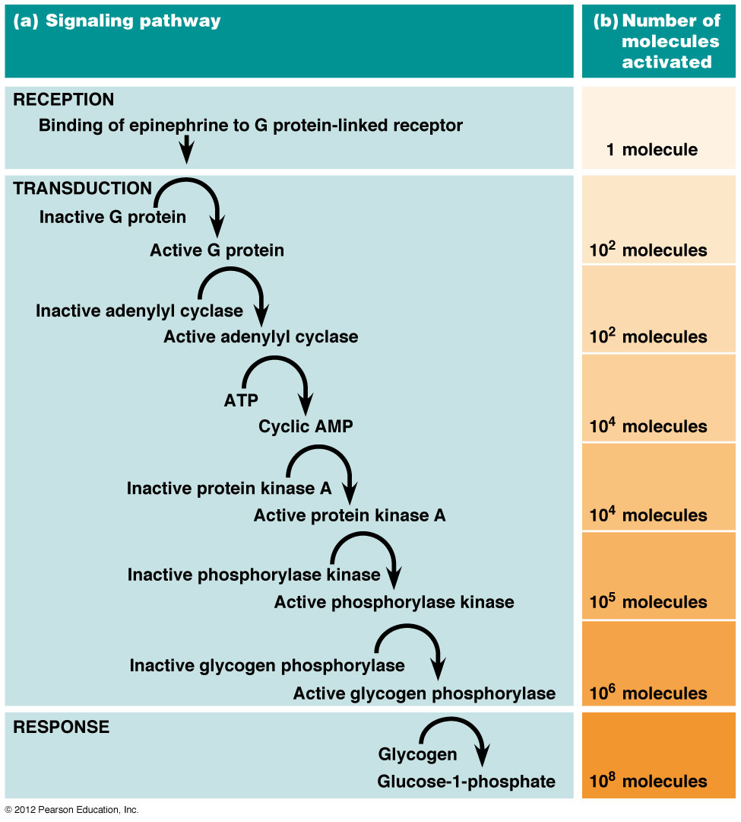
Signal amplification

Slide 22
Categories of receptors
Receptors can be classified into several basic categories
Ligand-gated channels (discussed in Chapter 13)
Plasma membrane receptors of two types
Those linked to G proteins
Those linked to protein kinases

Slide 23
G Protein-Linked Receptors
The G protein-linked receptor family is so named because ligand binding causes a change in receptor conformation that activates a particular G protein
G protein: guanine-nucleotide binding protein

Slide 24
Many Seven-Membrane Spanning Receptors Act via G Proteins
A portion of an activated G protein binds a target protein, altering its activity
A class of receptors of great clinical importance is the opioid receptors, to which narcotic drugs such as morphine bind

Slide 25
The Structure and Regulation of G Protein-Linked Receptors
G protein-linked receptors have a similar structure but quite different amino acid sequence
The receptor forms seven transmembrane α helices connected by alternating cytosolic or extracellular loops
The extracellular portion of each receptor has a unique messenger-binding site

Slide 26
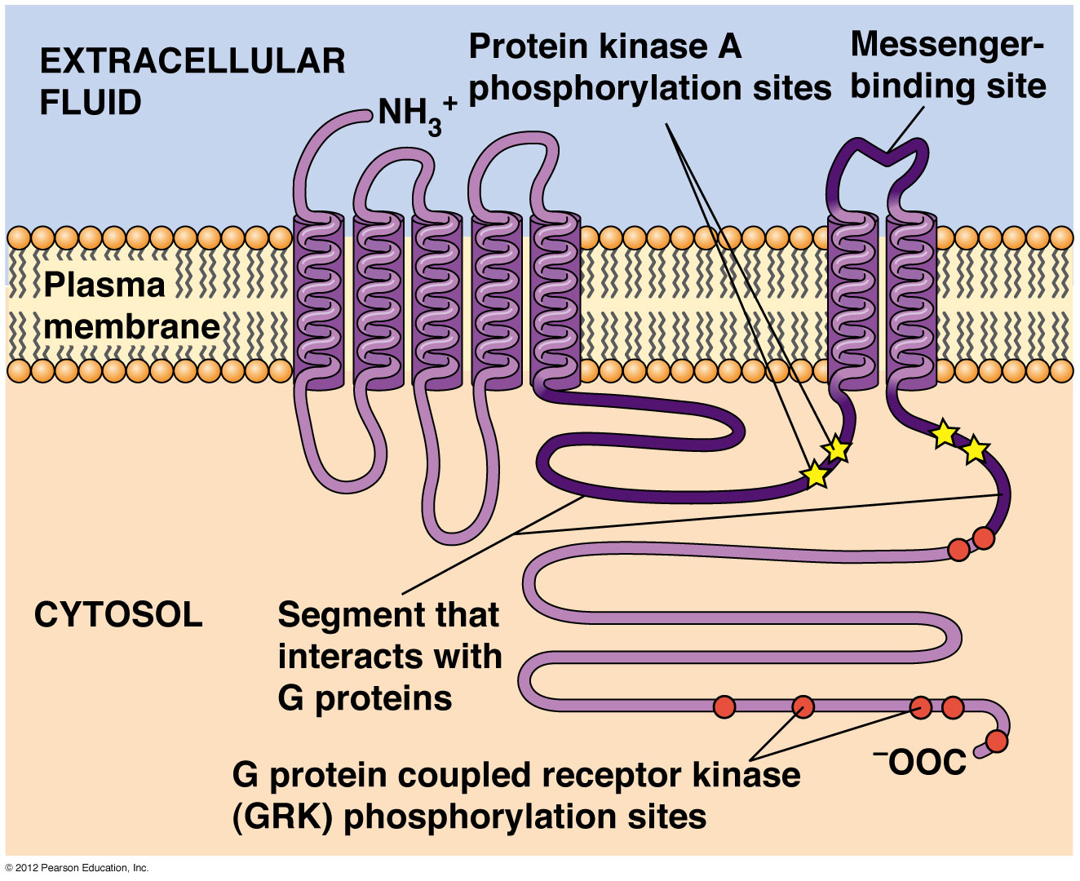
Structure of G Protein linked receptors

Slide 27
Regulation of G protein-linked receptors
G protein-linked receptors can be regulated in several ways
One is via phosphorylation of amino acids in the cytosolic domain, carried out by G protein-linked receptor kinases (GRKs), which act on activated receptors
β-arrestin binds phosphorylated β−adrenergic receptors and inhibits them

Slide 28
Protein kinase A
Protein kinase A (PKA) is activated by G protein-mediated signaling
PKA can phosphorylate other amino acids on the receptor and inhibit it
This is a good example of negative feedback during cell signaling

Slide 29
The Structure, Activation, and Inactivation of G Proteins
G proteins act like molecular switches whose on and off states depend on whether they are bound to GTP or GDP
There are large heterotrimeric G proteins and small monomeric G proteins
The heterotrimeric G proteins mediate signal transduction through G protein-linked receptors and have G_{α}, G_{β}, and G_{γ} subunits

Slide 30
G protein structure
G_{α} is the largest subunit of G_{αβγ}, and binds to GDP and GTP
When it binds to GTP it detaches from the G_{βγ} subunits which are permanently bound together
G_{s} are stimulators of signal transduction, G_{i} are inhibitors

Slide 31
G protein function
When a messenger binds to a G protein-linked receptor the resulting change in receptor conformation causes a G protein to associate with it and release its GDP
The G_{α} then binds a new GTP molecule and detaches from the complex
Either the G_{α} or the G_{βγ} initiates signal transduction depending on the G protein

Slide 32
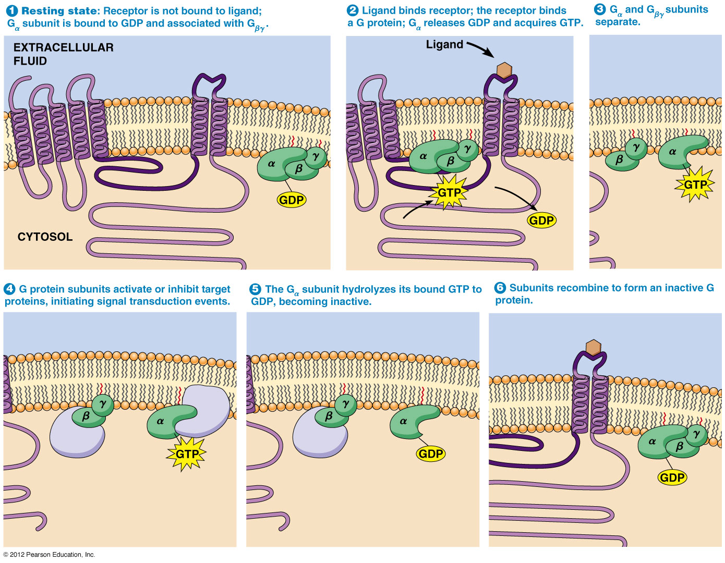
G Protein activation/inactivation cycle

Slide 33
G protein inactivation
G proteins remain active as long as the G_{α} subunit is bound to GTP and separate from the G_{βγ} subunit
Once the G_{α} subunit has hydrolyzed GTP to GDP, it reassociates with G_{βγ}
Some G_{α} proteins are not very efficient at GTP hydrolysis

Slide 34
Regulation of G proteins
G protein activity (for GTP hydrolysis) is greatly enhanced by regulators of G protein-signaling (RGS) proteins
These GTPase activating proteins (GAPs) are important regulators of G protein function
The most important G protein function is release or formation of second messengers

Slide 35
Cyclic AMP Is a Second Messenger Whose Production Is Regulated by Some G Proteins
Cyclic AMP (cAMP) is formed from cytosolic ATP by adenylyl cyclase, an enzyme that is anchored in the plasma membrane
The enzyme is inactive until bound to activated Gs_{α;} (by receptor-ligand stimulated acquisition of GTP and release from Gs_{βγ})
Gi_{α} inhibits adenylyl cyclase

Slide 36
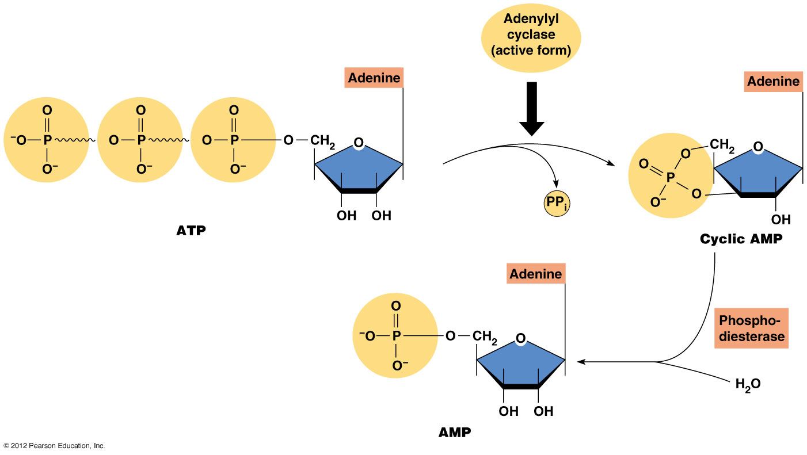
Structure & metabolism of cAMP

Slide 37
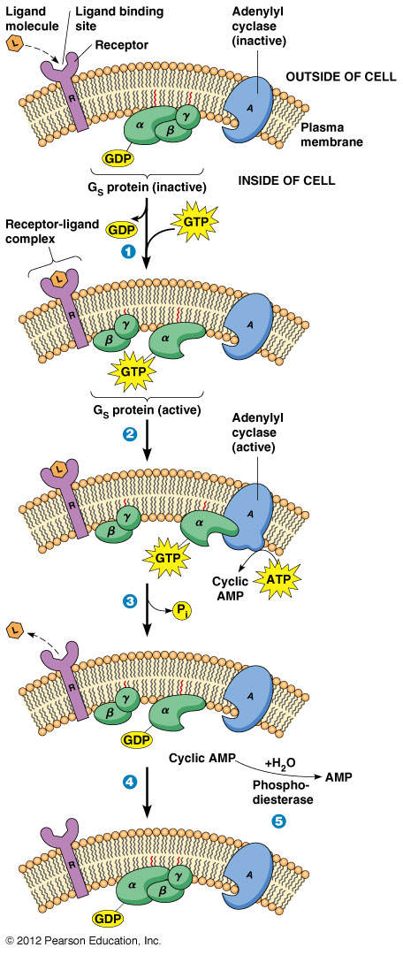
Roles of G protein & cAMP in signal transduction

Slide 38
G proteins are active only a short time
Because G proteins remain active for a very short time, they can respond quickly to changing conditions
Once a G protein becomes inactive, adenylyl cyclase stops making new cAMP
The cAMP that remains is degraded by phosphodiesterase

Slide 39
cAMP function
cAMP is important in many cellular events
Its main target is protein kinase A (PKA), which it regulates by separating the regulatory and catalytic subunits
PKA phosphorylates a variety of proteins on ser or thr residues, using ATP as the source of phosphate

Slide 40
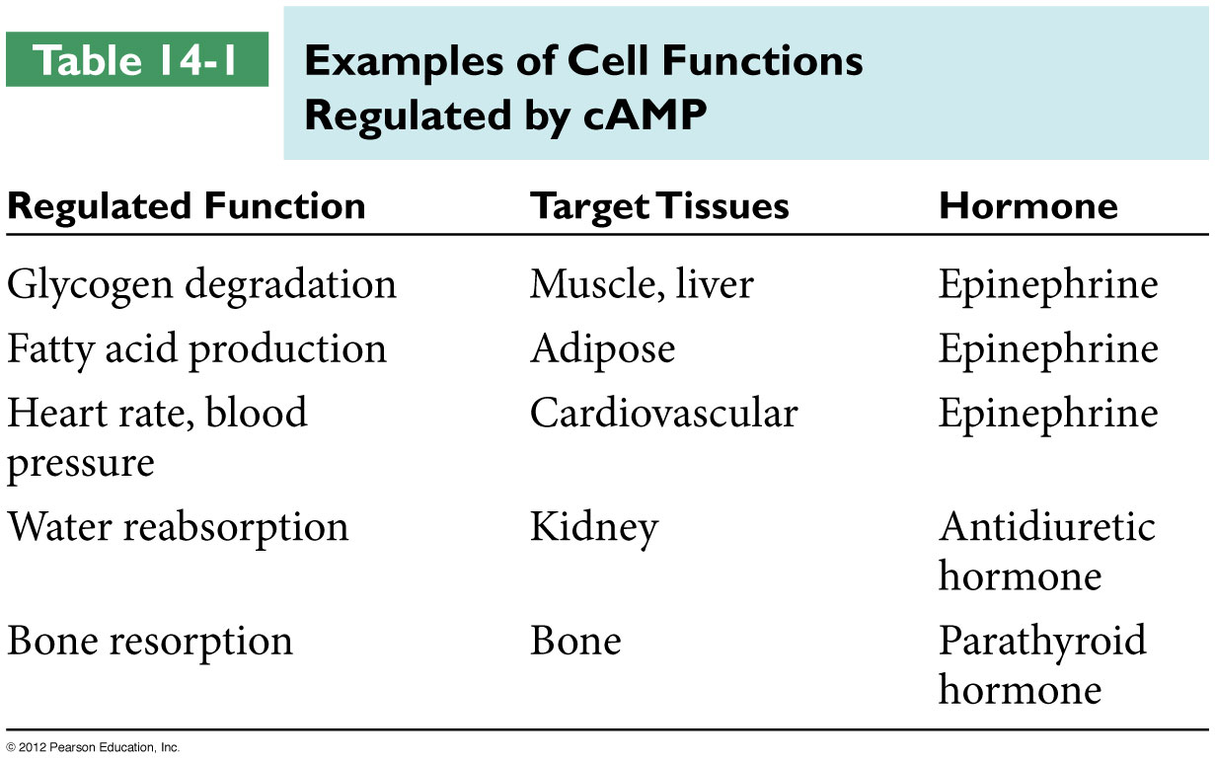

Slide 41
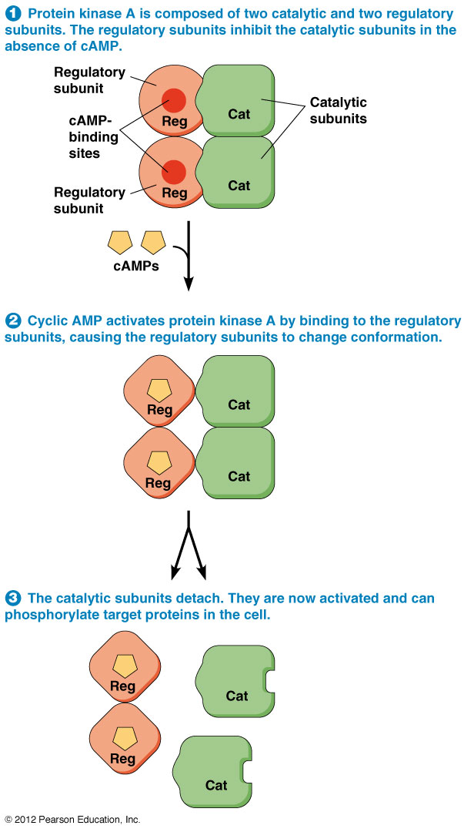
Activation of protein kinase A by cAMP

Slide 42
Signal Transduction Mechanisms:
Messengers & Receptors
(II)
Instructor: Dr. Mahmoud A. Srour
Course: Cell Biology 0202211
Reading:
Becker’s World of the Cell, 8th ed/ 2012.
Chap 14, p. 392-421.
Lec # 17 Sat 15.12.2012

Slide 43
Disruption of G Protein Signaling Causes Several Human Diseases
Some bacteria cause their diseases through their effects on heterotrimeric G proteins
Cholera: when Vibrio cholerae colonizes the gut it secretes cholera toxin; this toxin modifies Gs so that it cannot hydrolyze GTP
This alters secretion of salts and fluids in the intestine and can cause death by dehydration

Slide 44
G protein signaling and human diseases
Whooping cough: Bordetella pertussis secretes pertussis toxin that acts on Gi, so that it can no longer inhibit adenylyl cyclase
This causes an accumulation of fluid in the lungs and the persistent cough associated with the disease

Slide 45
Many G Proteins Use Inositol Trisphosphate and Diacylglycerol as Second Messengers
Inositol-1,4,5-trisphosphate (IP₃) functions as a second messenger
It is generated from PIP₂ (phosphatidylinositol-4,5-bisphosphate) when the enzyme phospholipase C is activated
It cleaves PIP₂ into IP₃ and diacylglycerol (DAG), both of which are second messengers in a variety of cellular events

Slide 46
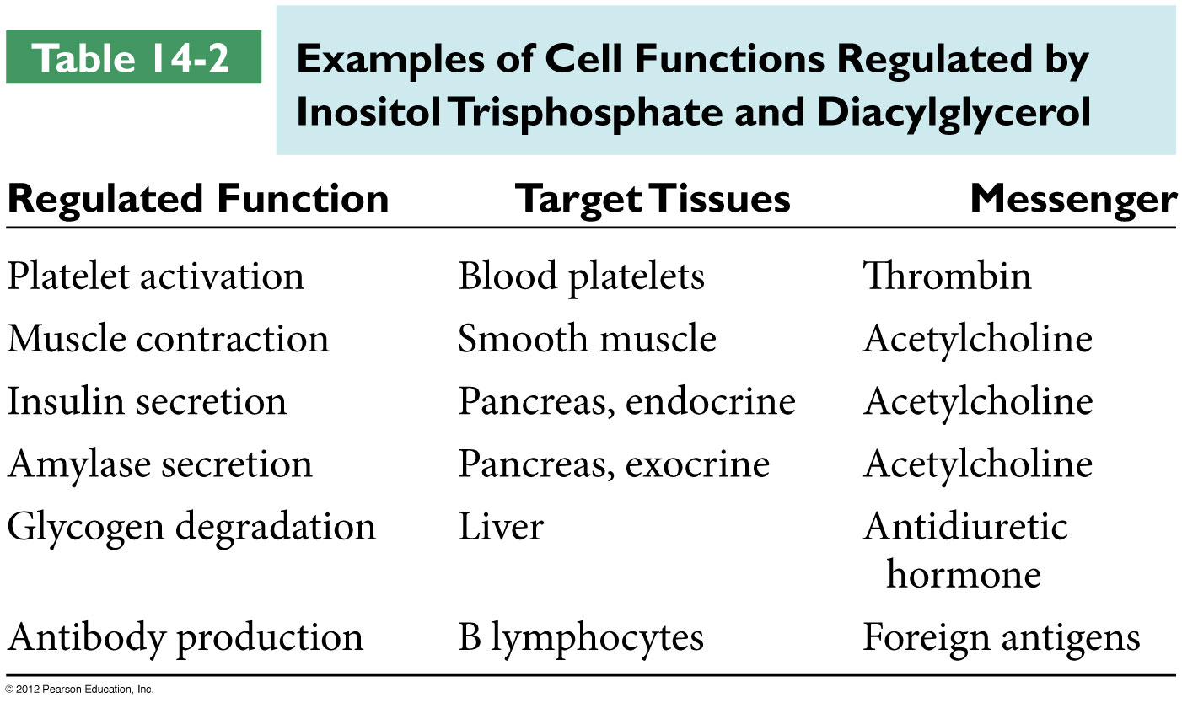

Slide 47
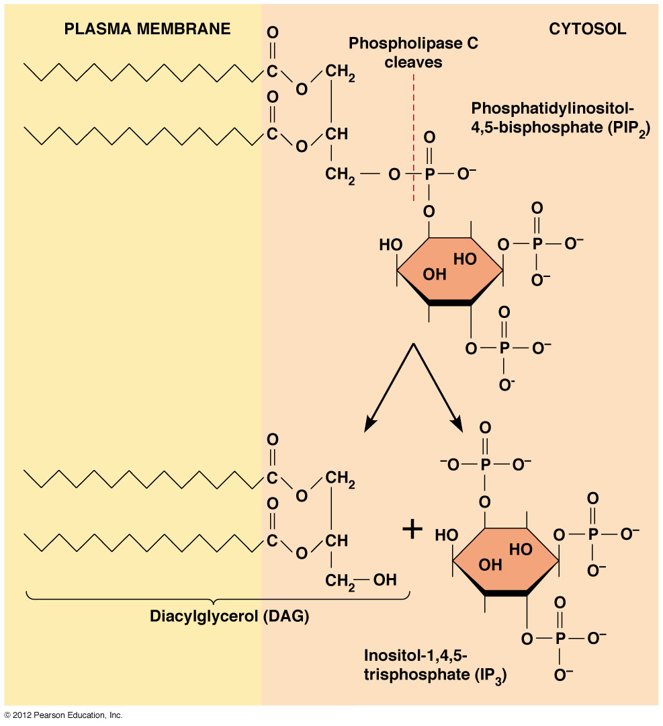
Formation of IP3 & DAG

Slide 48
IP₃ and diacylglycerol in signaling
A ligand binds its membrane receptor, leading to activation of a G protein, G_{q}
G_{q} activates a phospholipase C called C_{β}, generating both IP₃ and diacylglycerol
IP₃ diffuses through the cytosol and binds a ligand-gated calcium channel, the IP₃ receptor channel

Slide 49
IP₃ and diacylglycerol in signaling
When IP₃ binds the receptor, calcium is released into the cytosol
Calcium and diacylglycerol activate members of the protein kinase C (PKC) family, which then phosphorylate ser and thr residues on a variety of target proteins

Slide 50
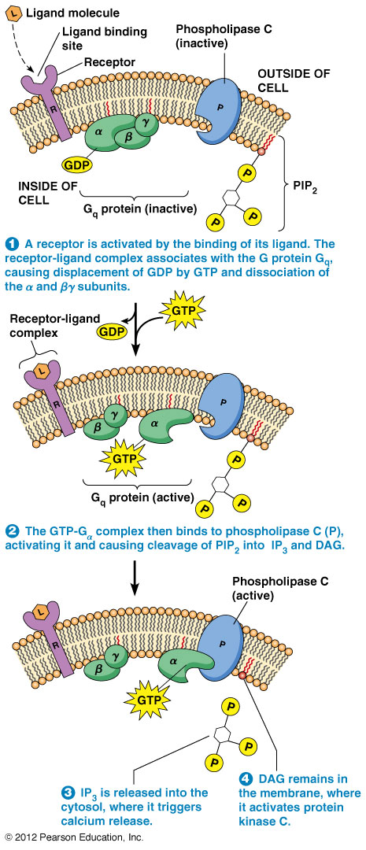
The role of IP₃ and diacylglycerol in signaling

Slide 51
The Release of Calcium Ions Is a Key Event in Many Signaling Processes
Calcium-sensitive fluorescent dyes (calcium indicators) can be used to demonstrate the importance of calcium release in signaling
Treating cells with calcium ionophores (renders membranes permeable to Ca++) results in the release of calcium in the absence of a stimulus, and further implicates calcium as an intermediary in IP₃ signaling

Slide 52
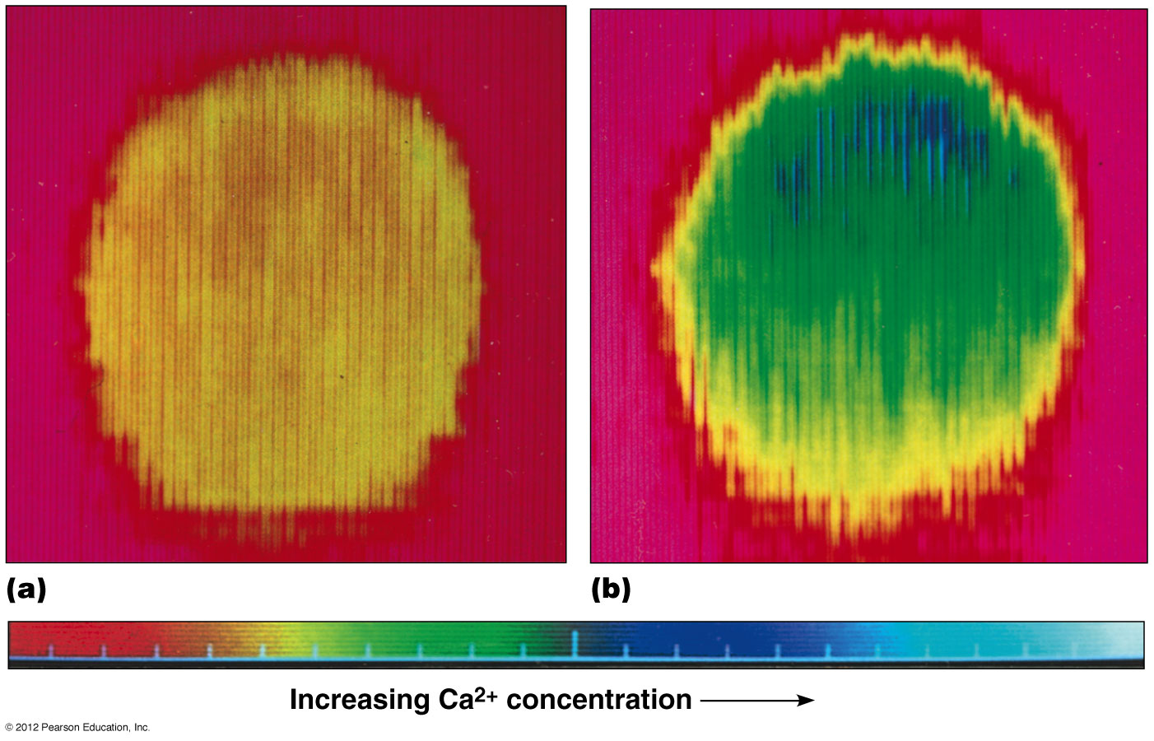
Increase in free cytosolic Ca²⁺ conc triggered by a hormone that stimulates the formation of IP3

Slide 53
Calcium in signaling
Ca²⁺ plays an essential role in regulating a variety of cellular functions
Calcium concentrations are maintained at low levels through calcium ATPases in the plasma membrane and ER; these transport calcium ions out of the cytosol

Slide 54
Calcium in signaling (continued)
Calcium concentrations can be released by opening calcium channels in the plasma membrane, as in neuronal signaling
Calcium can also be released from storage in the ER through the IP₃ receptor channel
The IP₃ receptor channel and the ryanodine receptor channels are sensitive to calcium

Slide 55
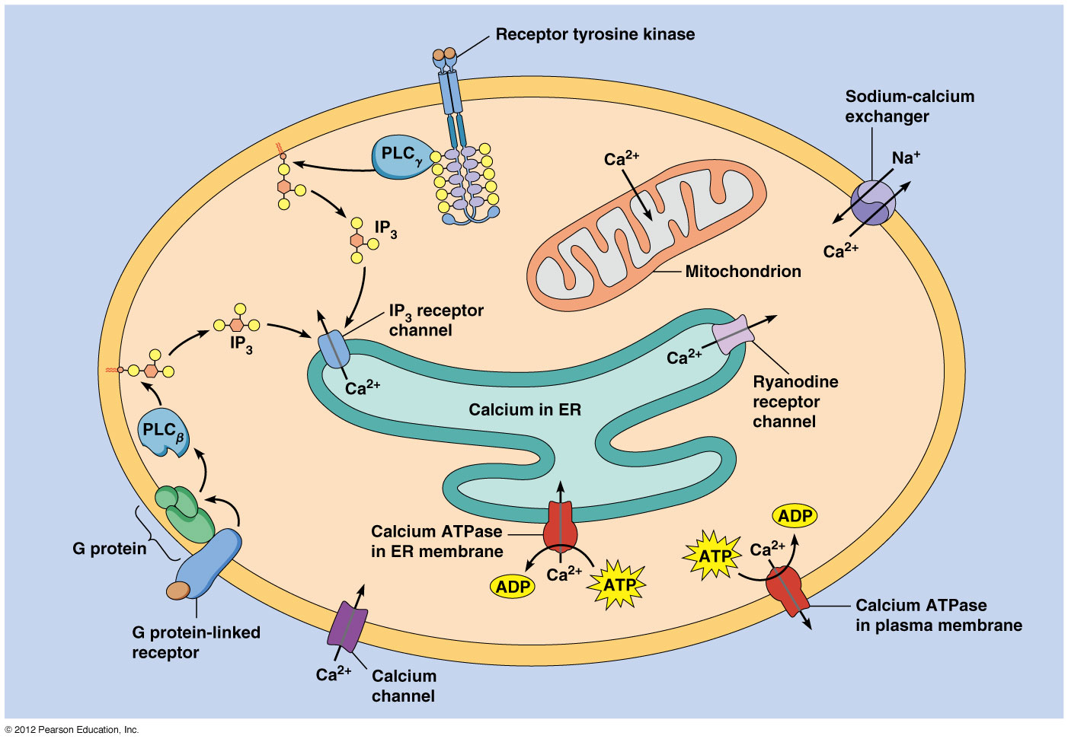
Overview of calcium regulation in cells

Slide 56
Calcium in signaling (continued)
A rapid increase in calcium ions can cause the ryanodine receptor channels to open, allowing calcium to enter the cytoplasm from the ER
This is termed calcium-induced calcium release

Slide 57
Calcium Release Following Fertilization of Animal Eggs
Animal sperm are activated by release of calcium
Activated sperm then bind to the surfaces of mature eggs and unite with them, triggering the release of Ca²⁺ from internal stores
Ca²⁺ release begins at the site of sperm entry then spreads across the egg surface like a wave

Slide 58
Transient increase in free Ca2+ conc that occurs in an egg cell immediately after fertilization

Slide 59
Roles of calcium in fertilization
Calcium release is necessary for two crucial events
It stimulates vesicles called cortical granules to release their contents and alter the properties of the vitelline envelope (slow block to polyspermy)
It induces egg activation, the resumption of metabolic processes and reorganization of egg contents, necessary for embryonic development to proceed

Slide 60
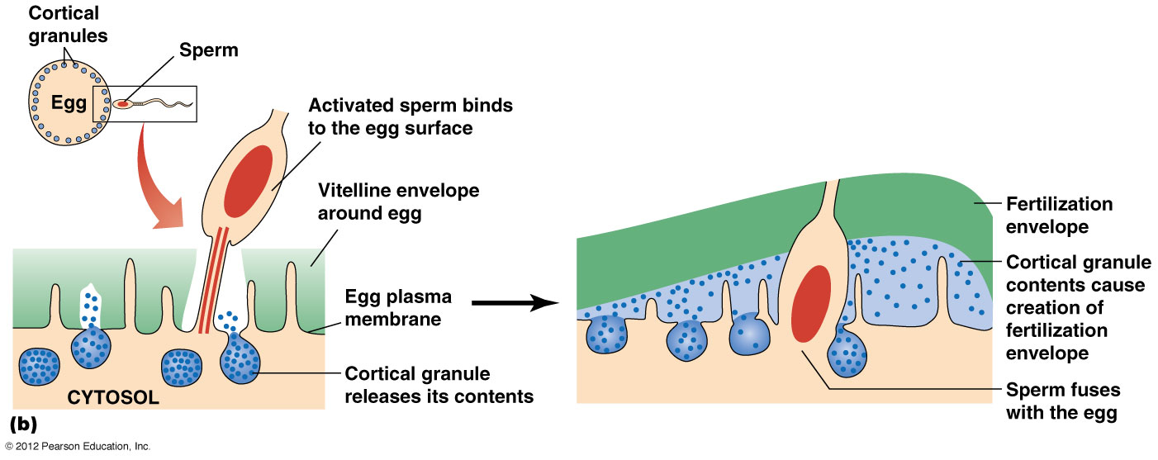
Roles of calcium in fertilization

Slide 61
Calcium Binding Activates Many Effector Proteins
Calcium can bind directly to effector proteins, altering their activity
The protein calmodulin mediates calcium-activated processes in the cell
Calmodulin has a structure like an arm with a hand at each end; each binds two Ca²⁺

Slide 62
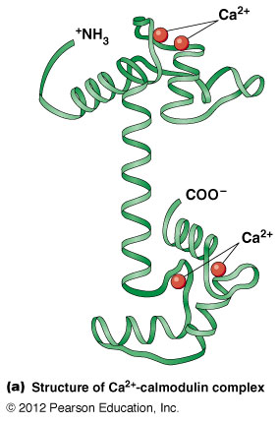

Slide 63
Calmodulin function
Two Ca²⁺ bind at each “hand” of calmodulin inducing a conformation change and forming the active calcium-calmodulin complex (1, 2)
In the presence of a protein with a calmodulin binding site, calmodulin binds it by wrapping around the binding site (3)
Calmodulin binding can dramatically alter the protein’s activity

Slide 64
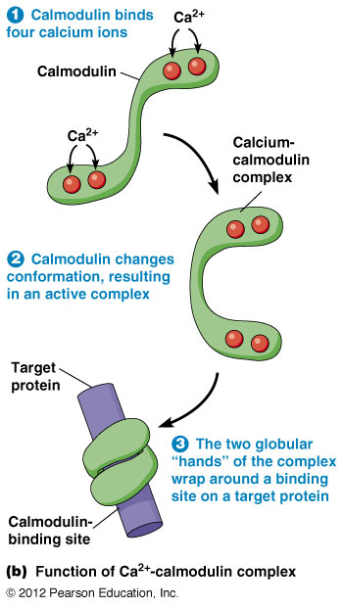

Slide 65
Protein Kinase-Associated Receptors
Protein kinase-associated receptors are not only receptors, but also function as kinases
Ligand binding stimulates their kinase activities
Signaling of these receptor protein kinases is transmitted through a phosphorylation cascade
Kinases are either tyrosine kinases or serine/threonine kinases

Slide 66
Growth Factors Often Bind Protein Kinase-Associated Receptors
For cells to divide they need enough nutrients for growth and signals to stimulate cell growth
Cultured cells in vitro will not grow, even with enough nutrients, unless blood serum is provided
Messengers in the serum that stimulate growth are called growth factors

Slide 67
Components of blood plasma and serum
Plasma is whole blood including platelets (which contain clotting components) but without red and white blood cells
Plasma cannot support cell growth
Serum is the clear fluid remaining after blood has clotted, during which the platelets secrete growth factors

Slide 68
Platelet-derived growth factor
The growth factors secreted by platelets stimulate fibroblasts to form new connective tissue
The serum that remains after clotting contains large amounts of platelet-derived growth factor (PDGF)
The receptor for PDGF is a receptor tyrosine kinase

Slide 69
Receptor tyrosine kinases
Several growth factors stimulate receptor tyrosine kinases
Insulin
Insulin-like growth factor-1
Fibroblast growth factor
Epidermal growth factor
Nerve growth factor

Slide 70
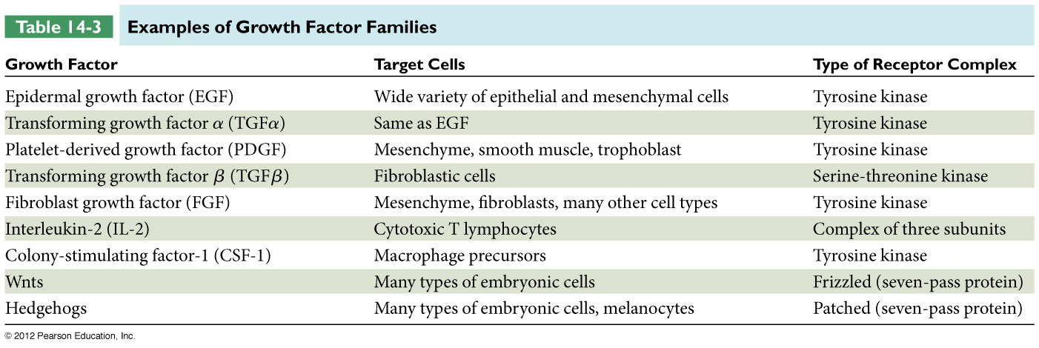

Slide 71
Receptor Tyrosine Kinases Aggregate and Undergo Autophosphorylation
Many receptor tyrosine kinases (RTKs) trigger a chain of events in the cell that culminate in cell growth, proliferation, or specialization

Slide 72
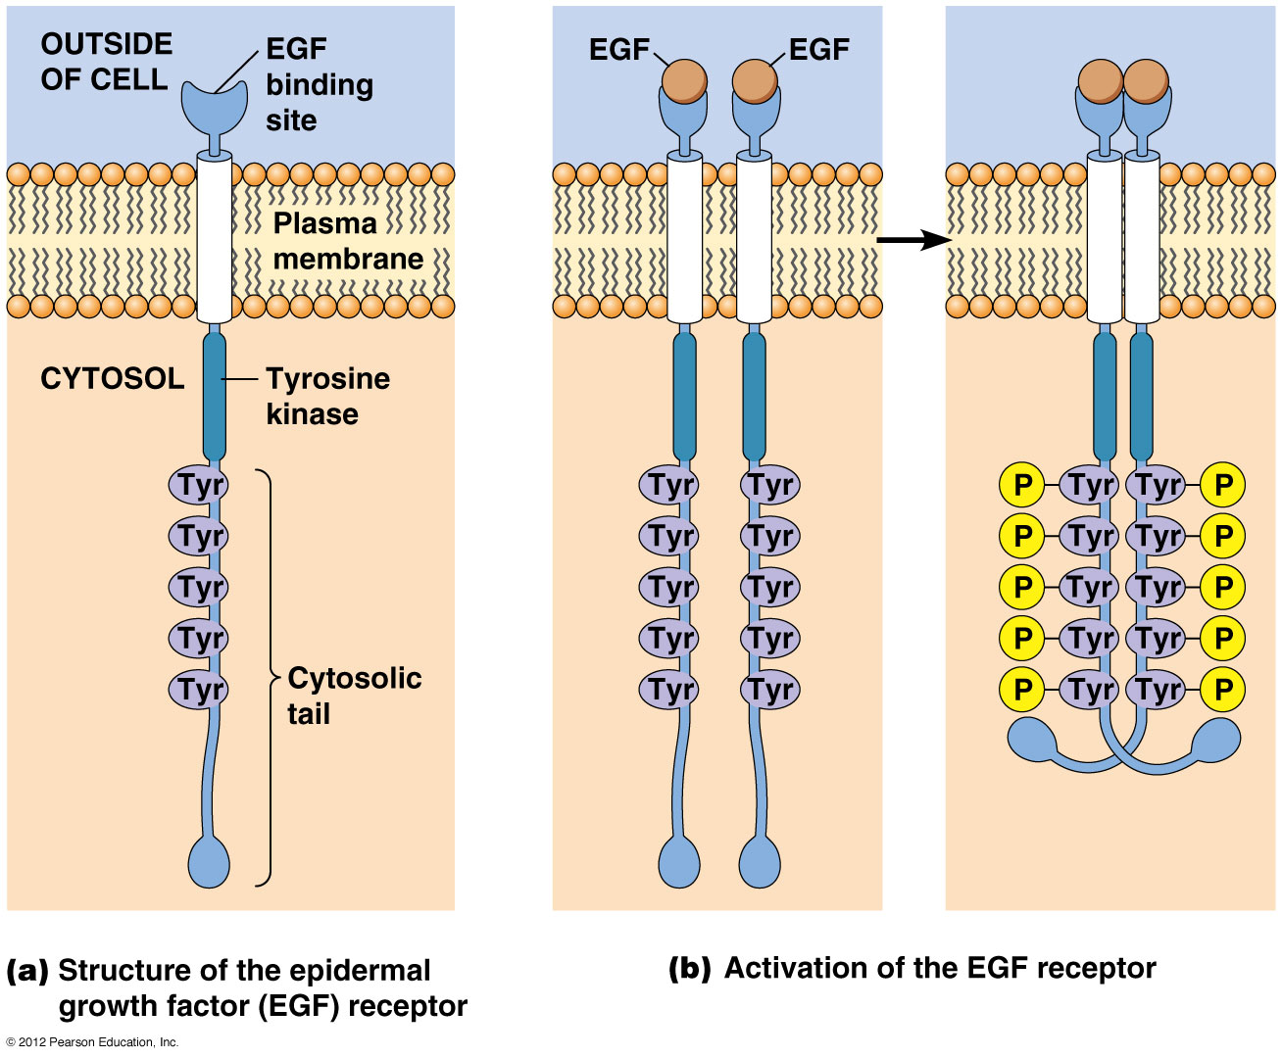

Slide 73
The Structure of Receptor Tyrosine Kinases
Receptor tyrosine kinases often consist of a single polypeptide chain with just one transmembrane segment
The extracellular part of the receptor contains the ligand-binding domain
On the cytosolic side is the tyrosine kinase domain

Slide 74
Structure of receptor tyrosine kinases
Sometimes the receptor and tyrosine kinase are two separate proteins
In this case the nonreceptor tyrosine kinase binds to the receptor and is activated in response to ligand binding
E.g., Src was the first nonreceptor tyrosine kinase discovered

Slide 75
The Activation of Receptor Tyrosine Kinases
Signal transduction is initiated upon ligand binding that causes aggregation of receptor tyrosine kinases
In some cases, receptors dimerize upon ligand binding, and phosphorylate each other
Because they phosphorylate the same type of receptor as themselves, this is called autophosphorylation

Slide 76
RTKs Initiate a Signal Transduction Cascade Involving Ras and MAP Kinase
Once autophosphorylation of the receptors occurs the receptor recruits cytosolic proteins (1)
The cytosolic proteins have amino acid stretches (domains) that recognize the phosphotyrosine and nearby residues on the receptor
One such domain is called the SH2 domain because the residues are similar to sequences on Src (SH = Src Homology)

Slide 77
Signal transduction through RTKs

Slide 78
End

Slide 82
Hormone Signaling
Plants and animals use secreted chemical signals called hormones to coordinate the function of cells and tissues over long distances
Hormones differ in many ways
Animal hormones are better understood than plant hormones

Slide 83
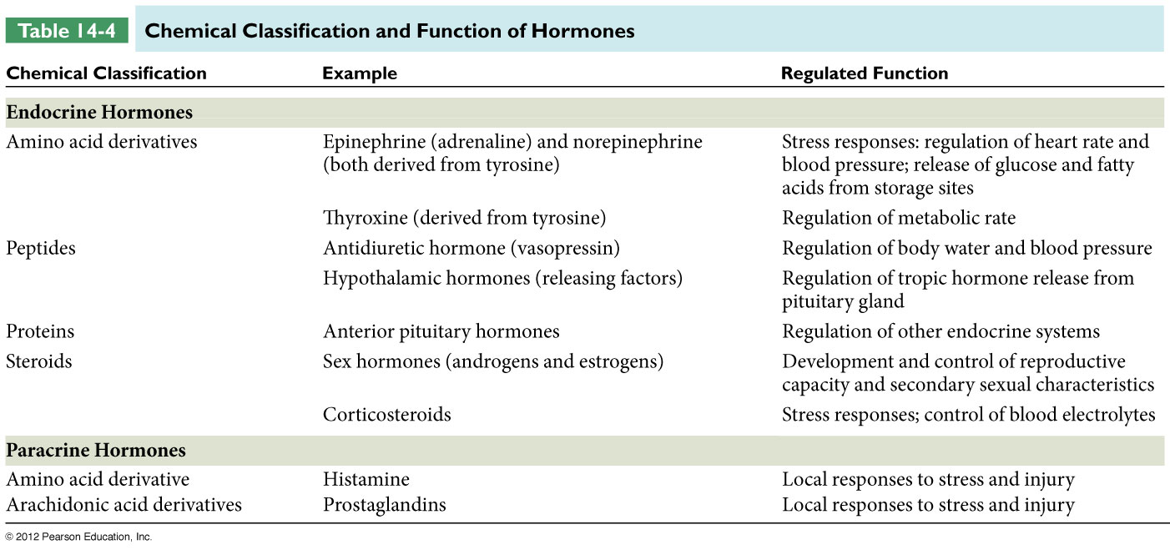

Slide 84
Hormones Can Be Classified by the Distance They Travel and by Their Chemical Properties
Endocrine hormones travel from sending to receiving cells via the circulatory system
They are synthesized by endocrine tissues and are secreted directly into the bloodstream, with a life span ranging from a few seconds to many hours
As they circulate, they encounter their receptors in target tissues

Slide 85
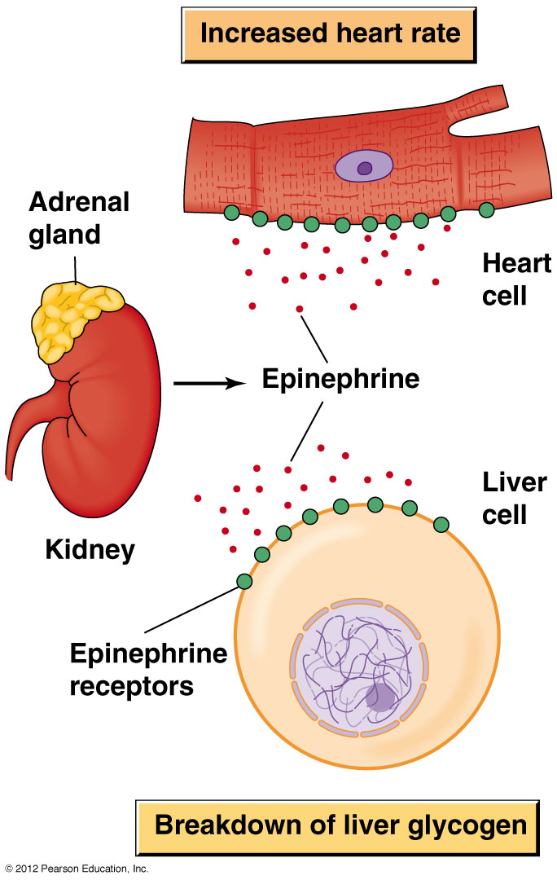

Slide 86
Chemical classification of endocrine hormones
Endocrine hormones fall into four categories
Amino acid derivatives (e.g., epinephrine)
Peptides (e.g., vasopressin)
Proteins (e.g., insulin)
Lipid-like hormones such as steroids (e.g., testosterone)

Slide 88
Signal Transduction
Signal Transduction is defined as the ability of a cell to change behaviour in response to a receptor-ligand interaction.
The ligand is the primary messenger.
As the result of binding the receptor, other molecules or second messengers are produced within the target cell.
Second messengers relay the signal from one location to another (such as from plasma membrane to nucleus).
Often a cascade of changes occur within the cell which results in a change in the cell’s function or identity.

Slide 89
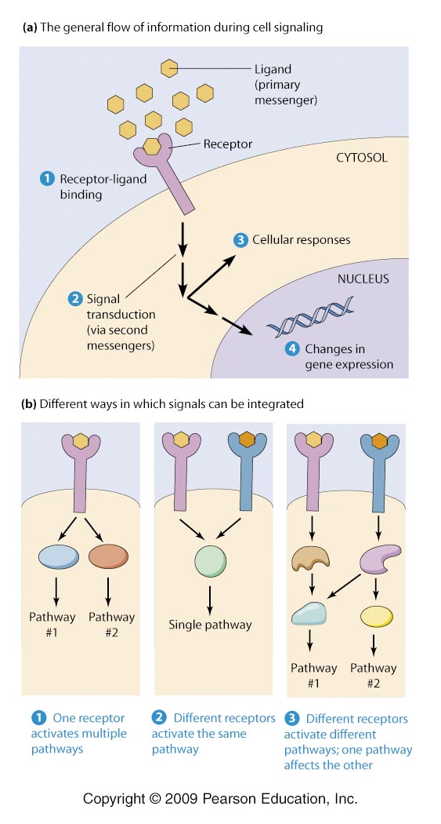

Slide 90
Signal Transduction Pathway
The signal transduction pathway can act to amplify the cellular response to an external signal.
Messenger molecules may be amino acids, peptides, proteins, fatty acids, lipids, nucleosides or nucleotides.
Hydrophilic messengers bind to cell membrane receptors.
Hydrophobic messengers bind to intracellular receptors which regulate expression of specific genes.

Slide 91
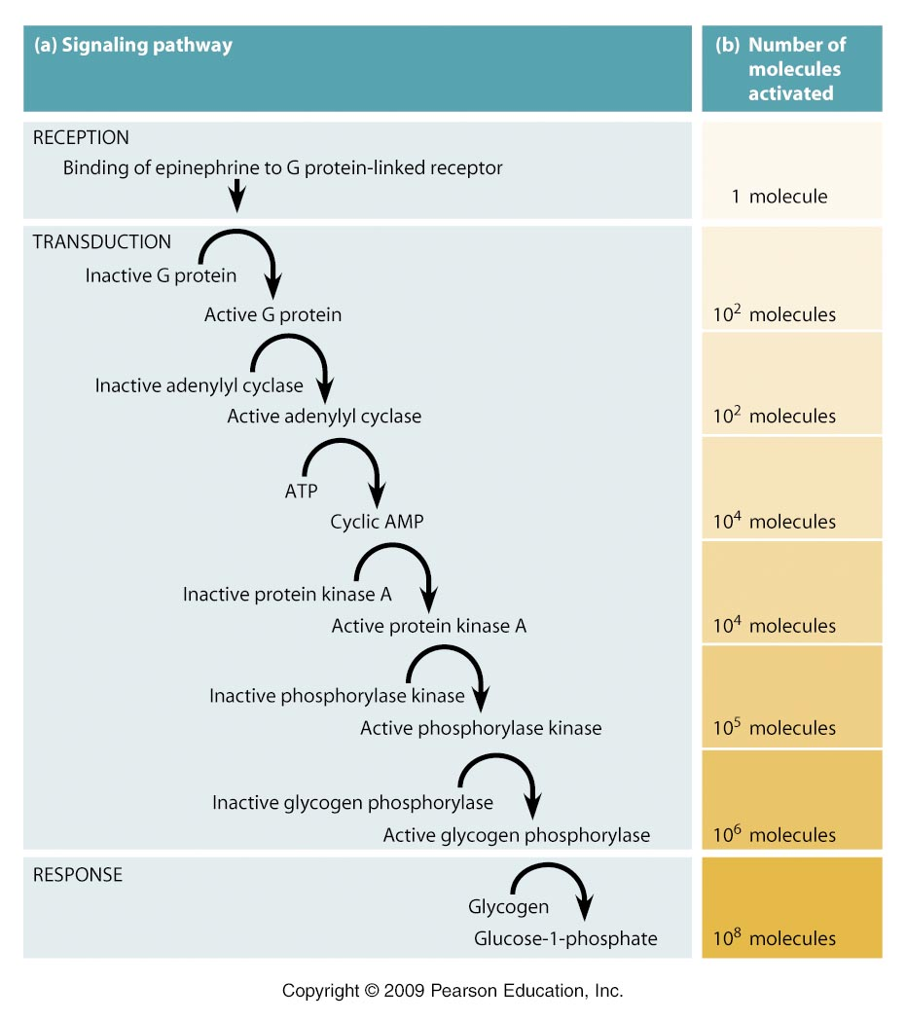

Slide 92
A ligand binds its receptor through a number of specific weak non-covalent bonds by fitting into a specific binding site.
In situations where even low concentrations of a ligand will result in binding of most of the cognate receptors, the receptor affinity is considered to be high.
Low receptor affinity occurs when a high concentration of the ligand is required for most receptors to be occupied.
The dissociation constant (Kd,) is the concentration of ligand required to occupy one half of the total available receptors.
This measurement of receptor affinity is often in the range of 10⁻⁴ to 10⁻⁹ mM.

Slide 93
With prolonged exposure to a ligand (and occupation of the receptor) cells often become desensitized.
Desensitization of the cell to a ligand depends upon receptor down-regulation by either 1) removal of the receptor from the cell surface (receptor-mediated endocytosis) or 2) alterations to the receptor that lower the affinity for ligand or that render it unable to initiate the changes in cellular function (such as phosphorylation).
Desensitization may lead to tolerance, a phenomenon that results in the loss of medicinal effectiveness of some medicines that are over prescribed.
Receptor binding activates a "preprogrammed" sequence of signal transduction events that make use of previously dormant cellular processes.

Slide 94
G Proteins
Activiated G Proteins bind to enzymes or other proteins and alter the target protein’s activity.
G Proteins are guanine-nucleotide binding proteins.
G Protein-linked Receptors have an extracellular N-terminus and a cytosolic C-terminus separated by seven transmembrane alpha helices connected by peptide loops.
One of the extracellular segments has an unique messenger-binding site.
The cytosolic loop between the 5th and 6th alpha helices specifically binds a particular G protein.

Slide 95
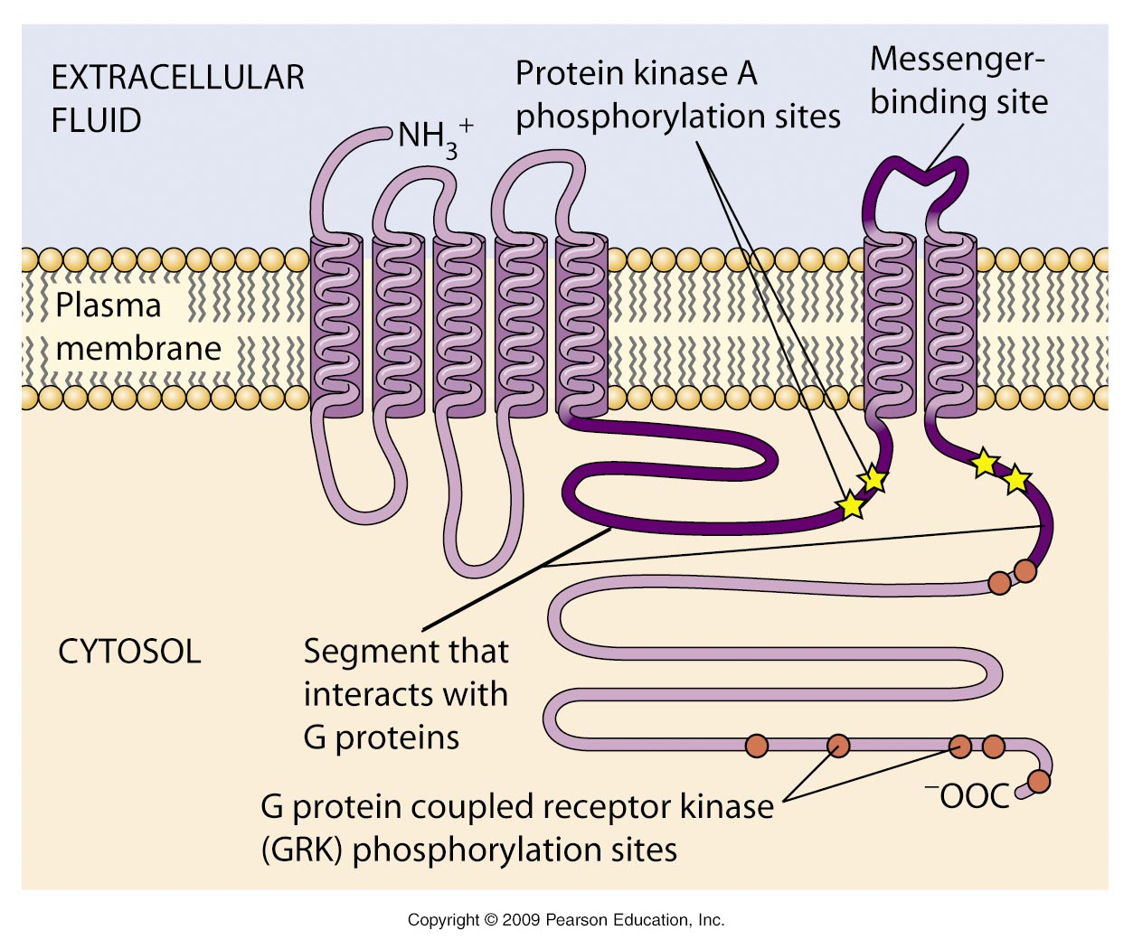

Slide 96
G Proteins bound to GTP are active, those bound to GDP are not.
The two classes of G Proteins are large heterotrimeric G Proteins and small monomeric G Proteins.
In heterotrimeric G proteins (G alpha, beta, gamma), when a messenger binds the G Protein-linked receptor, the receptor changes conformation to allow association of the trimeric G Protein with the receptor.
G-alpha subunit binds the guanine nucleotide (GDP or GTP).

Slide 97
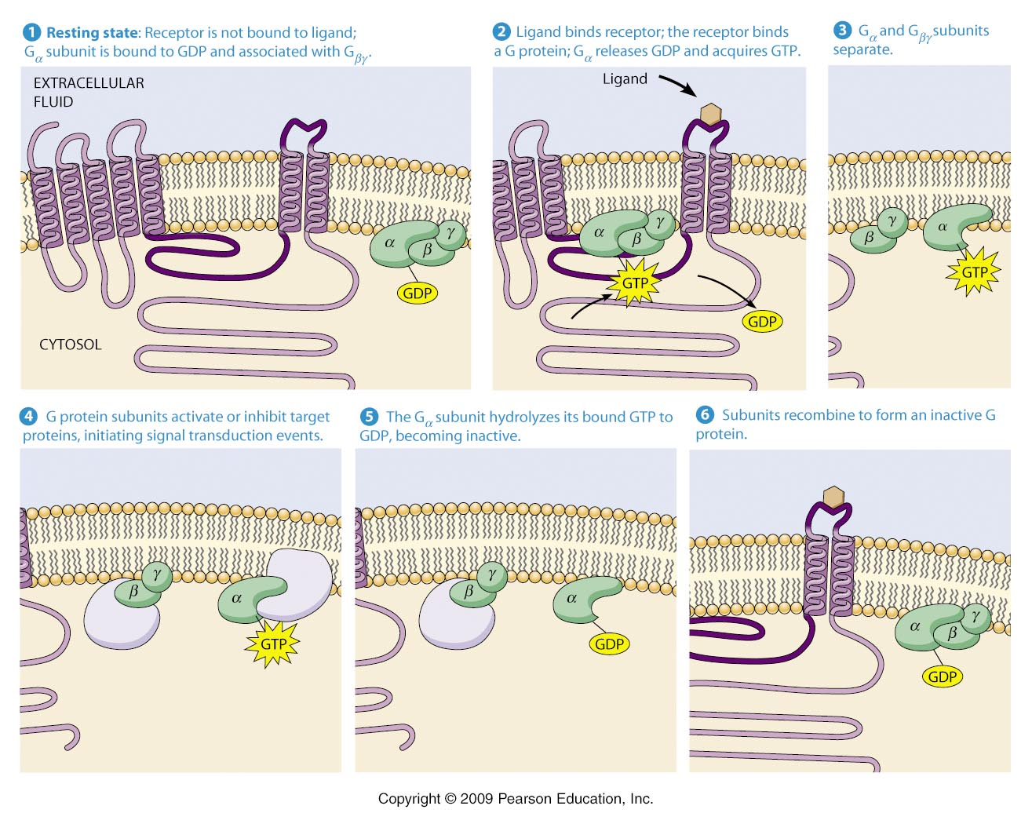

Slide 100
This interaction causes the G alpha subunit to release the GDP, pick up a GTP and detach from the complex.
Depending upon the G protein in question, either the GTP-G alpha complex, the G beta- G gamma complex or both bind target protein(s).
The G alpha will remain an activating messenger until the GTP is hydrolyzed by the G alpha subunit (GTP -> GDP +Pi).
The "inactive" GDP-G alpha will then reassociate with the G-beta-G alpha complex to rapidly turn down this pathway when the original stimulatory signal is removed.

Slide 101
Large numbers of G proteins provide diversity for signal transduction events.
Some bind potassium or calcium ion channels in neurotransmitters.
Some activate kinases (enyzmes that phosphorylate).
Some cause either the release or formation of major second messengers such as cyclic AMP (cAMP) and calcium ions.
Cyclic AMP is a second messenger used by a major class of G proteins.
Cyclic AMP (cAMP) is generated by adenylyl cyclase which is embedded in the plasma membrane with the enzymatic activity in the cytoplasm.

Slide 102
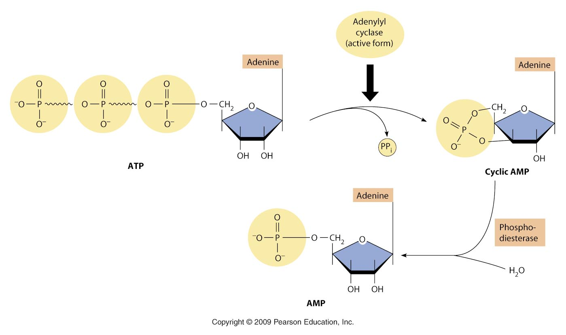

Slide 103
Adenylyl cyclase is activated by binding an activated alpha subunit of the Gs G-protein (GTP-Gs).
Phosphodiesterase continally degrades cAMP so in the absence of the ligand and active G-Protein, cAMP levels are reduced.
Protein kinase A (PKA), a cAMP-dependent kinase, is the main intracellular target of cAMP.
PKA phosphorylates a number of proteins that bear the key short stretch of amino acids, the PKA phosphorylation site (PKA PO4 site).
PKA transfers a phosphate from the ATP to a serine or threonine in the PKA PO4 site. cAMP activates the catalytic subunits by causing the release of the negative regulatory subunits.

Slide 105
Disruption of G Protein signaling causes several human diseases.
Vibrio cholerae (causes cholera) secretes the cholera toxin which alters salt and fluid in the intestine normally controlled by hormones that activate Gs G-Protein to increase cAMP.
The cholera toxin enzymatically changes Gs so that it is unable to convert GTP to GDP.
Gs can not then be inactivated and cAMP levels remain high causing intestinal cell to secrete salt and water.
Eventually dehydration can lead to death (cholera).

Slide 106
Many G proteins use inositol triphosphate and diacylglyceral as second messengers G Protein-linked Receptor.
The Gp G-Protein is activated by a ligand binding its G Protein-linked receptor to activate phospholipase C.
Phosphatidylinositol-4,5-bisphosphate (PIP2) is cleaved by phospholipase C into two molecules cytosolic inositol-1,4,5-triphosphate (InsP3) and membrane-bound diacylglycerol (DAG).

Slide 107
The InsP3 receptor, a ligand-gated calcium channel in the endoplasmic reticulum, binds InsP3 and calcium ions are released into the cytosol.
Calcium binds a protein known as calmodulin, and the Ca-calmodulin complex act to activate an number of processes.
DAG remains membrane-bound and activates protein kinase C (PKC).

Slide 108
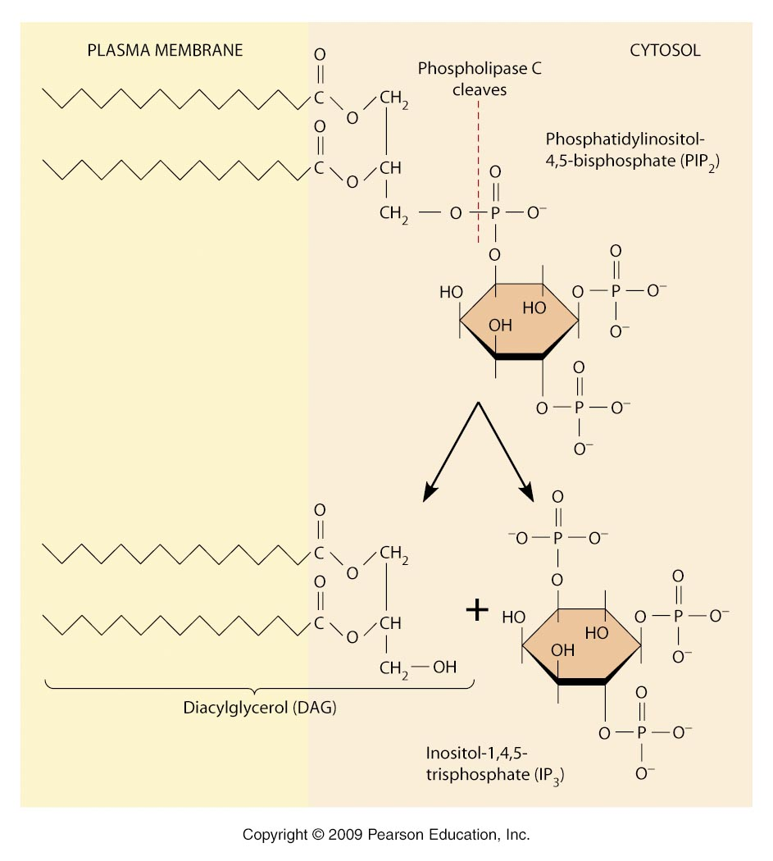

Slide 109
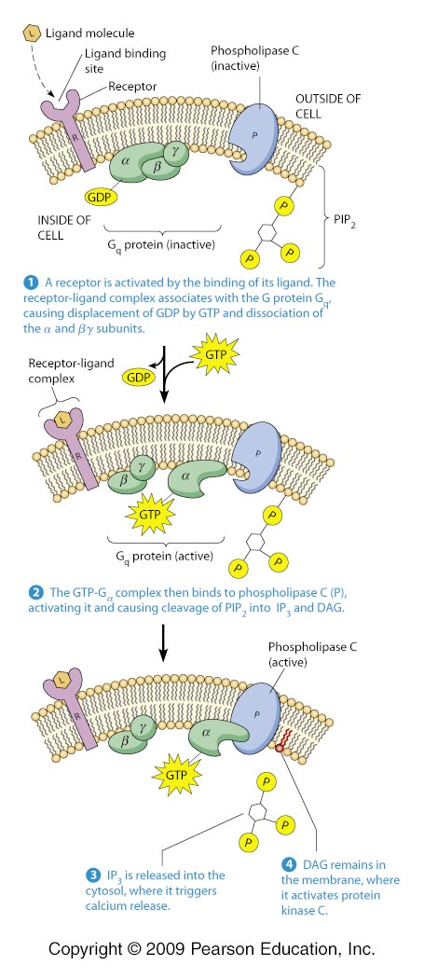

Slide 110
Calcium as a signal
The release of calcium ions is a key event in many signaling processes.
Intracellular concentrations can be followed by injection of calcium indicator fluorescent dyes.
Presence of ligand or increase in InsP3 and monitoring the increase in fluorescence
The calcium ionophore releases calcium from the intracellular stores that mimics effect of InsP3 activation.
Calcium ions act to regulate many cellular functions.

Slide 111
Calcium levels in the cytoplasm is normally kept low (10-4) by calcium pumps in the plasma membrane (out of the cell) and by sodium-calcium exchangers
a) out of the cell,
b) into the endoplasmic reticulum (ER) lumen and
c) into the mitochondrion.
Calcium stores can be released from the ER by the InsP3 receptor channel and ryanodine receptor channel which opens in the presence of calcium itself (calcium-induced calcium release).

Slide 112
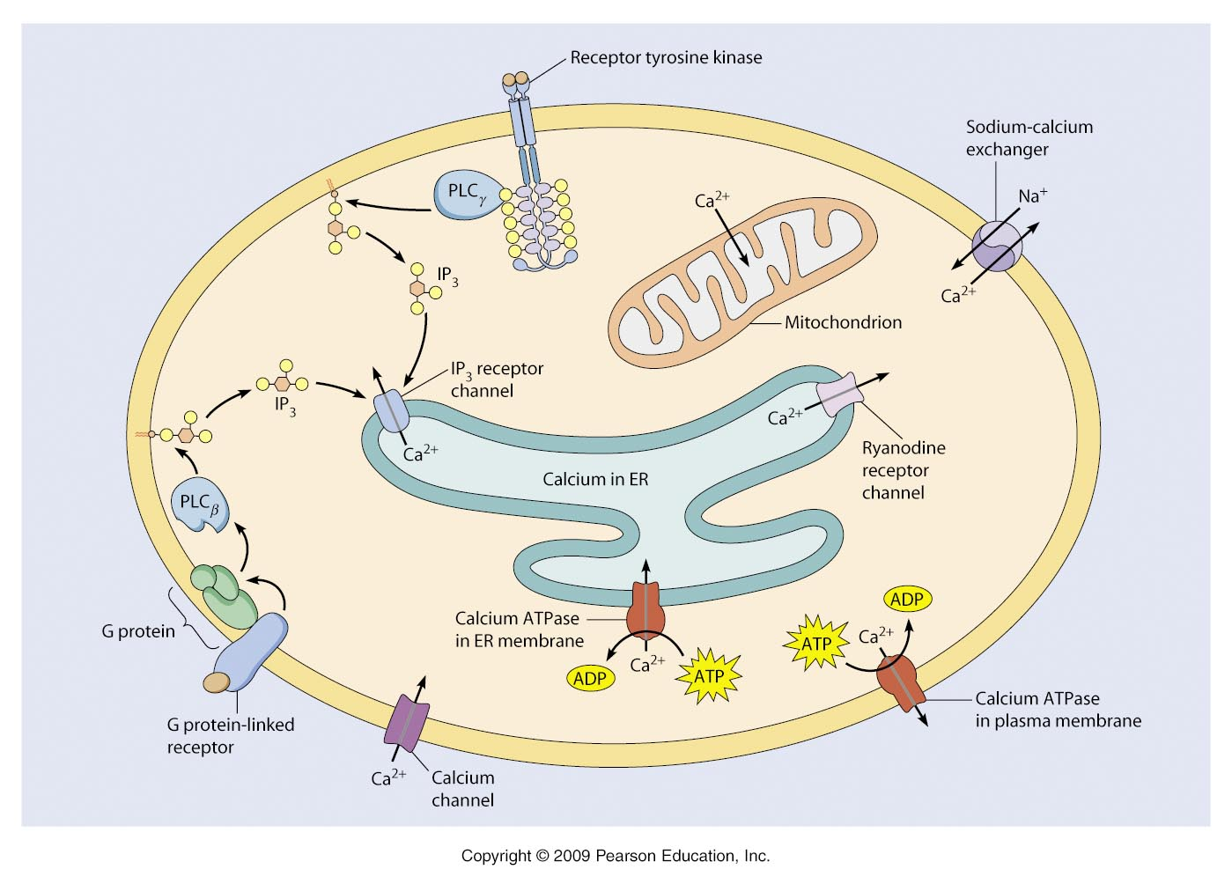

Slide 113
Although other proteins bind calcium to control activity, most often binding to the protein calmodulin, to form a calcium-calmodulin complex, is an intermediate step.
When calcium ions are present, two bind each globular end (4 in total), the helical arm region then changes conformation (the active complex) and then the wraps around the calmodulin-binding site of target proteins.
These are often protein kinases and protein phosphatases which vary depending upon the target cell (different cells have different responses).

Slide 115
Fertilization of animal eggs reveals an important example of calcium-mediated signal transduction after a receptor-ligand interaction.
Initially the sperm binds the egg’s surface at the membrane and within 30 seconds, a wave of calcium release spreads from the site of sperm contact.
Two main events in fertilization rely on calcium release. 1) Calcium stimulates the fusion of the cortical granules with the egg’s plasma membrane to alter the coat surrounding the egg to help prevent the binding of another sperm cell to the egg (slow block to polyspermy). 2) Calcium initiates egg activation, the resumption of metabolic processes.

Slide 116
