Slide 1
Transport Across Membranes: Overcoming the Permeability Barrier
Instructor: Dr. Mahmoud A. Srour
Course: Cell Biology 0202211
Reading:
Becker’s World of the Cell, 8th ed/ 2012.
Chap 8, p. 194-223.
Lec # 12 Sat 10.11.2012

Slide 2
Cells and transport processes
Small organic molecules and ions move through the membrane by special processes
The solute concentration is usually higher inside the cell than outside – need to overcome the concentration gradient
Transport will be selective
20% of E coli genome is for transport proteins
A central aspect of cell function is selective transport, the movement of ions or small organic molecules (metabolites; components of metabolic pathways)

Slide 3
Transport is central to cell function
A central aspect of cell function is selective transport, the movement of ions or small organic molecules (metabolites; components of metabolic pathways)

Slide 4
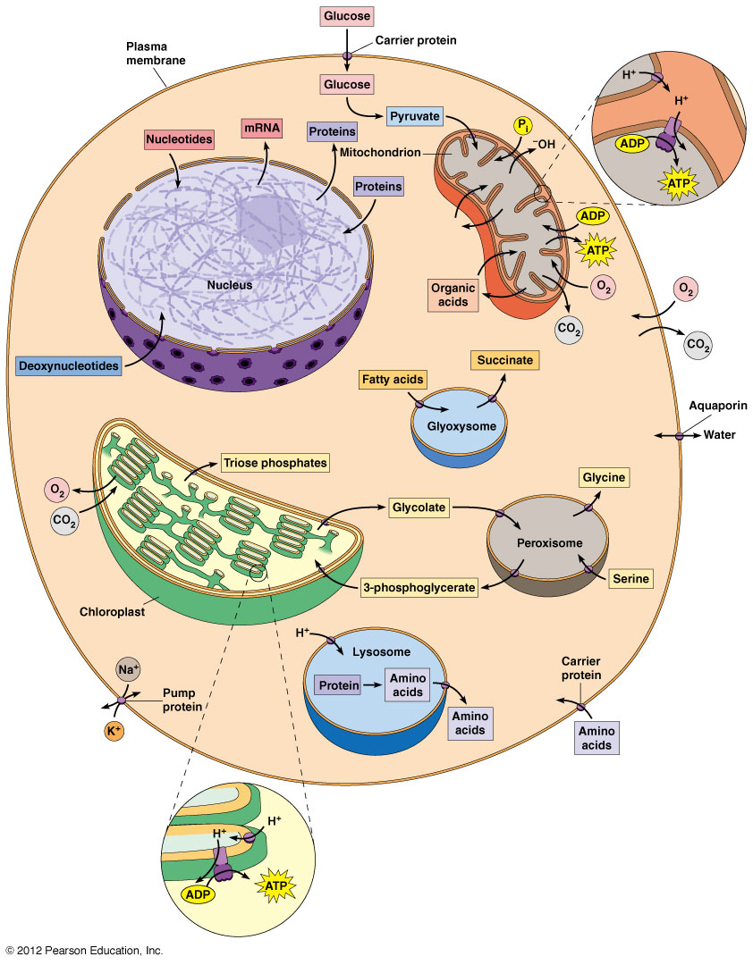
Transport processes within a composite eukaryotic cell

Slide 5
Three mechanisms of solute transport across membrane
Simple diffusion
direct, unaided movement
High to low concentration movement
O₂, CO₂, and EtOH
Facilitated diffusion
Transport protein move molecules down the concentration or charge gradient or both
Speeds up the movement
Active transport
Requires energy to move molecules against the concentration gradient
ATP or another solute (H⁺ or Na⁺) to move the molecule

Slide 6
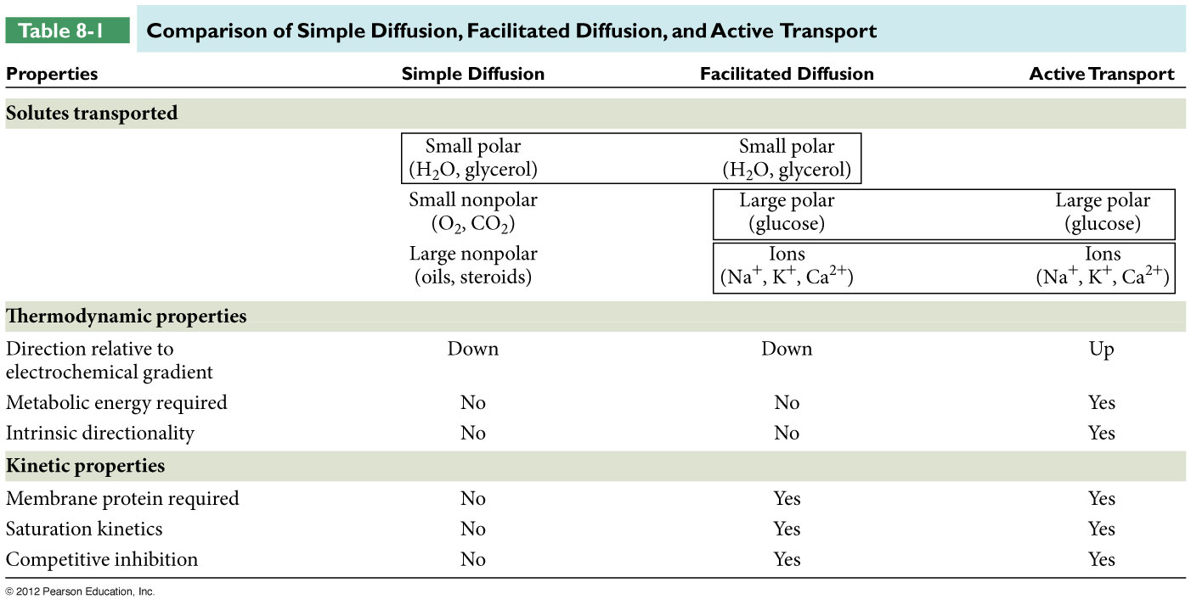
Three mechanisms of solute transport across membrane

Slide 7
Movement of a Solute Across a Membrane
The movement of a molecule that has no net charge is determined by its concentration gradient
Simple or facilitated diffusion involve exergonic movement “down” the concentration gradient (negative DG)
Active transport involves endergonic movement “up” the concentration gradient (positive DG)

Slide 8
The electrochemical potential
The movement of an ion is determined by its electrochemical potential, the combined effect of its concentration gradient and the charge gradient across the membrane
The active transport of ions across a membrane creates a charge gradient or membrane potential (V_{m}) across the membrane. One side of the membrane is positive and the other is negative

Slide 9
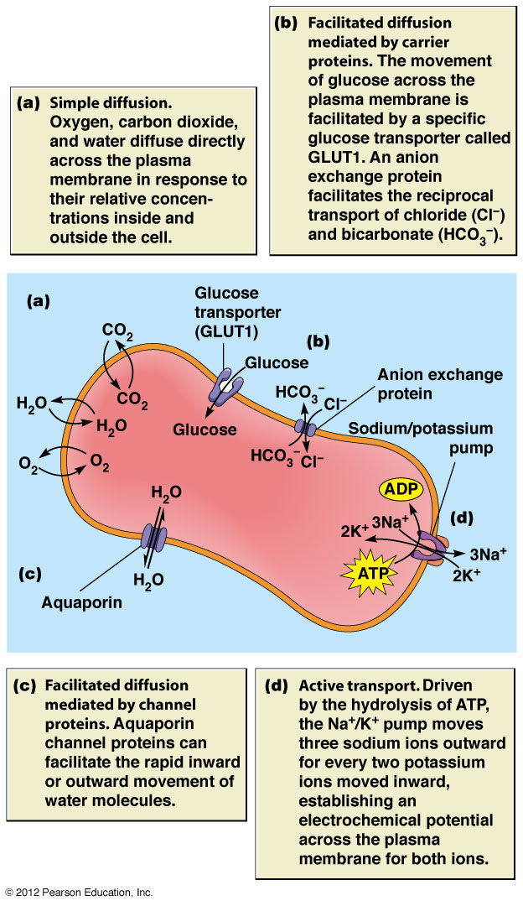
The Erythrocyte Plasma Membrane Provides Examples of Transport Mechanisms

Slide 10
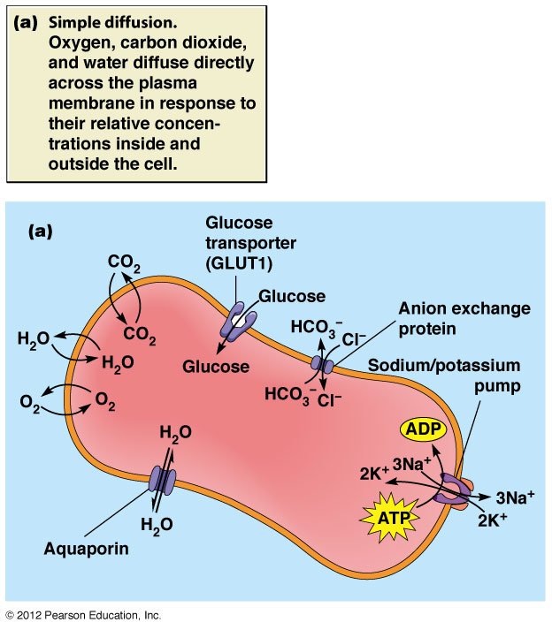

Slide 11
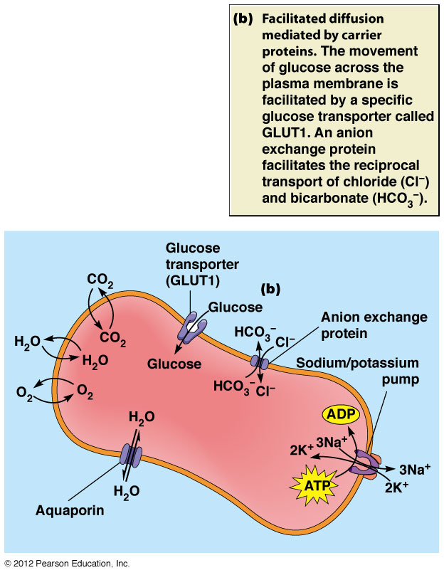

Slide 12
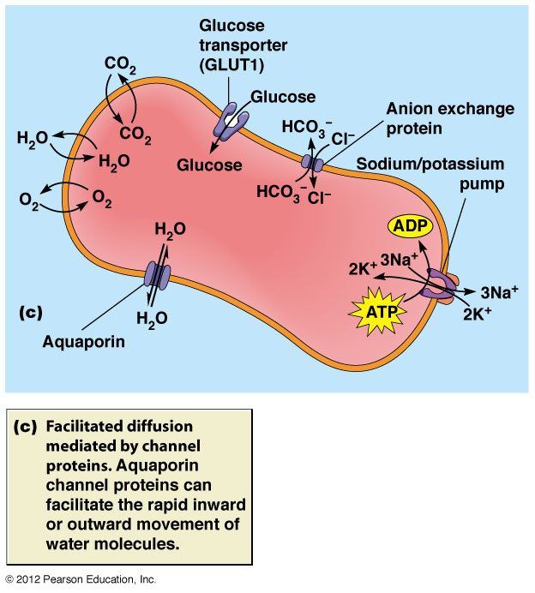

Slide 13
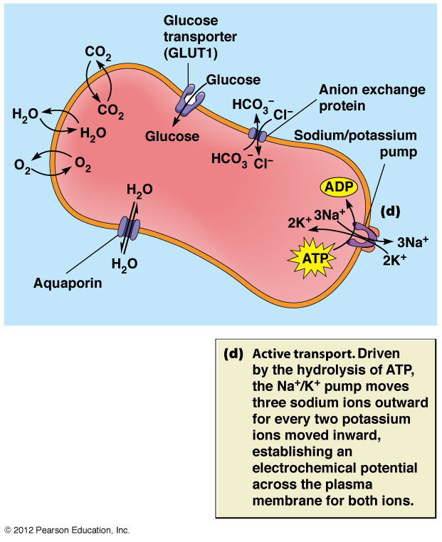

Slide 14
Simple Diffusion: Unassisted Movement Down the Gradient
Down a concentration gradient – higher to lower
Usually small, relatively non-polar molecules – must move past the hydrophobic interior
Involves no transport proteins - unassisted
Kinetically there is no saturation point at high concentration
Linear relationship between diffusion rate and concentration gradient

Slide 15
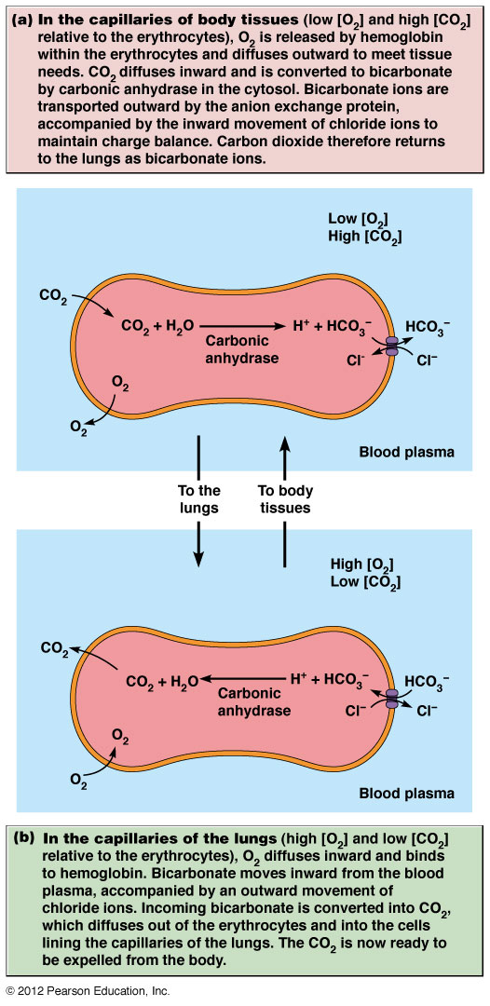
Transport of O₂ , CO₂ & HCO3- across RBC membrane
Picks up O₂ in the lungs to move to tissues
tissues have ↓ [O₂]
CO₂ can also move but usually as HCO₃⁻
changes places with O₂

Slide 16
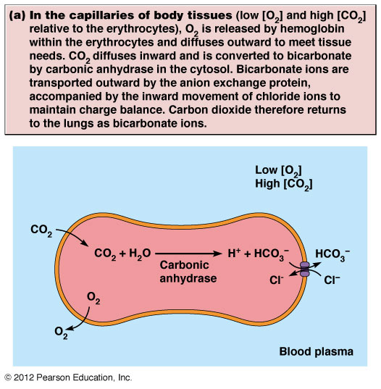

Slide 17
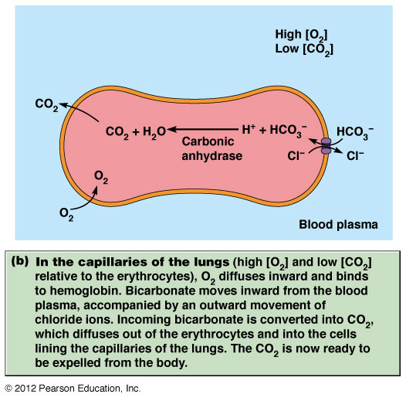

Slide 18
Diffusion Always Moves Solutes Toward Equilibrium
If a membrane allows the movement of solutes, overtime the solutes will balance out across the membrane
Try to get to the lowest free energy – move down the concentration gradient from high to low
When equal on both sides, it is at equilibrium
solute can still move but no net change

Slide 19
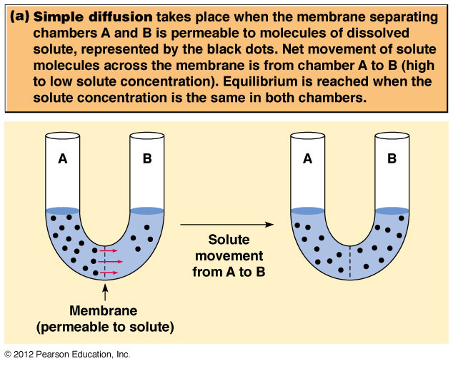

Slide 20
Osmosis
Movement of WATER only across the semi-permeable membrane until water concentration is the same on both sides
Solutes disrupt the 3-D interactions of H₂0, so essentially uncharged
H₂O moves from higher free energy or lower [solute] to lower free energy or higher [solute]
H₂O moves in to ‘dilute’ the H₂O on the other side

Slide 22
Water Movement
Hypertonic solution – high [solute], H₂O out, cell shrinks
Isotonic solution – [solute] equal, no net movement of H₂O, no change
Hypotonic solution – low [solute], H₂O in, cell burst

Slide 23
Factors Affecting Diffusion
Size – small - H₂O, O₂ and CO₂, still hindered by the bilayer
Glucose is small but will need a transport protein
Polarity – non-polar = permeable, polar ≠ permeable
partition coefficient – measure of polarity: ratio of its solubility in an organic solvent to its solubility in water
Charge -

Slide 24
Ion Permeability
Ions have a strong association with H₂O
shell of hydration – restricts movement of ions, must remove the H₂O
Ion gradient needed to maintain cell function and electrochemical potential
important to mitochondria and chloroplasts
Protein channels take the place of H₂O and allow the ions to move across membrane

Slide 25
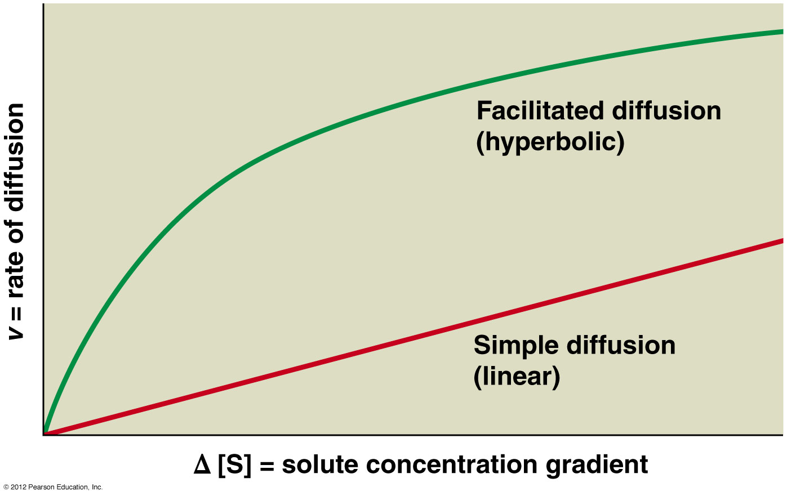
Comparison of the kinetics of simple diffusion and facilitated diffusion

Slide 26
Facilitated Diffusion: Protein-Mediated Movement Down the Gradient
Too large or too polar to move by simple diffusion, even if exergonic reaction
requires no energy
Requires transport protein to recognize the solute and help move it across the membrane
Move down a concentration or electrochemical gradient

Slide 27
2 Classes of Transport Proteins
Carrier proteins – transporters or permeases
Bind 1 or more solutes, undergo conformational change to move solute to the other side
Shield polar and charged R groups from the bilayer interior
Channel proteins – hydrophilic channels thru the membrane – pores
No conformational change
Small and highly selective – ions, probably because no conformation changes
Movement is quicker

Slide 28
Carrier Proteins and Channel Proteins Facilitate Diffusion by Different Mechanisms
Carrier proteins
Allosteric protein with 2 conformations – binding site open to solute, binding initiates change in shape to move solute across the membrane
Similar to enzymes – permease
Specific for solute, small group of similar solutes or 1 form of stereoisomer (stereospecific)
D form of glucose, galactose and mannose but not L
Can become saturated if [transportable solute] goes up
Follows Michaelis-Menton kinetics, saturation, V_{max} in the movement of solute
Can have competitive inhibition of binding site

Slide 29
Carrier Proteins
Carrier proteins differ in the number of solutes transported and the direction they move
Uniport (uniporter) – 1 solute in one direction only (in or out dependent on gradient).
Coupled transport – 2 solutes transported together so both must be present
Symport (co-transporter or symporters) – both solutes move in the same direction (in or out)
Antiport (counter transport or antiporters) – solutes move in opposite direction (1 in, 1 out)

Slide 30
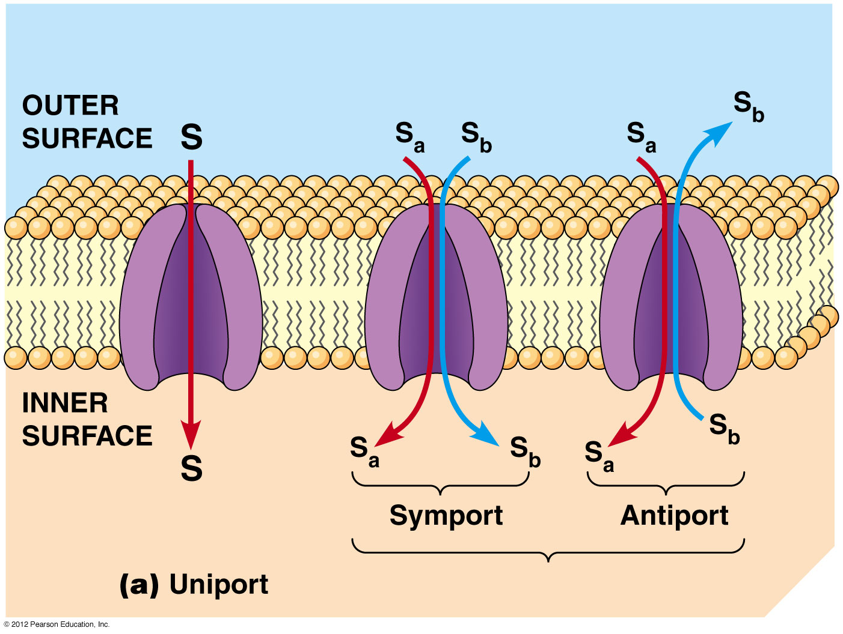
Comparison of Uniport, Symport & Antiport Transport by carrier proteins

Slide 31
Transport Across Membranes: Overcoming the Permeability Barrier
Instructor: Dr. Mahmoud A. Srour
Course: Cell Biology 0202211
Reading:
Becker’s World of the Cell, 8th ed/ 2012.
Chap 8, p. 194-223.
Lec # 13 Mon 12.11.2012

Slide 32
The Glucose Transporter: A Uniport Carrier
Blood glucose is 65-90 mg/dl (3.6-5 mM) and cell levels are much lower
Glucose transporter (GLUT1) can move glucose 50,000 times faster than simple diffusion in RBCs
12 hydrophobic membrane spanning regions lined with hydrophilic residues
inhibited by related monosaccharides
Other GLUT proteins, GLUT2 in liver cells moves glucose out after glycogen breakdown
GLUT3 and GLUT4 are found in cerebral neurons and skeletal muscles respectively,

Slide 33
The Glucose Transporter: A Uniport Carrier
Low cellular glucose allows movement in, rapid phosphorylation to glucose-6-phosphate keeps it in the cell for glycolysis
No transport protein for G-6-P, membrane proteins can’t move phosphorylated molecules
In most mammalian cells, intracellular levels of glucose are in the range of 0.5-1.0 mM compared to 3.6-5 mM in the blood

Slide 34
Glucose Transport
T₁ is open to the outside; T₂ is open to the inside

Slide 35
Erythrocyte anion exchange protein: an Antiport Carrier
Anion exchange protein (Cl⁻/HCO₃⁻ exchanger, band 3 protein): chloride –bicarbonate exchanger
alternative conformation model that has each ion bind at the same time on opposite sides of the membrane
Move Cl⁻ and bicarbonate ions – specific for these 2 ions, 1:1 ratio

Slide 36
Erythrocyte anion exchange protein: an Antiport Carrier (continued)
Dependent on the [HCO₃⁻]
↑ [HCO₃⁻] in cells – bicarb binds inside and Cl⁻ outside and then switch
↓ [HCO₃⁻] in cells – bicarb binds outside and Cl⁻ inside and switch
Maintains the pH when CO₂ is present to be converted to HCO₃⁻ by carbonic anhydrase
Also keeps the net charge of cell balanced

Slide 37
Anion Exchange Protein

Slide 38
Channel Proteins facilitate diffusion by forming hydrophilic transmembrane channels
Hydrophilic transmembrane channels that usually allow the movement of ions across the membrane
3 types
Ion channels
Porins
Aquaporins

Slide 39
Ion Channels
Highly selective for ions – each has its own ion
Specific ion binding and constricted center that serves as size filter
Short and long term regulation
Channels are ‘gated’ to regulate flow of ions by conformation changes that are different from carrier proteins
Voltage gated – responds to changes in membrane potential – nerves
Ligand-gated – triggered by the specific binding of solute to channel protein – nerve terminus
Mechanosensitive – sensitive to mechanical forces that act on the cell membrane – stereocillia in the ear

Slide 40
Clinical correlation: Cystic Fibrosis
In Cystic fibrosis (CF), the lung epithelial cells (cells lining the airways) have a defected chloride ion channel
The defected ion channel is called “cystic fibrosis transmembrane conductance regulator (CFTR) protein
CFTR protein helps to maintain the proper concentration of Cl- in the airways
Defects in CFTR leads to excessive buildup of mucus in the lungs and are vulnerable to chronic bacterial infections

Slide 41
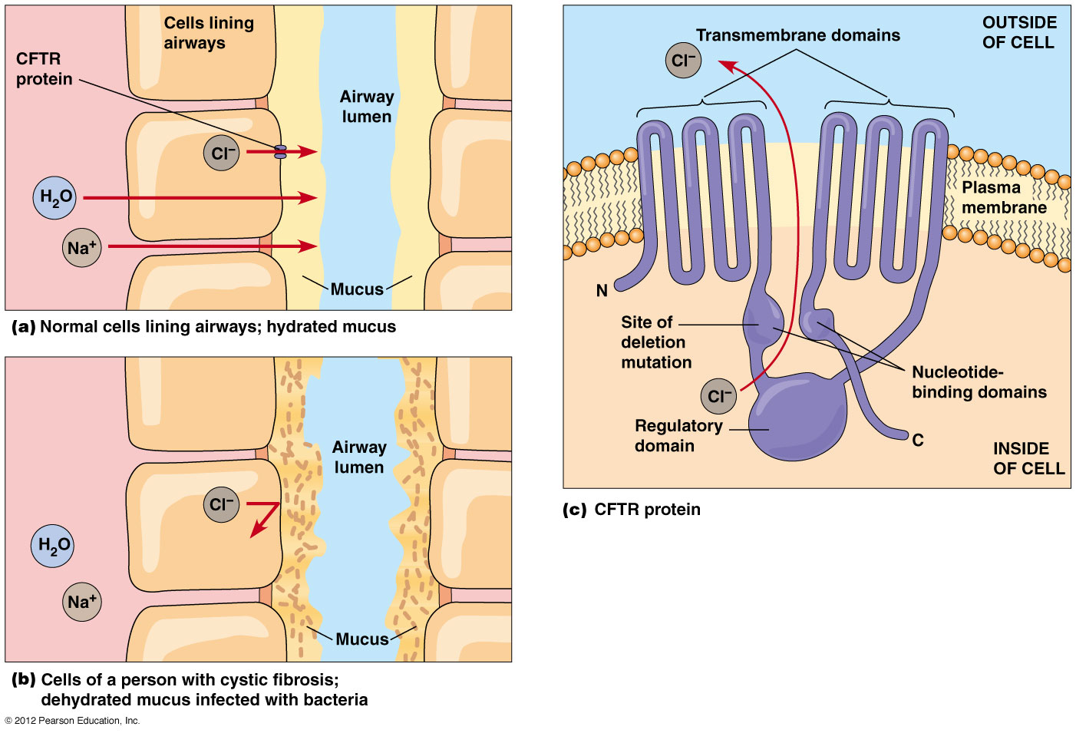
Cystic fibrosis and chloride ion secretion

Slide 42
Porins: transmembrane proteins that allow rapid passage of various solutes
In mitochondria, chloroplasts and bacteria
outer membrane
Larger openings that are less specific
Closed β sheet structure called a β barrel that has a water filled pore at its center
Hydrophobic amino acids on outside of barrel to anchor in membrane
Hydrophilic amino acids on inside to allow for passage through
Moves hydrophilic solutes and dictated by the pore size of the particular porin

Slide 43
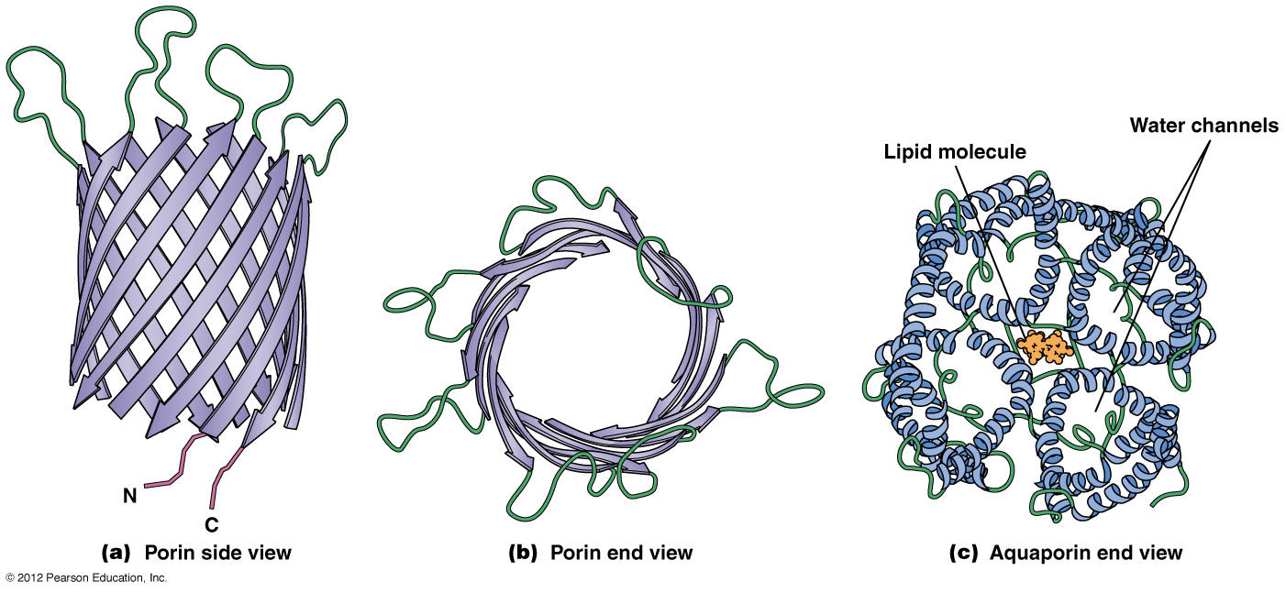
Porin and aquaporin channel proteins
Notes:
One hydrogen atom has mass of 1 Da, so 1 Da = 1 g/mol

Slide 44
Aquaporins: transmembrane proteins that allow rapid passage of water
Exist in Special tissues such as the proximal tubules of the kidney, RBC and vacuolar membranes in plants
Aquaporins have tetrameric structure and each monomer has 6 helical transmembrane segments
Prokaryotes appear not to contain aquaporins (??)

Slide 45
Porin and aquaporin channel proteins
Notes:
One hydrogen atom has mass of 1 Da, so 1 Da = 1 g/mol

Slide 46
Active Transport
Protein mediated movement up the gradient or electrochemical potential, away from equilibrium, requires energy
Proteins are called pumps – very selective
Active transport performs 3 functions in cells & organelles
Essential nutrients from environment even when lower outside the cell than inside
Remove wastes and secretory products even when higher concentration outside the cell
Maintain non-equilibrium of intercellular concentrations of K⁺, Na⁺, Ca²⁺ and H⁺

Slide 47
Differences
Simple and facilitated diffusion are non-directional – depends on the concentration or electrochemical gradient
Active transport is uni-directional – moves in one direction against the gradient
Active transport is coupled to an energy source
Linked to ATP hydrolysis
Movement of 2 solutes together

Slide 48
Energy Sources
Direct – movement of solute or ions is linked to an exergonic reaction – ATP hydrolysis
Transport ATPase or ATPase pumps
Indirect – co-transport of 2 solutes
One moves down its concentration gradient and the other is against the gradient
Usually Na⁺ and H⁺ move down the electrochemical gradient and transports sugar or AA against gradient
Symport or antiport

Slide 49
Direct Active Transport
ATPases that link active transport to the hydrolysis of ATP
4 types of pumps
P-type
V-type
F-type
ABC-type

Slide 50
Summary of ATPases

Slide 51
P-type ATPase
Involves Phosphorylation – reversible PO₄ on an aspartic acid residue
8 – 10 transmembrane segments
All are cation transporters
Maintain the ion concentration across the membrane – Na⁺/K⁺ pump
Acidify the gastric juices – H⁺ ATPase
Move Ca²⁺ out of the cell or into the ER – Ca²⁺ ATPase
Mostly in eukaryotic cells
P-type has 5 subfamilies

Slide 52
V-type ATPase
Pumps protons into Vacuoles
Golgi, lysosomes, endosomes, vacuoles and vesicles
No phosphorylation
2 components to the mechanism
Integral component embedded in the membrane
Peripheral component that juts out from the membrane surface
ATP binding site
All cation movement

Slide 53
F-type ATPases
F is for Factor
Found in bacteria, chloroplasts and mitochondria to save solar radiation or substrate oxidation as ATP
Moves protons in both direction depending on electrochemical gradient
2 subunits (such as ATP synthase)
Integral component – F_{o} is the pore for the protons
Peripheral component – F₁ is the ATP binding site
Use ATP to generate gradient and can also use gradient to make ATP (called ATP synthase when generate ATP)

Slide 54
ABC-type ATPases
ATP-binding cassettes (catalytic domain)
Found in prokaryotes but also finding in eukaryotes as well (48 genes in human genome for ABC-transporters
4 domains
2 hydrophobic in the membrane, 6 transmembrane regions each
2 peripheral on the cytoplasmic side, ATP activity
May be 4 polypeptides or 1 large protein
Moves a variety of solutes, most are specific for 1 or a class of closely related solutes
Ions, sugars, AA, small peptides and polysaccharides
Multi-drug resistant (MDR) transporter will move several chemotherapeutic drugs out of the cell

Slide 55
Examples of Direct Active transport: Na⁺/K⁺ Pump
Maintains electrochemical gradient for osmotic equilibrium, driving force for co-transport of molecules and transmission of nerve impulses
Extracellular – low K⁺; high Na⁺
Intracellular – high K⁺; low Na⁺
Pump uses ATP as energy source and its hydrolysis is coupled to bringing K⁺ in and Na⁺ out
1 ATP can move several ions across
Directional – Na⁺ activates on inner surface and always out, K⁺ activates on the outer surface and always in

Slide 56
Na⁺/K⁺ Pump
Tetrameric trans-membrane protein
2 α and 2 β subunits
α subunit binds Na⁺ and ATP on cytoplasmic side and binds K⁺ on the outside
β subunit is glycosylated and function not clear
Has 2 conformations – E₁ (, open to inside; high affinity for Na⁺) and E₂ (open to outside; high affinity for K⁺)
Allosteric protein

Slide 57
Na⁺/K⁺ Pump
Found in most animal cells
Most animal cells have a high intracellular level of K+ ions and a low intracellular sodium ions> K+ [inside]/ K+ [outside] ratio is 35:1& the Na+[inside]/Na+[outside] is 0.08:1
Per molecule of ATP hydrolyzed, 2 K+ are moved in and 3 Na+ are moved out
Functions:
Maintain intracellular levels of K+ and Na+
Maintain membrane potential

Slide 58
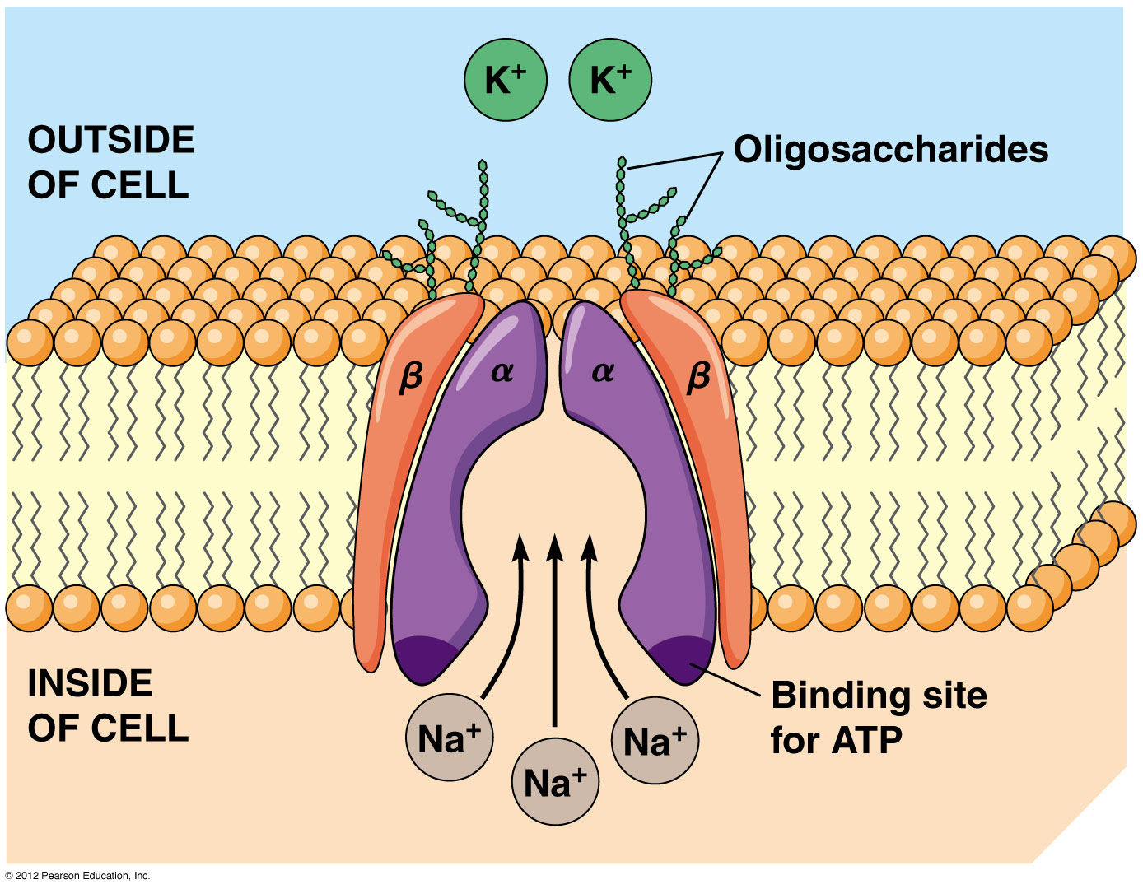
The Na⁺/K⁺ Pump

Slide 59
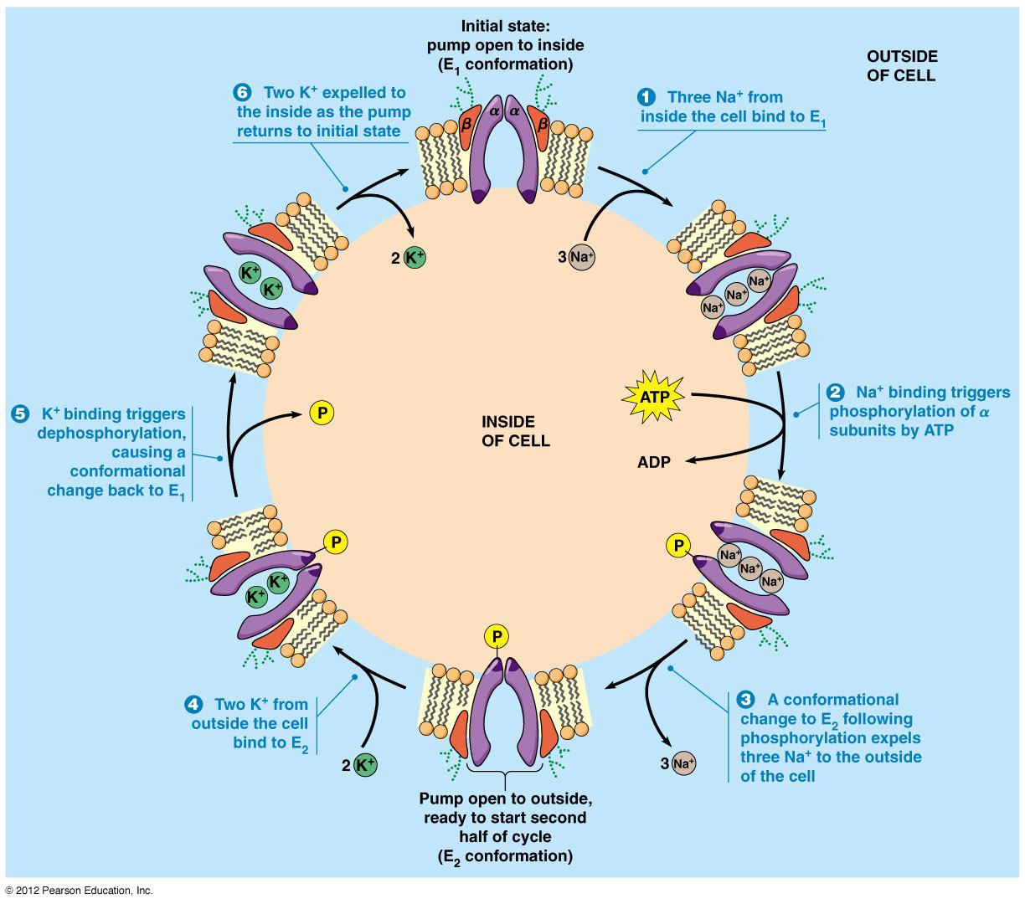
The Na⁺/K⁺ Pump

Slide 60
Indirect Active Transport
Movement of an ion down an electrochemical gradient and transports a 2nd solute along such as sugar, AA or other organic molecule
Na⁺ in animals, H⁺ in plants, fungi and bacteria
Symport mechanism
Na⁺ into the cell and AA and sugar goes in
Na⁺/K⁺ pump will remove the excess ions
Can also drive antiport movement of Ca²⁺ and K⁺

Slide 61
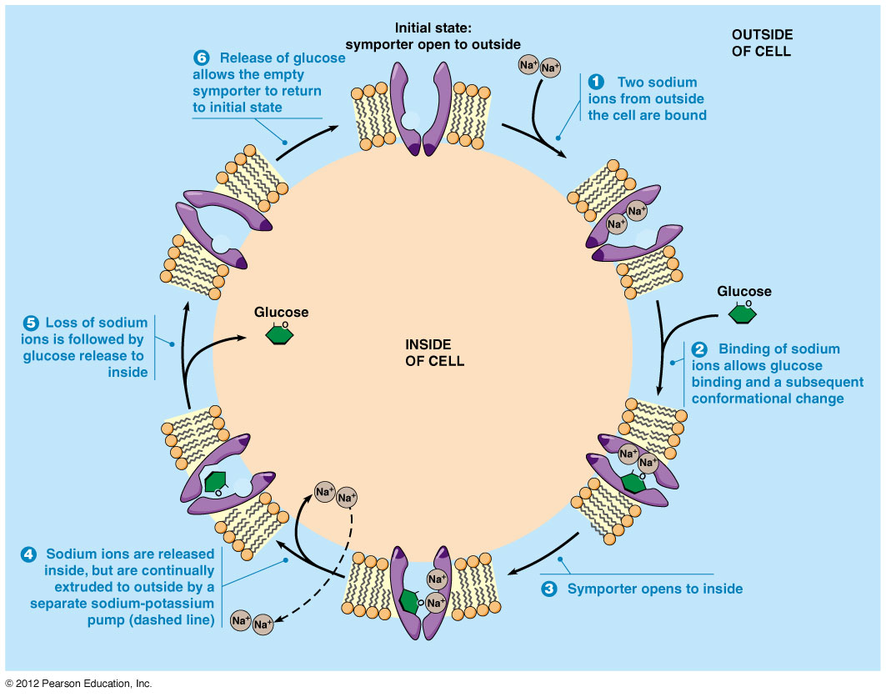
Na+ / Glucose symporter SGLT proteins)

