Slide 1
The Endomembrane System and Peroxisomes
Instructor: Dr. Mahmoud A. Srour
Course: Cell Biology 0202211
Reading:
Becker’s World of the Cell, 8th ed/ 2012.
Chap 12, p. 324-64.
Lec # 14-15 Mon 26.11.2012

Slide 2
Endoplasmic Reticulum
Endoplasmic- within the cytoplasm
Reticulum – network
Function
Biosynthesis of proteins destined for incorporation into plasma membrane
Synthesis of proteins destined for export from cell
Biosynthesis of lipids a) cholesterol b) plasma membrane
Incorporation into organelles of endomembrane system

Slide 3
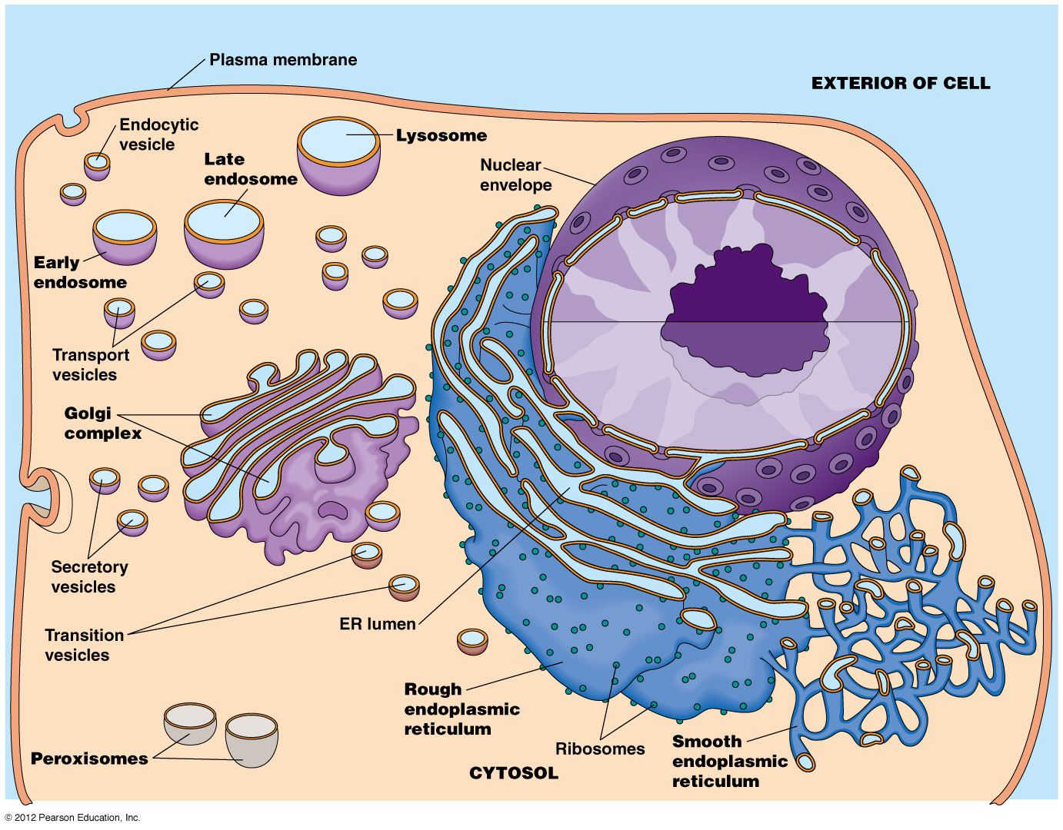
The endomembrane system

Slide 4
Smooth Endoplasmic Reticulum
No Ribosomes
Most prominent in tissues like ovary and testes
Continuous with rough endoplasmic reticulum
Tubular

Slide 5
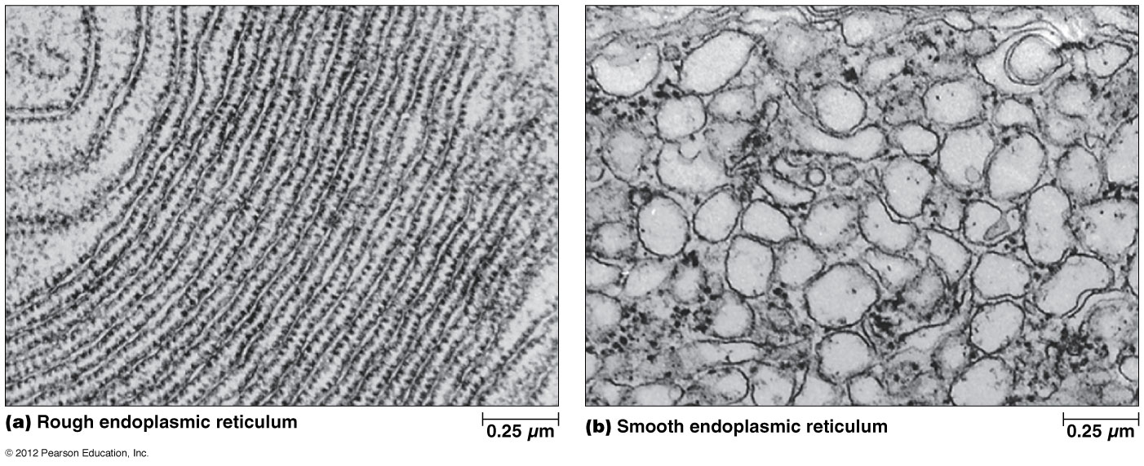
Rough and smooth ER

Slide 6
Smooth Endoplasmic Reticulum
Drug Detoxification: involves hydroxylation
Addition of OH groups are more soluble and easier to excrete
If not soluble, hydrophobic toxins may stay in membrane of cells
Reduced form of Cytochrome P-450 hydroxylates organic hydroxyl acceptor
Class of enzymes called mixed-function oxidases

Slide 7
Smooth Endoplasmic Reticulum
Example 1:
Elimination of barbiturate drugs
Phenobarbital induces increase of barbiturate detoxifying enzymes in liver
Induces Extensive formation of smooth ER
Also hydroxylates useful drugs such as antibiotics

Slide 8
Smooth Endoplasmic Reticulum
Example 2:
Another Member of Cytochrome P-450 protein family
Aryl hydrocarbon hydroxylase involved in metabolizing polycyclic hydrocarbons
Changes potential carcinogens to chemically active form which results in tumors
Cigarette smoke is an inducer of aryl hydrocarbon hydroxylase
Differences in activities & side effects of certain drugs can result from differences in the presence or activity of particular Cyto P-450 genes in different patients (pharmacogenetics)

Slide 9
Smooth Endoplasmic Reticulum
Carbohydrate Metabolism
Membrane of smooth ER of hepatocytes contain glucose-6-phosphase (breaks down glucose-6-phosphate into free glucose that leaves liver cells via GLUT2)
Glycogen is stored in liver
Allows glucose to leave cell and travel into blood system

Slide 10
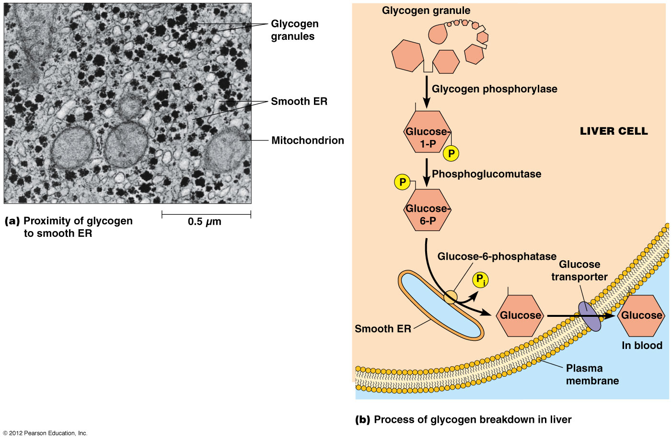
The role of SER in the catabolism of Liver Glycogen

Slide 11
Smooth Endoplasmic Reticulum
Calcium Storage
Sarcoplasmic Reticulum in muscle cells is an example of smooth ER that specializes in storage of calcium
ER lumen contains high concentrations of calcium-binding proteins
Calcium ions are pumped into the ER by ATP-dependent calcium ATPases and are released when needed for muscle contraction (triggered by neurotransmitters)

Slide 12
Smooth Endoplasmic Reticulum
Steroid Biosynthesis
Cholesterol, cortisol, testosterone, estrogen
All share a 4-ring structure but differ by hydroxyl groups & carbons side chains
P-450 monooxygenases are important in steroid hormones synthesis by hydroxylation

Slide 13
Rough Endoplasmic Reticulum
Transitional Elements (TE) – plays role in formation of transition vesicles
Transition Vesicles – shuttle lipids and/or proteins from ER to Golgi complex
Microsomes: sealed vesicles released upon fragmentation of ER
Flattened sacs
Proteins enter lumen cotranslationally
Proteins are anchored by hydrophobic interactions or covalent attachment to membrane lipids
Soluble proteins are released into lumen

Slide 14
RER: biosynthesis of membrane lipids
Phospholipid translocastors (flippases) catalyze translocation of phospholipids through ER membranes
When vesicles from ER membrane fuse with other organelles of endomembrane system, the distinct component of cytosolic & lumenal monolayers established in ER are maintained
In cases of no fusion, cytosolic phospholipid exchange proteins recognize specific phospholipids and move them to destination (mitochondria, chloroplast, peroxisome)

Slide 15
RER: posttranslational modifications of proteins
Responsible for addition of carbohydrates to proteins
Folding of proteins
Recognition and removal of misfolded proteins
Assembly of multimeric proteins
Contains enzymes for posttranslational and cotranslational modification such as disulfide bonds
Quality control – ER associated degradation ofproteins ERAD (cytoplasmic proteases)

Slide 16
Golgi Apparatus
The Golgi Complex
(1898) Camillo Golgi
Flattened sacs or cisternae
Cis (CGN) or Trans face of Golgi (TGN)
Between cis & trans is medial cisternae of Golgi where processing occurs

Slide 17
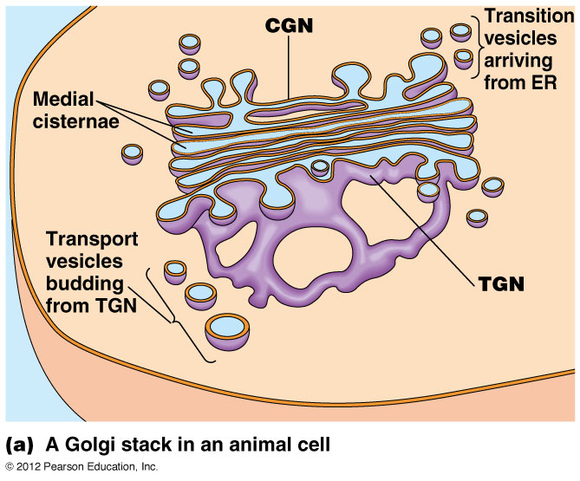

Slide 18
Golgi Apparatus
Two Models depict flow of lipids & proteins from CGN to TGN
Stationary Cisternae Model – shuttle vesicles bind & fuse
Cisternal Maturation Model – Golgi cisternae transform from CGN (with aid of ER vesicles) and accumulate specific enzymes. CGN transform to medial cisternae then trans cisternae Golgi network with new enzymes.
Time elapsed fluorescence microscopy support maturation model

Slide 19
Golgi Apparatus
Anterograde & Retrograde Transport
Anterograde - vesicles from ER fuse with Golgi then plasma membrane
Retrograde - flow from plasma to Golgi to ER

Slide 20
Roles of the ER and Golgi in Protein Glycosylation
Much of the protein processing carried out in the ER and Golgi involves glycosylation, the addition of carbohydrate side chains to proteins
Enzyme-catalyzed reactions involving the resulting glycoproteins then modify the oligosaccharide side chain

Slide 21
RER: glycosylation
Two general kinds of Protein Glycosylation
N-linked glycosylation (N-glycosylation) –oligosaccharide unit to attach to nitrogen on certain asparagine residues
O-linked glycosylation – oligosaccharide unit to attach to oxygen on hydroxyl group of certain serine or threonine residues

Slide 22
Initial Glycosylation Occurs in the ER
All carbohydrate side chains initially have a common core oligosaccharide consisting of two units of N-acetylglucosamine, nine mannose units, and three glucose units
Formation of Core Oligosaccharide occurs in the Cytoplasm
Dolichol Phosphate inserted into ER membrane
2 N-acetylglucosime (GlcNAc) are added to dolichol
Addition of 5 mannose sugars

Slide 23
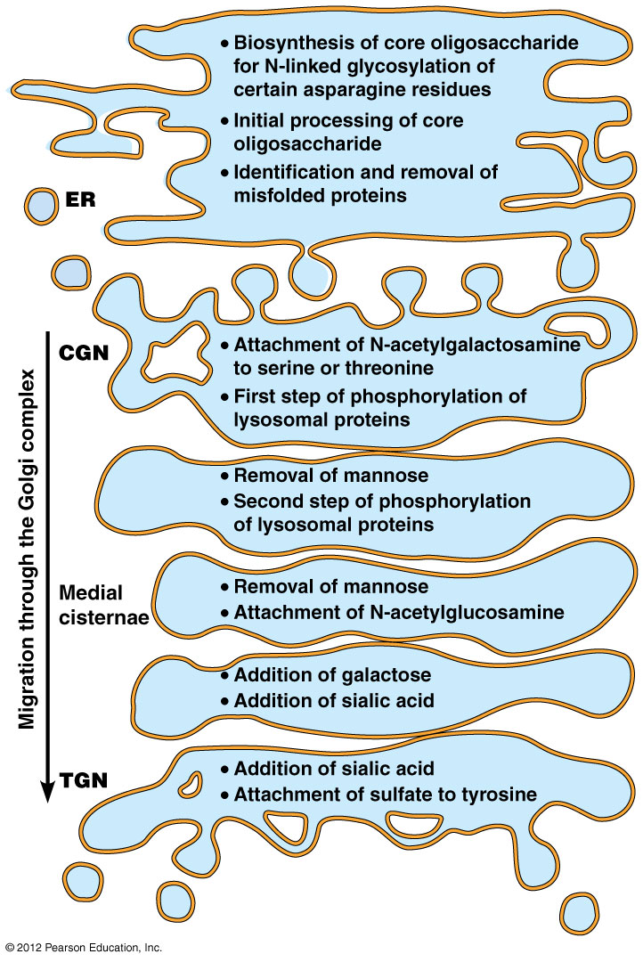
Steps of glycosylation & modification of proteins

Slide 24
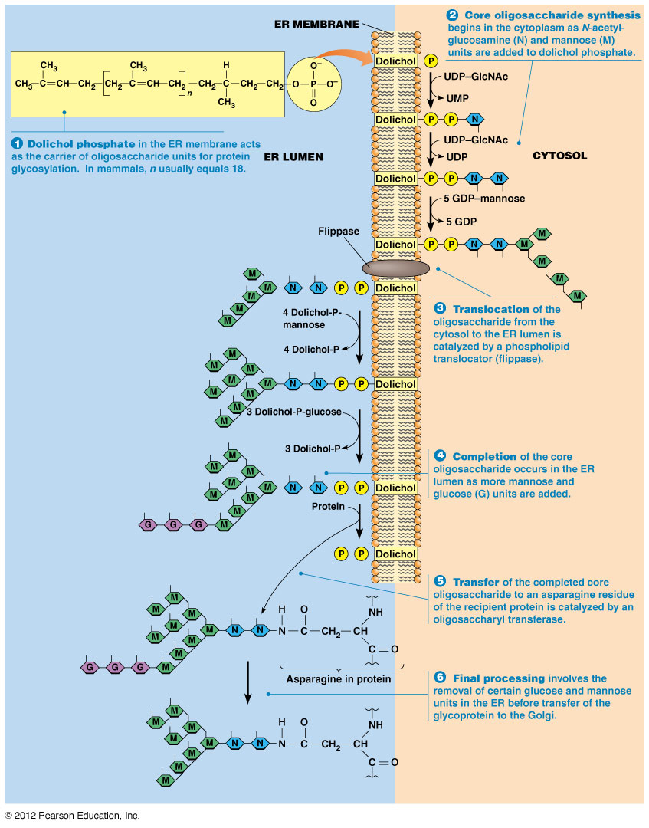
N-Glycosylation of proteins in ER

Slide 27
Initial Glycosylation Occurs in the ER (cont’d)
Oligosaccharide is usually added cotranslationally
Promotes proper folding
Proteins such as calnexin (CNX) and calreticulin (CRT) binds to glycoprotein to form a complex for disulfide bridge
Thiol oxidoreductase (ERp57) promotes disulfide bonds
If a protein is missing a sugar, UGGT (UDP-glucose: glycoprotein glucotransferase) will add a sugar so CNX/CRT will promote formation of disulfide bond

Slide 28
Further Glycosylation Occurs in the Golgi Complex
Posttranslational Modification
Terminal glycosylation – removal of a few carbohydrates of core oligosaccharide and sometimes nothing more
In some cases, more complex oligosaccharides are generated by Addition of N-acetylglucosamine and other monosacharides such as galactose, sialic acid and fucose
Galactosyl transferase is found exclusively in Golgi which adds on galactose

Slide 29
Further Glycosylation Occurs in the Golgi Complex (cont’d)
Golgi has 2 major classes of enzymes
Glucan synthetases – catalyzes formation of oligosaccharide from monosaccharide
Glycosyl transferases – attach carbohydrates to proteins

Slide 30
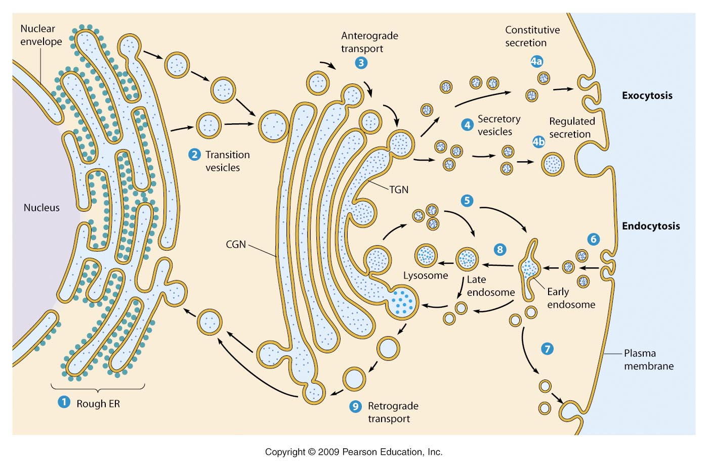

Slide 32
Roles of the ER and Golgi Complex in Protein Trafficking
Protein Trafficking from ER to Golgi
Membrane-bound & soluble proteins must be directed to a variety of intracellular locations including ER, Golgi, endosomes, and lysosomes
Each protein has a tag for a particular vesicle
Tag may be amino acid sequence, oligosaccharide chain, hydrophobic domain
Membrane lipids may be tagged by one or more phosphate groups by a kinase

Slide 33
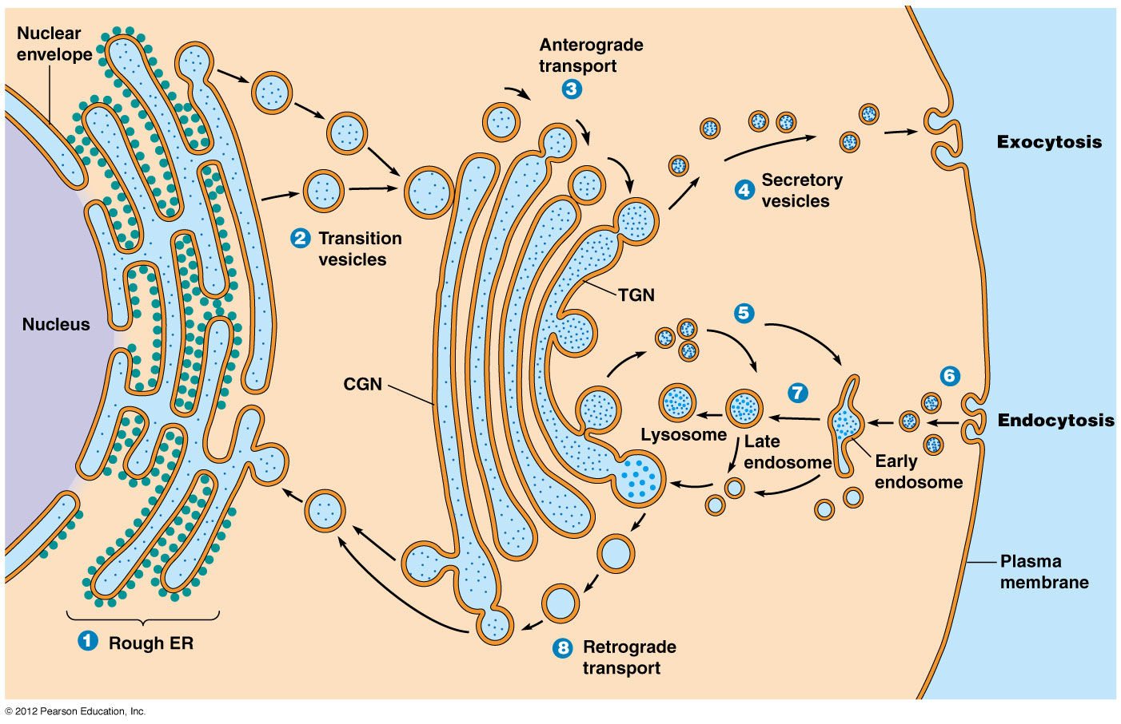

Slide 34
ER-Specific Proteins Contain Retention and Retrieval Tags
Retention Tags
RXR (arginine, any, arginine) tag is placed on protein and stays in ER
Retrieval tags – placed on proteins that should return to ER. Receptors on Golgi will bind to KDEL (Lys-Asp-Glu-Leu) or KKXX (Lys-Lys-any-any) and return proteins to ER
Question: If proteins are returned to ER, why go to Golgi?

Slide 35
Golgi Complex Proteins May Be Sorted According to the Lengths of Their Membrane-Spanning Domains
Proteins of Golgi
Some have retention or retrieval tags attached to proteins so they will remain or come back to Golgi
Specific proteins are integral proteins spanning the membrane (hydrophobic regions)
Hydrophobic regions is a third way to keep proteins in Golgi
Proteins will migrate from CGN to TGN until the thickness of membrane exceeds length of hydrophobic membrane-spanning domain

Slide 36
Targeting of Soluble Lysosomal Proteins to Endosomes and Lysosomes Is a Model for Protein Sorting in the TGN
Lysosomal specific proteins have mannose-6-phophate formed from mannose by 2 Golgi specific enzymes
In TGN of Golgi are mannose-6 phosphate receptors (pH 6.4) where enzymes bind and packaged into transport vesicle
These vesicles form Early Endosome which bind to plasma membrane

Slide 37
Endosome Pathway
Early Endosome matures to late endosome (pH 5.5)
At this low pH (pH 5.5) bound lysosomal enzymes release from receptors (MPRs) in Late Endosome. This release prevents retrograde movement back to Golgi
Late Endosome matures into a new lysosomes or delivers its contents to an active lysosome

Slide 38
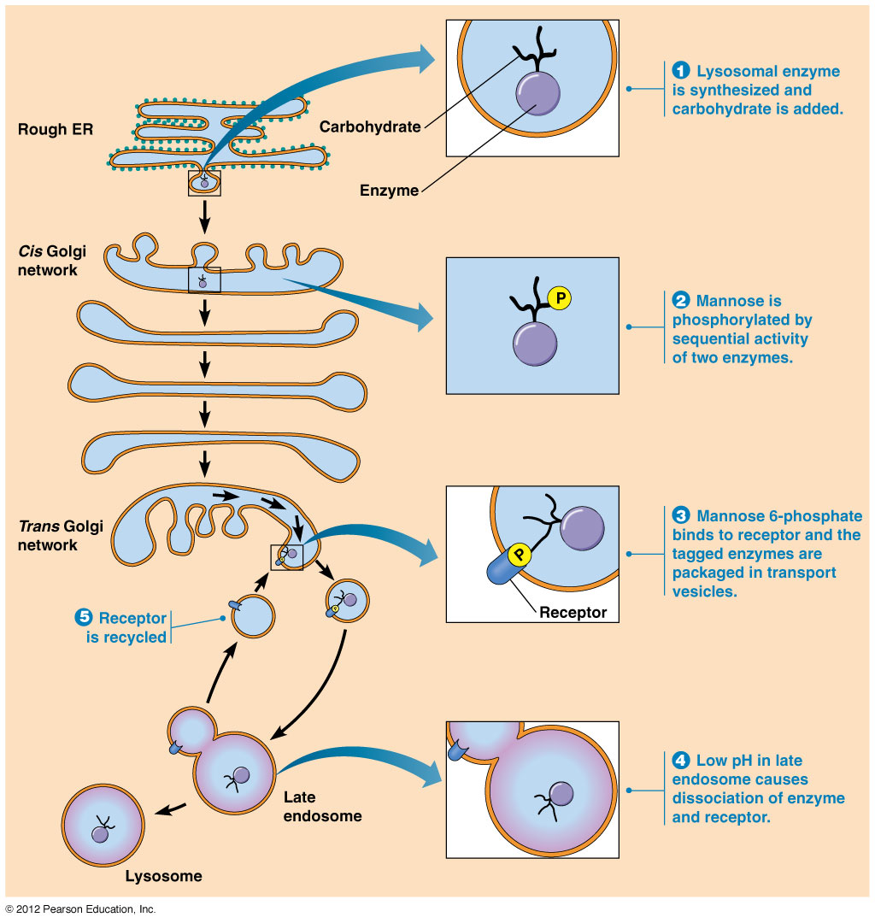

Slide 39
Secretory Pathways Transport Molecules to the Exterior of the Cell
Secretory pathways move proteins from the ER through the Golgi complex to secretory vesicles and secretory granules
The secretory granules then discharge their contents to the exterior of the cell
Experiment using electron microscopy autoradiography shows the movement of proteins through secretory pathways

Slide 40
Secretory Pathways
1967 James Jamieson & George Palade labeled amino acids and watched movement
Method: they treated slices of guinea pancreatic tissue with radioactive aa to pulse label newly synthesized proteins >examined by TEM
After 3 minutes, labeled proteins are found found in ER
After 7 minutes found in Golgi
37 minutes into vesicles
117 minutes vesicles discharge protein into extracellular matrix

Slide 41
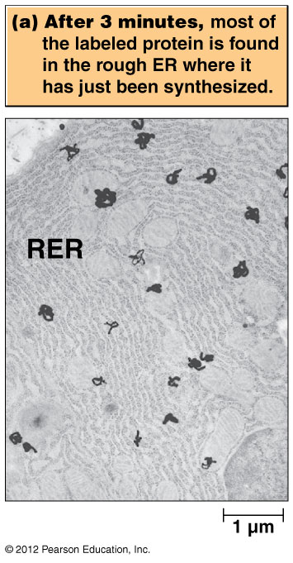
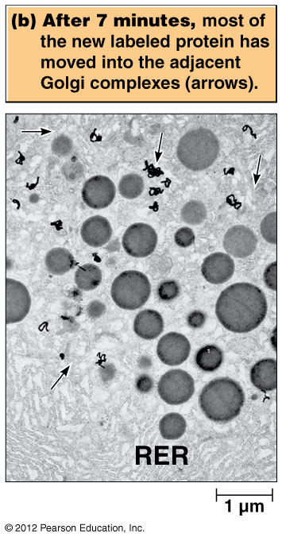

Slide 42
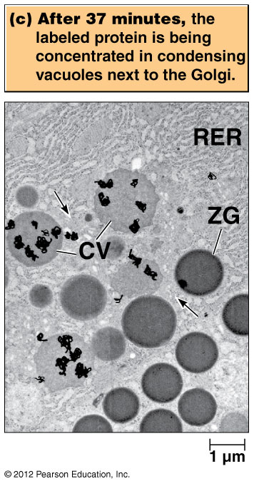

Slide 43
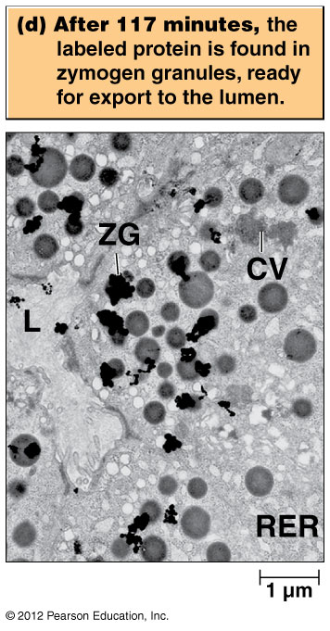

Slide 44
Secretory Pathways (cont’d)
After budding from TGN, secretory vesicles constantly move to cell membrane and release proteins by exocytosis
Experiment removed KDEL retrieval tag from ER proteins and they did not return to ER but were secreted.

Slide 45
Two modes of secretion in eukaryotic cell
Constitutive Secretion
Regulated secretion

Slide 46
Constitutive Secretion
After budding from the TGN, some vesicles move directly to the cell surface and immediately fuse with the plasma membrane
This unregulated process is continuous and independent of external signals
It is called constitutive secretion; one example is mucus secretion by the intestinal lining

Slide 47
Constitutive secretion, by default?
Constitutive secretion was once thought to be a default pathway for proteins synthesized by rough ER
It was thought that proteins destined to stay in the endomembrane system must have a tag to avoid constitutive secretion
Current evidence suggests that some tags may be required for constitutive secretion

Slide 48
Regulated Secretion
Secretory vesicles involved in regulated secretion accumulate in the cell and only fuse with the plasma membrane in response to specific signals
An important example is neurotransmitter release
Regulated secretory vesicles form by budding from the TGN as immature secretory vesicles

Slide 49
Regulated secretion (continued)
Maturation of secretory proteins involves their concentration, called condensation, and sometimes proteolytic processing
The mature secretory vesicles move close to the site of secretion and remain there until receiving a signal
The signal triggers vesicles to release their contents by fusion with the plasma membrane

Slide 50
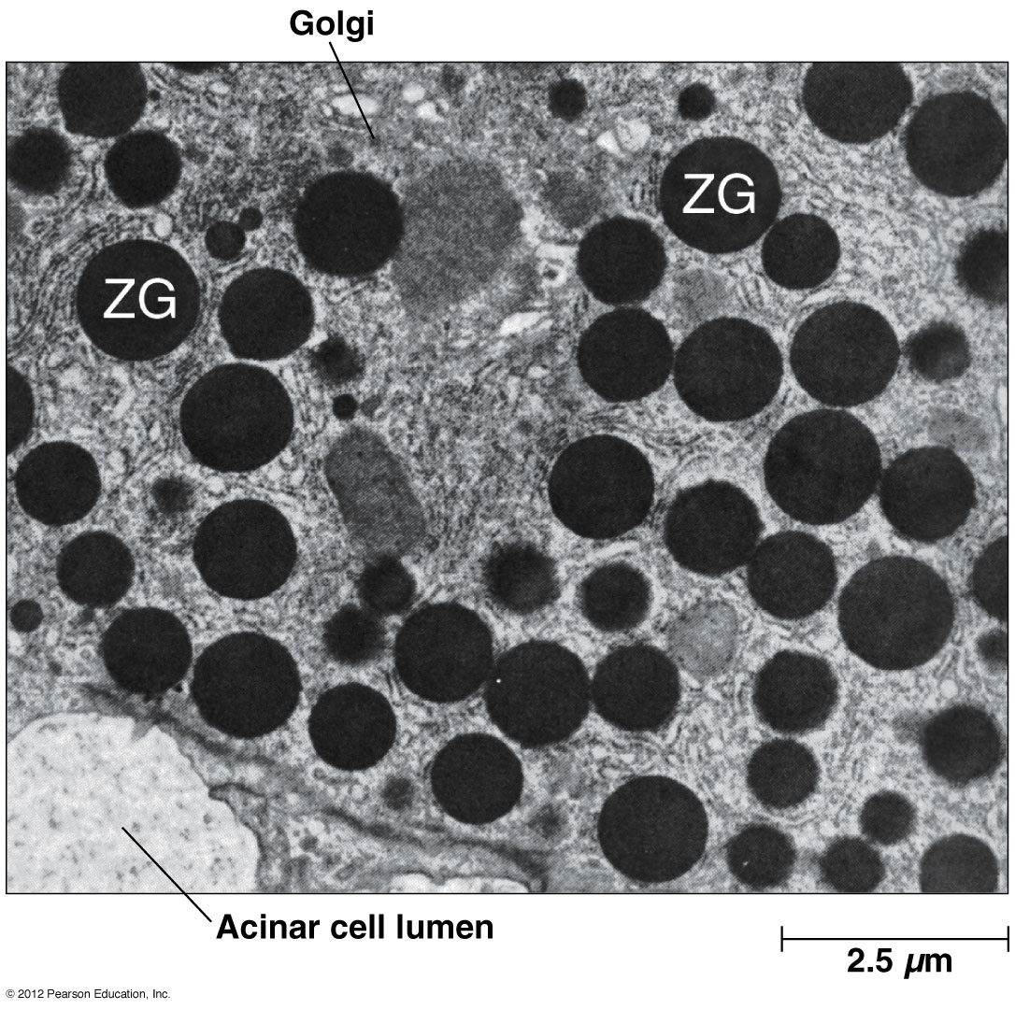

Slide 51
Peroxisomes

Slide 52
Peroxisomes
Peroxisomes are bounded by single membranes but are not derived from ER
Thus they are not part of the endomembrane system
The defining characteristic of peroxisomes is the presence of catalase, for degrading H₂O₂
Found in all eukaryotic cells but specially prominent in kidney and livers cells, in algae and photosynthetic cells of plants, and in germinating seedlings of plant species that store fat in seeds

Slide 53
The Discovery of Peroxisomes Depended on Innovation in Equilibrium Density Centrifugation
Researchers used a gradient of sucrose concentration to isolate specific cellular components
They identified a region distinct from known organelles that contained the enzyme urate oxidase
This region of the gradient contained peroxisomes

Slide 54
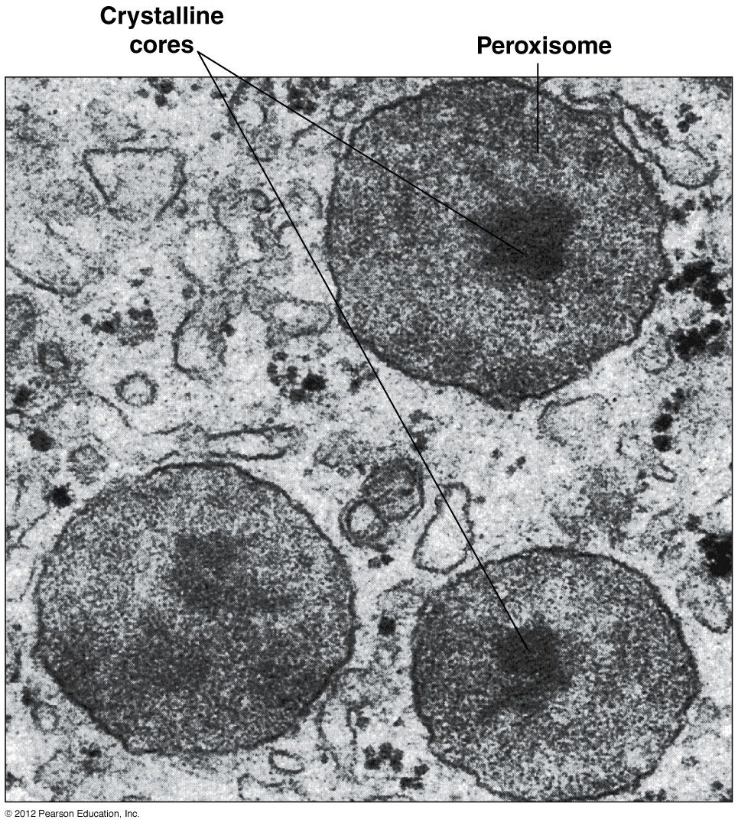
Peroxisomes in animal cells
The crystalline core in animal cells is almost always
urate oxidase

Slide 55
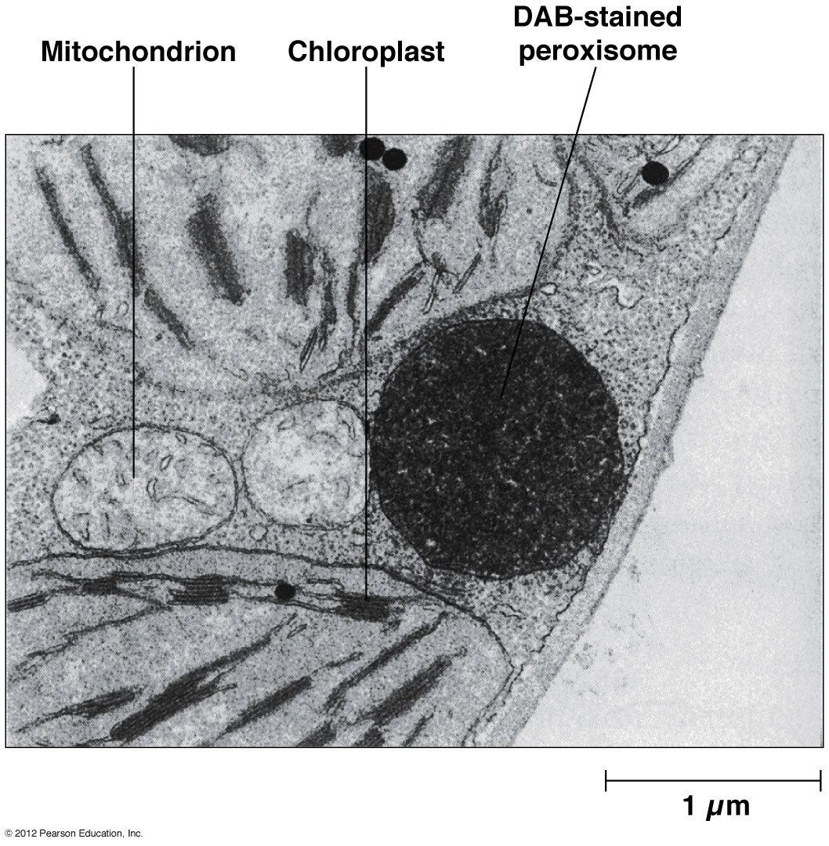
Cytochemical localization of Catalase in plant peroxisomes

Slide 56
Most Peroxisomal Functions Are Linked to Hydrogen Peroxide Metabolism
The essential roles of peroxisomes include
Hydrogen peroxide metabolism
Detoxification of harmful compounds
Oxidation of fatty acids
Metabolism of nitrogen-containing compounds
Catabolism of unusual substances

Slide 57
Hydrogen Peroxide Metabolism
Oxidases generate H₂O₂ in peroxisomes
The hydrogen peroxide is detoxified by catalase

Slide 58
Hydrogen peroxide can be detoxified another way
Alternatively, catalase can function as a peroxidase
The result is the same in either case – hydrogen peroxide is degraded while still inside the peroxisome

Slide 59
Detoxification of Harmful Compounds
Peroxisomes detoxify reactive oxygen species (H₂O₂, O₂⁻) and organic peroxides
If these accumulate they can cause oxidative stress; superoxide dismutase and other peroxisome enzymes detoxify them
Catalase uses a variety of other toxic substances as electron donors, including methanol, ethanol, formic acid, formaldehyde, nitrites and phenols

Slide 60
Oxidation of Fatty Acids
Peroxisomes contain enzymes for β-oxidation of fatty acids. In animals ~205-50% of fatty acid oxidation occurs in peroxidation & the rest in mitochondria
In animal cells, they oxidize long-chain fatty acids; once the fatty acids are fewer than 16 carbons in length, the rest of the oxidation occurs in mitochondria
In plants and yeast, fatty acids are completely oxidized in peroxisomes

Slide 61
Metabolism of Nitrogen-Containing Compounds
Most animals (not primates) require urate oxidase to oxidize urate, formed during catabolism of nucleic acids and some proteins
.

Slide 62
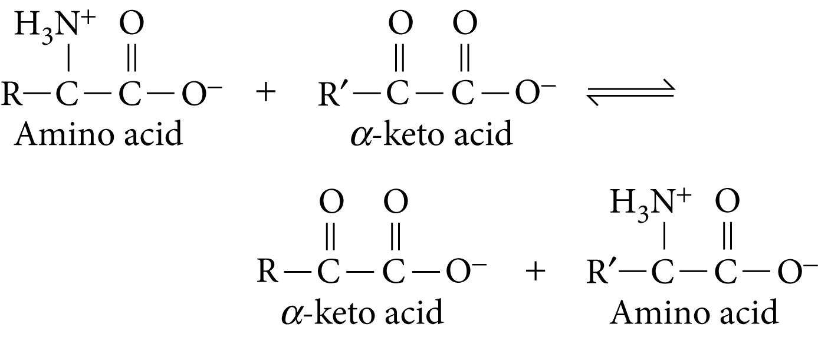
Aminotransferases
Aminotransferases catalyze the transfer of amino groups from amino acids to α-ketoacids in the degradation and synthesis of amino acids
.

Slide 63
Catabolism of Unusual Substances
D-amino acids are rare substances for which the cell has no degradative pathways, except in the peroxisome
In some cells peroxisomes also contain enzymes that break down xenobiotics, compounds foreign to living organisms
This includes short-chain hydrocarbons such as alkanes

Slide 64
Peroxisome Biogenesis Occurs by Division of Preexisting Peroxisomes
Peroxisomes increase in number as cells grow and divide; this proliferation is biogenesis
Proteins required for this process are peroxins

Slide 65
Peroxisome Biogenesis
Membrane components, matrix enzymes, and cofactors from the cytosol are incorporated into peroxisomes (1-3)
Then, new peroxisomes are formed by division of a preexisting one (4)
Some peroxisomes may obtain materials or form de novo from vesicles derived from the ER (5)

Slide 66
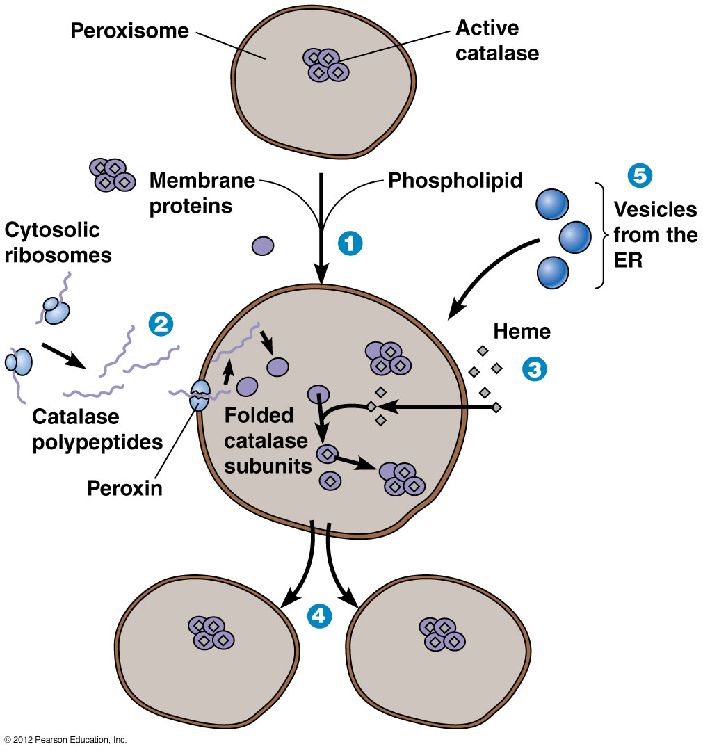
Biogenesis of peroxisomes and protein import

Slide 67
End

Slide 69
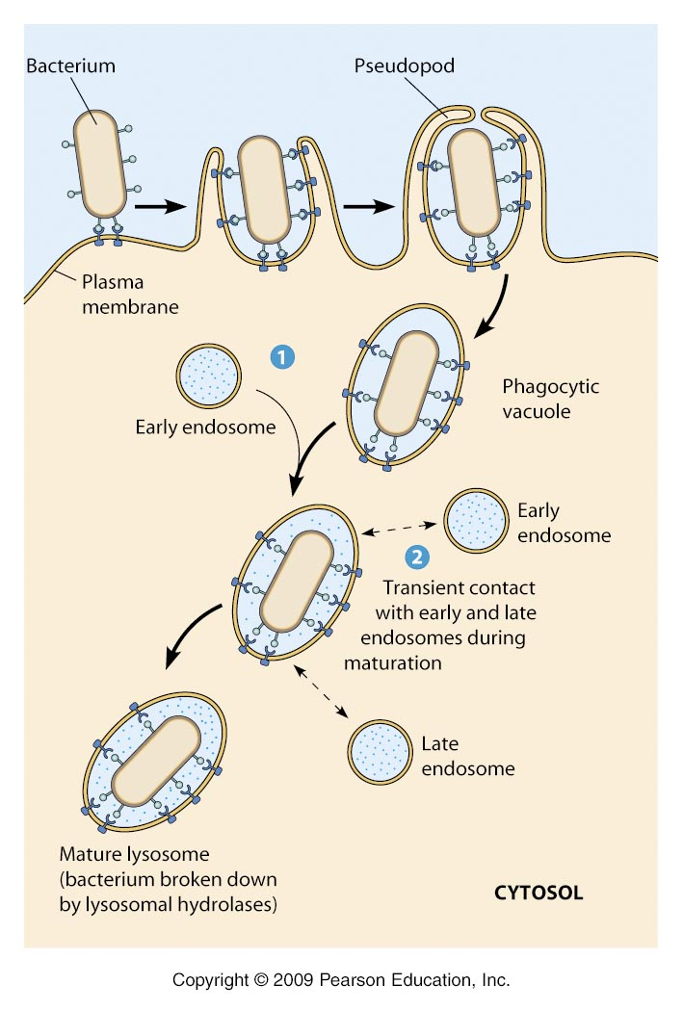

Slide 70
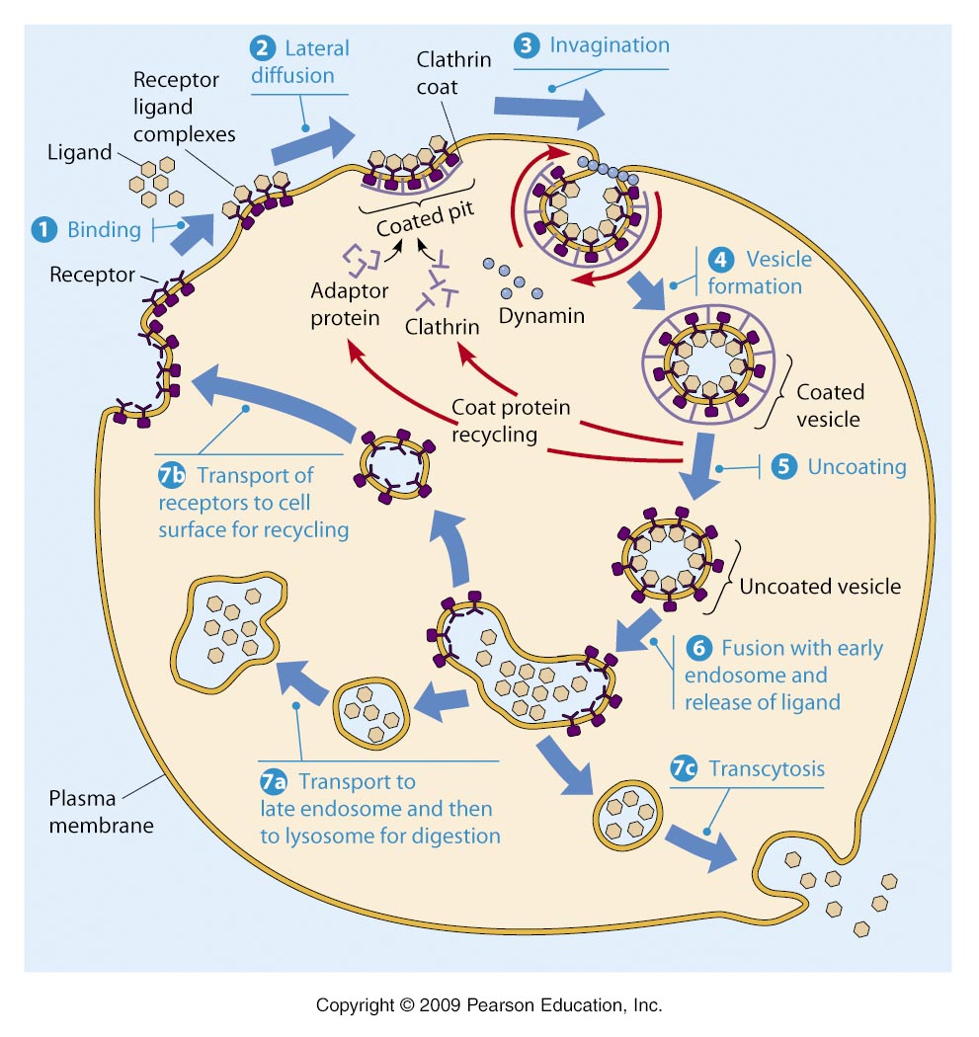
Receptor-Mediated Endocytosis

Slide 71
Secretory Pathways
1967 James Jamieson & George Palade labeled amino acids and watched movement
After 3 minutes found in ER
After 7 minutes found in Golgi
37 minutes into vesicles
117 minutes vesicles discharge protein into extracellular matrix

Slide 72
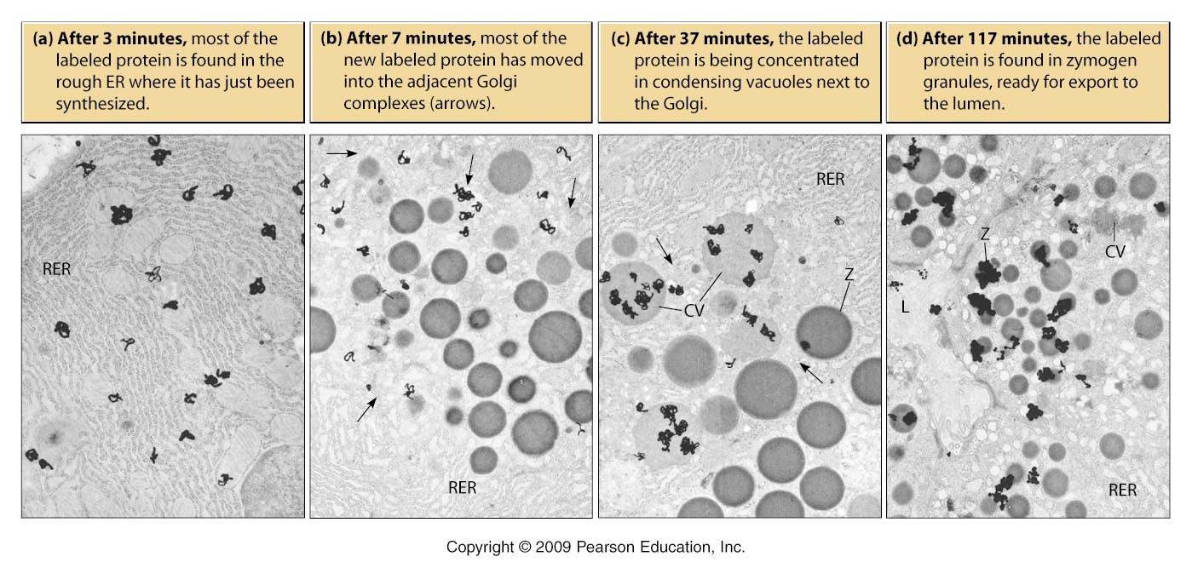

Slide 73
Secretory Pathways
After budding from TGN, secretory vesicles constantly move to cell membrane and release proteins by exocytosis
Experiment removed KDEL retrieval tag from ER proteins and they did not return to ER but were secreted.

Slide 74
Secretory Pathways
Regulated Secretion
Vesicles fuse with plasma membrane only in response to extracellular signals
Vesicles wait around plasmas membrane until signal response tells it to fuse and release
Examples: release of insulin form pancreatic B cells OR release of zymogens (precursors of hydrolytic enzymes)

Slide 75
Exocytosis
Release of cellular products destined for secretion (triggered by calcium or hormones)
Vesicles fuse with plasma membrane
Discharge contents
Inner surface of vesicle (lumen of ER and Golgi) become outer surface of plasma membrane
Addition of lipids and proteins to cell membrane

Slide 76
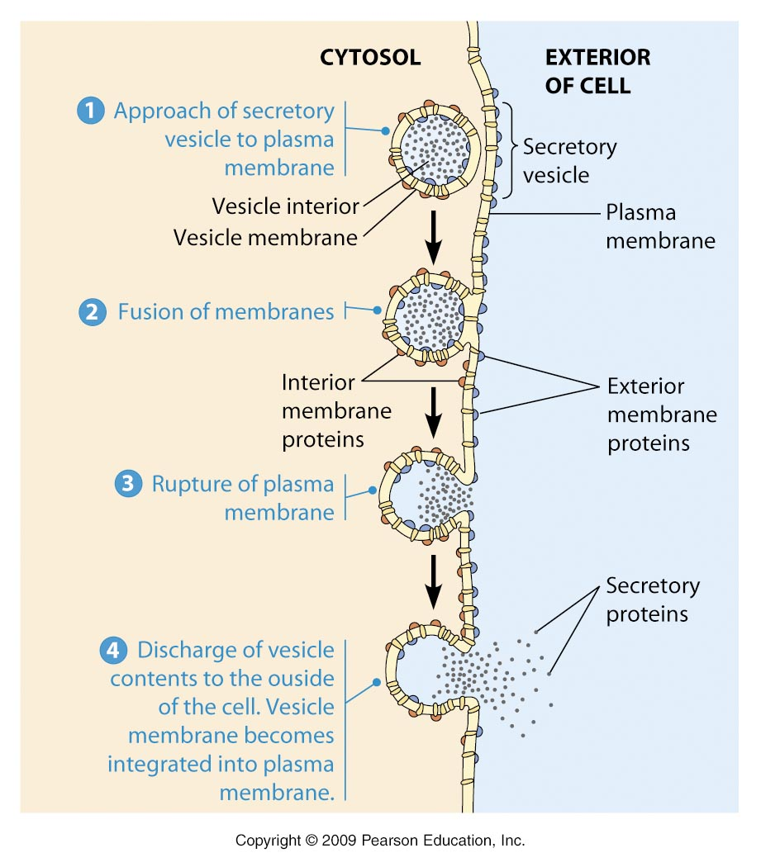

Slide 77
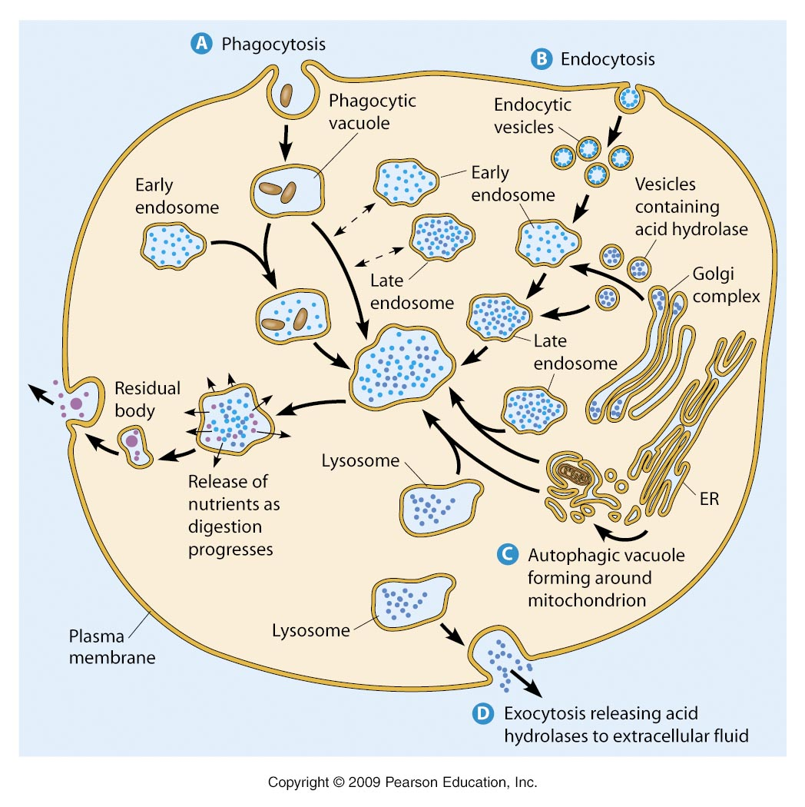
Lysosomes

Slide 78
Peroxisomes
Not developed from the ER (technically not part of endomembrane system)
Contain catalase (enzyme capable of breaking down H2O2)
Functions?

